Slide 1
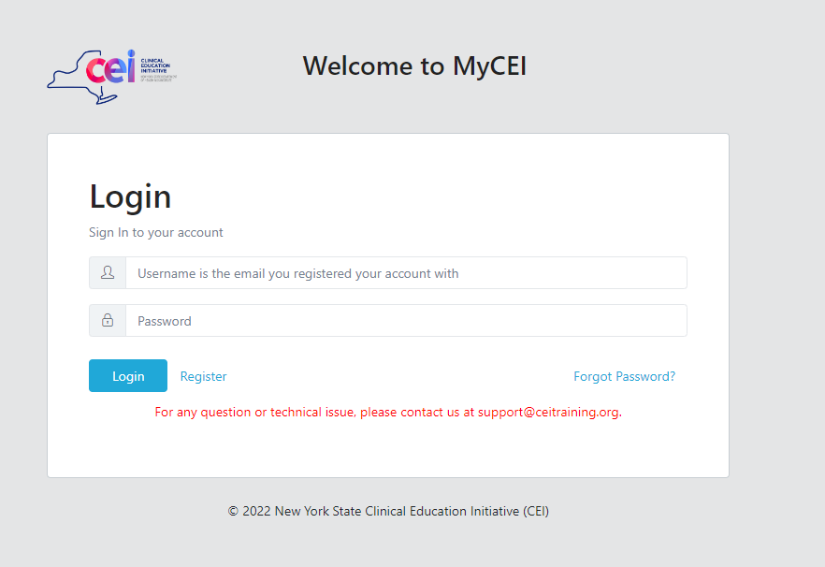
Welcome to “Contraception Myths: What Patients Hear – and What Providers Should Know”
CEI Webinar
Interested in claiming CME credit?
1. Register for the webinar:
Click on the registration link.
  If you already have a MyCEI account:
    Log into your account click “Register” for the training.
  If you don’t have a MyCEI account:
    Create one, then “Register” for the training.
2. After the training, you will receive an email:
  with instructions;
  a link to the evaluation; and
  the participation code required to claim CME credit
  Please complete the evaluation – we value all feedback!
3. The certificate can be printed or stored in your MyCEI account
4. Have questions during the webinar?
  Type them in the Chat or Q&A box, directed to “Host & Panelists”
For Support:
  Check: https://ceitraining.org/mycei/Support
  Email: support@ceitraining.org

Slide 2

Accreditation Statements
CME Accreditation/Certification Statement
The University of Rochester School of Medicine and Dentistry is accredited by the Accreditation Council for Continuing Medical Education (ACCME) to provide continuing medical education for physicians.
The University of Rochester School of Medicine and Dentistry designates this live activity for a maximum of 1 AMA PRA Category 1 Credits™. Physicians should claim only the credit commensurate with the extent of their participation in the activity.

Slide 3
ACCME Standards for Integrity and Independence in Accredited Continuing Education
The following planners, presenters and others have either indicated financial relationships with ineligible companies or that no financial relationships exist. An ineligible company is any entity whose primary business is producing, marketing, selling, re-selling, or distributing healthcare products used by or on patients. ACCME Standards for Integrity and Independence in Accredited Continuing Education
Financial Relationships of Planners
The following planners do not have any relevant financial relationships with ineligible companies
Margerite Urban, MD; Daniela DiMarco, MD, MPH; Jessica VanScott, MPH; Oksana Babiy, BS; Monica Barbosu, MD, PhD
The following planner(s) have disclosed financial relationships
None
No commercial funding was received to support this activity.

Slide 4

Health Equity Acknowledgement
Addresses Social Determinants
Takes an Active Role in Community and Institution
Seeks to Avoid Bias and Provides Affirming Services
Employs a Person-Centered Model of Care
In our commitment to incorporating a health equity framework, CEI acknowledges the following:
We recognize that social structures and institutions impact health outcomes--not just an individual’s behaviors. Structural racism, unfair criminal justice practices, and other systems of oppression result in inequitable health outcomes at both individual and community levels.
We all carry implicit biases that can impact how we interact with others. It is important to recognize biases so we can avoid causing harm and provide affirming care to all patients.
We will do our best to promote health equity in our programming, but we may not get everything right. CEI wants to hear from you how we can do better. When you complete the evaluation form, please let us know how we can make this and other presentations more inclusive.

Slide 5
Contraception Myths:
What Patients Hear – and What Providers Should Know
Stacy Sun, MD, MPH
Assistant Professor of Obstetrics and Gynecology, University of Rochester
Associate Program Director of Complex Family Planning Fellowship
University of Rochester School of Medicine and Dentistry

Slide 6
Financial Relationship of Speaker(s)
The following presenters and others have either indicated financial relationships with ineligible companies or that no financial relationships exist. An ineligible company is any entity whose primary business is producing, marketing, selling, re-selling, or distributing healthcare products used by or on patients. ACCME Standards for Integrity and Independence in Accredited Continuing Education
Stacy Sun, MD, MPH
NONE

Slide 7
LEARNING OBJECTIVES
1. Identify common misconceptions about the efficacy, safety, and appropriate use of major contraceptive methods including emergency contraception, long-acting reversible, barrier, and hormonal methods.
2. Explain the evidence that counter prevalent myths about contraception, such as impacts on fertility, cancer risk, weight change, bone health, and long-term health.
3. Apply myth-busting strategies in practice by responding accurately to common patient or public concerns about contraception.

Slide 8

Combatting Misinformation

Slide 9
Which topics should we focus on today?
Long-acting reversible contraception (IUDs, Nexplanon)
Emergency contraception
Combined hormonal contraceptive pills (COCPs)
Depo-provera injection
Ring/patch
All please!

Slide 10
Every patient needs a urine pregnancy test before starting contraception
Myth
Fact
Depends
Unsure

Slide 11
How to be reasonably certain that someone is not pregnant
Is ≤7 days after the start of normal menses.
Has not had sexual intercourse since the start of last normal menses.
Has been correctly and consistently using a reliable method of contraception.
Is ≤7 days after spontaneous or induced abortion.
Is within 4 weeks postpartum.
Is fully or nearly fully breastfeeding (exclusively breastfeeding or the vast majority [≥85%] of feeds are breastfeeds), amenorrheic, and <6 months postpartum.
2024 U.S. Selected Practice Recommendations for Contraceptive Use (U.S. SPR).
Notes:
Key criteria for same-day start/how to implement these principles in practice (and when to perhaps not)
• No unprotected sex since LMP
• Within 7 days of normal menses
• Postpartum/post-abortion timing
• Impact on continuation rates

Slide 12
IUDs cause infertility
Myth
Fact
Depends
Unsure

Slide 13
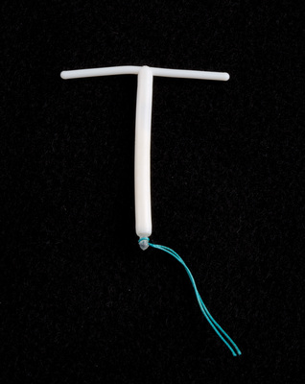
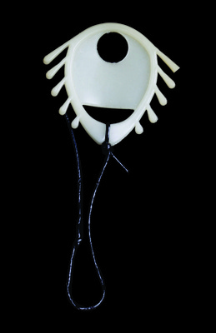
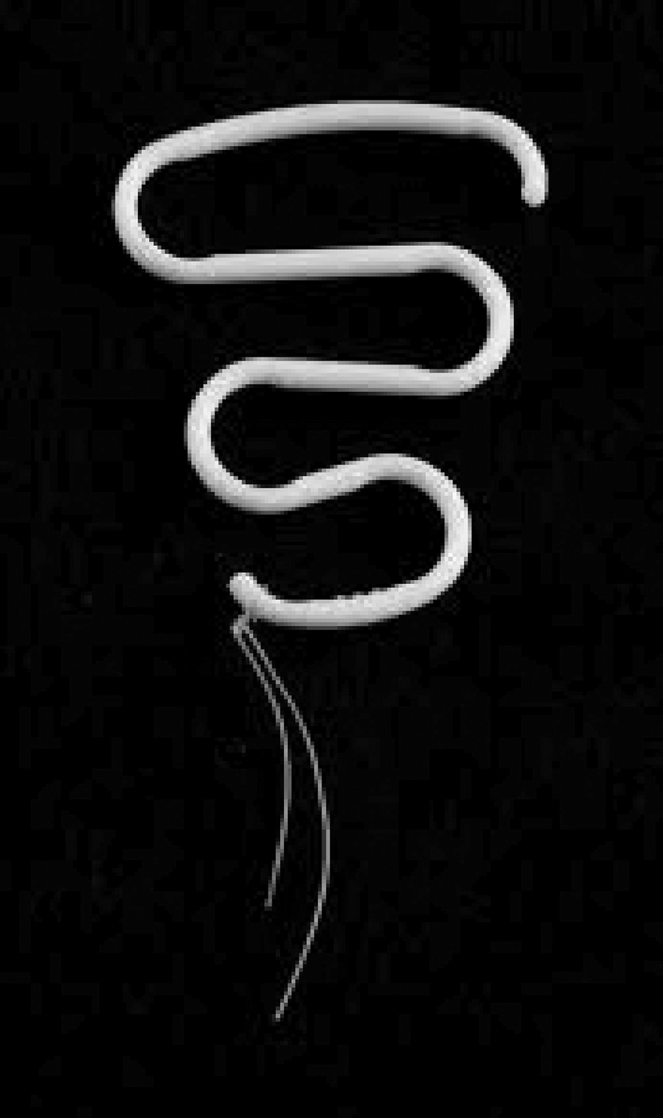
Brief history of IUDs
1962 – Lippes Loop
1969 – Copper-T 200
1970 – Progestasert
1971 – Dalkon Shield
  Pulled from market
1984 – Copper T380A
2000 – Mirena
2013 – Skyla
2015 – Liletta
2016 – Kyleena
2026 - Miudella
https://www.reproductiveaccess.org/2024/03/a-history-the-iud/
Notes:
Three years later, it was pulled from the market because of an ill-designed removal string that wasn’t sealed on either end and funneled bacteria into the uterus. This facilitated Pelvic Inflammatory Disease, sepsis, infertility, miscarriage, and death.^{15,16} More than 300,000 lawsuits were filed against A.H. Robins, forcing the company to file for bankruptcy.^{15,16} The Dalkon Shield can be attributed to a large decrease in IUD use and a sharp increase in distrust for IUDs.^{15,16} Subsequently, many IUDs were taken off the market. Only Progestasert remained on the American market.¹⁵

Slide 14
Intrauterine Contraception and Fertility
~2000 women enrolled in case-control study
IUD use not associated with infertility (OR=0.9)
Chlamydia associated with infertility (OR=2.4)
Results confirmed by similar studies
Hubacher D, et al. NEJM. 2001.
Notes:
[Insert Lecture Name Here]
Slide 14
Talking Points
Previous studies of IUDs, many no longer in use, suggested that copper IUDs might cause tubal infertility, decreasing the use of this method in nulligravid women.
Hubacher et al. enrolled 1,895 women in a case-control study: 358 women with primary infertility with tubal occlusion documented by hysterosalpingogram, 953 women who were infertile without tubal occlusion (infertile controls), and 584 primigravid women (pregnant controls).
Information was obtained about the women’s past use of contraceptives including copper IUDs, previous sexual relationships, and history of STIs. Each subject had antibody testing for Chlamydia trachomatis. Stratified analysis and logistic regression analyses were employed.
Odds ratio for tubal occlusion associated with previous use of a copper IUD was 1.0 (95% CI, 0.6–1.7) using infertile controls. When the primigravid women served as controls, the odds ratio was 0.9 (95% CI, 0.5–1.6). Odds ratio for tubal occlusion associated with chlamydia was 2.4 (95% CI, 1.7–3.2).
Previous use of a copper IUD is not associated with increased risk of tubal occlusion among nulligravid women; rather, chlamydial infection is.
These results have been confirmed by other studies: Hov GG, Skjeldestad FE, Hilstad T. Use of IUD and subsequent fertility: Follow-up after participation in a randomized clinical trial. Contraception. 2007;75:88-92. ; Skjeldestad F, Bratt H. Fertility after complicated and non-complicated use of IUDs. A controlled prospective study. Adv Contracept. 1988;4:179-84. ; Wilson JC. A prospective New Zealand study of fertility after removal of copper intrauterine contraceptive devices for conception and because of complications: A four-year study. Am J Obstet Gynecol. 1989;160:391-6.
Reference
Hubacher D, Lara-Ricalde R, Taylor D, et al. Use of copper intrauterine devices and the risk of tubal infertility among nulligravid women. NEJM. 2001;345:561-7.
---
Original content for this slide submitted by ARHP’s Clinical Advisory Committee for Choosing a Birth Control Method in May 2009. Original funding received from a collaboration of pharmaceutical companies including Bayer, Duramed and Schering Plough. This slide is available at www.arhp.org/core.

Slide 15
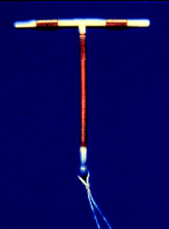
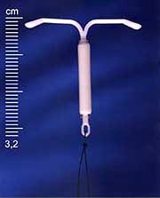
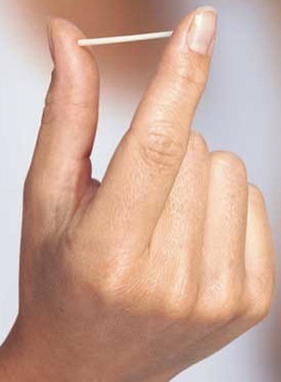
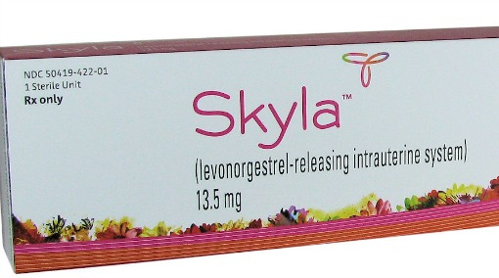

Long Acting Reversible Contraception (LARC)

Slide 16
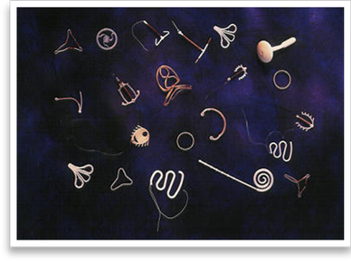
Copper and Progestin IUDs
Mechanism: barrier, toxic to sperm and eggs
Continuation at 1 year = 80%
Office insertion procedure
Rapid return of fertility after removal
Similar contraceptive efficacy to sterilization

Slide 17
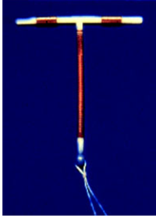
Copper Intrauterine Device: ParaGard
380mm² copper with efficacy for 12 years
Mechanism: spermatotoxic
May have increased dysmenorrhea and menstrual blood loss
Most effective form of EC!
Notes:
Talking Points
The Cooper T 380A IUD is a small T-shaped device made of polyethylene. The device has two flexible arms that fold down for insertion and expand to form a T shape when released inside the uterus. The vertical stem of the device is wound with fine copper wire, and the two horizontal arms also have a sleeve of cooper. At the bottom of the vertical stem, a 3-mm bulb houses a monofilament polyethylene string that enables the device’s easy removal.
The Copper-T IUD is approved for 10 years of use; however, efficacy lasts 12 years or more.
Mechanism of Action:
The exact mechanism of action of the copper IUD is not clear; however, substantial evidence suggests that the primary mechanism of action is prevention of fertilization.
Copper-containing IUDs reduce the motility and viability of the sperm and the development of ova.
Research shows that sperm counts found in the cervical mucus and uterine tube are much lower in women using IUDs than those in nonusers.
A clinical study found that women using copper-containing IUDs had uncoordinated contractions, which suggests that the device may act by hindering sperm transport.
Candidates:
Women who desire long-term contraception.
Women who do not want the systematic effects of hormones.
Women who desire a quickly reversible method
Advantages
Fertility returns rapidly after removal of the copper IUD.
There is no ongoing cost after insertion.
The Cooper-T IUD may be associated with a decreased risk for endometrial cancer, but the exact mechanism for this association is unclear.
Contraindications (WHO Criteria):
Puerperal sepsis
Immediate post-septic abortion
Unexplained vaginal bleeding before evaluation
Malignant gestational trophoblastic disease
Cervical cancer awaiting treatment (when IUD initiated)
Endometrial cancer
Uterine fibroids with distortion of the uterine cavity
Distortion of the uterine cavity
Current PID (when IUD initiated)
Current STI (when IUD initiated)
Known pelvic TB (when IUD initiated)
Disadvantages:
Menstrual changes
The Copper T IUD can increase the duration and amount of menstrual flow and menstrual cramping.
Expulsion is rare, occurring in only 5% of users, but the most likely cause of IUC failure. Expulsion is most common within the first three months after insertion
Uterine perforation is a rare complication of IUC, occurring approximately once every 770 to 1600 insertions. Perforation generally occurs at insertion, when a portion of the device becomes embedded in the uterine wall.
There’s a possible increased risk of PID during early postinsertion period in women with cervical infections.
Studies suggest that women with chlamydial infection or gonorrhea at the time of IUD insertion were at an increased risk of PID relative to women without infection. The absolute risk of PID was low for both groups (0-5% for those with STIs and 0-2% for those without).
Counseling:
Inform women that IUDs do not cause an increased risk of STIs, tubal infertility, and ectopic pregnancies.
Describe how to check for the string, follow-up visits, and warning signs.
Insertion as emergency contraception
Can be inserted up to 5 days after unprotected intercourse to prevent pregnancy
More effective than use of emergency contraception pills. Insertion of a copper T IUD can reduce the risk of pregnancy after unprotected intercourse by more than 99%. ECPs have the potential to reduce unintended pregnancy by 75%-89%.
The LNG IUS should NOT be used for emergency contraception.
To view the Copper T IUD insertion video visit http://www.youtube.com/watch?v=FuPFbgSm0QQ
References
Beining RM, Dennis LK, Smith LK, Smith EM, Dokras A. Meta-Analysis of Intrauterine Device Use and Risk of endometrial cancer. Ann Epidemiol. 2008.
D’Souza RE, et al. Randomised controlled trial assessing the acceptability of GyneFix versus Gyne-T380S for emergency contraception. J Fam Plann Reprod Health Care. 2003;29(2):23-9.
Fortney JA, Feldblum PJ, Raymond EG. Intrauterine Devices. J Reprod Med. 1999. March;44(3):269-274.
Larsson G, Milsom I, Jonasson K, Lindstedt G, Rybo G. The long-term effects of copper surface area on menstrual blood loss and iron status in women fitted with an IUD. Contraception. 1993;48(5):471-80.
Maslow KD, Lyons EA. Effect of oral contraceptives and intrauterine devices on midcycle myometrial contractions. Fertil Steril. 2003;80(5):1224-7.
Milsom I, Rybo G, Lindstedt G. The influence of copper surface area on menstrual blood loss and iron status in women fitted with an IUD. Contraception. 1990;41(3):271-81.20.
Mohllajee AP, Curtis KM, Peterson HB. Does insertion and use of an intrauterine device increase the risk of pelvic inflammatory disease among women with sexually transmitted infection? A systematic review. Contraception. 2006 Feb;73(2):145-53
Nelson AL. The intrauterine contraceptive device. Obstet Gynecol Clin North Am. 2000;27(4):723-40.12.
Thonneau PF, Almont TE. Contraceptive efficacy of intrauterine devices. Am J Obstet Gynecol. 2008. March;198(3): 248-253.
Trussel J. Contraceptive efficacy. In: Hatcher RA, Trussel J, Nelson AL, et al. Contraceptive Technology: 19th revised ed. New York, NY: Ardent Media, 2007.
Trussel J. Emergency contraception. In: Hatcher RA, Trussel J, Nelson AL, et al. Contraceptive Technology: 19th revised ed. New York, NY: Ardent Media, 2007.
WHO Medical Eligibility Criteria for Contraceptive Use, 3rd edition 2004.
---
Original content for this slide submitted by ARHP’s Clinical Advisory Committee for Choosing a Birth Control Method in May 2009. Original funding received from a collaboration of pharmaceutical companies including Bayer, Duramed and Schering Plough. This slide is available at www.arhp.org/core.

Slide 18
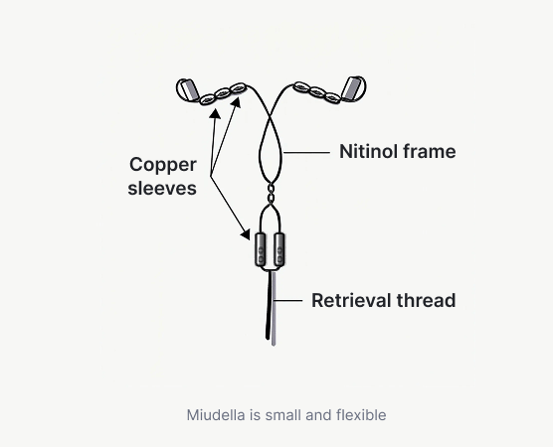
Copper Intrauterine Device: Miudella (new!)
FDA approved 3 years
Flexible nitinol frame with 175 mm² of copper
Less bleeding than paragard

Slide 19
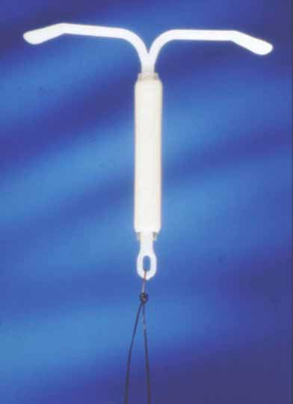
Levonorgestrel Intrauterine Device: Mirena
Releases levonorgestrel 20 μg/day
  FDA approval
    8 years for prevention of pregnancy
    5 years for treatment of heavy menstrual bleeding
  Mechanism: thickens cervical mucus
Does NOT inhibit HPA axis
  40-70% women will still ovulate
Shorter, lighter, less crampy menses
25% amenorrhea after one year
NEW EVIDENCE! Can be used for EC
Notes:
Talking Points
Long-acting, progestin-only intrauterine contraceptive method
The T-shaped reservoir placed within the uterine cavity releases 20 μg of levonorgestrel per day initially; rate decreases progressively to 10 μg/day after 5 years.
Approved for 5 years of use; data demonstrate 7-year efficacy
LNG IUS requires an office visit for insertion and an office visit for removal.
Mechanism of Action:
LNG IUS thickens the cervical mucus and inhibits sperm motility and function.
The endometrial atrophy that is a consequence of the high endometrial levels of LNG leads to a substantial decrease in menstrual flow and absence of bleeding in some women who use this form of intrauterine contraception.
Candidates:
All women of reproductive age who are seeking a long-term, highly effective contraceptive.
IUD is especially appropriate for:
Women who are looking for a convenient method
Women with menstrual symptoms that may improve with LNG IUS, Similar to long-acting, progestin-only DMPA, use of the LNG IUS generally improves menorrhagia, dysmenorrhea, and anemia; decreases the risk of PID and ectopic pregnancy relative to non-use.
Lactating women
Advantages:
Use of the LNG IUS may reduce menstrual symptoms in women with uterine fibroids or adenomyosis, thereby reducing the need for hysterectomy.
Data from the United Kingdom also suggest that use of the LNG IUS may reduce the occurrence of benign endometrial polyps in patients who have breast cancer and are taking tamoxifen.
Can be used by lactating women.
Contraindications (WHO MEC):
Puerperal sepsis
Immediate post-septic abortion
Unexplained vaginal bleeding before evaluation
Malignant gestational trophoblastic disease
Cervical cancer awaiting treatment
Current breast cancer
Endometrial cancer
Uterine fibroids with distortion of the uterine cavity (makes insertion difficult, but is possible to use)
Distorted uterine cavity (makes insertion difficult, but is possible to use)
Current PID (initiation of IUD)
Current purulent cervicitis or chlaymdial infection or gonorrhea at initiation
Acute PID or recent history of PID
Risk factors for STIs and PID
Postpregnancy infection (if within the past 3 months)
Distorted uterine cavity
Uterine or cervical cancer or unresolved abnormal Pap smear
Genital bleeding of unknown source
Acute cervicitis, vaginitis, or genital actinomycosis
Increased susceptibility to infection
Disadvantages:
Uterine perforation is a possible, but rare complication of LNG IUS use (1/1000), occurring only at the time of insertion.
Rates of expulsion from 2% to 12% have been reported. Most expulsions occur in the first months following insertion, with decreasing frequency thereafter.
Enlarged ovarian follicles have been diagnosed in about of 12% of subjects using the LNG IUS. Most of these follicles are asymptomatic, although some may be accompanied by pelvic pain or dyspareunia. Usually, the enlarged follicles disappear spontaneously during 2–3 months of observation, and surgical intervention is usually not required.
Obese women have an elevated risk of dysfunctional uterine bleeding and endometrial neoplasia, so the LNG IUS may be an appropriate choice in these women.
Counseling:
Users of the LNG IUS may experience progestin-related side effects such as mood changes, acne, headache, breast tenderness, and follicular ovarian cysts. These side effects are more common during the initial months of use and occur less often over time.
During the first 3–6 months of use, women may experience an increased number of bleeding and spotting days and irregular bleeding patterns. Thereafter, the number of bleeding and spotting days usually decreases, but bleeding may remain irregular.
Breast tenderness and nausea are quite uncommon.
Inform women that LNG IUS do not cause an increased risk of STIs, tubal infertility, and ectopic pregnancies.
Explain noncontraceptive benefits and possible menstrual changes.
Describe how to check for the string, follow-up visits, and warning signs.
To view the LNG IUS insertion video visit http://www.youtube.com/watch?v=hlfV8tKgw6E
References
ACOG Committee on Practice Bulletins. No. 73. Use of Hormonal Contraception in Women with Coexisting Medical conditions. Obstet Gynecol. 2006;107:1453-72.
Gardner FJ, Konje JC, Abrams KR, et al. Endometrial protection from tamoxifen-stimulated changes by a levonorgestrel-releasing intrauterine system: a randomised controlled trial. Lancet. 2000;356:1711-7.
Hatcher RA, et al. A Pocket Guide to Managing Contraception. 4th ed. Tiger, GA: The Bridging the Gap Foundation, 2001.
Hidalgo M, Bahamondes L, Perrotti M, Diaz J, Dantas-Monteiro C, Petta C. Bleeding patterns and clinical performance of the levonorgestrel-releasing intrauterine system (Mirena) up to two years. Contraception. 2002;65(2):129-32.
Hubacher D, Grimes DA. Noncontraceptive health benefits of intrauterine devices: a systematic review. Obstet Gynecol Surv. 2002;57:120-8.
Inki P, Hurskainen R, Palo P, Ekholm E, Grenman S, Kivel A, Kujansuu E, Teperi J, Yliskoski M, Paavonen J. Comparison of ovarian cyst formation in women using the levonorgestrel-releasing intrauterine system vs. hysterectomy. Ultrasound Obstet Gynecol. 2002 Oct;20(4):381-5.
Jonsson B, Landgren B-M, Eneroth P. Effects of various IUDs on the composition of cervical mucus. Contraception. 1991;43:447.
Luukkainen T. The levonorgestrel intrauterine system: therapeutic aspects. Steroids. 2000;65:699-7.
Mirena [package labeling]. Montville, NJ: Berlex Laboratories, Inc.; 2000.
Mirena Prescribing Information. Berlex Laboratories, Inc., Montville, NJ; 2000.
Mohllajee AP, Curtis KM, Peterson HB. Does insertion and use of an intrauterine device increase the risk of pelvic inflammatory disease among women with sexually transmitted infection? A systematic review. Contraception. 2006 Feb;73(2):145-53.
Nelson AL. The intrauterine contraceptive device. Obstet Gynecol Clin North Am. 2000;27(4):723-40.
Silverberg SG, Haukkamaa M, Arko H, et al. Endometrial morphology during long-term use of levonorgestrel-releasing intrauterine devices. Int J Gynecol Pathol. 1986;5(3):235-41.
Trussel J. Contraceptive efficacy. In Hatcher RA, Trussel J, Nelson AL, Cates W, Stewart FH, Kowal D. Contraceptive Technology: 19th revised ed. New York, NY: Ardent Media, 2007.
---
Original content for this slide submitted by ARHP’s Clinical Advisory Committee for Choosing a Birth Control Method in May 2009. Original funding received from a collaboration of pharmaceutical companies including Bayer, Duramed and Schering Plough. This slide is available at www.arhp.org/core.

Slide 20
Levonorgestrel Intrauterine Device: Liletta
“Generic” Mirena
Releases 19.5 ug/day of LNG
Same bleeding profile as Mirena and FDA approvals
Marketed by Medicine 360- NOT FOR PROFIT company

Slide 21
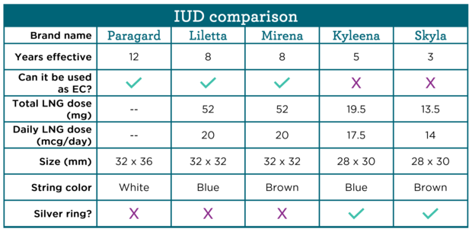
What about the Skyla or Kyleena?
https://providers.bedsider.org/birth-control/which-iud-should-i-get/
Notes:
Mirena is 32 X 32mm

Slide 22
Dispelling myths about IUDs
Can be used in:
  People with multiple partners
  People with history of STDs or PID
  Nulliparous patients
  Teens/adolescents
  Immediately post partum/post abortion
  People with a history of ectopic pregnancy
MacIsaac L. Obstet Gynecol Clin N Am. 2007. Toma A. Pediatr Adolesc Gynecol. 2006. Otero-Flores JB. Contraception. 2003. Suhonen S. Contraception. 2004. WHO. 2004.
Notes:
Talking Points
What concerns associated with IUDs limit the use of this highly effective method of contraception?
Need for monogamous relationship—No longer a barrier. [MacIsaac]
Recent research shows it is a good option for many teens. [Toma]
Postpartum or post-abortion—It is safe to insert either type of IUD immediately postpartum or post-abortion, and there may be practical advantages to doing so (patient is known not to be pregnant, is highly motivated to begin contraception, and will have less discomfort with insertion). [MacIsaac]
History of STIs—According to WHO guidelines, IUDs should not be inserted in women who have current purulent cervicitis or chlamydial infection or gonorrhea. Check for and treat gonorrhea and Chlamydia prior to insertion. Women with these infections who already have an IUD in place can usually be treated without removal of the IUD. The advantages of IUDs generally outweigh the risks in women who have vaginitis or other STIs. [WHO]
Pelvic inflammatory disease (PID) incidence for IUD users is similar to that of the general public. Risk of PID is increased only during the first month after insertion.
Copper and levonorgestrel intrauterine system (LNG IUS) IUDs do not appear to differ in PID risk, with LNG IUS potentially offering protection from PID. [MacIsaac]
Infertility, due to tubal infection or inflammation—Research consistently demonstrates no difference in fertility rates in multiparous women who stopped using IUDs. [Vessey and Andersson]
Not for use in nulliparous women—No basis in evidence for this. [Otero-Flores and Suhonen]
Ectopic pregnancy risk—Highly effective contraceptives protect against intrauterine and ectopic pregnancies. [MacIsaac]
References
MacIsaac L, Espey E. Intrauterine contraception: the pendulum swings back. Obstet Gynecol Clin N Am. 2007;34:91-111.
Toma A, Jamieson MA. Revisiting the intrauterine contraceptive device in adolescents. J Pediatr Adolesc Gynecol. 2006;19:291-296.
Vessey MP, Lawless M, McPherson K, et al. Fertility after stopping use of intrauterine contraceptive device. Br. Med J. (Clin Res Ed) 1983;286(6359):106.
Andersson K, Batar I, Rybo G. Return to fertility after removal of a levonorgestrel releasing intrauterine device and Nova-T. Contraception. 1992;46:575.
Otero-Flores JB, Guerrero-Carreno FJ, Vazquez-Estrada LA. A comparative randomized study of three different IUDs in nulliparous Mexican women. Contraception. 2003;67(4):273–6.
Suhonen S, Haukkamaa M, Jakobsson T, et al. Clinical performance of a levonorgestrel releasing intrauterine system and oral contraceptives in young nulliparous women: a comparative study. Contraception. 2004;69(5):407–12.
World Health Organization (WHO). Medical eligibility criteria for contraceptive use. 3rd edition. 2004. Geneva, Switzerland
Svensson L, Westrom L, Mardh PA. Contraceptives and acute salpingitis. JAMA. 1984;251(19):2553-5.
Sivin I, Stern J, Coutinho E, et al. Prolonged intrauterine contraception: a seven-year randomized study of the levonorgestrel 20 mcg/day (LNg 20) and the Copper T380 Ag IUDS. Contraception. 1991;44(5):473-80.
Farley T, Rowe P, Meirik O, et al. Intrauterine devices and pelvic inflammatory disease: an international perspective. Lancet. 1992;339:1904.
---
Original content for this slide submitted by ARHP’s Clinical Advisory Committee for Choosing a Birth Control Method in May 2009. Original funding received from a collaboration of pharmaceutical companies including Bayer, Duramed and Schering Plough. This slide is available at www.arhp.org/core.

Slide 23
The implant can move to another part of your body
Myth
Fact
Depends
Unsure

Slide 24

Progestin Implant (Implanon/ Nexplanon)
Single 40-mm x 2-mm rod with 68 mg of etonogestrel released at 60 mcg/day
Inserted in the inner upper arm
Mechanism: Inhibits ovulation for 5 years
1st year failure rate: 0.05%
Main side effect: unpredictable bleeding pattern
  34% Infrequent bleeding
  22% Amenorrhea
  17% Prolonged bleeding
  7% Frequent bleeding
FDA approved 2006
Notes:
Talking Points
One rod is 40 mm x 2 mm and its core is 40% ethylene vinyl acetate (EVA) and 60% etonogestrel.
The effectiveness of Implanon in overweight women has not been determined; women who weighed more than 130% of their ideal body weight were not studied.
Mechanism of Action:
The single-rod implant relies on ovulation inhibition over the entire duration of use.
To protect against pregnancy after 5 years, the health care provider must insert a new rod.
Advantages:
High efficacy
Long-term
Rapid reversibility. After implant is removed, most women (94%) ovulate by 3 months, the majority within 3 weeks.
Rapid procedures; insertion takes 1 minute and removal takes 3 minutes
Can use when lactating as soon as 6 wks postpartum
Noncontraceptive benefits, such as improved dysmenorrhea and possibly acne.
Contraindications:
Known or suspected pregnancy
Current or past history of thrombosis
Hepatic tumor or active liver disease
Undiagnosed abnormal genital bleeding
Known or suspected carcinoma of the breast or history of breast cancer
Hypersensitivity to the components of the implant
Disadvantages:
Bleeding irregularities, including infrequent bleeding (26.9%), amenorrhea (18.6%), prolonged bleeding (15.1%), and frequent bleeding (7.4%).
One study found that ethinyl estradiol may help control bleeding during the first few months of implant use.
Other side effects include weight gain (2.3%), emotional liability (2.3%), headache (1.6%), acne (1.3%), and depression (1.0%).
There is no evidence of long-term effects such as decreased bone mineral density (BMD) and deep vein thrombosis, or anemia with the etonogestrel implant. On the contrary, lumbar spine BMD improved in studies.
References
Beerthuizen R, van Beek A, Massai R, Mäkäräinen L, Hout J, Bennink HC. Bone mineral density during long-term use of the progestogen contraceptive implant Implanon compared to a non-hormonal method of contraception. Hum Reprod. 2000;15(1):118-122.
Croxatto HB, Mäkäräinen L. The pharmacodynamics and efficacy of Implanon. An overview of the data. Contraception. 1998;58(6):91S-97S.
Croxatto HB, Urbancsek J, Massai R, Coelingh Bennink H, van Beek A. A multicentre efficacy and safety study of the single contraceptive implant Implanon. Implanon Study Group. Hum Reprod. 1999;14(4):976-981.
Diaz S. Contraceptive implants and lactation. Contraception. 2002;65(1):39-46.
Funk S, Miller MM, Mishell DR Jr, et al; The Implanon US Study Group. Safety and efficacy of Implanon, a single-rod implantable contraceptive containing etonogestrel. Contraception. 2005;71(5):319-326.
Implanon [package insert]. Roseland, NJ: Organon USA, Inc; 2005.
Meirik O, Fraser IS, d’Arcangues C, et al. WHO Consultation on Implantable contraceptives for women. Hum Reproduct Update. 2003;9(1):49-59.
Trussel J. Contraceptive efficacy. In Hatcher RA, Trussel J, Nelson AL, Cates W, Stewart FH, Kowal D. Contraceptive Technology: 19th revised ed. New York, NY: Ardent Media, 2007.
UptoDate, Inc. Implanon image. http://www.uptodate.com/online/content/image.do?imageKey=obst_pix/implanon.htm&title=Implanon. Accessed on April 29, 2009.
Urbancsek J. An integrated analysis of nonmenstrual adverse events with Implanon. Contraception. 1998;58(6):109S-115S.
Weisberg E, Hickey M, Palmer D, et al. A pilot study to assess the effect of three short-term treatments on frequent and/or prolonged bleeding compared to placebo in women using Implanon. Hum Reprod. 2006;21(1):295-302.
Zheng SR, Zheng HM, Qian SZ, Sang GW, Kaper RF. A randomized multicenter study comparing the efficacy and bleeding pattern of a single-rod (Implanon) and a six-capsule (Norplant) hormonal contraceptive implant. Contraception. 1999;60(1):1-8.
---
Original content for this slide submitted by ARHP’s Clinical Advisory Committee for Choosing a Birth Control Method in May 2009. Original funding received from a collaboration of pharmaceutical companies including Bayer, Duramed and Schering Plough. This slide is available at www.arhp.org/core.

Slide 25
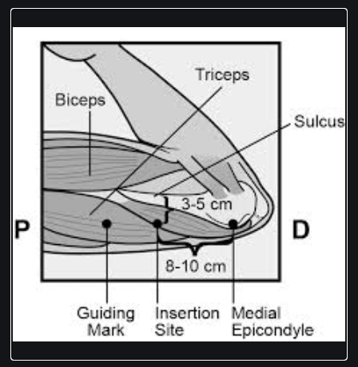
Complications are rare!
  Migration or difficulty with removal - Typically associated with deep placement
  Improved with patient and provider post-insertion palpation
Case reports
  Axillary migration
  Delayed-type hypersensitivity

Slide 26
You need to start birth control pills after a period
Myth
Fact
Depends
Unsure

Slide 27
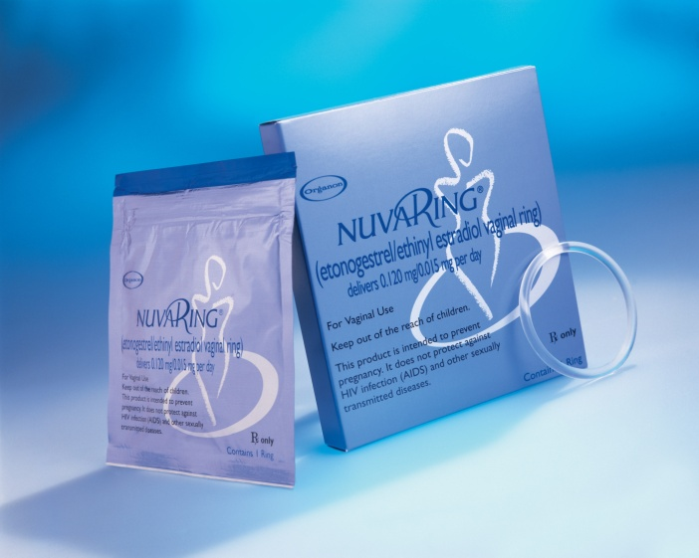

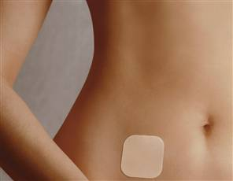
Combined Hormonal Contraception (CHC)

Slide 28
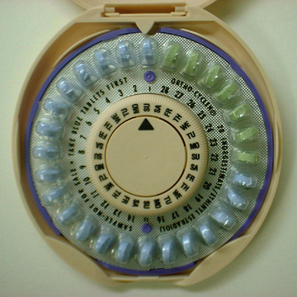
Combined Hormonal Contraception (CHC)
Mechanisms
  Inhibits pituitary signals for ovulation
  Thickens cervical mucous
Ethinyl estradiol and progestin
  Many different regimens
Many non-contraceptive benefits
Notes:
Talking Points
Combined oral contraceptives (COCs) are a combination of estrogen and progestin.
Most COC formulations now contain 20 to 35 mcg of ethinyl estradiol plus one of 8 available progestins.
A high number of unintended pregnancies are due to misuse or discontinuation of OCs. By the third month of use, the typical user misses three or more pills each cycle. These data are not presented to focus blame on OCs but to suggest that many women using daily methods are at risk for unintended pregnancy.
Consider the “quick start” method when initiating oral contraceptives.
Mechanism of Action:
The progestin in COCS is the main actor in preventing pregnancy. It suppresses the secretion of gonadotropin (mainly luteinizing hormone) by the pituitary gland. The estrogen primarily inhibits follicle-stimulating hormone secretion.
The estrogen also works synergistically with the progestin to affect the uterine lining and cervical mucus production.
Candidates:
Women with dysmenorrhea and menorrhagia
Women who want to regulate menses
Women who will use a daily method consistently
Advantages:
Reduced menstrual flow and dysmenorrhea for most users
Reduce the risk of ovarian cancer by 40-80% after ~ one year of use and decrease the risk from 10-12% annually thereafter. (Burkman) Even after discontinuing COC use, protection continues for 15-20 years. COCs also reduce the risk of endometrial cancer by 40-50%, and like ovarian cancer, protection increases with duration of use.
90 percent protection from ectopic pregnancy with current OC use.
Reduced incidence of benign breast disease
Effective in reducing acne.
Possible Advantages: 1) May preserve bone density, and 2) May protect against iron deficiency anemia, ovarian cysts with higher doses, and pelvic inflammatory disease.
Contraindications:
Multiple risk factors for arterial cardiovascular disease, such as smoking, diabetes, hypertension
Known thrombogenic mutations
Current or history of current ischemic heart disease, history of stroke, history of or current deep venous thrombosis or pulmonary embolism
Vascular disease
Complicated valvular heart disease
Hypertension (systolic ≥160 or diastolic ≥ 100)
Smoking (>15 cigarettes/day and age 35 or older)
Migraine headache with aura
Major surgery with prolonged immobilization
Current breast cancer
Active viral hepatitis
Severe cirrhosis
Benign or malignant liver tumors
Breastfeeding <6 weeks postpartum
Disadvantages:
Obesity may impair the effectiveness of COCs, increasing the risk of contraceptive failure by 8-12% with typical use.
Counseling:
Breakthrough and /or irregular bleeding may occur. Other side effects include breast tenderness, nausea, and bloating.
Many of these side effects usually disappear after the first few cycles of pill use.
Side effects are less likely with low-dose pills. But the lower the dose the more likely breakthrough bleeding will occur.
OC use does not increase breast cancer risk.
Use of combination OCs increases the risk of venous thromboembolism. However, the annual risk is low (1.0–3.0 per 10,000 women) and approximately half that associated with pregnancy (5.9 per 10,000).
Obesity and use of COCs are independent risk factors for venous thromboembolism.
OC use does not increase the risk of heart attack or stroke among healthy nonsmokers under age 35 who do not have other risk factors for these events.
References
ACOG Committee on Practice Bulletins. No. 73. Use of Hormonal Contraception in Women with Coexisting Medical conditions. Obstet Gynecol. 2006;107:1453-72.
Burkman R, Schlesselman JJ, Zieman M. Safety concerns and health benefits associated with oral contraception. Am J Obstet Gynecol. 2004;190(Suppl):S5-S22.
Burkman RT, Fisher AC, LaGuardia KD. Effects of low-dose oral contraceptives on body weight: results of a randomized study of up to 13 cycles of use. J Reprod Med. 2007 Nov;52(11):1030-4.
Burkman RT. Management of the Fibroid Uterus. Adv Obstet Gynecol. 1996;3:103-128.
Davis A. Wysocki S. Clinician/patient interaction: communicating the benefits and risks of oral contraceptives. Contraception. 1999;59(1 Suppl):39S-42S.
Farmer RDT, Preston TD. The risk of venous thromboembolism associated with low estrogen oral contraceptives. J Obstet Gynecol. 1995;15:195-200.
Gallo MF, Grimes DA, Schulz KF, Helmerhorst FM. Combination contraceptives: effects on weight (Cochrane Review). In: The Cochrane Library, Issue 4, 2003. Chichester, UK: John Wiley & Sons, Ltd.
Goldzieher JW. The hypothalamo-pituitary-ovarian system. Pharmacology of the Contraceptive Steroids. (New York: Raven Press, 1994)185-98.4 Moghissi KS. Effects of microdose progestogens on endogenous gonadotrophic and steroid hormones, cervical mucus properties, vaginal cytology and endometrium. Fertil Steril. 1971;22(7):424-34.
Hardman JG, Limbird LE (eds.) Goodman & Gillman’s The Pharmaceutical Basics of Therapeutics. Ninth edition. Section XIII: Hormones and hormone synthesis. New York: The McGraw-Hill Companies, Inc., 1996.
Marchbanks PA, McDonald JA, Wilson HG, et al. Oral contraceptives and the risk of breast cancer. N Engl J Med. 2002;346:2025-32.
Martin SL, Curtis KM, Glasier AF. Combined hormonal contraception and bone health: a systematic review. Contraception. 2006;73(5):445-469.
Moghissi KS. Effects of microdose progestogens on endogenous gonadotrophic and steroid hormones, cervical mucus properties, vaginal cytology and endometrium. Fertil Steril. 1971;22(7):424-34.
Mosher WD, Martinez GM, Chandra A, et al. Use of contraception and use of family planning services in the United States: 1982-2002. Advance Data 2004 Dec 10;(350):17-52.
National Association of Nurse Practitioners in Women’s Health (NPWH). National survey on weight gain and oral contraceptives. Washington, DC:NPWH, 1999.
Peterson HB, Lee NC. The health effects of oral contraceptives: misperceptions, controversies, and continuing good news. Clin Obstet Gynecol. 1989;32:339-55.
Potter L, Oakley D, deLeon-Wong E, Canamar R. Measuring compliance among oral contraceptive users. Fam Plann Perspect. 1996:28:154-158.
Redmond G, Godwin AJ, Olson W, Lippman JS. Use of placebo controls in an oral contraceptive trial: methodological issues and adverse event incidence. Contraception. 1999;60:81-85.
Redmond GP, Olson WH, Lippman JS, Kafrissen ME, Jones TM, Jorizzo JL. Norgestimate and ethinyl estradiol in the treatment of acne vulgaris: a randomized, placebo-controlled trial. Obstet Gynecol. 1997;89:615-622.
Rosenberg MJ, Meyers A, Roy V. Efficacy, cycle control, and side effects of low- and lower-dose oral contraceptives: a randomized trial of 20 ug and 35 ug estrogen preparations. Contraception. 2000;60:320-329.
Rosenberg MJ, Waugh MS, Long S. Unintended pregnancies and use, misuse and discontinuation of oral contraceptives. J Reprod Med. 1995;40:355-360.
Rosenberg MJ, Waugh MS. Oral contraceptive discontinuation: a prospective evaluation of frequency and reasons. Am J Obstet Gynecol. 1998;179:577-582.
Skegg DC, Noonan EA, Paul C, et al. Depot medroxyprogesterone acetate and breast cancer. A pooled analysis of the World Health Organization and New Zealand studies. JAMA. 1995;273:799-804.
Spector TD, Hochberg MC. The protective effect of the oral contraceptive pill on rheumatoid arthritis: an overview of the analytic epidemiological studies using meta-analysis. J Clin Epidemiol. 1990;43(11):1221-1230.
Trussel J. Contraceptive efficacy. In: Hatcher RA, Trussel J, Nelson AL, et al. Contraceptive Technology: 19th revised ed. New York, NY: Ardent Media, 2007.
Trussel J, et al. Obesity and oral contraceptive pill failure. Contraception. 2009;79:334-338.
WHO Medical Eligibility Criteria for Contraceptive Use, 3rd edition 2004.
---
Original content for this slide submitted by ARHP’s Clinical Advisory Committee for Choosing a Birth Control Method in May 2009. Original funding received from a collaboration of pharmaceutical companies including Bayer, Duramed and Schering Plough. This slide is available at www.arhp.org/core.

Slide 29

Combination Oral Contraceptives (COC)
Currently used by ~19%
Ever used by 80% of US women
1-year failure rates
  Ideal: 0.3%
  Typical: 9%
Continuation at 1 year = 70%
Requires daily pill taking
15% miss pills regularly
Notes:
11% of women discontinued the pill in the first month (19% of these women failed to adopt another method)
One study with electronic chip showed that by the third cycle, 54% of women missed three or more pills.

Slide 30
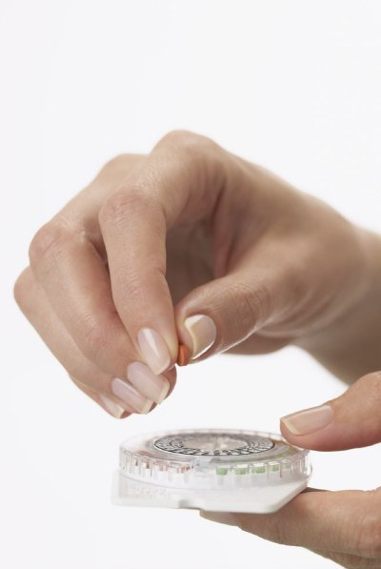
When to start?
Quick-start method (same day start)
  Similar safety and efficacy to period-start
  Improved uptake and fewer delays
  Need for backup contraception for 7 days
Lara-Torre E. Contraception. 2002. Leeman L. Obstet Gynecol Clin N Am. 2007. Westoff C.
Contraception. 2002.
Notes:
Talking Points
Conventional initiation of OC use within 5 days of the beginning of the next menstrual cycle may mean a delay of several weeks between the time a woman receives her prescription and starts OC use. During this interval, up to 25% of women do not begin OCs after receiving the prescription.
Consider the Quick Start method when initiating oral contraceptives, the patch, ring, injection, or implant.
If last menstrual period (LMP) was within the last 5 days, the method can be started immediately.
If LMP was more than 5 days ago and a pregnancy test is negative, assess the last episode of unprotected sex to determine if EC is required (or immediately insert copper IUD).
In unprotected sex within last 2 weeks, start the contraceptive method today and advise patient to return to the clinic for a pregnancy test in 3 weeks.
Instruct women who are using the pill, patch, ring, injection, or implant to use backup contraception for the first 7 days.
Research shows that there are no significant differences in the number of bleeding-spotting days or any other bleeding parameter between the immediate and conventional starters.
The Quick Start method:
Significantly improves the continuation rate for OCs.
Produces better compliance at 3 months in adolescents.
Reduces the likelihood of additional and a potential unplanned pregnancy
References
Lara-Torre E, Schroeder B. Adolescent compliance and side effects with quick start initiation of oral contraceptive pills. Contraception. 2002;66:81-5.
Leeman L. Medical barriers to effective contraception. Obstet Gynecol Clin N Am. 2007;34:19-29.
Westoff C, Kerns J, Morroni C, et al. Quick start: novel oral contraceptive initiation method. Contraception. 2002;66:141-5.
---
Original content for this slide submitted by ARHP’s Clinical Advisory Committee for Choosing a Birth Control Method in May 2009. Original funding received from a collaboration of pharmaceutical companies including Bayer, Duramed and Schering Plough. This slide is available at www.arhp.org/core.

Slide 31
Initiation of Hormonal Contraceptives
Pregnancy test
Pelvic exam
Pap smear
STI screening
Leeman L. Obstet Gynecol Clin N Am. 2007
Notes:
Talking Points
Oral contraceptives are not teratogenic and will not produce adverse fetal effects.
WHO, Planned Parenthood, and ACOG support unbundling services and not linking the provision of contraception with a pelvic exam, Pap smear, or STI screening.
Oral contraceptives are not linked to cervical cancer or infection—no need for Pap smear or STI screening before OCs are started.
Pelvic exams are not a requirement for starting hormonal contraception.
ACOG recommends delaying the first Pap smear until 3 years after sexual activity starts or age 21.
WHO guidelines state that measuring blood pressure before OCs are started is desirable but that OCs should not be denied if blood pressure cannot be measured.
References
ACOG practice bulletin. Cervical cytology screening. Int J Gynaecol Obstet. 2003;83(45):237-47.
Leeman L. Medical barriers to effective contraception. Obstet Gynecol Clin N Am. 2007;34:19-29.
Stewart FH, Harper CC, Ellertson CE, et al. Clinical breast and pelvic examination requirements for hormonal contraception: current practice vs evidence. JAMA. 2001;285:2232-9.
World Health Organization. Medical eligibility requirements for contraceptive use. 3rd edition. 2004. Geneva, Switzerland.
---
Original content for this slide submitted by ARHP’s Clinical Advisory Committee for Choosing a Birth Control Method in May 2009. Original funding received from a collaboration of pharmaceutical companies including Bayer, Duramed and Schering Plough. This slide is available at www.arhp.org/core.

Slide 32

Side Effects: Hormonal Contraception
Progestin-Related
Estrogen-Related
Bloating
Anxiety
Irritability
Depression
Menstrual irregularities
Reduced libido
Breast tenderness
Nausea
Vomiting
Headaches
Elevated blood pressure (rare)
Notes:
Talking Points
Side effects related to Progestin:
Bloating
Anxiety
Irritability
Depression
Menstrual irregularities
Reduced libido
Progestins
Most Androgenic: levonorgestrel, norgestre
Androgenic: norethindrone, ethynodiol diacetate
Least Androgenic: desogestrel, norgestimate
Spirinolactone like: drosperinone
Side effects related to Estrogen:
Breast tenderness
Nausea
Vomiting
Headaches
Elevated blood pressure (rare)
---
Original content for this slide submitted by ARHP’s Clinical Advisory Committee for Choosing a Birth Control Method in May 2009. Original funding received from a collaboration of pharmaceutical companies including Bayer, Duramed and Schering Plough. This slide is available at www.arhp.org/core.

Slide 33
It’s okay to skip periods
Myth
Fact
Depends
Unsure

Slide 34
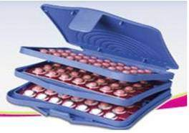
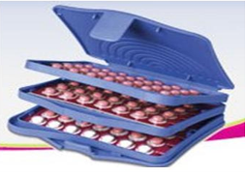
Extended Combined Oral Contraception (COC)
Delays or eliminates menstruation
Menstrual and nonmenstrual benefits
Extended methods:
    Continuous use of COCs, transdermal patch & vaginal ring
    Seasonale®, Seasonique ® & Lybrel ® - dedicated extended OC regimen
Anderson FD. Contraception. 2003. Kaunitz AM. Contraception. 2000. ARHP. 2003. NuvaRing Product Information. 2001. Stewart FH. Obstet Gynecol. 2005. Kwiecien M. Contraception. 2003. Sulak PJ. Am J Obstet Gynecol 2002.
Notes:
Talking Points
When OCs were first introduced in the 1960s, social, cultural, and religious pressures favored a method associated with a “natural” cycle in which withdrawal of hormones for 7 days was followed by bleeding.
Women continue to be prescribed the standard 21/7 OC regimen, although there is no known medical benefit to routine monthly bleeding.
Advantages
Extended-regimen contraception has been used for years by clinicians to relieve menstrual-related complaints and to treat women with menorrhagia, dysmenorrhea, endometriosis, chronic pelvic pain, and anemia.
Disadvantage
The major disadvantage is an increase in breakthrough bleeding during the first few cycles of use of a hormonal method as the body adjusts to the new hormone balance.
Extended Products
Seasonale , Seasonique and Lybrel are products approved for extended contraception.
Traditional cyclic OCs, vaginal ring, and transdermal patch can be dosed continuously, but the FDA has not approved this indication. When conventional OCs are used, three pill packs (63 active pills followed by a 7-day pill-free interval) are usually prescribed.
The NuvaRing is approved for 3-weeks-in, 1-week-out use, but studies have been conducted on its extended use.
Counseling
Women considering extended use of the pill should be reassured that:
It is not necessary to bleed every month when using hormonal contraceptives.
Neither menstrual blood nor iron builds up with hormonal methods.
Extended use of combination OCs is safe for the lining of the uterus.
Monthly menses is not needed to prove a woman is pregnant; accurate pregnancy tests are available for those who need reassurance.
It is important to counsel women that unpredictable breakthrough bleeding is initially more likely than with conventional OCs, and that this will lessen over time.
References
Anderson FD, Hait H, Seasonale-301 Study Group. A multicenter, randomized study of an extended cycle oral contraceptive. Contraception 2003;68:89-96.
Association of Reproductive Health Professionals. Choosing when to menstruate: the role of extended contraception. Clinical Proceedings, April 2003. Available at: http://www.arhp.org/healthcareproviders/cme/onlinecme/extendedregimencp/index.cfm?ID=328.
Kaunitz AM. Menstruation: choosing whether…and when. Contraception. 2000;62:277-84.
Kwiecien M, Edelman A, Nichols MD, Jensen JT. Bleeding patterns and patient acceptability of standard or continuous dosing regimens of a low-dose oral contraceptive: a randomized trial. Contraception 2003;67:9-13.
Stewart FH, Kaunitz AM, Laguardia KD, Karvois DL, Fisher AC, Friedman AJ. Obstet Gynecol. Extended use of transdermal norelgestromin/ethinyl estradiol: a randomized trial. 2005 Jun;105(6):1389-96.
Sulak PJ, Kuehl TJ, Ortiz M, Shull BL. Acceptance of altering the standard 21-day/7-day oral contraceptive regimen to delay menses and reduce hormone withdrawal symptoms. Am J Obstet Gynecol 2002;186:1142-1149.
---
Original content for this slide submitted by ARHP’s Clinical Advisory Committee for Choosing a Birth Control Method in May 2009. Original funding received from a collaboration of pharmaceutical companies including Bayer, Duramed and Schering Plough. This slide is available at www.arhp.org/core.

Slide 35
It takes at least 3 months to get pregnant after stopping birth control pills.
Myth
Fact
Depends
Unsure

Slide 36
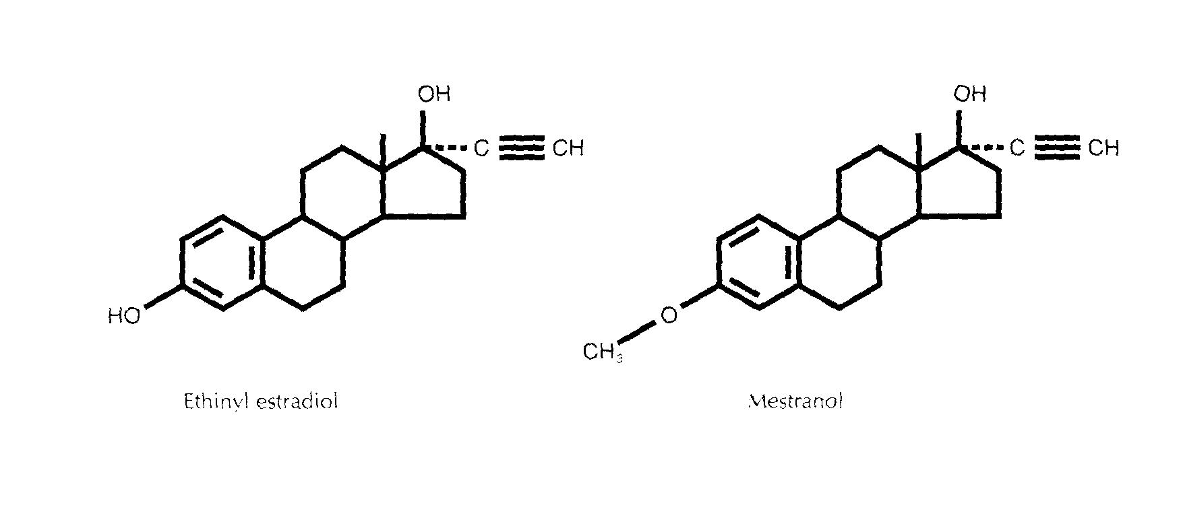
COCs: Pros and Cons
Pros
  Fertility control (rapid return!)
  Non-contraceptive health benefits
Cons
  Daily use
  Increased risks in some conditions

Slide 37
COC/CHCs: Health Benefits
Treatment of acne, dysmenorrhea, heavy or irregular menses, PMS, endometriosis, PCOS
Decreased risk of
  Benign breast disease (RR 0.7)
  Pelvic inflammatory disease (RR 0.5)
  Functional ovarian cysts
  Iron deficiency anemia
  Ovarian cancer (OR 0.6)
  Endometrial cancer (OR 0.5)
Notes:
Talking Points
Combined oral contraceptive pills have many non-contraceptive benefits.
Primarily, they alleviate menstrual disturbances.
Studies have shown COCs to substantially decrease:
dysmenorrhea
menstrual blood loss
premenstrual syndrome
anovulatory bleeding
References
Larsson G, Milsom I, Lindstedt G, Rybo G. The influence of a low-dose combined oral contraceptive on menstrual blood loss and iron status. Contraception. 1992;46(4):327-34
Parsey KS, Pong A. An open-label, multi-center study to evaluate Yasmin, a low-dose combination oral contraceptive containing drospirenone, a new progestogen. Contraception. 2000;61:105-11
Freeman EW, Borisute H, Deal L, Smith L, et al. A continuous-use regimen of levonorgestrel/ethinyl estradiol significantly alleviates cycle-related symptoms: Results of a Phase 3 stud. Fertil Steril .2005;84:S25.
Davis A, Godwin A, Lippman J, et al. Triphasic norgestimate ethinyl estradiol for treating dysfunctional dysphoric disorder. Obstet Gynecol. 2005;106:492-501
---
Original content for this slide submitted by ARHP’s Clinical Advisory Committee for Choosing a Birth Control Method in May 2009. Original funding received from a collaboration of pharmaceutical companies including Bayer, Duramed and Schering Plough. This slide is available at www.arhp.org/core.

Slide 38
Birth control pills lead to weight gain
Myth
Fact
Depends
Unsure

Slide 39
Dispelling myths about COCs
Weight Gain:
  50% no change
  25% gain
  25% loose
“Rest” from the pill: Not required
Birth defects: Not teratogenic
Breast cancer: Good evidence of no increased risk (Gaffield Contraception 2009)
Notes:
Weight gain: Cochrane review 2008
Pills and breast cancer: royal college study followed women for 39 years, no increased risk. Contraception 2009- systematic review showed that women with family history of breast cancer do not increase risk of disease by using COC
After stopping COC, no more than a two week delay in return to menses is expected when stopping COC
The evidence on the impact of exogenous hormone use on the risk of new-onset or recurrence of breast cancer is complex. Recent evidence suggests that currently available hormonal contraception, including progestin-only methods such as the levonorgestrel (LNG) 52 mg intrauterine device (IUD), may be associated with a small absolute increase in breast cancer diagnosis, roughly one additional cancer diagnosis per 7690 users per year.

Slide 40
Estrogen causes blood clots in everyone
Myth
Fact
Depends
Unsure

Slide 41
Combined Hormonal Contraception: Health Risks
Non-smokers on modern-dose COCs have no increased risk of heart attack; little if any of stroke
Thromboembolic events are more common in pregnancy than on COCs
  Pregnancy: 60 per 10,000 women per year
  COCs: 10 per 10,000
  Neither: 5 per 10,000
Hannaford PC, Webb AM. Evidence-guided prescribing of combined oral contraceptives: consensus statement. An International Workshop. Contraception 1996;54:125-9.

Slide 42
Contraindications: CHCs
Smokers > 35
Breast Cancer
DVT, PE, known thrombophilia
Heart attack, angina, uncontrolled hypertension, vascular disease
Diabetes with vascular/renal disease
Stroke, migraines with aura
Severe liver disease or tumor, cholestatic jaundice
www.cdc.gov
Notes:
Active or personal history of these conditions, may be worsened by estrogen
Conditions compatible with Estrogen:
Diabetes with good control & no vascular disease
Sickle cell disease
Seizure disorder (but watch for drug interactions!)
Recovered from viral hepatitis
Talking Points
Most healthy women are potential candidates for COCs.
There are a few WHO Category 3 conditions for which COCs are usually not used unless there are no other contraceptive methods available and/or acceptable because of the increased risk of complications.
These conditions include the female who is <21 days postpartum, lactating (6 weeks-6 months), has gallbladder disease, is on medications that may interfere with COC efficacy, or has undiagnosed abnormal vaginal/uterine bleeding.
Women who have WHO Category 4 conditions are advised against COC use.
These include a current or past history of:
deep vein thrombosis or pulmonary embolism
cerebrovascular accident\
coronary (or ischemic) heart disease
complicated structural heart disease (eg, pulmonary hypertension, atrial fibrillation or history of subacute bacterial endocarditis)
Pregnancy
lactation <6 weeks postpartum
complicated diabetes mellitus (e.g., retinopathy, neuropathy, nephropathy)
breast cancer
headaches (including migraine headaches) with focal neurologic symptoms\
liver disease (including liver cancer, benign hepatic adenoma, active viral hepatitis, severe cirrhosis)
surgery involving the lower extremities and/or prolonged immobilization
severe hypertension (160+/100+ mm Hg or with vascular complications).
Reference
World Health Organization (WHO). Improving Access to Quality Care in Family Planning: Medical Eligibility Criteria for Contraceptive Use, 2nd edition. Geneva, Switzerland: World Health Organization, 2000
---
Original content for this slide submitted by ARHP’s Clinical Advisory Committee for Choosing a Birth Control Method in May 2009. Original funding received from a collaboration of pharmaceutical companies including Bayer, Duramed and Schering Plough. This slide is available at www.arhp.org/core.

Slide 43
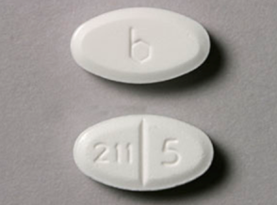
Hormonal methods: Progestin Only Pills (POPs)
Mechanism: thickens cervical mucus
Norethindrone 0.35 mg
Must take at same time daily
    Three hour window
Pros: No DVT risk
      Safe for breast-feeding
Cons: Must take on time!
      Irregular bleeding
Notes:
Talking Points
Often called “mini-pills,” progestin-only pills are a good contraceptive choice for women who can’t use estrogen.
There are currently two formulations--norethindrone (Micronor, each pill contains .35 mg of norethindrone) and norgestrel (Ovrette), each pill contains .075 mg of norgestrel).
Efficacy of progestin-only pills requires consistent use. Women should take the pill at the same time every day.
Mechanism of Action:
Progestin-only pills prevent contraception through multiple mechanisms including suppressing ovulation and midcycle gonadotropin peaks and altering the cervical mucus, the endometrium, and fallopian tubes.
Candidates:
Progestin-only pills are useful for women who want immediately reversible hormonal contraception but for whom estrogen is contraindicated because of breastfeeding, cardiovascular disease, and migraine, for example.
Advantages:
Progestin-only pills (COCs also are used) can be used to correct dysfunctional uterine bleeding. This bleeding usually results from anovulation and occurs at the extremes of life.
Progestin-only pills do not have the estrogen-related side effects that COCs have, such as nausea, headache, and bloating, but they do cause irregular vaginal bleeding.
These pills protect against cancer of the uterus and ovaries, benign breast disease, and pelvic inflammatory disease.
Contraindication:
The only contraindication to taking progestin-only pills is current breast cancer.
Disadvantages:
Progestin-only users should be prepared to use a back-up method in case they don’t take the pill as required.
The primary side effect is irregular menstrual bleeding, including spotting or breakthrough bleeding, amenorrhea, or shorted cycles. Irregular bleeding decreases in many users by cycle 12. Less common side effects are headache, breast tenderness, and dizziness.
Counseling:
The pill must be taken at the same time each day.
If a pill is more than 3 hours late, a backup method of contraception should be used for at least the next 48 hours. Inform women about emergency contraception.
Explain the range of bleeding disturbances that may occur, including frequent bleeding, prolonged bleeding, irregular bleeding, or, in some cases, amenorrhea. In many women, this irregular bleeding improves within a few months. If bleeding is heavy or particularly bothersome, women should contact their health care provider.
References
Apgar BS, Greenberg G. Using Progestins in Clinical Practice. AFP. 2000;62:1849-1850.
American College of Obstetricians and Gynecologists. Birth Control Pills. 2006. http://www.acog.org/publications/patient_education/bp021.cfm
Progestin-only oral contraceptives: An update. Contraception Report. 1999. Vol. 10, Issue 4.
Trussel J. Contraceptive efficacy. In Hatcher RA, Trussel J, Nelson AL, Cates W, Stewart FH, Kowal D. Contraceptive Technology: 19th revised ed. New York, NY: Ardent Media, 2007.
WHO Medical Eligibility Criteria for Contraceptive Use, 3rd edition 2004.
---
Original content for this slide submitted by ARHP’s Clinical Advisory Committee for Choosing a Birth Control Method in May 2009. Original funding received from a collaboration of pharmaceutical companies including Bayer, Duramed and Schering Plough. This slide is available at www.arhp.org/core.

Slide 44
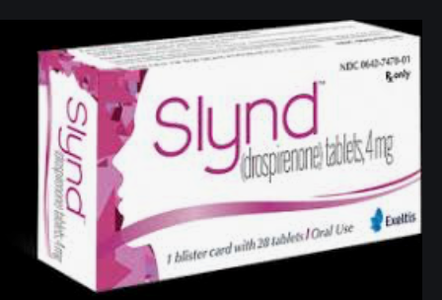
New POP: Drosperinone 4 mg
Progestin only pill that will suppress ovulation!
  24/4 regimen
As “forgiving” as COC- 24hr missed pill safety window
Less bleeding irregularities than other POPs
May LOWER BP
Access issues: COST but online coupons
Palacios et al. Eur Journal CRHC, April 2020, Archer et al. Contraception, 92 (2015)
Notes:
No reportsof VTE

Slide 45
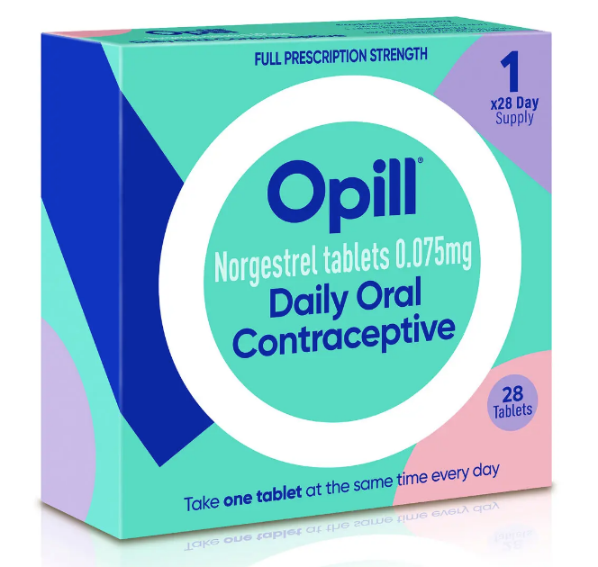
New POP: OTC Contraception
Norgestrel 0.075mg
FDA approved: June 2023
Available: March 2024
Notes:
OTC contraception!
Enantiomer (pair of molecules that are mirrors of each other) of LNG- this means a long half life

Slide 46
Depo-provera causes brain tumors
Myth
Fact
Depends
Unsure

Slide 47
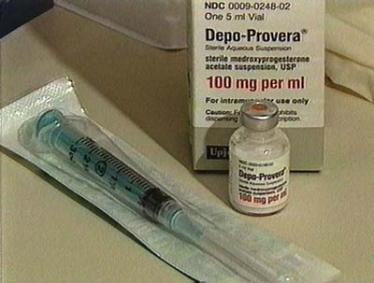
Hormonal contraception: Depot Medroxyprogesterone Acetate
Two formulations to be given every 12 weeks:
  150mg IM or 104mg SC
Mechanism: Inhibits ovulation, thickens cervical mucus
Effective for up to 15* weeks
Notes:
There is also a sub Q formulation 104mg
Wt gain: cited as 12-19% reason for discontinuation, studies have not shown consistent wt gain
One year continuation rates= 56% (pills 67%)
RCTs have not shown significant weight gain in depo users, although not definitive,
Observational studies have shown inc weight in overweight adolescents and normal and overweight adults but less likely in obsese adult women
40-50% amenorrhea after 4-5 injections
References
ACOG practice bulletin. No. 73: Use of hormonal contraception in women with coexisting medical conditions. Obstet Gynecol. 2006;107:1453-72.
Cromer BA, Lazebnik R, Rome E, et al. Double-blind randomized controlled trial of estrogen supplementation in adolescent girls who receive depot medroxyprogesterone acetate for contraception. Am J Obstet Gynecol. 2005;192:42-7.
DiVasta AD, Gordon CM. Bone health in adolescents. Adolesc Med. 2006;17:639-52.
Kaunitz AM, Arias R, McClung M. Bone density recovery after depot medroxyprogesterone acetate injectable contraception use. Contraception. 2008;77:67-76.
Leeman L. Medical barriers to effective contraception. Obstet Gynecol Clin N Am. 2007;34:19-29.
World Health Organization. WHO statement on hormonal contraception and bone health. Available at: http://www.who.int/reproductive-health/family_planning/bone_health. html. Accessed November 30, 2006.
---
Original content for this slide submitted by ARHP’s Clinical Advisory Committee for Choosing a Birth Control Method in May 2009. Original funding received from a collaboration of pharmaceutical companies including Bayer, Duramed and Schering Plough. This slide is available at www.arhp.org/core.

Slide 48

May have a small increased risk of meningioma, but the overall risk of meningioma in the general population remains very low
  5 out of 10,000 women using medroxyprogesterone acetate may possibly develop meningioma compared to 1 out of 10,000 women not using the medication.
Roland N, Neumann A, Hoisnard L, Duranteau L, Froelich S, Zureik M et al. Use of progestogens and the risk of intracranial meningioma: national case-control study BMJ 2024; 384 :e078078 doi:10.1136/bmj-2023-078078
Notes:
Study from France showed: Out of 10,000 women, 5 will possibly develop meningioma w/ depo but out of 10,000 women, 1 will possibly develop meningioma w/o depo. This study was not conducted on an US population. In the United States, out of 10,000 people, 10 will possibly develop a meningioma The study also did not publish overall meningioma incidence in France, so it's unclear if their study group had a lower baseline incidence than the general population in France.
It is important to interpret the results of this study with caution, as noted in a response from BMJ, because this study has several limitations and warrants further research.
Hormonal birth control has many noncontraceptive health benefits that patients should understand when considering their birth control options, including medroxyprogesterone acetate.
There are nonhormonal methods of birth control that patients may choose to consider.

Slide 49
Depo-provera leads to weight gain
Myth
Fact
Depends
Unsure

Slide 50
Hormonal contraception: Depot Medroxyprogesterone Acetate
Controversies
  Bone loss
    Premenopausal women who us DMPA for up to 5 years, loss of bone mineral density associated with DMPA is reversed after stopping
  Weight changes
    More weight gain in overweight or obese people
    Weight changes in after the first shot → most indicative of probability of future weight gain
Notes:
RCTs have not shown significant weight gain in depo users, although not definitive,
Observational studies have shown inc weight in overweight adolescents and normal and overweight adults but less likely in obsese adult women
Talking Points
What do you know about Depo-Provera and bone loss?
The FDA approved a “black box” warning despite lack of evidence that prolonged use of DMPA causes an increase in fractures or has an effect on postmenopausal bone health.
In premenopausal women who use DMPA for up to 5 years, loss of bone mineral density (BMD) associated with DMPA is substantially reversed after they stop using it.
Family planning experts have called for removal of the black box warning. The American College of Obstetricians and Gynecologists and the World Health Organization support long-term contraceptive use of DMPA for women 18 to 45 years old.
Environmental factors such as nutrition and exercise have a more substantial impact on bone mass than DMPA. Risks of Depo-Provera must be balanced against risks of pregnancy.
Health care providers should:
Encourage patients to promote bone health with weight-bearing exercise, intake of calcium and vitamin D, avoidance of tobacco, and limits on alcohol.
Examine risks of DMPA along with genetic and lifestyle factors that contribute to osteoporosis.
References
ACOG practice bulletin. No. 73: Use of hormonal contraception in women with coexisting medical conditions. Obstet Gynecol. 2006;107:1453-72.
Cromer BA, Lazebnik R, Rome E, et al. Double-blind randomized controlled trial of estrogen supplementation in adolescent girls who receive depot medroxyprogesterone acetate for contraception. Am J Obstet Gynecol. 2005;192:42-7.
DiVasta AD, Gordon CM. Bone health in adolescents. Adolesc Med. 2006;17:639-52.
Kaunitz AM, Arias R, McClung M. Bone density recovery after depot medroxyprogesterone acetate injectable contraception use. Contraception. 2008;77:67-76.
Leeman L. Medical barriers to effective contraception. Obstet Gynecol Clin N Am. 2007;34:19-29.
World Health Organization. WHO statement on hormonal contraception and bone health. Available at: http://www.who.int/reproductive-health/family_planning/bone_health. html. Accessed November 30, 2006.
---
Original content for this slide submitted by ARHP’s Clinical Advisory Committee for Choosing a Birth Control Method in May 2009. Original funding received from a collaboration of pharmaceutical companies including Bayer, Duramed and Schering Plough. This slide is available at www.arhp.org/core.

Slide 51
Emergency contraception is an abortifacient
Myth
Fact
Depends
Unsure

Slide 52
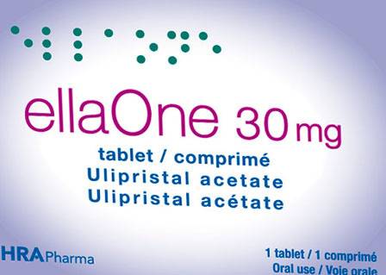
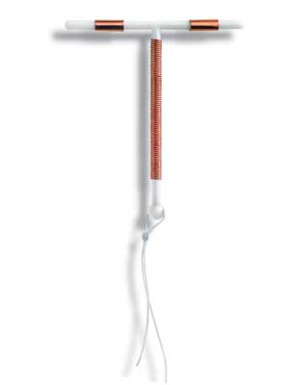
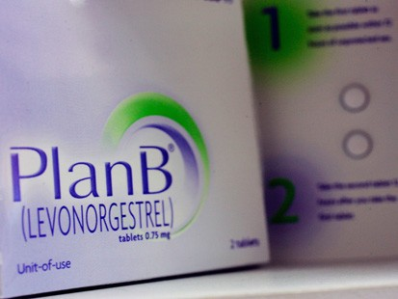
Contraception in an emergency…
Notes:
In 2002 only 2% reproductive age women had used
In 2008 about 10%
15 studies have shown that EC does not increase sexual risk taking!
Advance provision increases use and effectiveness!

Slide 53


Emergency Contraception
NOT abortifacient
Two ORAL types:
  Levonorgestrel (Plan B Onestep, NextChoice)
  Ulipristal acetate (Ella)- MORE EFFECTIVE
Mechanism: disrupts or delays ovulation
LNG EC Available OTC for all ages= Plan B Onestep
Ulipristal not available OTC
Decreased Efficacy: BMI >25, timing, repeat UPT
Glasier Contraception (84) 2011; 363-367

Slide 54
EC: Levonorgestrel vs. Ulipristal
 | Levonorgestrel | Ulipristal (more effective)
Hormone type | Progestin | Anti-progestin
Dose | 1.5 mg once | 30mg once
Timeframe | Within 72hrs (120hrs) | Within 120hrs
Effectiveness | Decreases with time, BMI, cycle day | Does NOT decrease with time, but with BMI >35
Availability | OTC for Onestep Generics= rx | Rx only
Notes:
13-29% n/v

Slide 55
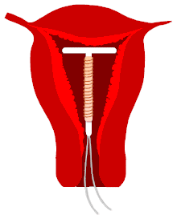
Non-oral Emergency Contraception
The copper IUD and LNG IUD!
Inhibits fertilization & implantation
Inserted up to 5 days after intercourse
Reduces risk of pregnancy by 99%
Can then be used for on-going contraception
Notes:
Over 12,000 insertions post-coital with 12 reported failures.

Slide 56
The monthly vaginal ring can be inserted for 4 weeks
Myth
Fact
Depends
Unsure

Slide 57

CHC: Monthly Vaginal Contraceptive Ring- NuvaRing
Ethylene vinyl ring for intravaginal release
  Etonogestrel 120 μg/day
  Ethinyl estradiol 15 μg/day
Mechanism: Inhibits ovulation
How to use:
  Leave in for 3 weeks, then remove for 1 week, withdrawal bleed; insert new ring
    OR
  Continuously: remove every 4 weeks
    35 days of hormone
FDA approved Oct. 2001
Notes:
Avoids first pass metabolism by gut and liver, increased bioavailability of hormones
Talking Points
Ring is flexible, transparent, and colorless to nearly colorless.
Ring comes in one size that fits most women; no fitting is required. One ring is inserted into the vagina per cycle and is to remain in place continuously for 3 weeks, followed by a ring-free week.
When inserted, the ring delivers ~ 120 μg of etonorgestrel and 15 μg of ethinyl estradiol/day to the systemic circulation over a 3-week period. After insertion, maximum serum concentrations of etonorgestrel and ethinyl estradiol are achieved in approximately 1 week and show a gradual linear decline thereafter.
Women not previously using hormonal contraception should insert the ring on or before day 5 of the cycle, counting the first day of menstruation as day 1. Back-up contraception is recommended for the first 7 days of ring use.
Women switching from a combination OC may insert the ring any time within 7 days after the last combined estrogen/progestin OC and no later than the day that a new cycle of pills would have been started. No back-up method is needed.
Mechanism of Action:
Similar to COC’s mechanism of action.
The ring inhibits ovulation and sperm motility, fertilization, and implantation.
Candidates:
Women who desire the convenience of a 3-week regimen, as well as those who have difficulty using a daily method.
Women who want to regulate their periods.
The hormonal benefits of the vaginal ring are similar to those of the contraceptive skin patch and pill.
No data are available regarding the efficacy of the vaginal contraceptive ring in women of heavier body weight.
Ring improves vaginal flora, leading to reduced frequency of bacterial vaginosis.
A multicenter trial showed a low incidence of gastrointestinal problems, such as nausea and vomiting.
Advantages:
Convenient, once a month use
Privacy
Cycle control, few women experience untimely spotting or bleeding
Contraindications:
Same as those for combination OCs (except those related to intestinal absorption problems)
Significant pelvic relaxation
Vaginal obstruction
Unable to touch genitalia
Disadvantages:
Possibility of leukorrhea and vaginitis
Hormone-related side effects associated with use of the vaginal ring, such as headache and nausea, are similar to those seen with OCs, although more study is needed. Local adverse effects associated with use of the vaginal ring include leukorrhea, vaginitis, and a slight risk (1%) of device expulsion. The ring is rarely felt during intercourse.
Counseling:
The ring is easy to insert; there is no wrong way to insert it.
The ring can be placed anywhere in the vagina, but the deeper it’s placed, the less likely it will be felt.
After 3 weeks, remove the ring for one week and then insert a new ring.
Patients need to be cautioned that the ring can be inadvertently expelled from the vagina while removing a tampon or during bowel and bladder emptying, especially with straining or constipation. Often women are not aware that the device has been expelled.
If the ring falls out, it should be rinsed with warm water and reinserted within 3 hours.
References
Brunei V, Pontello V, Luisi S, Petraglia F. An open-label, multicentre trial to evaluate the vaginal bleeding pattern of the combine contraceptive vaginal ring NuvaRing. Eur J Obstet Gynecol Reprod Biol. 2008.
Dieben TO, Roumen FJ, Apter D. Efficacy, cycle control, and user acceptability of a novel combined contraceptive vaginal ring. Obstet Gynecol. 2002;100:585-93.
Herndon EJ, Zieman M. New contraceptive options. Am Fam Physician. 2004;69:853-860.
Lete I, Doval JL, Perez-Campos E, et al. Factors affecting women’s selection of a combined hormonal contraceptive method: the TEAM-06 Spanish cross-sectional study. Contraception. 2007;76:77-83.
Linn ES. Progress in contraception: new technology. Int J Fertil. 2003;48:182-91.
NuvaRing Prescribing Information. Organon Inc., West Orange, NJ; 2001.
Roumen FJME, Apter D, Mulders TMT, Dieben TOM. Efficacy, tolerability and acceptability of a novel contraceptive vaginal ring releasing etonogestrel and ethinyl oestradiol. Hum Reprod. 2001;16:469-75.
Timmer CJ, Mulders TMT. Pharmacokinetics of etonogestrel and ethinylestradiol released from a combined contraceptive vaginal ring. Clin Pharmacokinet. 2000;39:233-42.
Trussel J. Contraceptive efficacy. In Hatcher RA, Trussel J, Nelson AL, Cates W, Stewart FH, Kowal D. Contraceptive Technology: 19th revised ed. New York, NY: Ardent Media, 2007.
Vaginal ring. Mayo Clinic. January 2008. http://www.mayoclinic.com/health/birth-control/BI99999/PAGE=BI00017
---
Original content for this slide submitted by ARHP’s Clinical Advisory Committee for Choosing a Birth Control Method in May 2009. Original funding received from a collaboration of pharmaceutical companies including Bayer, Duramed and Schering Plough. This slide is available at www.arhp.org/core.

Slide 58
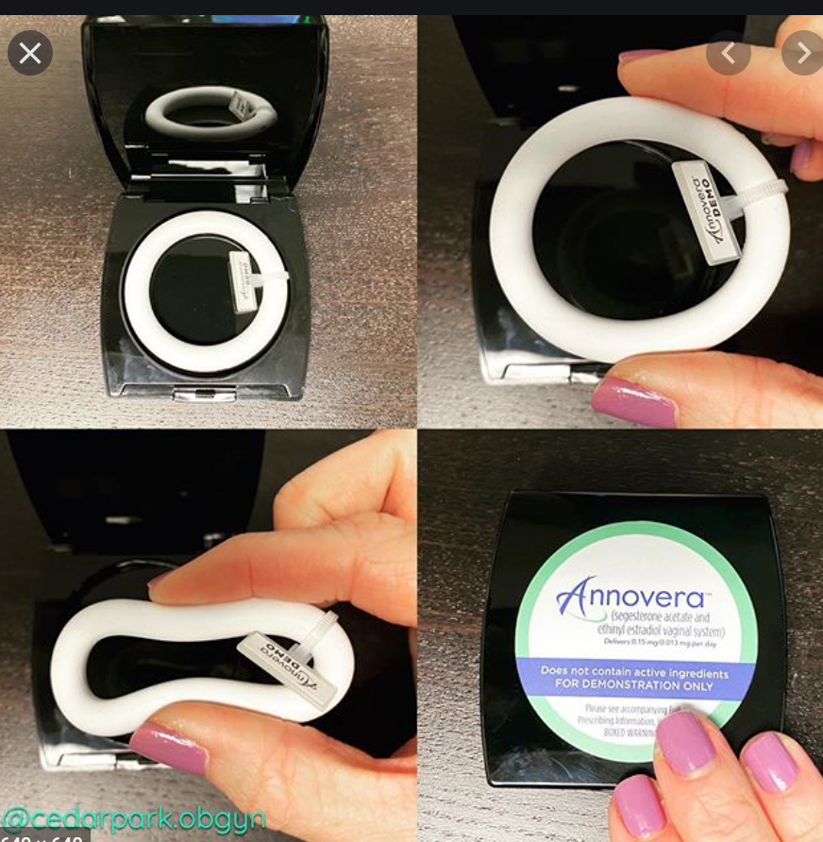
CHC: 1-year contraceptive ring
FDA approval August 2018
13mcg/day Ethinyl Estradiol and 150mcg/day Segestrone
  Silicone ring
3 weeks in/ one week out
SAME RING for 13 cycles!
No refrigeration
Notes:
Segesterone and ethinyl estradiol ring — The one-year reusable segesterone acetate/ethinyl estradiol (SA/EE, commercial name Annovera) ring is 56 mm in overall diameter and 8.4 mm in cross-sectional diameter [4]. The ring is worn for three weeks and removed for one week, and that pattern is repeated for a total of 13 cycles. This pattern of use results in regular withdrawal bleeding and an overall pooled unintended pregnancy rate (Pearl index) of 2.98 per 100 woman-years. The ring contains two internal channels: one channel with both SA and EE and the other channel with SA only. The device releases approximately 150 mcg/day of SA and 13 mcg/day of EE over the 21-day use period. The inactive ingredients include silicone elastomers, titanium dioxide, dibutyltin dilaurate, and silicone medical adhesive. The device is latex-free. The median Tmax of both hormones is approximately 2 hours after vaginal insertion; concentrations become more constant approximately 96 hours after insertion. Other product advantages include that it does not require refrigeration for storage and that it is not orally active, which may appeal to lactating women. This one-year ring is approved by the US Food and Drug Administration and available for use.
Don’t use oild based lubricants

Slide 59

CHC: Weekly Contraceptive Patch: Xulane
Weekly transdermal patch
  norelgestromin 150 μg/day
  ethinyl estradiol 35 μg/day
Mechanism: ovulation inhibition
Change patch weekly x3, then no patch x1wk, withdrawal bleed, then new patch
9 days of hormone
Lower efficacy wt. >200 # (one study)
May have higher risk of thromboembolism than the pill
NEW 2020 patch- “Twirla” 30mcg EE/125mcg LNG (BMI <30)
Notes:
Ortho evra not marketed in US anymore= Xulane
Ethinyl estradiol and norelgestromin (EE/N) patch – The EE/N transdermal contraceptive patch (commercial name Xulane, formerly Evra) is a matrix system composed of three layers: the outer layer is water-resistant and protects the underlying layer from the environment, the middle layer is medicated and adhesive, and the inner layer is a clear release liner that is removed before patch application [1]. The medicated layer contains two hormones, EE and norelgestromin, the primary active metabolite of norgestimate. Approximately 35 mcg of EE and 150 mcg norelgestromin are released daily [1,2]. The patch covers 14 cm2 and consists of three layers.
●
Ethinyl estradiol and levonorgestrel (EE/LNG) patch – Although not yet commercially available, a patch releasing EE/LNG (commercial name Twirla) was approved by the US Food and Drug Administration in 2020 [3]. The patch will release approximately 30 mcg of EE and 125 mcg of LNG per day. The patch covers 28 cm2 and consists of five layers, with the innermost two layers containing the active ingredients. Decreased efficacyin BMI <30
Ethinyl estradiol and levonorgestrel (EE/LNG) patch – Although not yet commercially available, a patch releasing EE/LNG (commercial name Twirla) was approved by the US Food and Drug Administration in 2020 [3]. The patch will release approximately 30 mcg of EE and 125 mcg of LNG per day. The patch covers 28 cm2 and consists of five layers, with the innermost two layers containing the active ingredients.

Slide 60
Updates in contraception

Slide 61
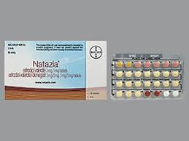
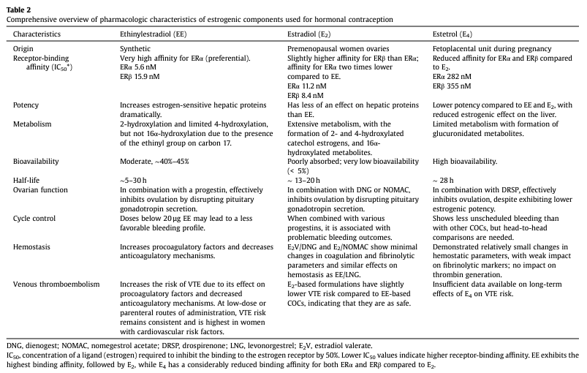
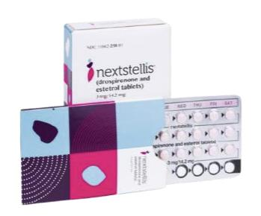
New estrogens!
Notes:
Big picture is that estetrol (E4) and estradiol (E2) is less thombogenic than ethynl estradiol because both are natural estrogens.
Nextstellis
drosperinone/estetrol 3/14.2 mg
24/4 regimen
Least thrombogenic in studies due to estetrol (E4) being a natural estrogen rather than a synthetic one like ethinyl estradiol (EE)
Natazia
Estradiol valerate (E2) 3 mg, 1 mg tablets
Estradiol valerate/dienogest 2mg/2mg, 2mg/3mg tablets
2 days estradiol valerate
5 days 2 mg EV and 2 mg DNG
17 days 2 mg EV and 3 mg DNG
2 days 1 mg EV
2 days placebo
Nice for perimenopausal patients with vasomotor symptoms and still need contraception
Natural estrogen is better at alleviating vasomotor symptoms compared to EE

Slide 62
CDC Evidence-Based Resource
The U.S. Medical Eligibility Criteria (US MEC) for Contraceptive Use, updated 2024
Evidence based risk of contraceptive method relative to medical condition
Ranks their safety (1-4)
Color coded summary chart OR get the APP
http://www.cdc.gov/reproductivehealth/unintendedpregnancy/Docs/USMEC-Color-final.doc

Slide 63
CDC Ranking Recommendations
1 | No restriction for the use of the contraceptive method for a woman with that condition
2 | Advantages of using the method generally outweigh the theoretical or proven risks
3 | Theoretical or proven risks of the method usually outweigh the advantages – not usually recommended unless more appropriate methods are not available or acceptable
4 | Unacceptable health risk if the contraceptive method is used by a woman with that condition
Notes:
Within the MEC, each combination of a medical condition with a contraceptive method has a recommendation for use, which is provided as a numeric classification- 1, 2, 3 or 4.
The numbers reflect an increasing degree of theoretical or proven risks for use of a particular contraceptive method for a woman with a particular condition. Category 1 classifications indicate no restriction for use, while category 4 classifications represent unacceptable health risks.
A number 2 means that most evidence suggests that it is generally safe for someone with the particular condition to use a particular method, and that the advantages of using the method generally outweigh the theoretical or proven risks.
A number 3 means that the theoretical or proven risks of the method usually outweigh the benefits of using that method, and other methods should be considered, if possible.
For some conditions, the numeric classification does not entirely capture the recommendation and a clarification statement is given.

Slide 64


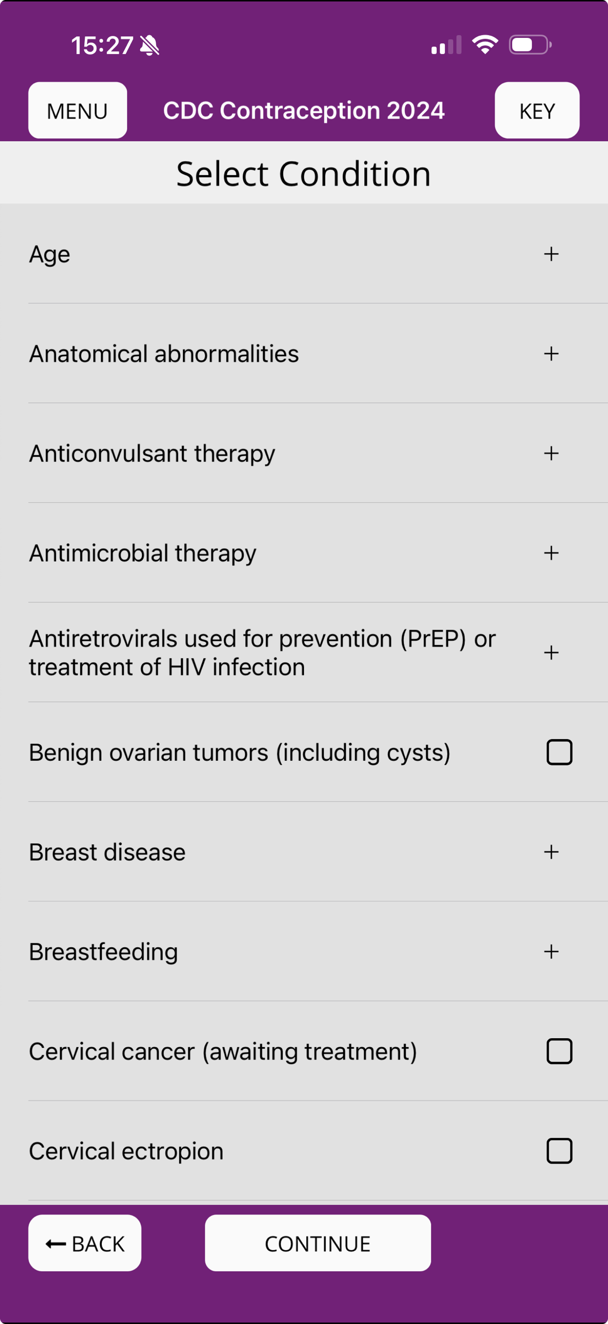
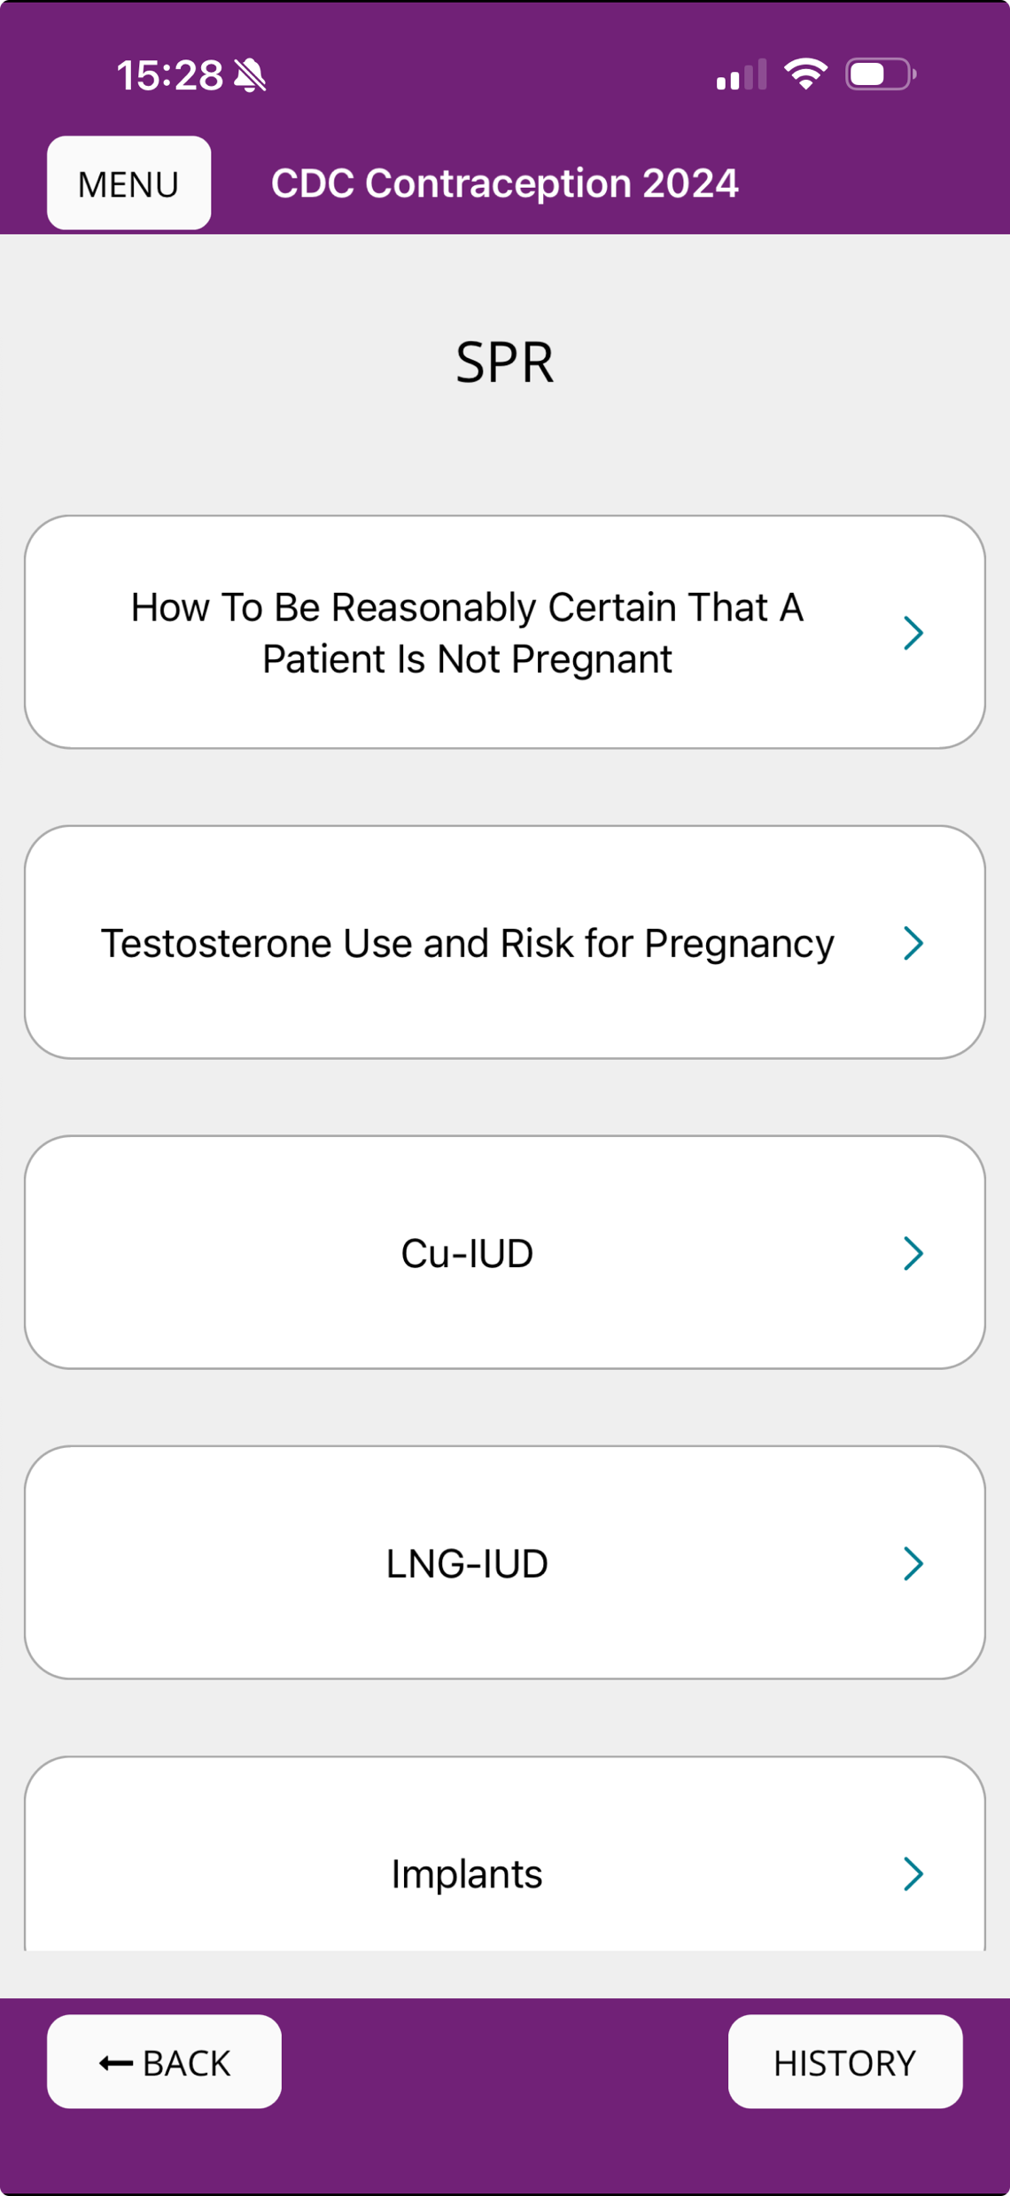
CDC US MEC and SPR App
Notes:
The updated CDC Contraception app for apple and android smart phones and tablets now includes both the MEC and SPR in a user-friendly format, with easy navigation between the two sets of guidance. It also easily links to other CDC guidance such as STD treatment guidelines. This updated app is available for download through our website. Many providers who use smartphones for other clinical references find this to be the easiest way to access the guidelines in everyday practice.

Slide 65

Have more contraception questions?
Refer to a complex family planning service near you!
  Specializes in difficult implant removals, patients with complex co-morbidities

Slide 66

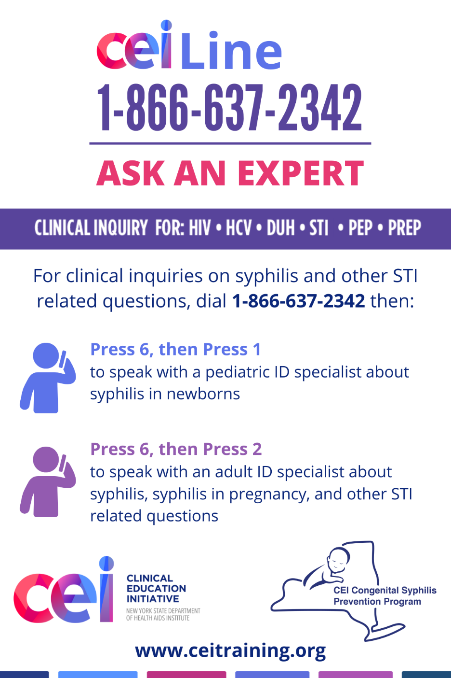
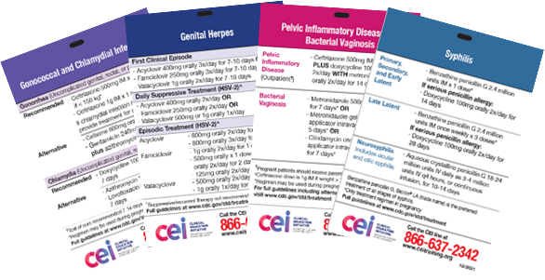
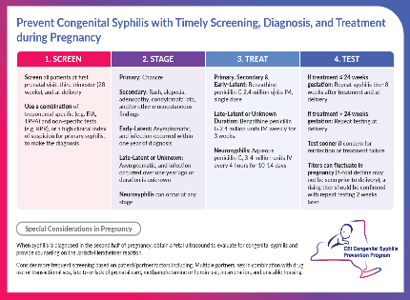
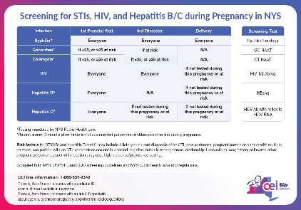





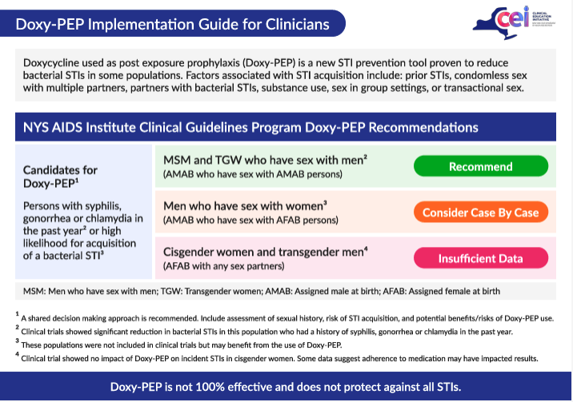
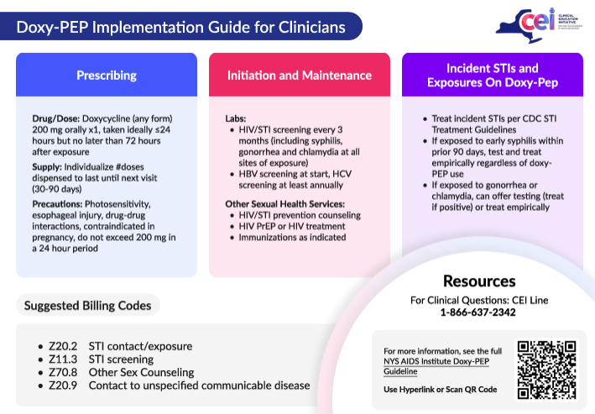
QUESTIONS?
Contact us!
www.ceitraining.org
NYS CEI Sexual Health Center of Excellence
205 St. Paul St, 5th Floor, Rochester, NY 14604
585-274-3045
Order STI Clinic Cards!
Scan the QR code or visit ceitraining.org
Follow CEI on
Instagram, Facebook, LinkedIn,
YouTube, and Podbean
or wherever you listen to podcasts!

