Slide 1


Growing Partnerships &
Removing Barriers from the Ground Up
Rural Health Symposium September 2024
Cherise Mc Daniel
Elizabeth L. Phillips, MPH, MCHES

Slide 2

Let’s Connect before Content
Who We Are
Sun River Health
Eastern Dutchess Rural Health Network (EDRHN)
Growing Partnerships & Removing Barriers from Ground Up
The Puzzle Problem
Find Problem Solvers (aka Stakeholders)
Move Puzzle Pieces (aka Community Assets)
Removing Barriers & Challenges
Embracing Opportunities to Sustain Community Impact

Slide 3
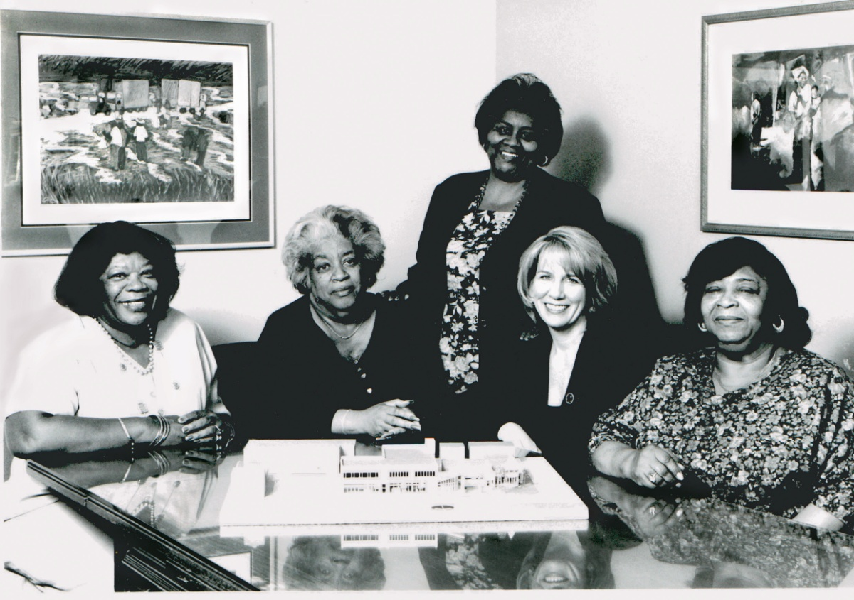
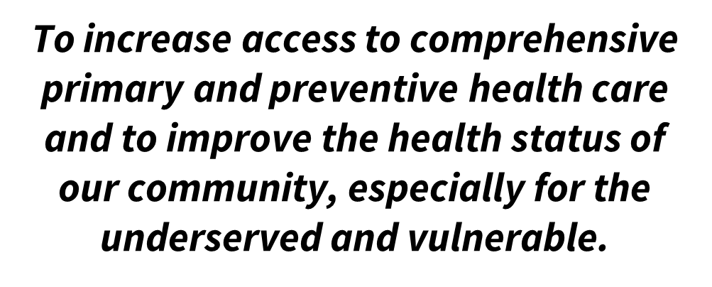

Who We Are
Our Enduring Legacy & Our Mission
From Left to Right: Willie Mae Jackson, Pearl Woods,
Rev. Jeannette Phillips, Anne Kauffman Nolon, Mary Woods.
Notes:
In the early 1970's a group of local residents and religious leaders addressed the lack of appropriate health services in their community.
In particular, a group of four women, fondly referred to as our “Founding Mothers,” spearheaded the efforts and have remained committed to the organization since its inception. Our CEO completes this picture having served in her position since 1977.

Slide 4
FQCHC Primary Care Model: One Stop
Medical Services
Primary Care / Family Medicine
Pediatrics
Women’s Health /
OB/GYN
Dental Care
Behavioral /
Mental Health
Urgent Care
Telemedicine
Specialty Care
Nutrition
Services
Podiatry /
Foot Care
Optometry
Substance Use Disorder Services
HIV Care and Prevention
Mobile Health Centers

Slide 5
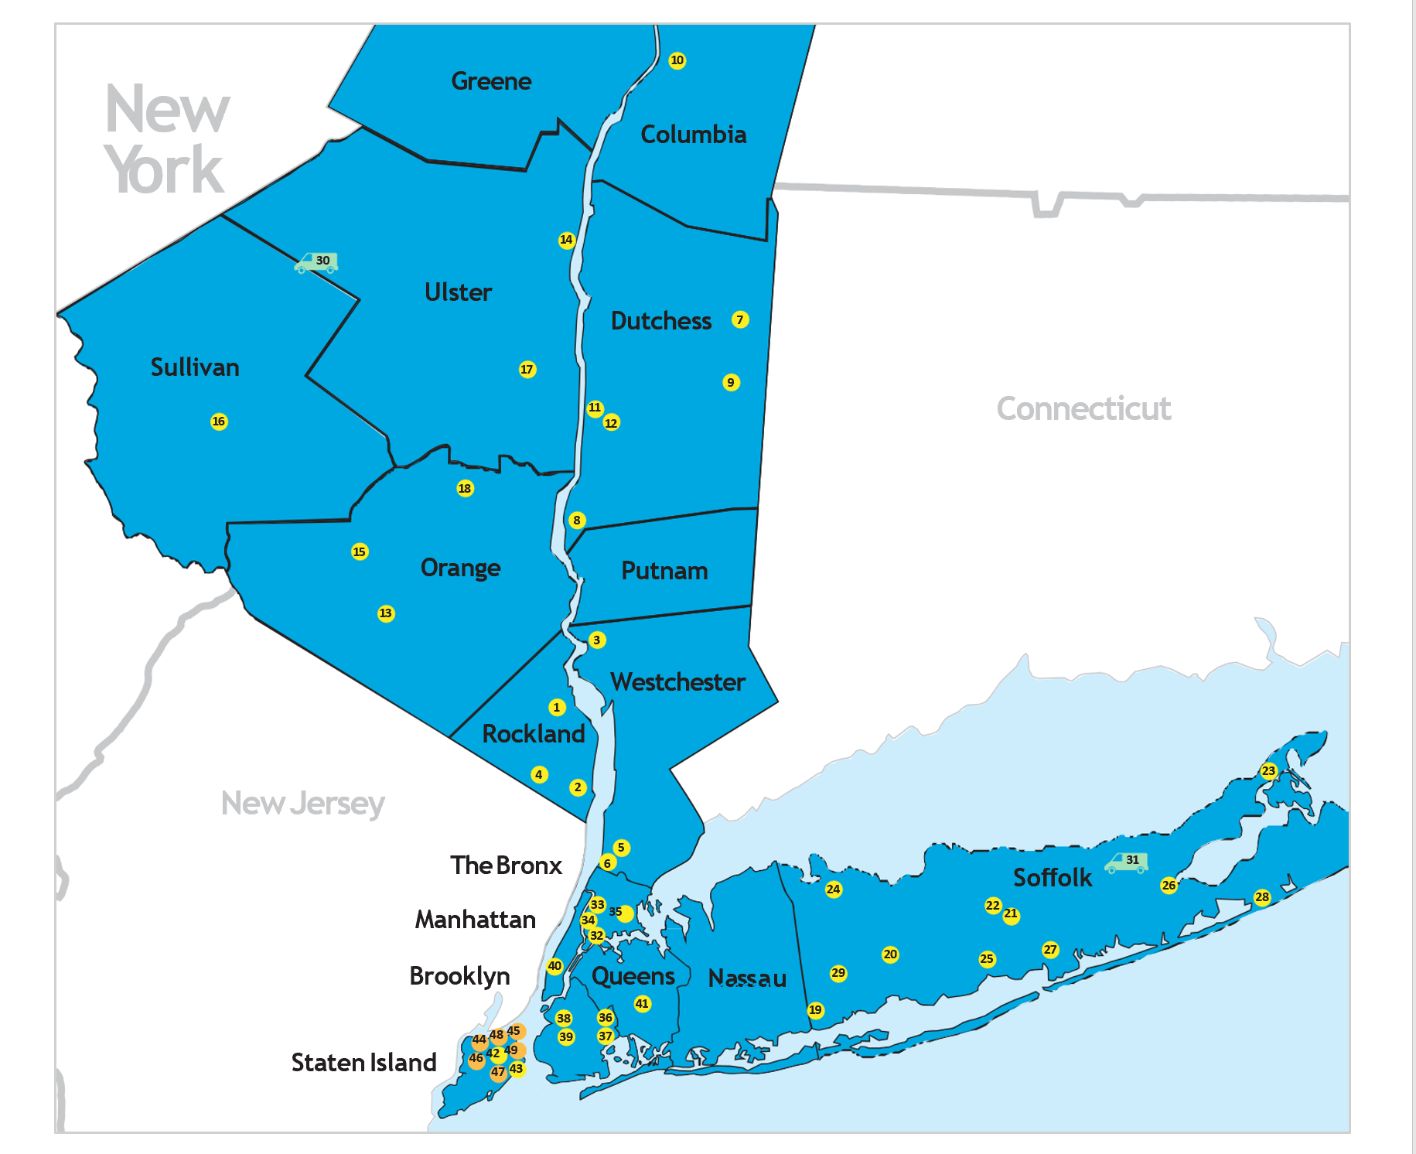

Health Center Network Map
We have a health center near you:
47 + sites throughout
Hudson Valley, Long Island and New York City
Notes:
Sun River Health is a network of 47 + Federally Qualified Health Centers (FQHCs) providing primary, dental, pediatric, OB-GYN, and behavioral health care to over 285,000 patients annually. With a dedicated staff of nearly 2,000 doctors, nurses, and health care professionals, we pride ourselves on delivering high-quality, affordable care to those who need it most.
Sun River Health started in 1975 when four African American mothers spearheaded efforts to open our first health center in Peekskill, NY to deliver accessible, high-quality, affordable services to patients in need – no matter their race, religion, income, or insurance status. Approaching 50 years of service, Sun River Health is still delivering on that promise to communities across the Hudson Valley, YC and LI.

Slide 6
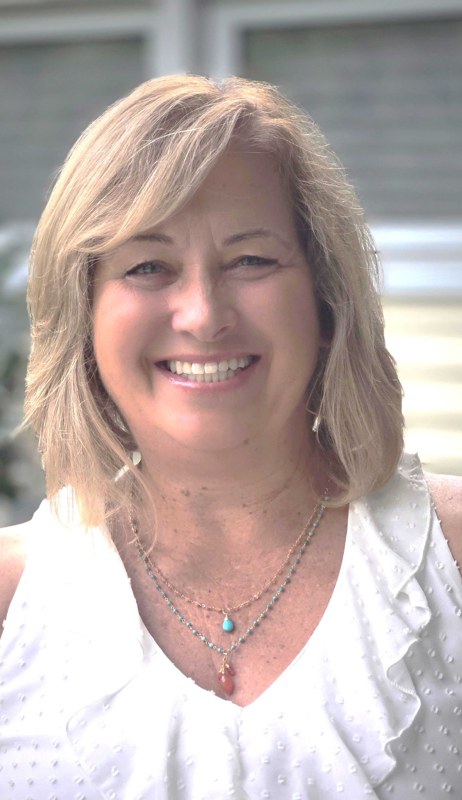
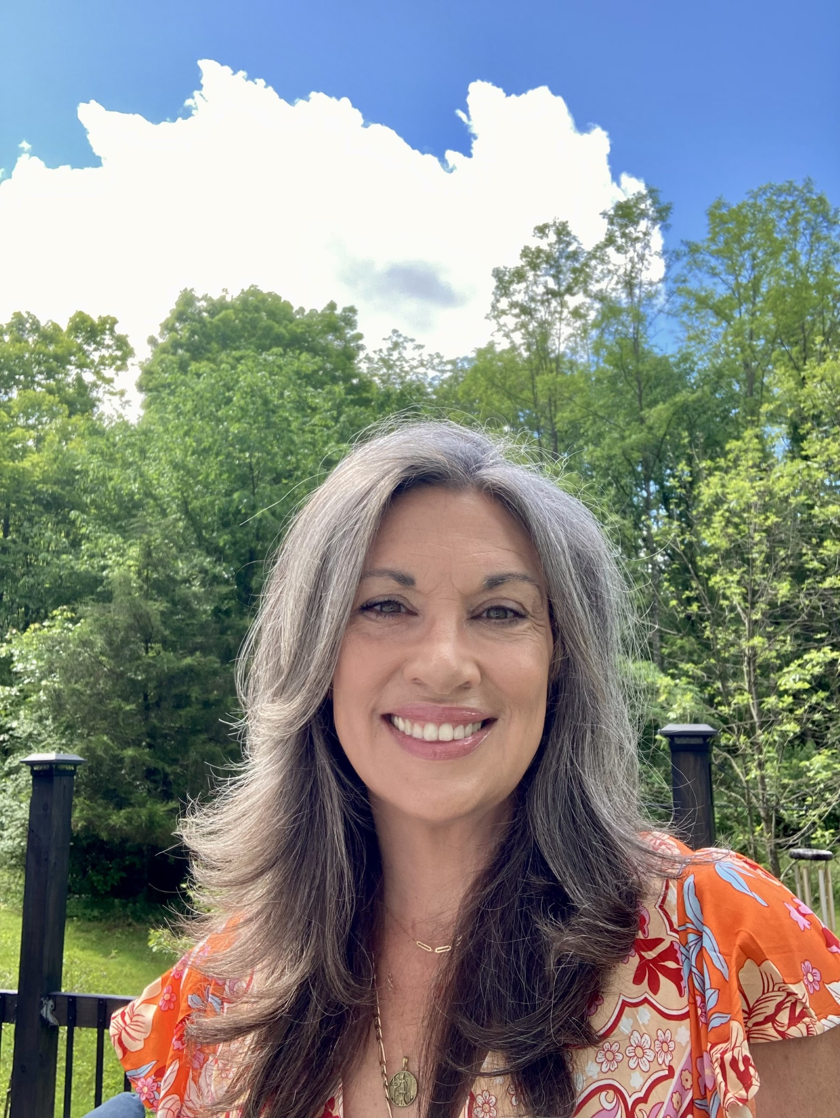
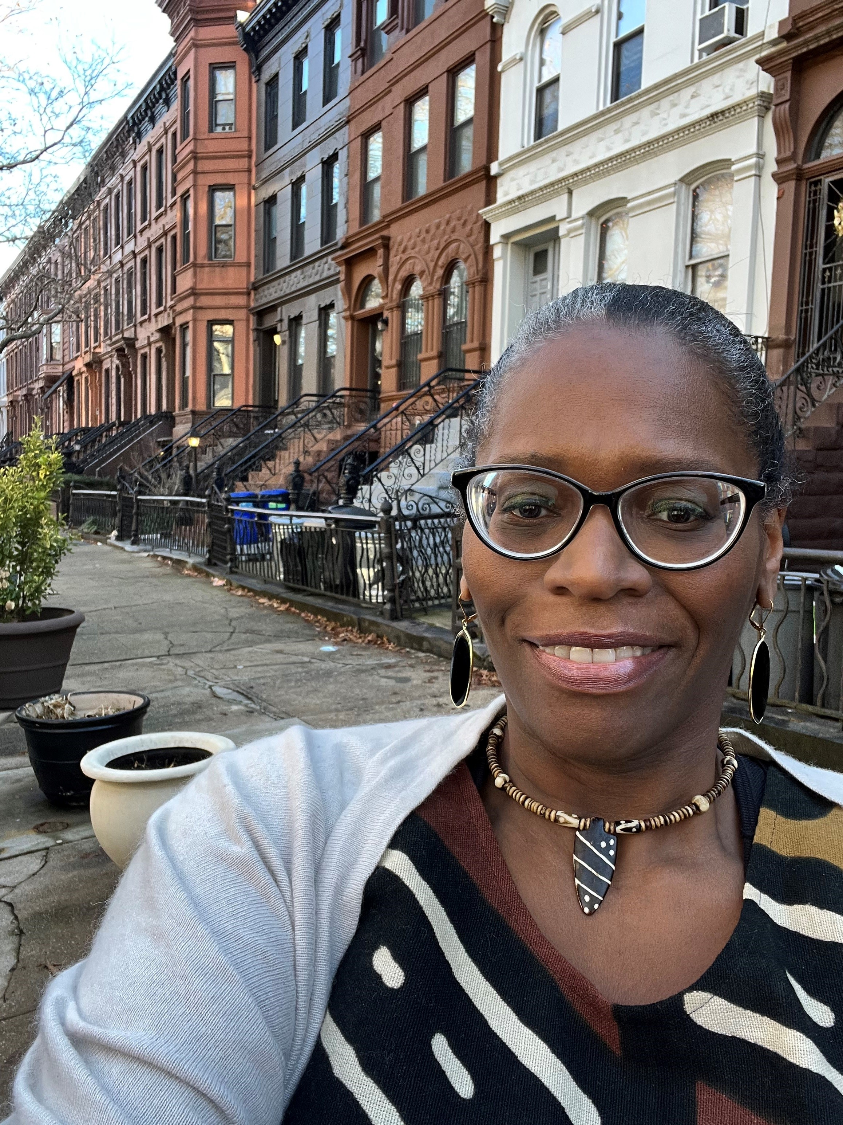


Sun River Health Eastern Dutchess Leadership
Elizabeth L . Phillips
VP Community Engagement
EDRHN Director
Sherry Wyckoff
VP Operations
Hudson Valley North Region
Sharon D’Errico
WIC Director
Cherise Mc Daniels
Health Center Director
Notes:
Sun River Health is uniquely positioned as a rural health care provider and the lead agency for the Eastern Dutchess Rural Health Network (EDRHN) with funding from the NY Charles D. Cook Office of Rural Health.

Slide 7
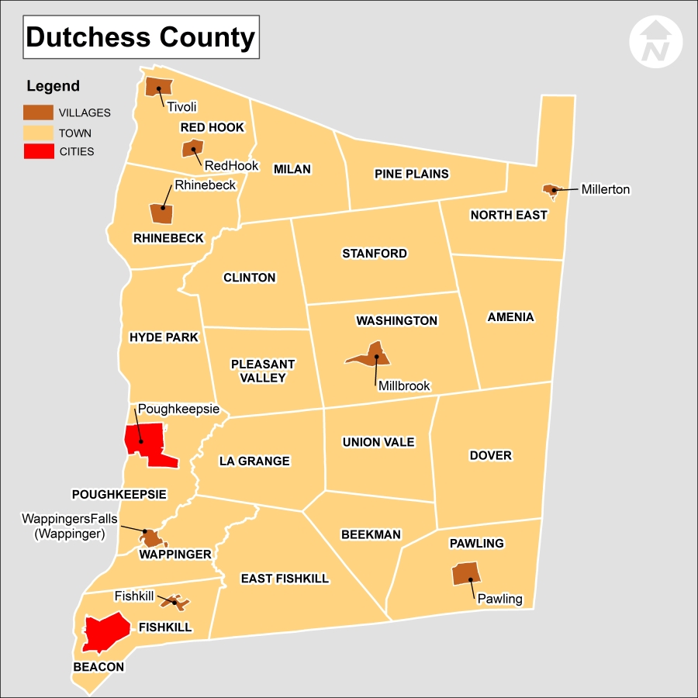

Eastern Dutchess Corridor:
Amenia
Dover
Millerton
Millbrook
Pawling
Pine Plains
Stanford

Slide 8
Quick Facts
SRH provides primary care for 5752 patients at Eastern Dutchess sites in Amenia & Dover.
Approximately 10 pantries are operating in Eastern Dutchess/ Northeast area, based on Dutchess County Helpline App.
200 households are served under our WIC program at SRH Eastern Dutchess sites in Amenia & Dover

Slide 9
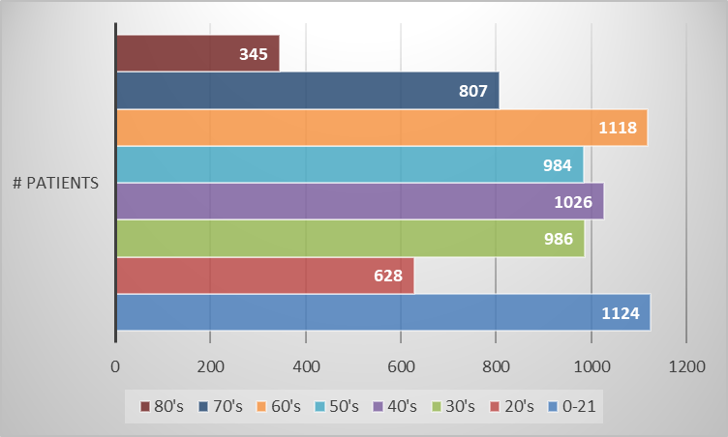
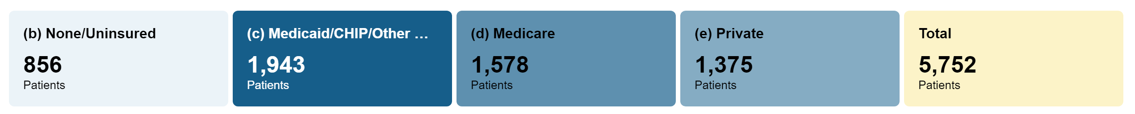
Patient Demographics
Eastern Dutchess 2023 – to present
Age
Insurance Payor Status

Slide 10
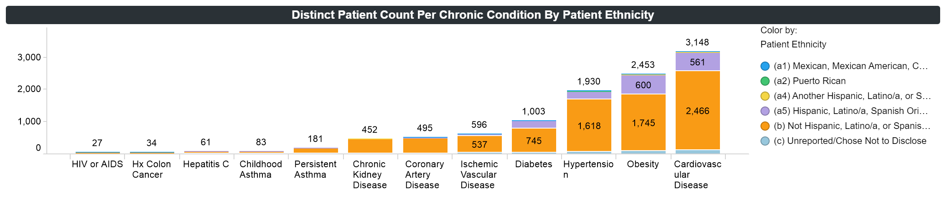
SRH Eastern Dutchess
Patient chronic conditions by ethnicity Jan 2023 – to present
Notes:
Quad Squad leads in chronic health conditions ( Obesity, Heart Disease, Hypertension and Diabetes)
Our health home managers report patients are experiencing two or more chronic health conditions.

Slide 11



WIC is Essential at SRH
The WIC Program serves families in the Eastern Dutchess region twice monthly.
During the months of June – September WIC promotes the purchase and use of fresh, locally grown produce.
WIC provides families with Farmers Market checks to everyone eligible in their household. All active WIC participants over the age of 6 months are eligible to receive this benefit.
WIC Program reaches out to families that were unable to attend their appointment & offers to mail Farmers Market checks an alternative to in-person benefit pick up.
Notes:
An essential asset for our community more than ever is WIC, with a proactive customer service mindset- so benefits are user friendly
This is another part of the puzzle towards solving food insecurity – leveraging existing benefits and promoting WIC to stretch dollars and boost WIC enrollment.
Moving forward, the WIC Program plans to work with Dutchess Outreach from this region in the spring prior to the Farmers Market season to discuss ways to optimize WIC participant attendance and use of local Farmers Markets.

Slide 12
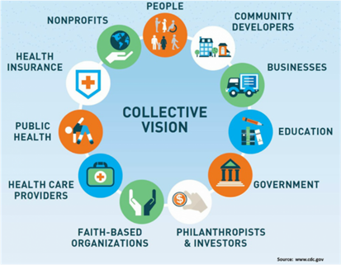
Eastern Dutchess County Rural Health Network
Increasing Access ▪ Sharing Resources ▪ Promoting Rural Health Strengths
MISSION
to improve the health care services in
Eastern Dutchess through the promotion of linkages among health care providers and to allow the development of new services by sharing resources.

Slide 13
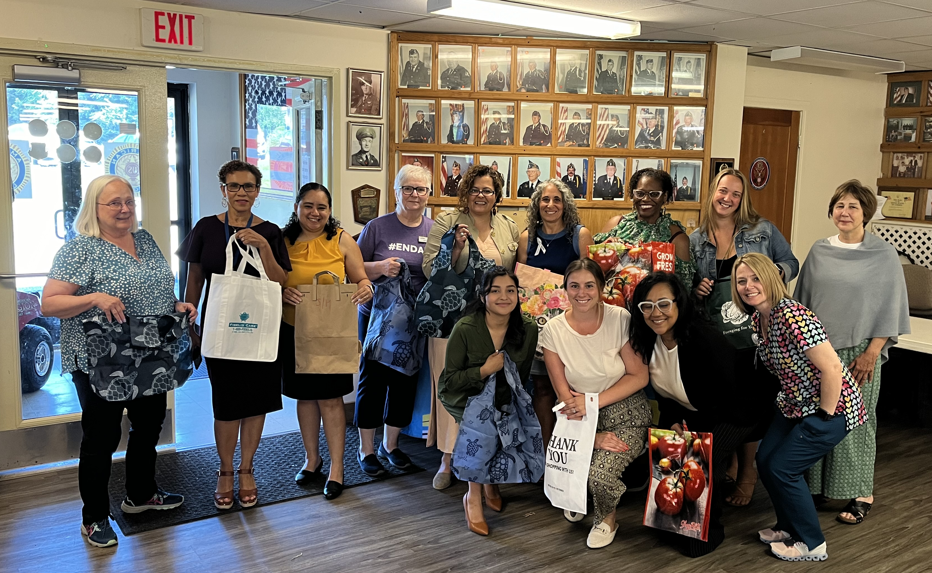
Eastern Dutchess Rural Health Network
Increasing Access ▪ Sharing Resources ▪ Promoting Rural Health Strengths
SRH is the lead agency for EDRHN with 4 subcontractors.
The Network convenes five times a year with representatives from 25 + institutions in attendance.
Periodic workgroups manage community events & coordinate trainings.
Notes:
EDRHN is a vibrant, inclusive coalition comprised of various multi-sector agencies coming together to exchange ideas, address emerging concerns, seek opportunities to improve health outcomes and addresss social determinants of health. The Network convenes five times a year with representatives from 25 + institutions in attendance. Typically, the meetings feature community partner presentations and highlights activities of our subcontractors that impact the rural health community.

Slide 14

Problems & Puzzles
Problems are like puzzle pieces for curious minds.

Slide 15

Rural Food Desert in Eastern Dutchess
Cornell Cooperative Ext/ SNAP Program Nutrition Educators
“The ED community never had many opportunities for grocery stores since I have been at CCE, but as the ones there began to close, it led to the area becoming a rural food desert”.
What are you observing – how are these changes impacting families you serve? “Over the last couple of years, I have heard from more families that they are using food pantries and shopping at dollar stores to get food for their families. There are farms in the area that supply area farmer’s markets with produce. Unfortunately, low-income families don’t feel like they belong there.”
Grocery Store Closures
Dover Plains chain grocery store closed
Millertown grocery store closed
Greater reliance on Dollar stores adds to poor health choices
Lack of transportation.
Not walkable community.
Nearest big box store 1hr away

Slide 16
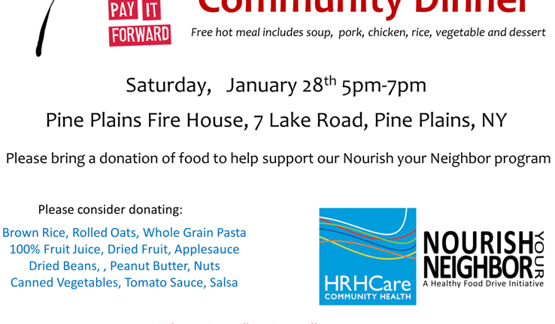

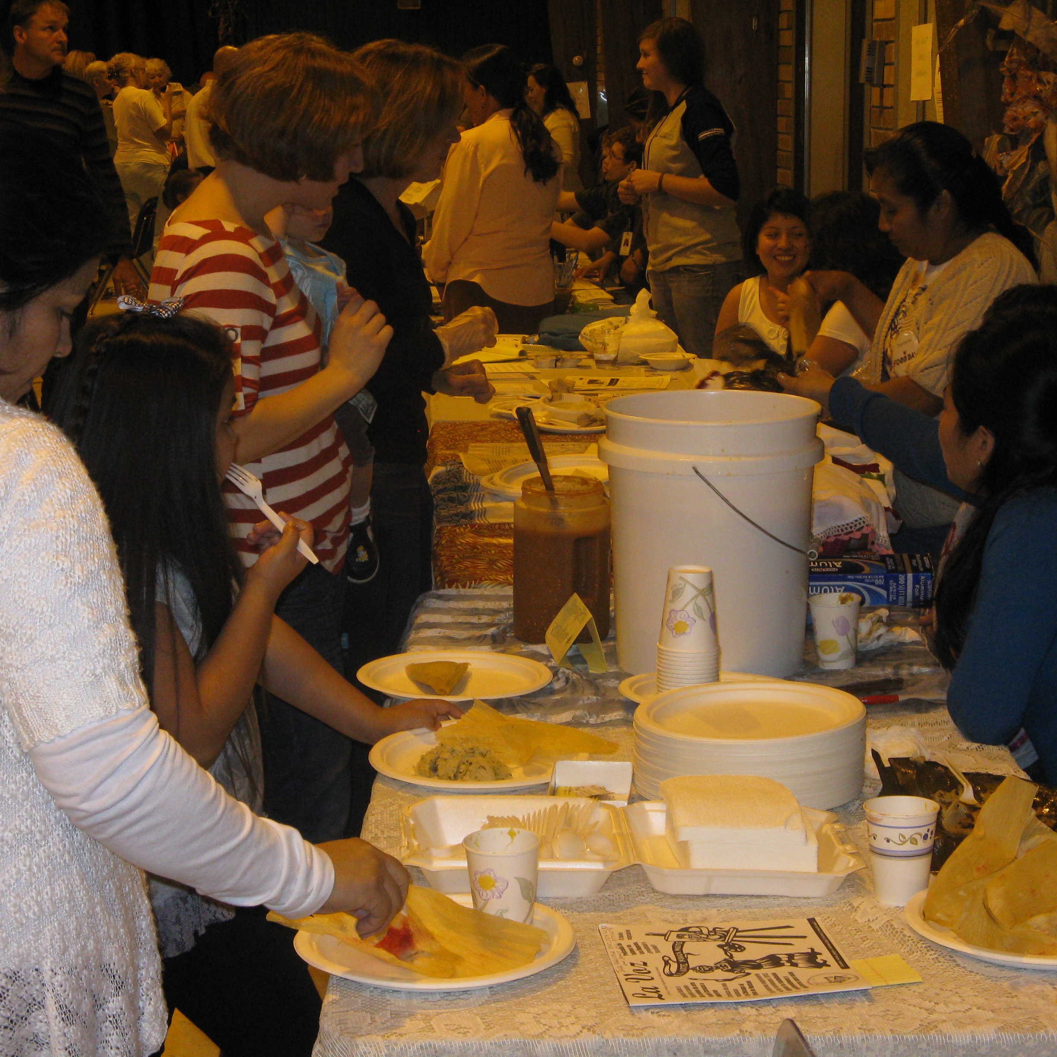

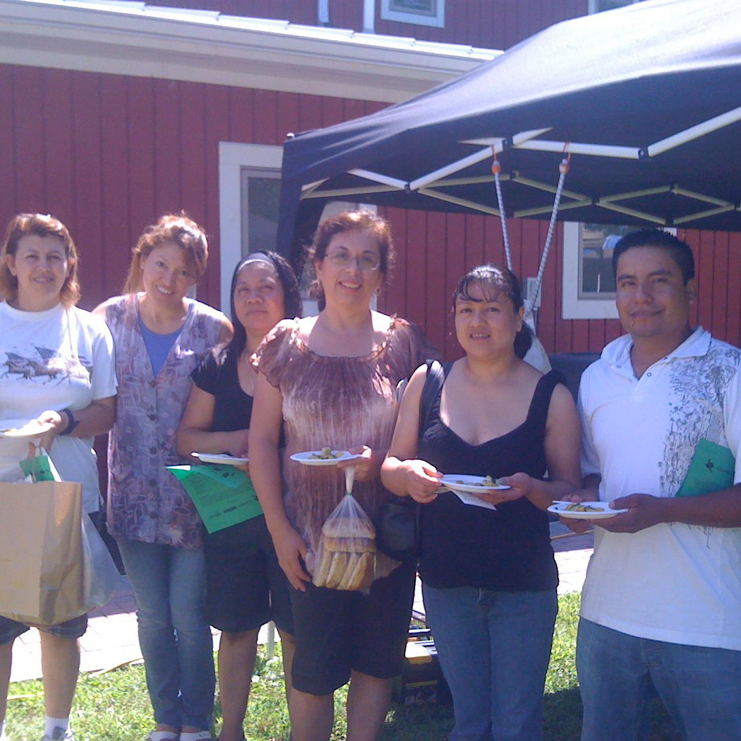
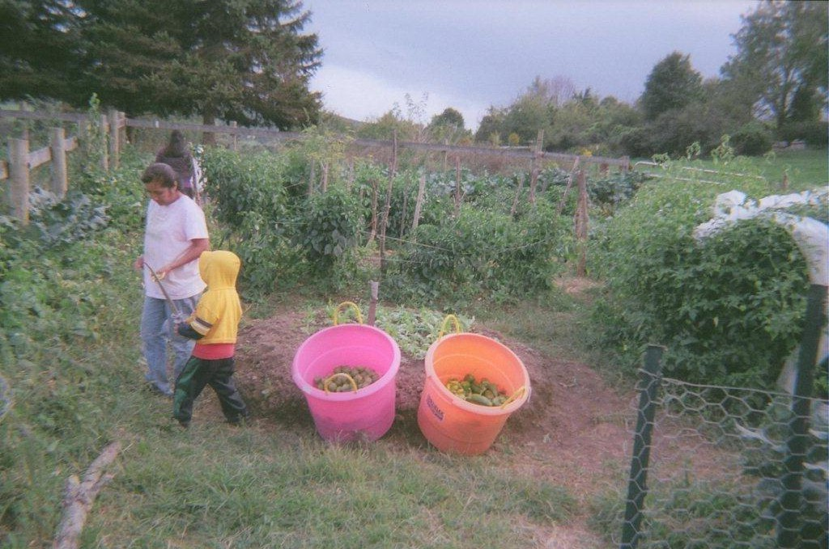
EDRHN Retrospect

Slide 17

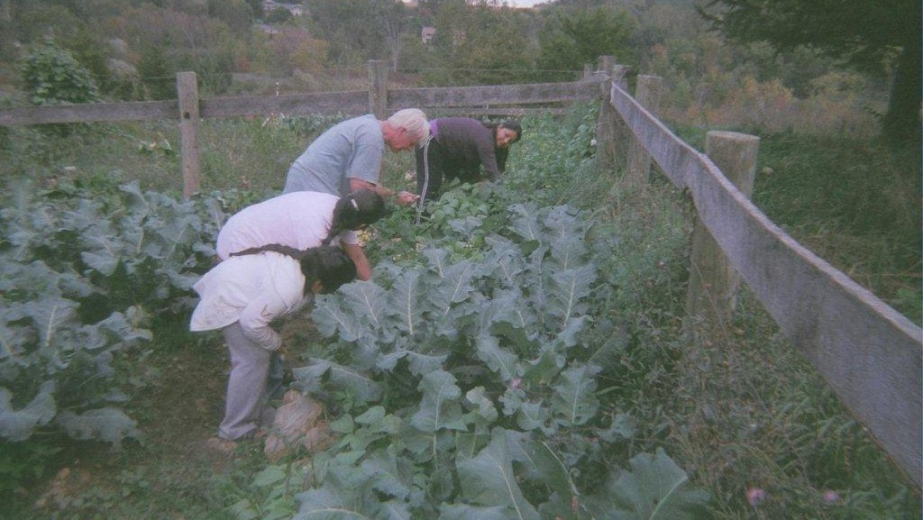
Amenia Community Garden Project (CGP)
The CGP was started in 2012 at Erin & Sam Bailey’s farm “Rhamilia” in Amenia
In 2013 CGP was registered with the NYS Farmer’s Market Nutrition Program
Share the Bounty Farmer’s Market, Amenia, was opened in 2013 with assistance of NECC on Tuesdays to coincide with WIC program.
CGP relocated in 2016 to SRH in Amenia with assistance from Somos la Llave del Futuro with a contribution of $3240 for materials
Manual labor was provided by volunteers and families participating in the CGP.
The garden has 10 raised beds available to patients, community members and staff.
During peak season, everyone shares their bounty with the health center for all patients to enjoy.
Notes:
The garden is still going strong to this day.
The Farmer’s Market is challenging to sustain – limited staff available to harvest and run the market.

Slide 18
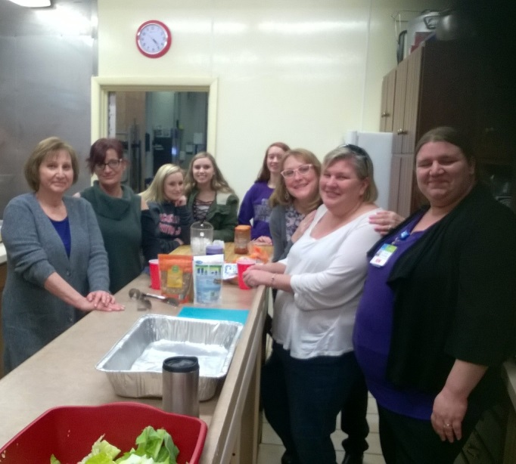
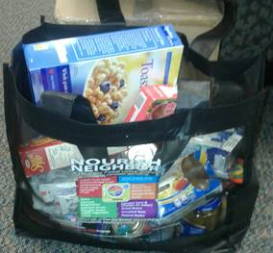
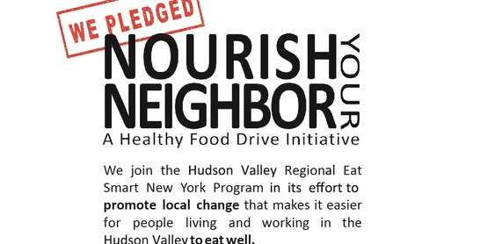
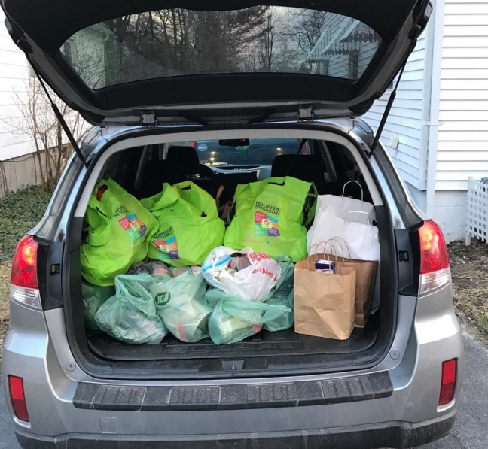
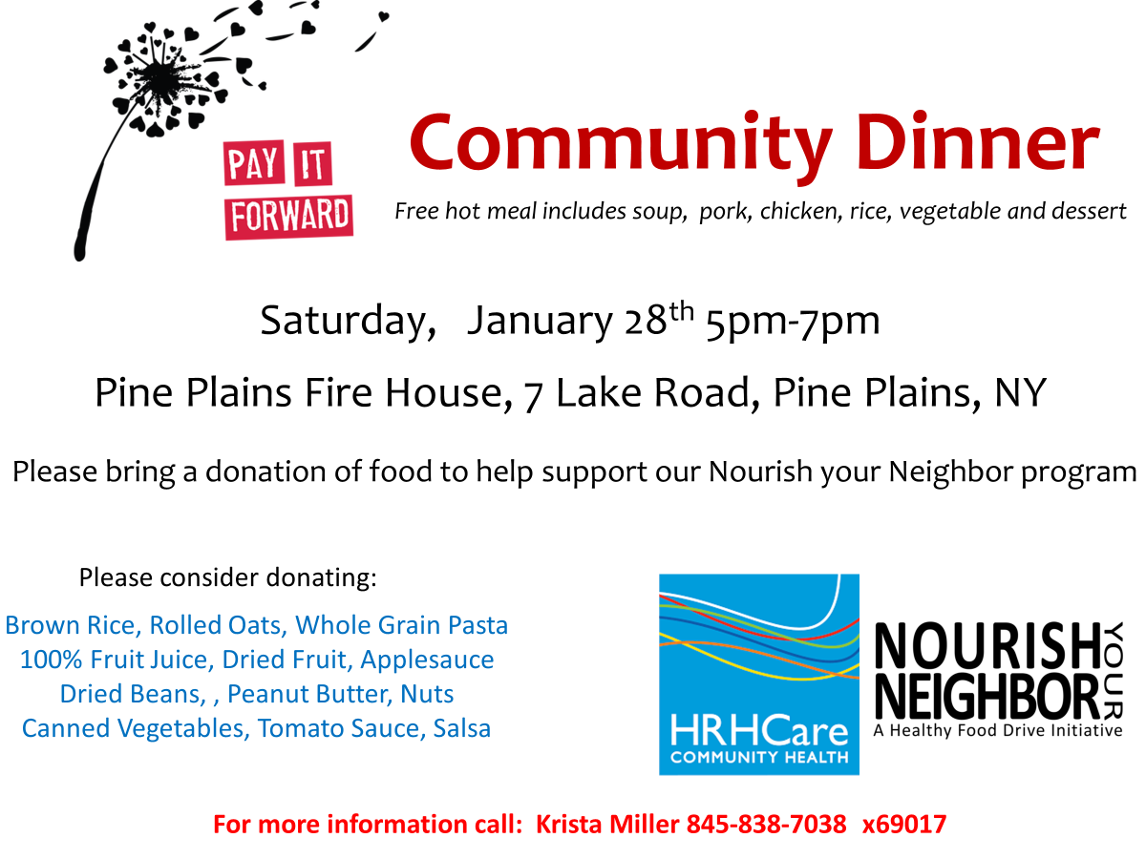
Notes:
2018 Our Health center tries to meet the needs of patients with food insecurity when they are at the health center limited/no food available on site
CCE – EDRHN partner starts Nourish your Neighbor program to support healthy food donations to food pantry
EDRHN members promotes program
Health centers (Amenia, Dover, Hudson, Poughkeepsie) shares information with staff and patients, willing to collect donations for patients
Health Centers (Amenia, Dover, Hudson) hosts on health-conscious community dinners and ask for health food donations as payment

Slide 19
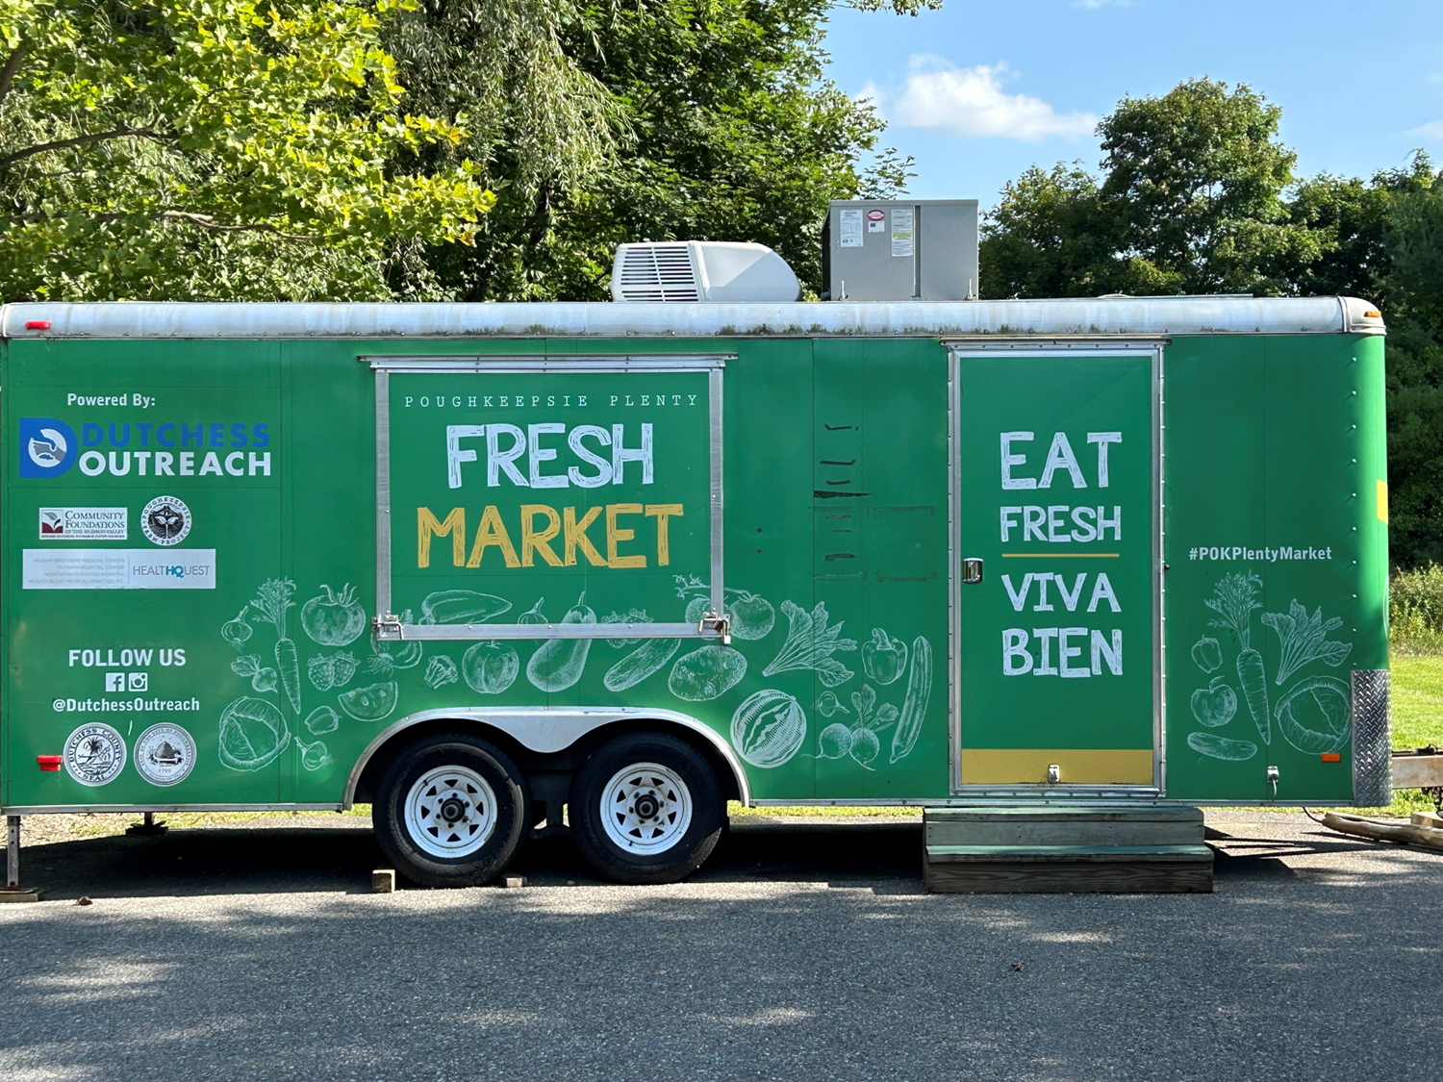
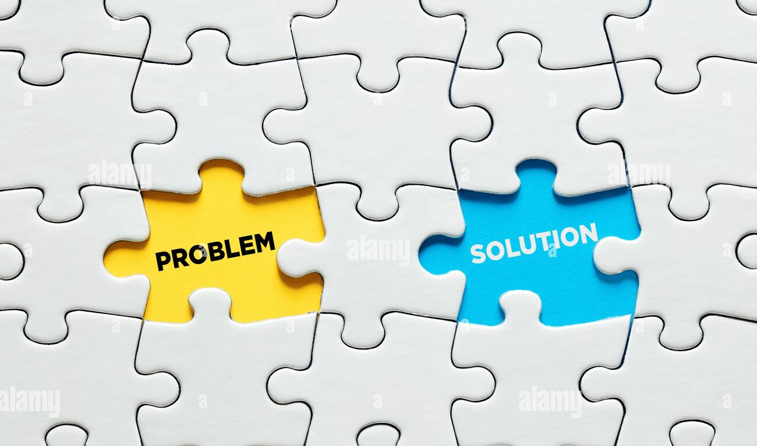


Slide 20
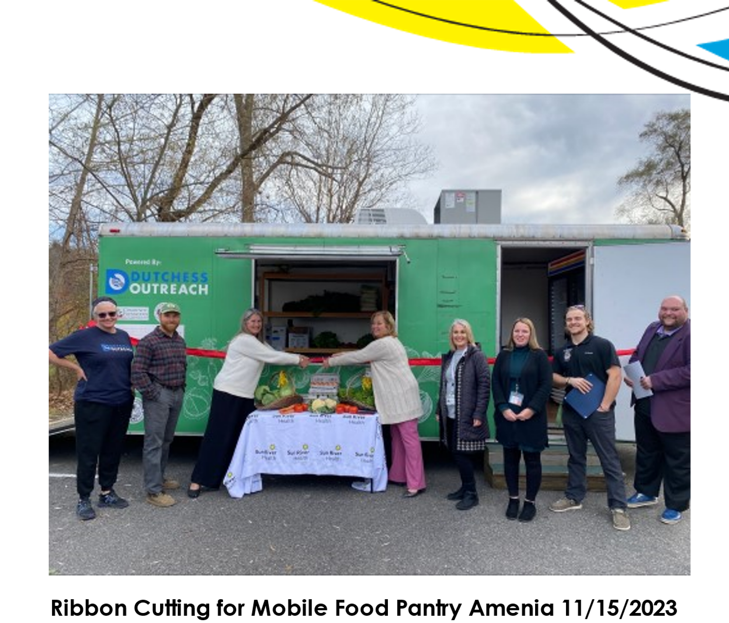

Food will be offered in a beautiful environment where guests can select what they want, with the same dignity and autonomy Dutchess Outreach is known for.”
Renee S. Miccio,
Executive Director
Dutchess Outreach,
Notes:
The refrigerated trailer will serve as a mobile pantry for the Amenia community and the entire tri-corner region of Dutchess County. This also marks Dutchess Outreach’s official extension into the Northeast section of Dutchess Outreach. Thanks to a grant with the Regional Food Bank of Northeastern New York, Dutchess Outreach has hired a Food Rescue Coordinator who will rescue excess or close-to-code food from local retailers once a week and deliver it to the mobile pantry.
“The opening of this program is a true testament to the power of partnership. Thanks to our friends at the Food Bank of the Hudson Valley, Sun River Health, and Assemblywoman Didi Barrett, we will be able to provide thousands of pounds of food to a rural area of Dutchess County that has long been considered ‘underserved’ in terms of food access.
On Wednesdays each week, Dutchess Outreach’s Coordinator will transport food to the mobile pantry, with an estimated in-kind value of $62,000 in rescued food for the year. Additional food will be sourced from Dutchess Outreach’s Urban Farm, local farm partners, and Sun River Health’s on-site garden. Sun River Health will staff the trailer, and the mobile pantry will be open on Thursdays.
“The Food Bank is proud to partner with organizations like Dutchess Outreach who are working to increase food access in underserved areas,” said Tom Nardacci, CEO of the Regional Food Bank of Northeastern New York and Food Bank of the Hudson Valley. “We’ve seen firsthand how transformational the Retail Store Donation Program can be thanks to our retail partners’ commitment to donating wholesome fresh produce, meat and dairy, and as we see the impact in communities throughout our region. We are thrilled to support Dutchess Outreach with grant funding for a Food Rescue Coordinator so they can obtain more nutritious food from Dutchess County retailers and serve our neighbors in Amenia.”

Slide 21
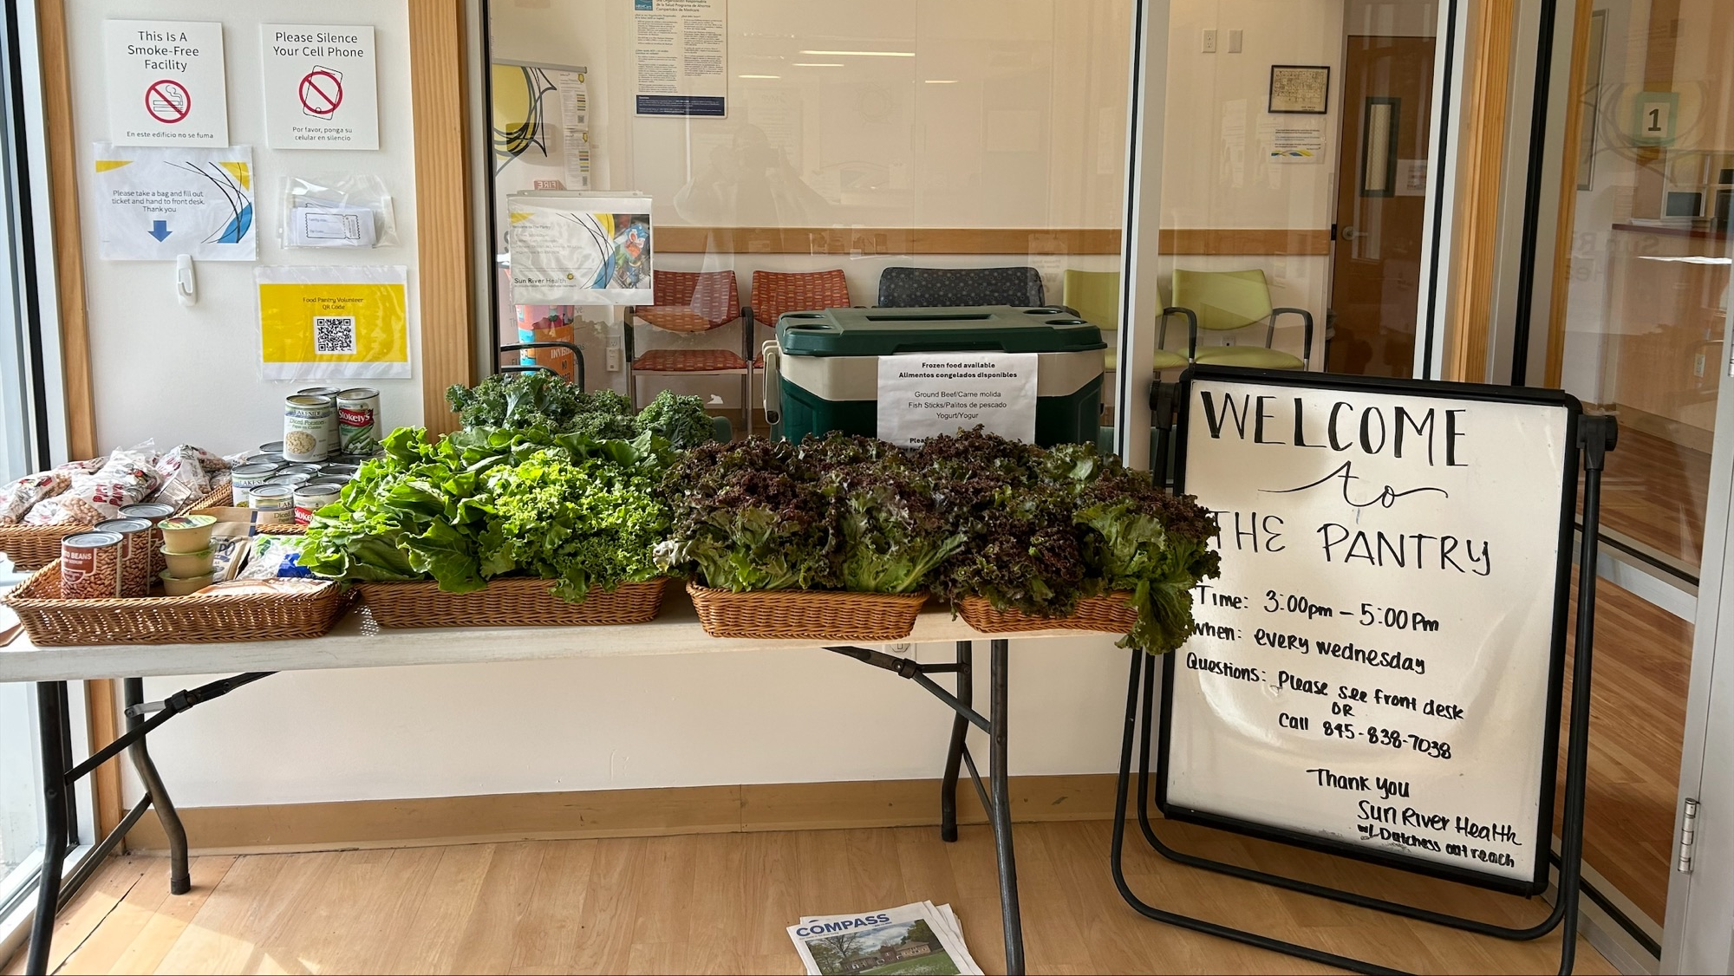
Notes:
Mobile food pantry is a promising solution for the community and SRH patients. At SRH our health center- values meeting our patients where they are at; the impact to address food access is potentially greater as the mobile pantry can be used by anyone in the community – true access for all, no wrong door.
October 2023, launched partnership w/ SRH Mobile Pantry produce in Dec added shelf stable
Pilot Phase & Year 1 Growing Pains
Build a workflow w/ inventory, staffing supported by SRH Ops, volunteers, CHW
Consistent presence
Promoting to public and assessing impact
Figure out easy options for data collection e.g. zip code/ household #
Easy Access for all – not just SRH; is accessible everyday on demand
Choice Pantry based on inventory – sourced by Dutchess Outreach in collaboration with local farms

Slide 22
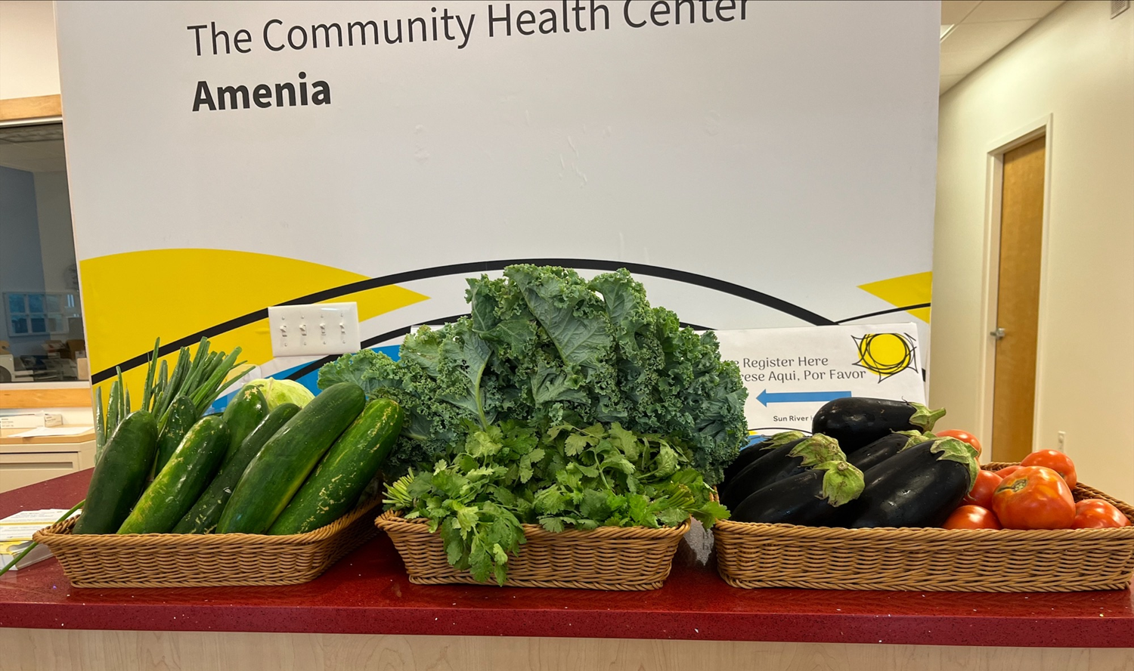
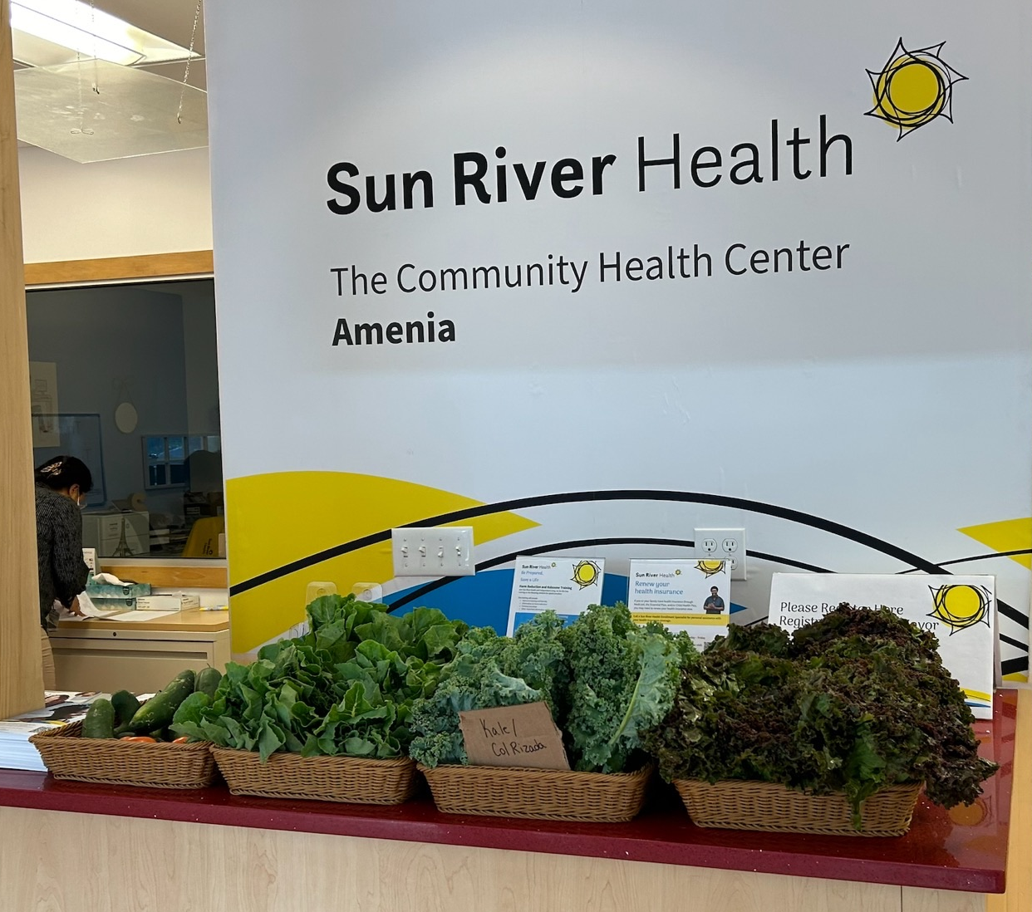

“Sun River Health is proud to partner with Dutchess Outreach to open this mobile food pantry that will help so many in Amenia and throughout northeastern Dutchess County,” said Anne Kauffman Nolon, MPH, Sun River Health CEO. ”
As I was reflecting on the impact that this kind of work can have on our patients, I was reminded of how this is exactly what Dr. Jack Geiger, the founder of the Community Health Center Movement, envisioned for all community health centers.
He was well known for writing prescriptions for food to be filled at the local grocery at the very first health center.
Notes:
Will Nelson, Farm Manager, from Ten Mile Farm Foundation, brought 10 cases of produce for distribution and partners with Dutchess Outreach as a produce supplier.
Ten Mile Farm has been delivering donations to SRH before we received the food pantry, SRH , Ops manager, has been ensuring it’s been given away to our patients.
In the 3 weeks leading up to this opening, the Amenia team has opened the pantry to close to 50 people and puts some produce in the entranceway for patients to access at any time.

Slide 23
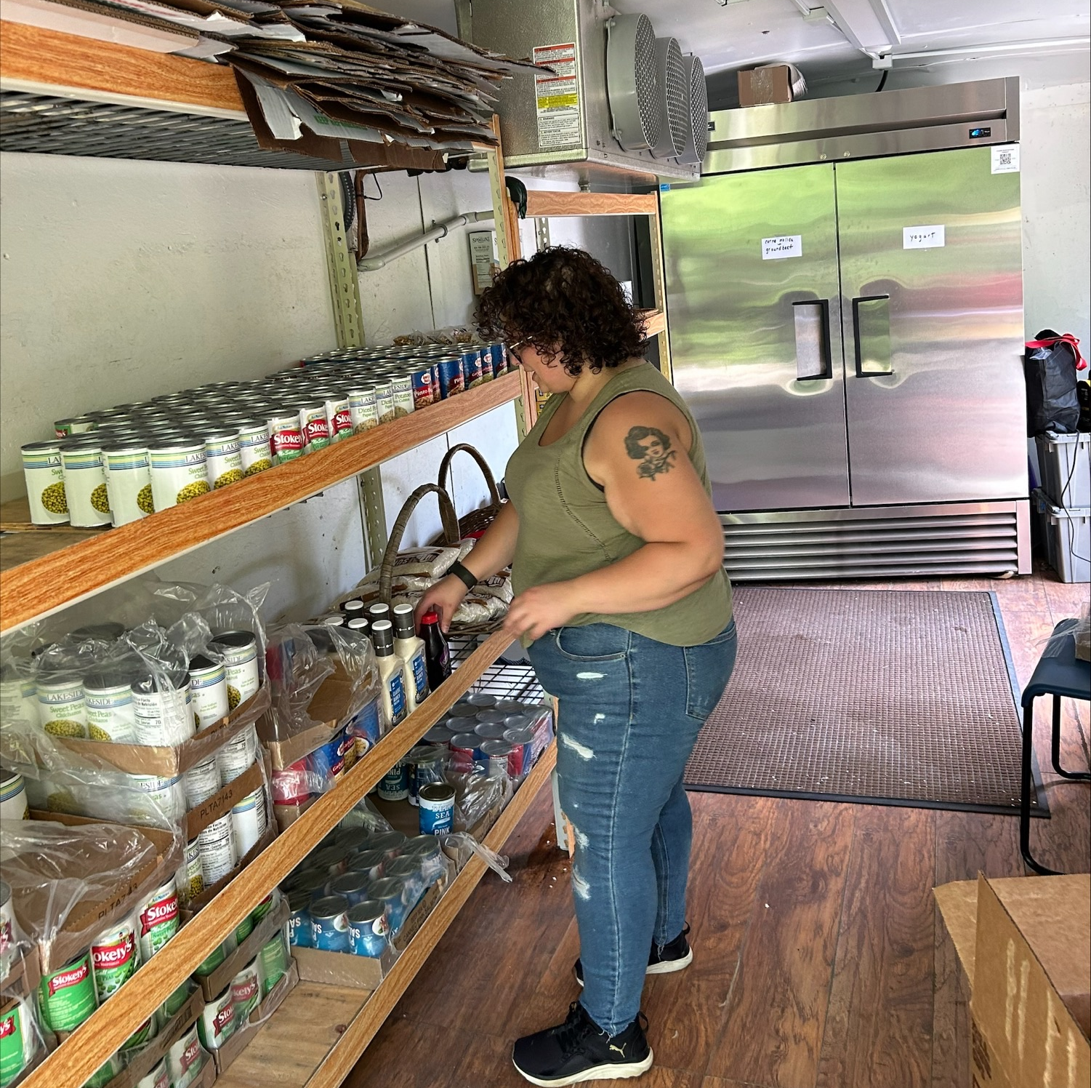
Patient Voice & Impact
Volunteering with Sun River Health has been a wonderful experience thus far. Everyone that utilizes the food pantry is grateful and kind, and I’ve enjoyed building rapport with newcomers and regulars alike.
Fresh produce has become a luxury for many, and I feel that we are truly making a difference by providing nutrition to those in our community that may be struggling with financial instability.
I feel incredibly privileged to be in the position to help others, and I am thrilled that I've chosen to work with Sun River Health. Tori, Amenia Patient
Dutchess Outreach Mobile Food Pantry March 2024:
Total number of households 318
Total number of people in households 868
Notes:
Closing remarks
Testing out potential solutions helps to find the right puzzle pieces.
Sustainability is finding the right partners at the right time to put it all together.
Social Care Network will serve to help each stakeholder to have a voice at the table and close the gaps on referrals. There are efforts that are not being measured not because they don’t matter but there are barriers agencies face too: outdated tools, knowledge gaps in technology and human capacity to name a few.
Big Picture: Ensure resources like this mobile pantry partnership is embedded in the larger work coming forward with Social Care Networks to reflect the need, responsiveness to referrals and ability to facilitate meaningful connections—measure what is needed, what is and what is not being utilized and why.

Slide 24
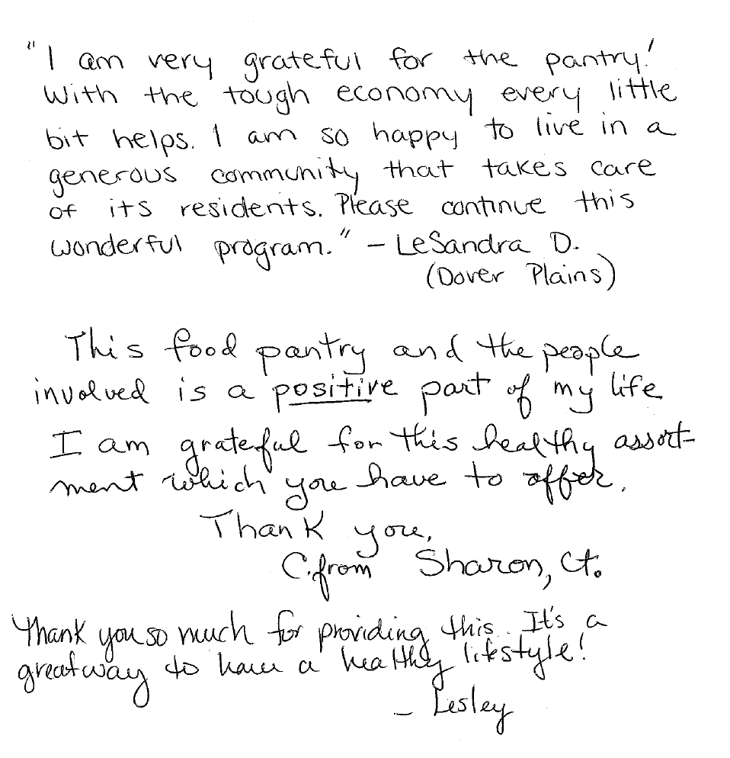
Community & Patient Voice Testimonials
Hola me llamo Luisa mi familia es de 6 yo vivo en Sharon yo he recicibido comida en la clínica de Amenia para mi familia para mí es una gran ayuda y para otros familias también gracias
Hello, My name is Luisa.
I have six family members. I live in Sharon Ct. I have received food at the Amenia clinic , health center, for my family. For me it a big help and for other families as well.

Slide 25

Eastern Dutchess County Rural Health Network
Increasing Access ▪ Sharing Resources ▪ Promoting Rural Health Strengths
Open Discussion..
Reactions.. Thoughts?
Thank You.
Notes:
Closing remarks
Testing out potential solutions helps to find the right puzzle pieces.
Sustainability is finding the right partners at the right time to put it all together.
Social Care Network will serve to help each stakeholder to have a voice at the table and close the gaps on referrals. There are efforts that are not being measured not because they don’t matter but there are barriers agencies face too: outdated tools, knowledge gaps in technology and human capacity to name a few.
Big Picture: Ensure resources like this mobile pantry partnership is embedded in the larger work coming forward with Social Care Networks to reflect the need, responsiveness to referrals and ability to facilitate meaningful connections—measure what is needed, what is and what is not being utilized and why.

