Slide 1
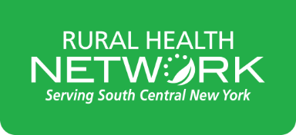
Rural Cultural Competence Presented at the NYS Association of Rural Health Symposium September 19, 2024
Mary Maruscak Director, Community Health Education Rural Health Network of South Central New York mmaruscak@rhnscny.org
Notes:
Welcome, and thank you for being here.
I’m Mary Maruscak, Director of Community Health Education from the Rural Health Network of SCNY.
The training in which you’re about to participate was designed within our organization over the past several years, however we do update the data found within and we do sometimes tweak the content based on trainee feedback. After the training, you will receive an evaluation from me in addition to the one that those of you who are pursuing continuing education credits will receive. It will be very similar to the pre-eval you received, with some additional feedback questions that our very important to our data collection.
I would like to also introduce Emma Nalin, Coordinator of our Social Determinants Measurement at RHN, and Eddie Ho, and AmeriCorps VISTA serving a year with our CHE team, who has been very helpful in updating the data for today’s training.

Slide 2
Disclosure Statement
I have no financial interests, relationships, or conflicts of interest to disclose.

Slide 3
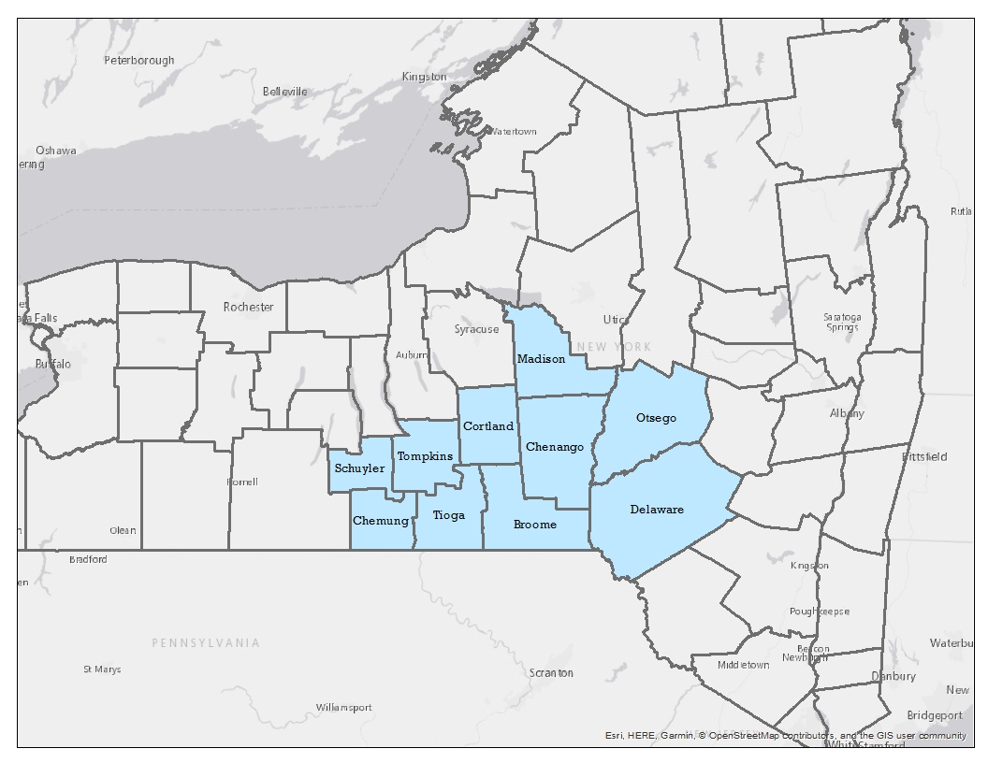
Rural Health Network of South Central NY
Our Programs:
Community Health Services
Getthere: Mobility Management
Food and Health Network of SCNY
Rural Health Service Corps (AmeriCorps and VISTA)
Rural Health Planning
Community Health Education
Broome
Chemung
Chenango
Cortland
Delaware
Madison
Otsego
Schuyler
Tioga
Tompkins
Notes:
The Rural Health Network of South Central New York has 5 main programs or areas of work, listed on the slide.
Our programs all vary in the counties and the regions that they cover, but combined we make up an 10 county region, with a historical service area of Broome, Tioga, and Delaware Counties.

Slide 4
What is Cultural Competence?
The integration and transformation of knowledge about individuals and groups of people into specific standards, policies, practices, and attitudes used in appropriate cultural settings to increase the quality of services, thereby producing better outcomes. Source: National Technical Assistance Center for State Mental Health Planning
The ability to think, feel, and act in ways that acknowledge, respect and build upon ethnic, sociocultural, and linguistic diversity. Source: Lynch and Hanson, 1998 Cultural Competence
Notes:
Script:
“These two definitions are both accurate and essentially are saying very similar things. They are different perspectives, though. “
Ask the audience: “Which one applies more to programmatic cultural competence, and which applies more to personal cultural competence?”
Take one or two responses and move on.
Why is it important that we be culturally competent from both a personal perspective as well as organizational?
When thinking about direct service, the attitudes that we adopt influence the way we interact, and also influence the way that others respond to us. We cannot build relationships with community members walking through the door or calling on the phone if we aren’t able to integrate this knowledge into our interactions with them.
Also, at RHN, think about the programs that we develop, the policies for which we advocate, the populations of people whose lives and health we hope to improve…we can’t do any of that effectively if we aren’t able to understand at a cultural level where those people are coming from.

Slide 5
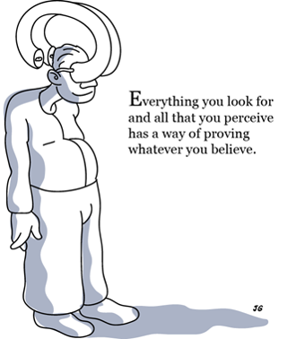
Mental Models
Deeply held internal images of how the world works, which limit us to familiar ways of thinking and acting.
Influence the way we make decisions and understand the world around us.
https://www.youtube.com/watch?v=AwfobcEkMi0
Notes:
https://www.youtube.com/watch?v=AwfobcEkMi0
Script:
Read bullet points.
Read text with image.
“We interpret situations based upon what we believe. That interpretation is what validates that belief, and that is how our mental models, for better or for worse, perpetuate.”
Show video.
Script:
“Mental Models work both ways. Our preconceived beliefs will influence our approach with working with people/families/communities of any culture, including rural. At the same time, the Mental Models of the people with whom we’re working, will influence how they respond to us.”

Slide 6
How do we acquire Cultural Competence?
Knowing
Understanding
Functioning
Notes:
First: Ask audience to interpret the slide. Script:
“There is a difference between knowing about cultural differences and actually having the ability to deliver programming and services in a culturally competent way. This image is a very simple illustration of how we move through the process, but there are some important points to remember, here:
First, while we may be culturally competent in one area, or some areas, it doesn’t mean that we’re competent in all areas.
Second, we need to operationalize how we move from knowing, to understanding, to functioning.”

Slide 7
Recognize the broad dimensions of culture
Make policy and practice fluid to accommodate necessary adjustments
Respect families as the primary source for defining needs and priorities
How do we acquire cultural competence?
Commit to structural and policy changes that support cultural diversity
Increase sensitivity to alienating behaviors
Change decision making processes to include families and the community
Notes:
First: Ask the audience to interpret the slide. Does this better illustrate a path to becoming culturally competent?
Script:
“This image is a much more accurate way to show the steps of achieving cultural competence.”
Read through the steps
“As you can see, achieving cultural competence is a cycle. We may learn the basics of a given culture, but as we get to the person/family/community, we’ll learn that we think we know is really only the tip of the iceberg. When that happens, we go back to the beginning of the cycle and we take that new knowledge and incorporate it what we already know.”
“And you can enter this cycle at any point. Don’t assume that you know nothing. You may recognize, for example, that you that are already sensitive to alienating behaviors in this particular culture. If that’s the case, you might ask yourself how you can change your decision making processes to include the people you’re serving. Or, for an organizational example, you might already have policies in place to support the cultural diversity of the people you serve, and your next step is to evaluate those policies and make adjustments.”

Slide 8
Why is it important?
Social Benefits
Increases mutual respect and understanding between client and organization Increases trust Promotes inclusion of all community members Increases community participation and involvement in health issues Assists clients and families in their care Promotes client and family responsibilities for health
Health Benefits
Improves client data collection Increases preventative care by client Reduces care disparities in the client population Increases cost savings from a reduction in medical errors, number of treatments and legal costs Reduced the number of missed appointments
Business Benefits
Incorporates different perspectives, ideas and strategies into the decision-making process Decrease barriers that slow progress Moves toward meeting legal and regulatory guidelines Improves efficiency of care services Increases the market share of the organization
Source: Becoming a Culturally Competent Health Care Organization, Signature Leadership Series
Notes:
Cultural competence in a hospital or care system produces numerous benefits for the organization, patients and community. Organizations that are culturally competent have improved health outcomes, increased respect and mutual understanding from patients, and increased participation from the local community. Additionally, organizations that are culturally competent may have lower costs and fewer care disparities.

Slide 9
Rural NY State Challenges
Population Decline
Rapidly Aging
Economies - Labor force decline
Higher rates of chronic disease = higher rates of morbidity and mortality
Lower prevalence of positive health-related behaviors
Lower access to care
Notes:
Living in a rural community is a social determinant of health - that is, the conditions, characteristics and culture of rural communities have an impact on rural people’s health.
Here is just a sample of information about rural New York. In these charts, non-metropolitan is the middle bar. Rural communities face economic challenges and bring in less household income compared with urban New York and the rest of the country. Some of this is offset by lower cost of living, but there is still less wealth being accumulated and flowing through the economy in rural areas.
Rural New Yorkers are generally older than their urban counterparts, and rural communities are more racially homogenous. Other important factors to consider - by definition, rural New Yorkers have to travel further to access goods and services, and rural communities have lower population density.Rural New York has twice as many veterans as urban New York. In 2018, so pre-pandemic, rates of poverty and unemployment were about the same between rural and urban New York, although poverty looks much different in rural and urban areas.
Which social determinant of health do you think might have the strongest impact? Income - economic stability.
Perhaps the most powerful social determinant of health is income. All of us have seen too many patients who could not afford their medications, a healthy diet, or a proper place to live—and how this affected their health status.
https://www.ruralhealthinfo.org/data-explorer?id=213&state=NY&classification=Nonmetropolitan
https://www.commongroundhealth.org/insights/library?search=rural
https://www.ruralhealthinfo.org/states/new-york
Do poll question 4
Do poll question 5

Slide 10
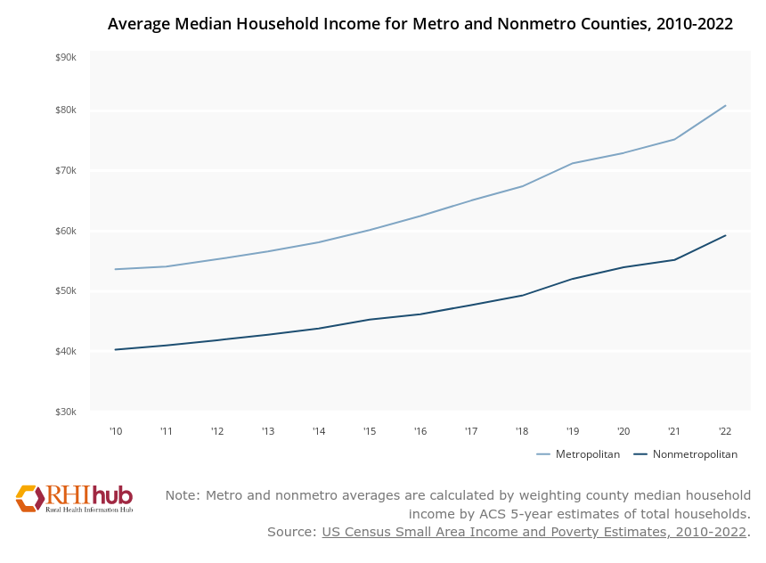
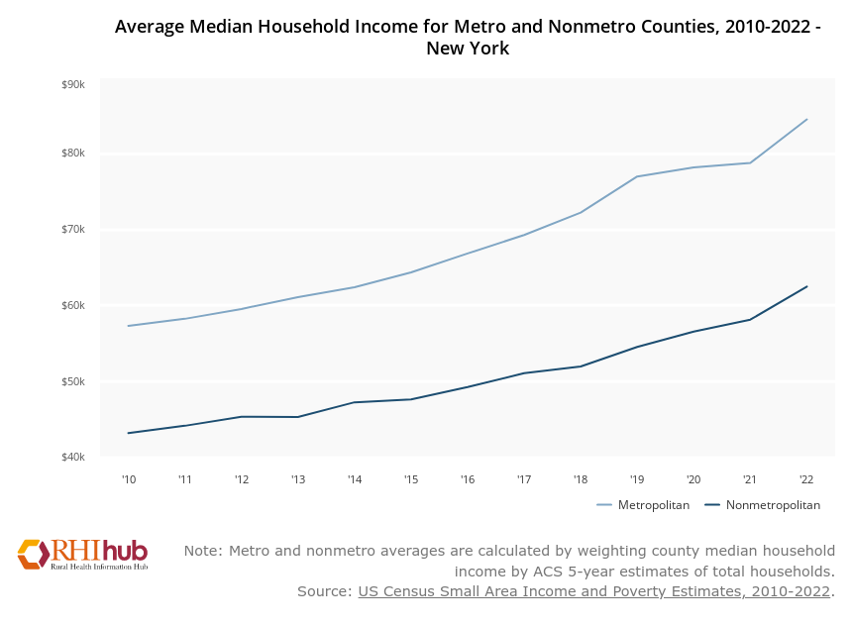
Median Household Income: Metro Vs. Nonmetro
$81k
$84k
$59k
$62k
Notes:
Living in a rural community is a social determinant of health - that is, the conditions, characteristics and culture of rural communities have an impact on rural people’s health.
Here is just a sample of information about rural New York. In these charts, non-metropolitan is the middle bar. Rural communities face economic challenges and bring in less household income compared with urban New York and the rest of the country. Some of this is offset by lower cost of living, but there is still less wealth being accumulated and flowing through the economy in rural areas.
Rural New Yorkers are generally older than their urban counterparts, and rural communities are more racially homogenous. Other important factors to consider - by definition, rural New Yorkers have to travel further to access goods and services, and rural communities have lower population density.Rural New York has twice as many veterans as urban New York. In 2018, so pre-pandemic, rates of poverty and unemployment were about the same between rural and urban New York, although poverty looks much different in rural and urban areas.
Which social determinant of health do you think might have the strongest impact? Income - economic stability.
Perhaps the most powerful social determinant of health is income. All of us have seen too many patients who could not afford their medications, a healthy diet, or a proper place to live—and how this affected their health status.
https://www.ruralhealthinfo.org/data-explorer?id=213&state=NY&classification=Nonmetropolitan
https://www.commongroundhealth.org/insights/library?search=rural
https://www.ruralhealthinfo.org/states/new-york
Do poll question 4
Do poll question 5

Slide 11
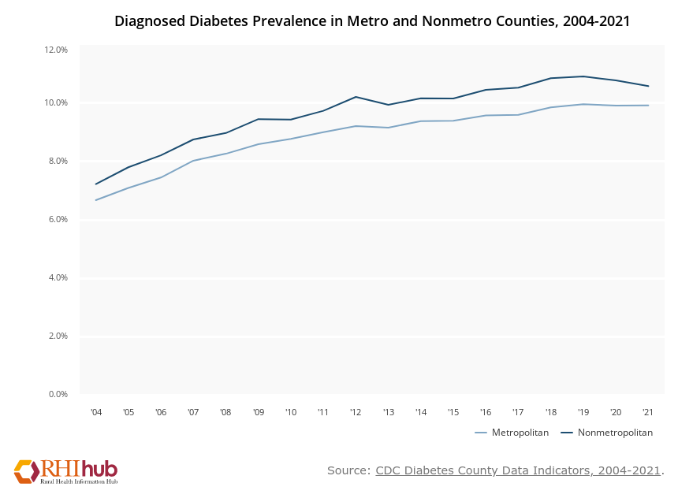
Chronic Conditions
10.6%
9.9%
Notes:
People in rural areas tend to have more chronic health conditions.
Line chart on the left is showing the metropolitan and nonmetropolitan proportion of the population with diagnosed diabetes from 2006 to 2017.
The stacked bar chart on the right is showing the number of expected and potentially excess heart disease deaths per 100,000 population for metropolitan and nonmetropolitan counties.

Slide 12
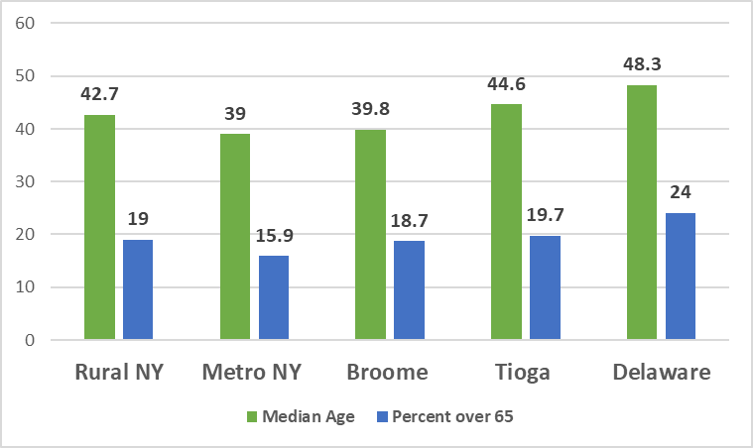
Aging in Rural Places
Southern Tier County Type | Average of County Median Age, 2019
Metro | 39.4
Non-metro | 43.61
Notes:
Why would age be a health disparity? Well, think about that definition of health disparities that we talked about before. Certainly older people are marginalized.
To the extent that people are denied human or civil rights on the basis of how they are categorized and treated by others, they are socially excluded. Older people are described as marginalized when they are seen as not having the mental or physical capacity to survive as independent agents. And again, think about factors of rural life that may start to stack up for an older person.

Slide 13
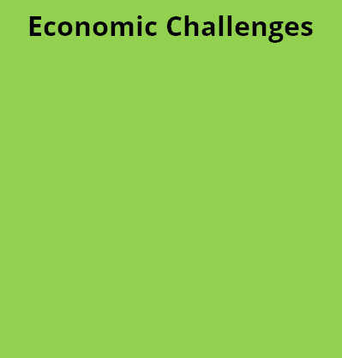
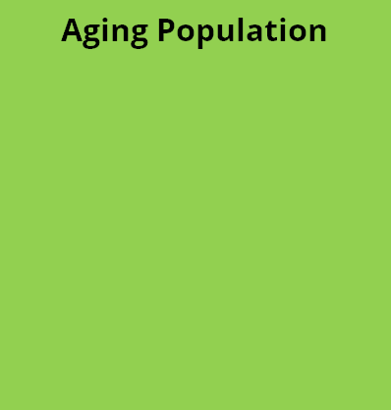
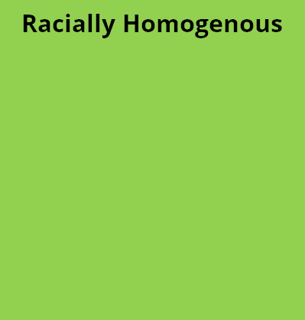
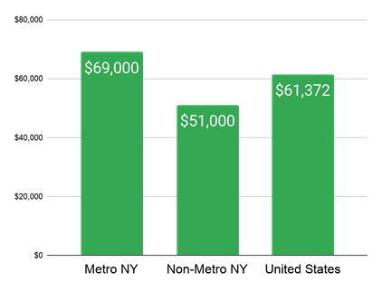
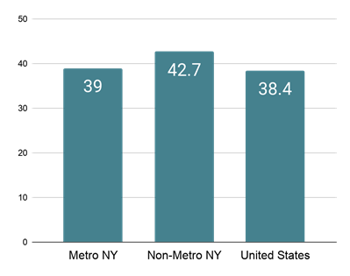
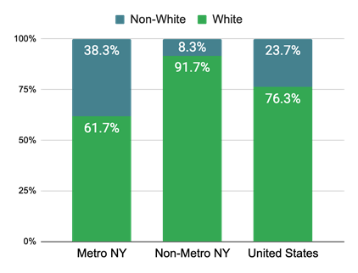
Overview of Rural Determinants of Health - New York State
Median Household Income (2017)
Median Age (2018)
% White (2018)
Notes:
Living in a rural community is a social determinant of health - that is, the conditions, characteristics and culture of rural communities have an impact on rural people’s health.
Here is just a sample of information about rural New York. In these charts, non-metropolitan is the middle bar. Rural communities face economic challenges and bring in less household income compared with urban New York and the rest of the country. Some of this is offset by lower cost of living, but there is still less wealth being accumulated and flowing through the economy in rural areas.
Rural New Yorkers are generally older than their urban counterparts, and rural communities are more racially homogenous. Other important factors to consider - by definition, rural New Yorkers have to travel further to access goods and services, and rural communities have lower population density.Rural New York has twice as many veterans as urban New York. In 2018, so pre-pandemic, rates of poverty and unemployment were about the same between rural and urban New York, although poverty looks much different in rural and urban areas.
Which social determinant of health do you think might have the strongest impact? Income - economic stability.
Perhaps the most powerful social determinant of health is income. All of us have seen too many patients who could not afford their medications, a healthy diet, or a proper place to live—and how this affected their health status.
https://www.ruralhealthinfo.org/data-explorer?id=213&state=NY&classification=Nonmetropolitan
https://www.commongroundhealth.org/insights/library?search=rural
https://www.ruralhealthinfo.org/states/new-york
Do poll question 4
Do poll question 5

Slide 14
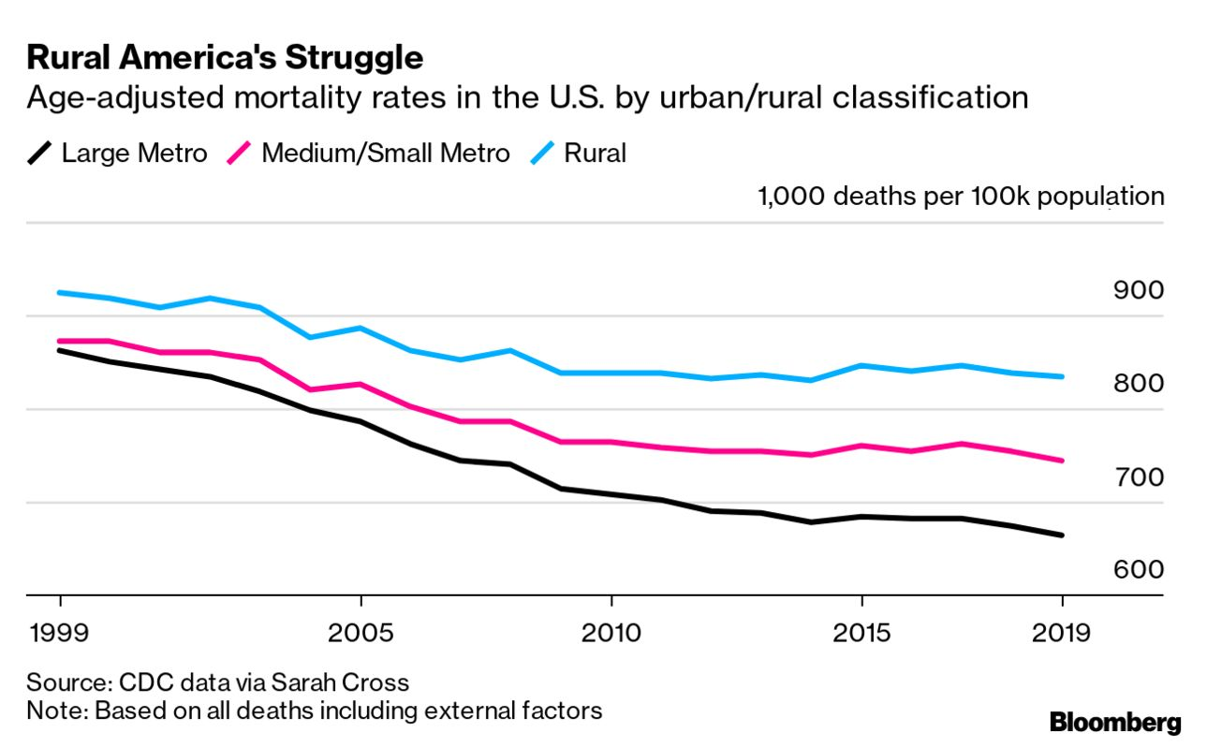
Notes:
The gap between the death rates of rural and urban US residents has over the past two decades.
This chart compares mortality rates in 1999 and 2019. It finds that death rates dropped in all groups except for middle aged rural white and Native American people.
The new data and other studies show that “chronic disease is driving this trend as much as anything else,” Warraich said, including heart disease, lung disease, liver disease and even dementia. Factors in the rise include not just substance use or distress, he said, but also poor nutrition, lack of exercise, smoking, access to high-quality medical care and other systemic issues.
It doesn’t help that many rural hospitals have been closing, he said, more in 2020 than any previous year.
From 1999 to 2019 the gap between rural and urban death rates grew from 62 per 100,000 to 169.5.
In urban areas, the total rate went from 861.5 to 664.5. In rural areas it went from 923.8 to 834.

Slide 15
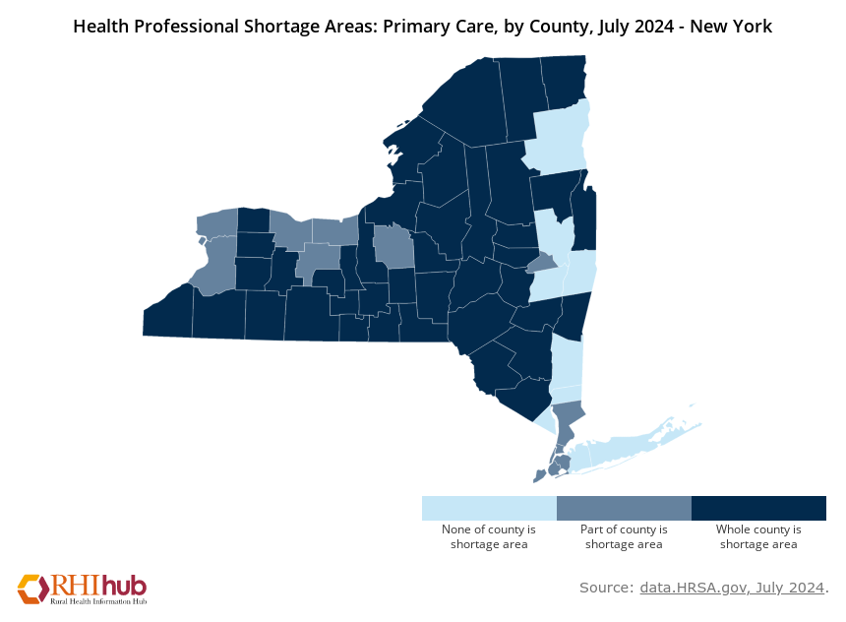
https://www.ruralhealthinfo.org/charts/5?state=NY
Notes:
Shortage designation identifies an area, population, or facility experiencing a shortage of health care services.
In this case, we’re talking about geographic HPSAs. A shortage of providers for an entire group of people within a defined geographic area
Only about 10% of physicians practice in rural America despite the fact that nearly 25% of the population lives in these areas¹
There are 60 dentists per 100,000 population in urban areas versus 40 per 100,000 in rural areas¹
There are 2,157 Health Professional Shortage Areas (HPSAs) in rural and frontier areas of all states and US territories compared to 910 in urban areas¹
uMedicare patients experiencing a heart attack who were treated in rural hospitals were less likely to receive recommended treatments than those treated in urban hospitals and had higher adjusted 30-day post heart attack death rates from all causes than those in urban hospitals
https://www.ruralhealthinfo.org/data-explorer?id=209&state=NY

Slide 16
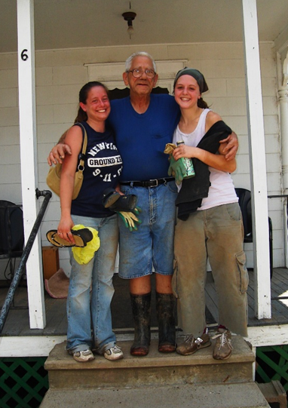
Rural Strengths
“I always say that when we start on the litany of things that are wrong with rural areas, they are poorer, they are sicker, they are older, have worse everything including health literacy, that the strengths of people in rural areas are often ignored,” Moser said. “People in rural areas tend to be more oriented to improving their community, they are not so self-interested. It’s more about improving the health of the community, the health of youngsters as well as the older folks. And they really believe in the homegrown change.”
-Dr. Debra Moser
https://www.ruralhealthinfo.org/rural-monitor/rural-health-literacy/

Slide 17
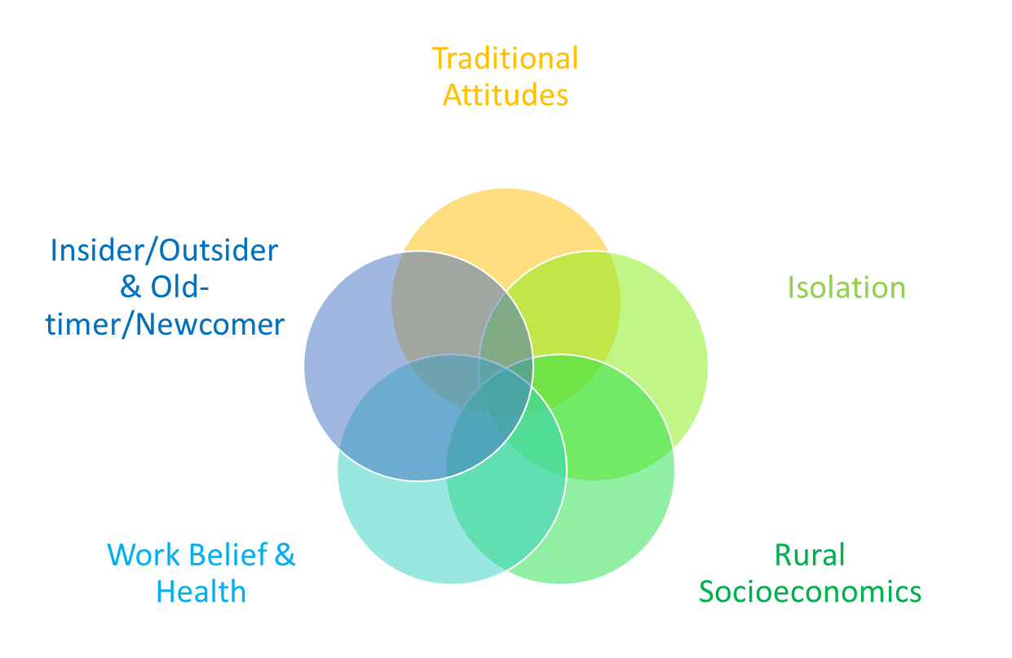
Rural Core Characteristics
Notes:
Script: “As we discuss these concepts individually and talk about the strengths and weaknesses of each, we ask that you think about how they are overlap and are interrelated. Positive or negative, we’re very unlikely to see just one of these characteristics in a given person/family/community.”
Have a large printout of this image on an easel pad. In the next section, as audience members share strengths and weaknesses of each, write them on the printout. This visual will illustrate the intersection of characteristics and can then discuss (see slide 25)

