Slide 1

Stakeholder-driven Community System Redesign
A Culturally Sensitive Approach to Improving Rural Population Health
Kristin Pullyblank, PhD, RN
Center for Rural Community Health, Bassett Research Institute
NYSARH Symposium
September 19th, 2024

Slide 2
Disclosures
I have no conflicts of interest to disclose.

Slide 3
Learning Objectives
At the end of this session, attendees will be able to:
Understand how community-driven approaches to population health improvement are culturally sensitive and lead to better health outcomes
Explain how establishing a local community data monitoring and feedback system to inform decision-making can lead to more equitable health outcomes
Understand the utility of implementing a rapid-cycle community action process to coordinate rural whole-of-community social systems

Slide 4




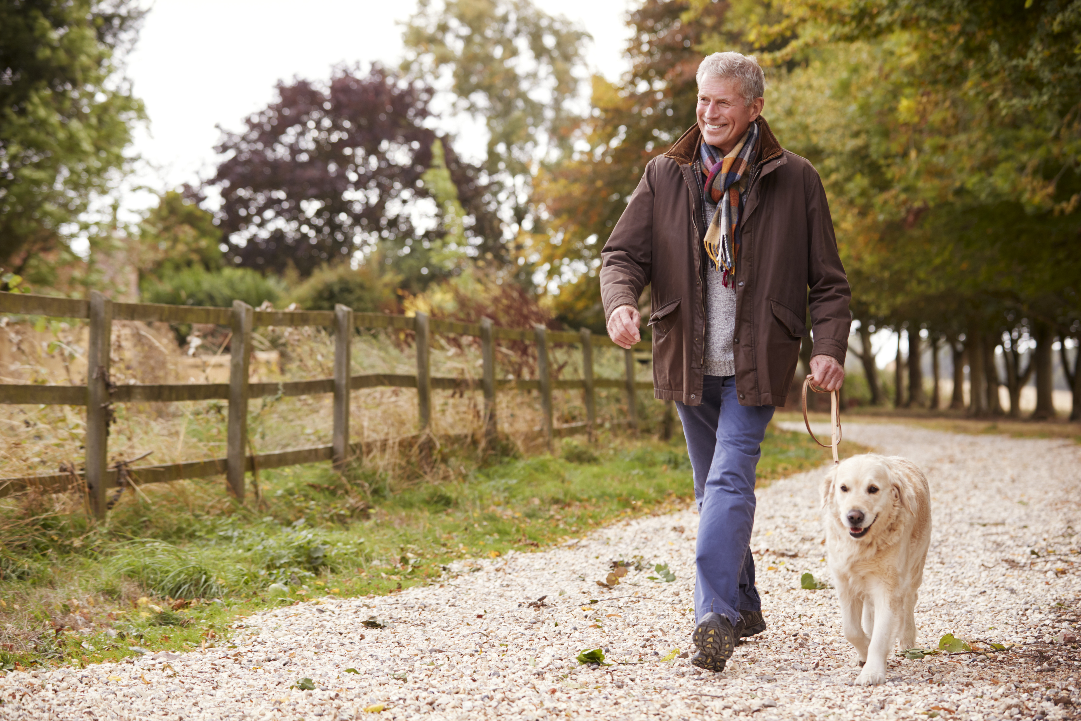
Community Systems and Population Health
Community
Clinic
Home
Grocery store
School
Fitness Center
Notes:
What is a community? Individuals, dyads, families, groups, organizations interacting (transacting) with one another in a variety of behavior settings within a defined geographic area. There are multiple centers of decision making (so it’s a decentralized system) about what services to provide and how to provide them and how to consume them. And they base these decisions on the currently established rules, policies, normative behaviors and also the resources. And feedback is continuously flowing into the community which will impact future decisions, future rules, future norms etc.
Complex, dynamic, ever-changing.

Slide 5
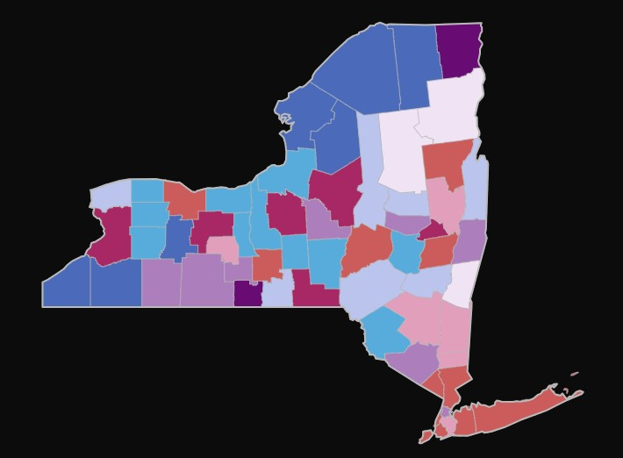
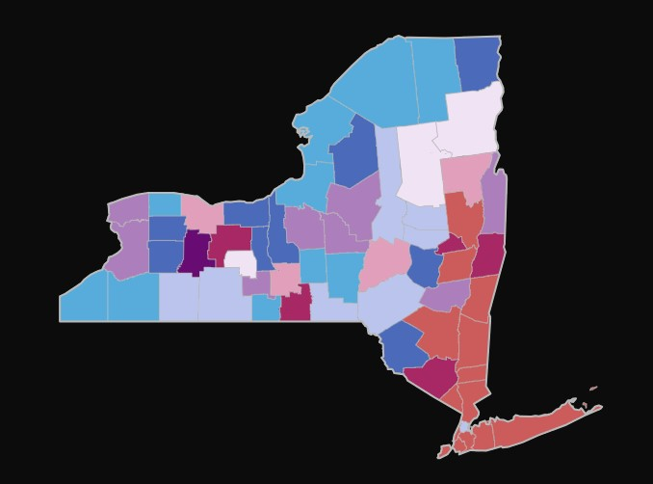
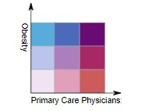
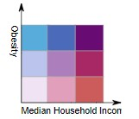
Context Matters: So much variability
Obesity by PCP availability
Obesity by household income
Notes:
Variability results from the local rules or norms (including culture) which dictate what services are provided.
Making a decision to engage in health promotion and disease prevention programs is constrained
Economics, safety, natural environment, built environment, education, politics all factor into an “individual” level decision
In an effort to be efficient, health care and public health are trying to implement one-size fits all approaches through centralized decision making meaning community members have very little power to decide what is best for them. Reducing a complex problem into its component parts (e.g. we’re going to solve diabetes prevention by instituting the NDPP), we have something we can measure. But we’re ignoring the complexity and constraints.
As public health professionals we don’t want to further contribute to dictating top-down what is best for a community
We don’t have the granular data—just surveillance data
We don’t understand the rules (norms or policies) of any one community system (the constraints, assets)

Slide 6
Essential Elements to a Community-Driven Approach
Create a data and monitoring feedback system to inform decision-making
Develop an information sharing hub so current assets/resources/capitals can be identified across the community and leveraged efficiently (ongoing learning system)
Establish a rapid prototyping process to test equitable solutions in a given community during a given time with the given constraints

Slide 7
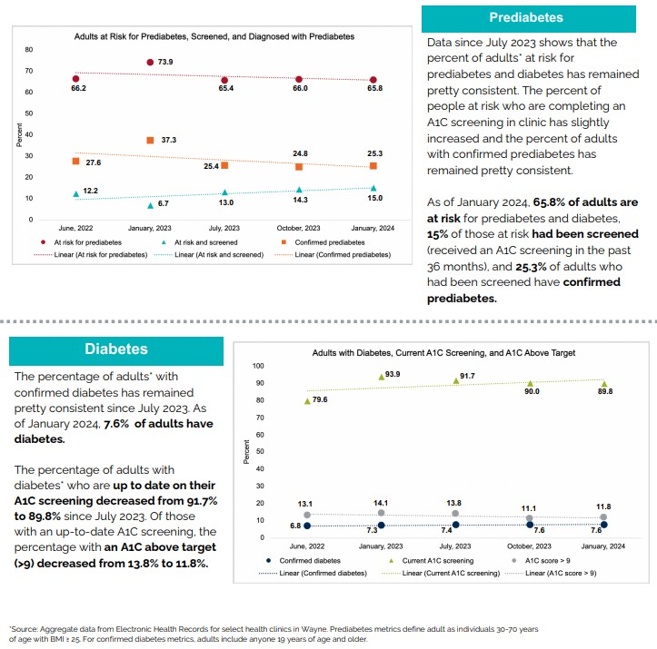
Data Monitoring and Feedback System
Coalition Generated Data
  Place-Based Mapping
  Social Network & Power Mapping
  Asset Mapping
Healthcare System Data
  % at risk for diabetes
  % screened
  % confirmed living with prediabetes
  % confirmed living with diabetes
Prototype data (determined by coalition members), possibly includes...
  Reach
  Effectiveness
  Implementation
  Adoption
Notes:
Investigating the community—what are assets, who has the power to make decisions. Knowing this will help the community make decisions about where their interventions could be most effective, or who to leverage.
What is the current diabetes landscape (healthcare system data). Help to develop a headline to follow
The presence of local data presents the opportunity to decrease uncertainty in a system and motivates individuals to use the data to make decisions that improves the situation for themselves and their communities. Local data are also important for timely feedback in the system as data allow local community members to see if and how an intervention is moving the system toward different outcomes. Most conventional interventions rely on state or regional data from public health surveillance systems. And for many rural communities, these data are suppressed, which may mask important community-level indicators or lead to overgeneralizing health concerns.

Slide 8
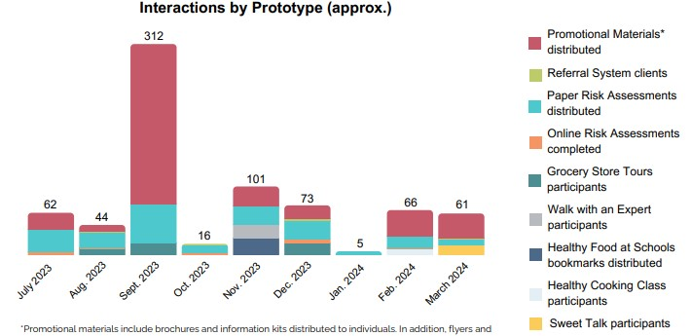
Data Monitoring and Feedback System
Notes:
Prototype data.

Slide 9
Community Information Sharing Hub
Local Businesses
Local Pharmacies
Diabetes Prevention Program
Community Coalition/
Hub
Unknown Local Agents
Health Care System(s)
Health Department
Non-Profit Orgs
Notes:
Stakeholders who are the providers and consumers of services; who can make the provision and consumption decisions. Grass roots and grass tops

Slide 10
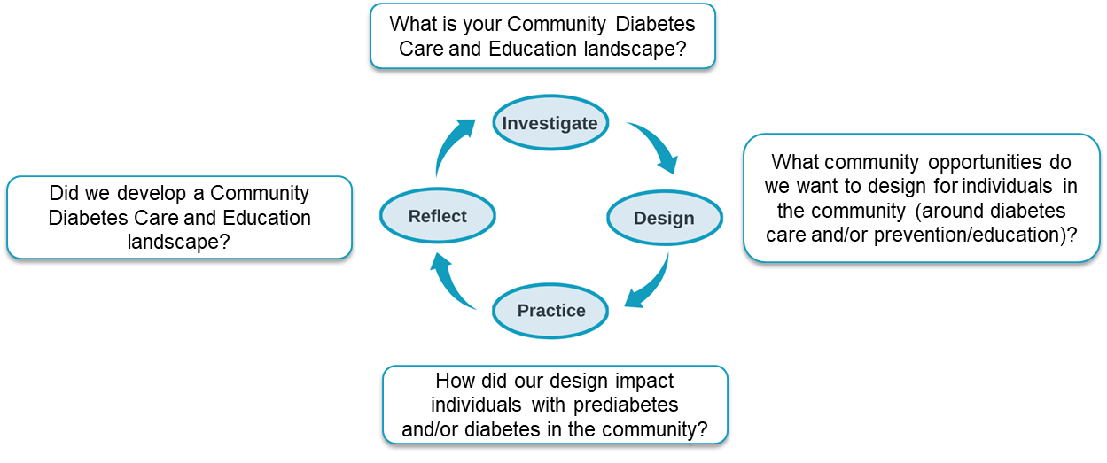
Rapid Prototyping Process-IDPR
Notes:
Through the use of a rapid cycle, quality improvement process that coalition members develop prototypes (programs, policies, practices) to implement in their community. There is no certainty in inputs or outcomes due to the complex dynamic nature of a community system, the IDPR process asks participants to initially develop a simplified version of the product to get some feedback on how it should work. Using that feedback, the prototypes are continuously refined,. Based on a hub-developed data-driven headline that guides their work, hub members have the freedom to design and implement multiple prototypes to ascertain how each one works under the constraints of the system.

Slide 11
 | Community A 8/1/23-7/31/24 | Community A Baseline | % change from project start | Community B 8/1/23-7/31/24 | Community B baseline | % change from project start
% at risk for prediabetes | 71.4 | 65.7 | 8.7% | 65.0 | 66.2 | -1.8%
% at risk and screened | 47.5 | 35.1 | 35.3% | 16.6 | 12.2 | 36.1%
% confirmed prediabetes | 35.8 | 39.8 | -9.8% | 29.8 | 27.6 | 8.0%
% living with diabetes | 15.9 | 12.7 | 25.2% | 7.9 | 6.8 | 16.2%
% living with diabetes with current A1c | 95.2 | 84.2 | 13.1% | 92.8 | 79.6 | 16.6%
% of those living with diabetes with current A1c above target | 11.6 | 14.4 | -19.4% | 8.8 | 13.1 | -32.8%

Slide 12
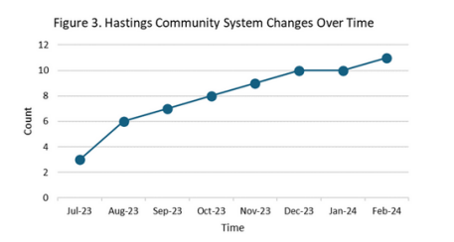
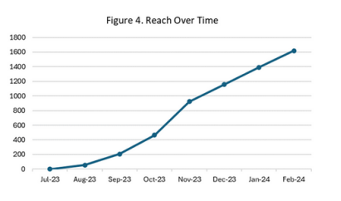
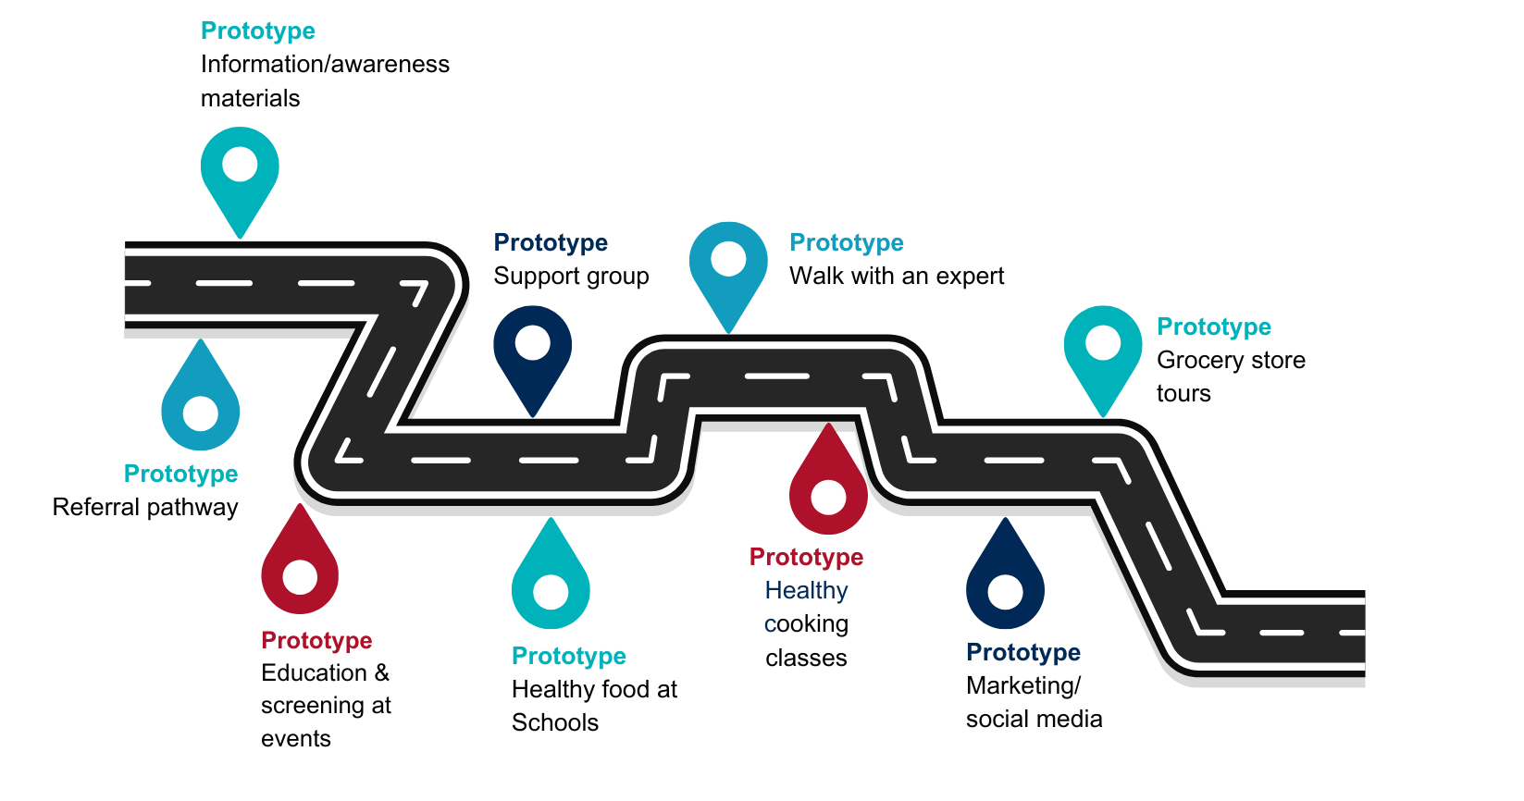
Progress
Community System Changes Over Time
Reach Over Time
Community B
12% of at-risk adults had been screened for prediabetes (baseline)
One-year Coalition Headline: Diabetes screening going up and more people aware of the condition and associated risks, as well as available resources, thanks to the collaborative work of the local diabetes community coalition.

Slide 13
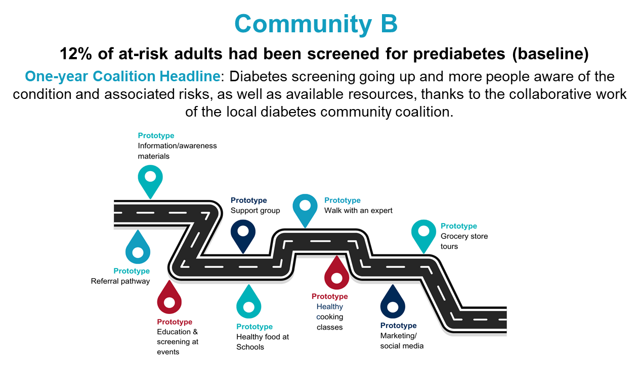
Progress
Community B
12% of at-risk adults had been screened for prediabetes (baseline)
One-year Coalition Headline: Diabetes screening going up and more people aware of the condition and associated risks, as well as available resources, thanks to the collaborative work of the local diabetes community coalition.

Slide 14

What’s next?
Truly a community driven approach: our job is to provide TA around the process
There is some resistance from community partners because it is a new paradigm, a new way of doing things
Long-term sustainability
Research opportunities
Notes:
NIH proposal to further study this community-driven process was submitted in July, and will take place across 10 communities and 18 clinics (RCT) within 4 rural counties of New York​
Primary outcome is diabetes screening rates
Our study is challenging the dominant paradigm which has been met with some resistance from community partners
What are the community rules that facilitate engaging in this process?
Knowing the above, how do we modify our process to help communities engage more effectively?
How do we effectively and efficiently measure community wide population health change
Opportunity to build a better data system to capture local data (national priority within the Office of Rural Health at the CDC)
How do we build capacity for these new systems for long-term sustainability?
How do we translate this process to other population health concerns and in other contexts?

Slide 15
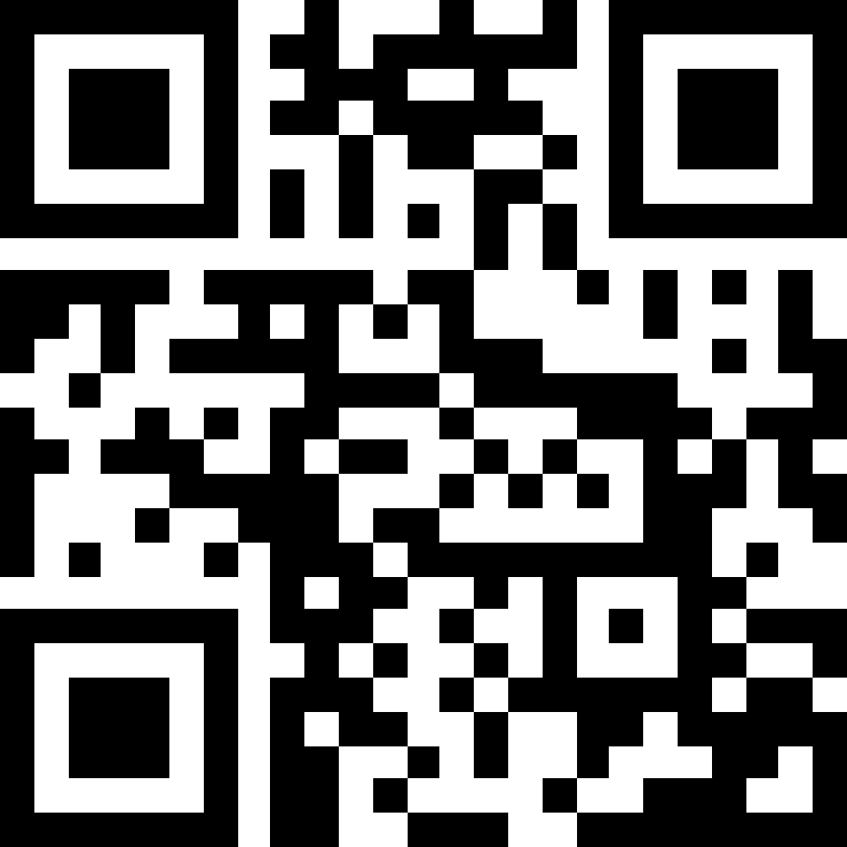
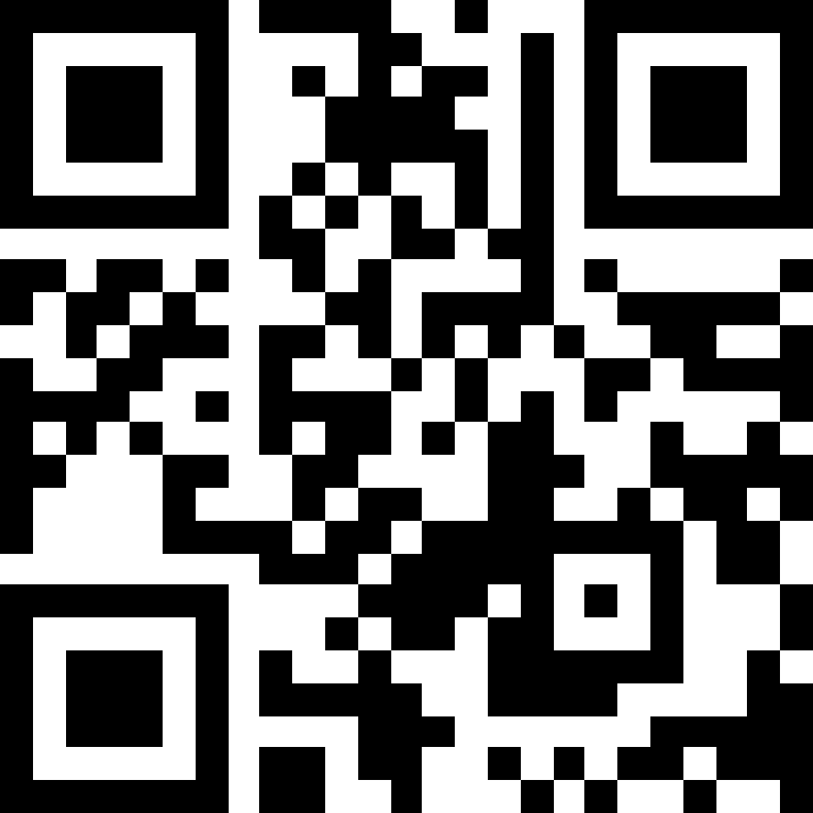
Want to Learn More?
Kristin Pullyblank, PhD, RN
kristin.pullyblank@bassett.org
607-547-6711
Pullyblank et al. (2024) Community-engaged systems for population health improvement: A novel approach to improve diabetes outcomes in rural communities.
Rosen et al. (2024) Investigate-Design-Practice-Reflect: An iterative community-engaged action process to improve population health.
Community B
12% of at-risk adults had been screened for prediabetes (baseline)
One-year Coalition Headline: Diabetes screening going up and more people aware of the condition and associated risks, as well as available resources, thanks to the collaborative work of the local diabetes community coalition.

