Slide 1
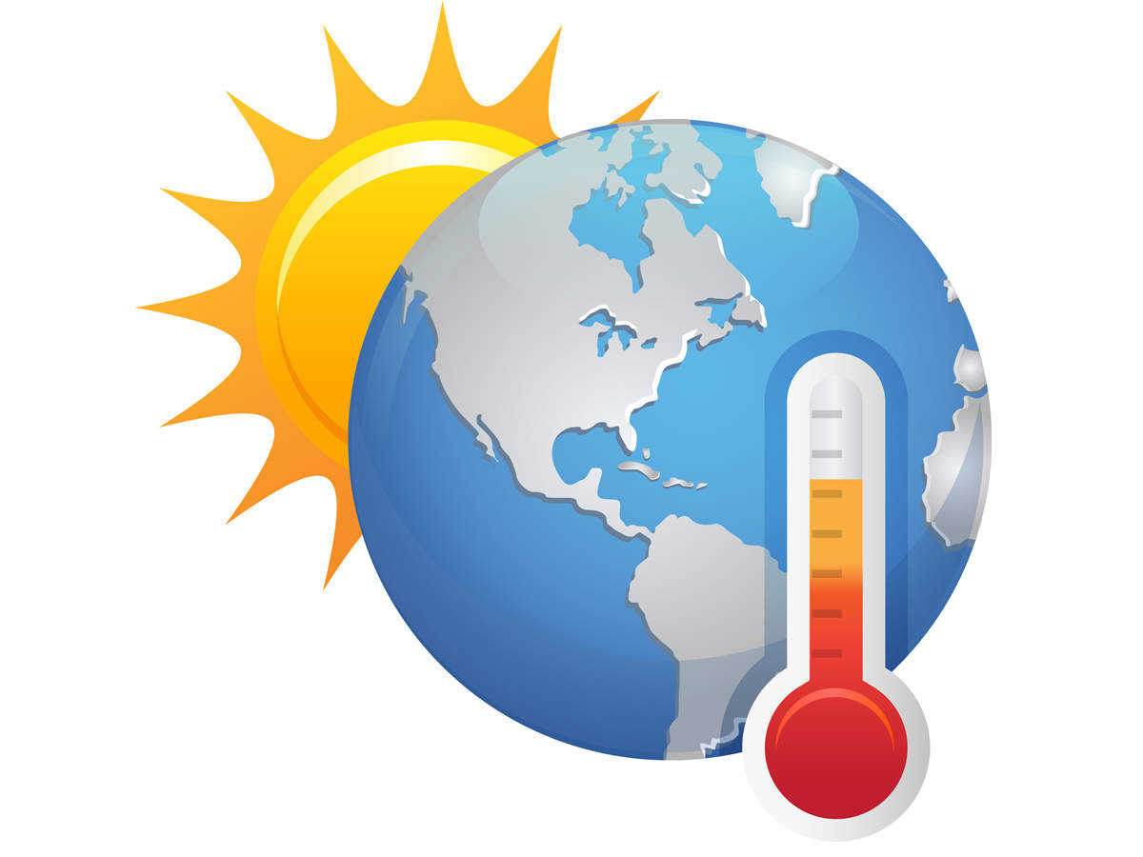
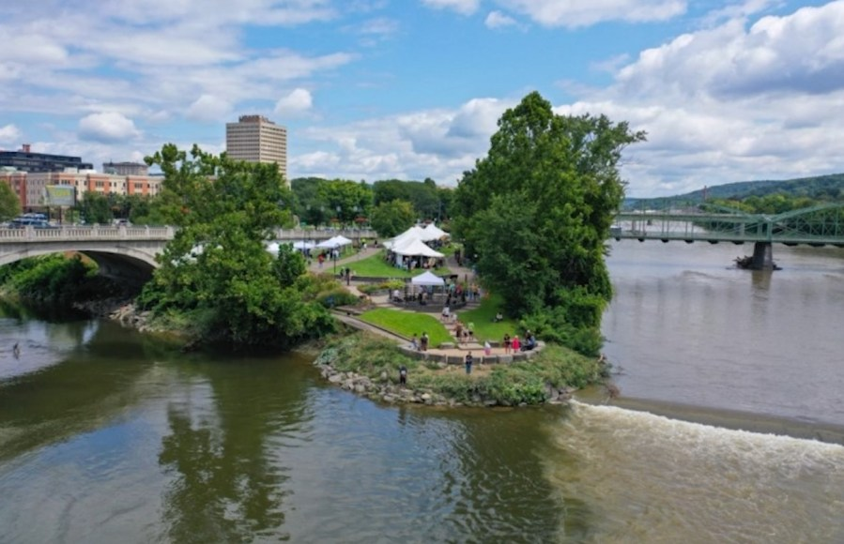
Healthy Communities in a Warming World
Yvonne Johnston, DrPH, MS, FNP Associate Professor & Founding Director Public Health Division Director O’Connor Office of Rural Health Studies
Andreas Pape, PhD Associate Professor Department of Economics Associate Dean The Graduate School
Pamela Mischen, PhD Professor Environmental Studies Program Faculty Advisor to the President & Chief Sustainability Officer Binghamton University
2024 Rural Health Symposium New York State Association of Rural Health
Holiday Inn Binghamton 2-8 Hawley Street, Binghamton NY 13901
September 19-20, 2024

Slide 2
Session Objectives
State the primary goal of the Binghamton 2 Degrees initiative and why 2 degrees is considered a tipping point.
Describe major climate-related events and activities of the Binghamton 2 Degrees initiative.
Explore the effects of climate change and its impacts on the health and well-being of communities.
Examine how social vulnerabilities and health inequities can compound the health impacts of climate change.
Discuss what actions can be undertaken to foster resilience and reduce health risks at the individual, organizational, health systems, and community level.
Review preliminary findings of the Binghamton 2 Degrees initiative.

Slide 3
Binghamton 2 Degrees Initiative
Binghamton 2 Degrees is a campus-wide initiative to engage Binghamton University and the broader community to consider the key question:
What will it mean to live in Binghamton under two degrees of warming and what can we do now to prepare?
The goal of the Binghamton 2 Degrees initiative is to raise awareness about climate change and engage communities in identifying local solutions for prevention, mitigation, and adaption.

Slide 4
Why 2 Degrees?
To achieve “Stabilization of greenhouse gas concentrations in the atmosphere at a level that would prevent dangerous anthropogenic interference with the climate system." (United Nations Framework Convention on Climate Change, 1992)
“A 2-degree rise in global temperatures is considered a critical threshold above which dangerous and cascading effects of human-generated climate change will occur.” (NASA Ames Newsroom, 2023)
“A robust understanding of the spatial patterns of climatic change as the world approaches 2°C warming is a priority for policy makers preparing actionable adaptation and mitigation plans.” (Park et al., 2023)

Slide 5
What have we done so far?
Working Groups
Energy & Carbon Production
Floods & Other Disasters
Agriculture & Food Insecurity
Community Health & Well-being
Migration & Housing
Actionable Research
Climate Science & Biodiversity
Data Modeling & Simulation
Disaster Planning & Response
Communications & Social Media
Effecting Change - Art & Music
Sustainability & Resilience
Climate-Focused Events
Climate Science Panel & Workshop
Festivals: Live at Confluence Park
Food Systems Panel
Community Energy Compass
Healthy Communities
Natural Disaster Preparedness
Climate Summit
Community Engagement Activities
Art & Music Exhibitions
Participatory Art & Writing
Workshops & Simulations

Slide 6
How close are we to reaching this critical point? [Intergovernmental Panel on Climate Change ]
"The extent to which current and future generations will experience a hotter and different world depends on choices now and in the near-term."
https://www.ipcc.ch/report/ar6/syr/downloads/report/IPCC_AR6_SYR_SPM.pdf

Slide 7
What would a 2°C change look like for Broome County? [Climate Mapping For Resilience and Adaptation]
Climate Projections under Lower & Higher Emissions for:
Early Century (2015-2044)
Mid Century (2025-2064)
Late Century (2070-2099)
https://livingatlas.arcgis.com/assessment-tool/explore/details

Slide 8
Climate Projections for Late Century (2070-2099)
Annual days with maximum temperature >90°F
Annual single highest maximum temperature (°F)
Average annual total precipitation (in inches)
Annual days with total precipitation > 1 inch
COUNTY (increase since 1976-2005) | > 90°F Days (low) | > 90°F Days (high) | High Temp (low) | High Temp (high) | Precipitation (low) | Precipitation (high) | > 1” Days (low) | > 1” Days (high)
Broome | 22.5 (+19.6) | 50.3 (+47.5) | 98.8 (+7.2) | 104.0 (+12.4) | 43.2 (+3.1) | 44.9 (+4.8) | 4.3 (+1.2) | 5.1 (+2.0)
Chenango | 20.3 (+18.1) | 46.8 (+44.6) | 97.9 (+7.0) | 103.0 (+12.0) | 44.4 (+3.0) | 46.0 (+4.6) | 3.8 (+1.2) | 4.6 (+2.0)
Delaware | 14.7 (+13.6) | 39.1 (+37.9) | 96.6 (+6.9) | 101.7 (+12.0) | 46.7 (+3.2) | 48.3 (+4.8) | 4.5 (+1.3) | 5.3 (+2.2)
Tioga | 25.0 (+21.2) | 53.7 (+49.9) | 99.3 (+7.1) | 104.5 (+12.3) | 41.3 (+2.9) | 42.9 (+4.4) | 3.9 (+1.1) | 4.6 (+1.9)
Tompkins | 22.9 (+19.5) | 49.7 (+46.3) | 98.7 (+6.7) | 103.7 (+11.8) | 41.1 (+2.7) | 42.6 (+4.2) | 3.1 (+1.0) | 3.8 (+1.6)
https://livingatlas.arcgis.com/assessment-tool/explore/details

Slide 9
Climate Change Impacts
Air Quality
Outdoor and Indoor Air Pollution
Wildfire Smoke
Airborne Allergens
Built Environment
Damaged or Stressed Infrastructure
Impacts on the Production and Distribution of Goods and Services
Threats to Quality of Life and Human Health
Coasts
Coastal Property and Infrastructure
Coastal Ecosystems
Land Losses
Energy
Disruptions to Energy Supply
Interruptions to Electricity Transmission
Strain on the Energy System
Increased Air Pollution
Transportation
Impacts on System Safety and Function
System Costs and the Economy
Reduced Access to Social Services and Necessities
Agriculture & Food Supply
Changes in Agricultural Productivity
Impacts to Soil and Water Resources
Health Challenges to Agricultural Workers and Livestock
Ecosystems
Changes in Species and Populations
Timing of Natural Events and Cycles
Changes in Ecosystem Interactions
Altered or Reduced Ecosystem Services
Freshwater Resources
Reduced Water Supplies
Impaired Water Quality
Stress on Water Infrastructure
Forests
Natural Disturbances
Reduced Carbon Storage
Impacts on Water Resources
Ocean and Marine Resources
Changes in Ocean Ecosystems
More Common and Severe Extreme Marine Events
Impacts on Marine Fisheries
https://www.epa.gov/climate-indicators/health-society

Slide 10
Climate Effects on Health
The most significant climate change impacts include:
Rising temperatures
More extreme weather
Rising sea levels
Increasing carbon dioxide levels
The health effects include:
Increased respiratory and cardiovascular disease
Injuries and premature deaths related to extreme weather events
Changes in the prevalence and geographical distribution of food- and water-borne illnesses and other infectious diseases
Threats to mental health
https://www.cdc.gov/climateandhealth/effects/default.htm#:~:text=The%20health%20effects%20of%20these,and%20threats%20to%20mental%20health

Slide 11
Climate Change & Health Equity
Certain social groups are particularly vulnerable to crises, for example, female-headed households, children, persons with disabilities, Indigenous Peoples and ethnic minorities, landless tenants, migrant workers, displaced persons, sexual and gender minorities, older people, and other socially marginalized groups.
The root causes of their vulnerability lie in a combination of their geographical locations; their financial, socio-economic, cultural, and gender status; and their access to resources, services, decision-making power, and justice.
https://www.hhs.gov/climate-change-health-equity-environmental-justice/climate-change-health-equity/index.html

Slide 12
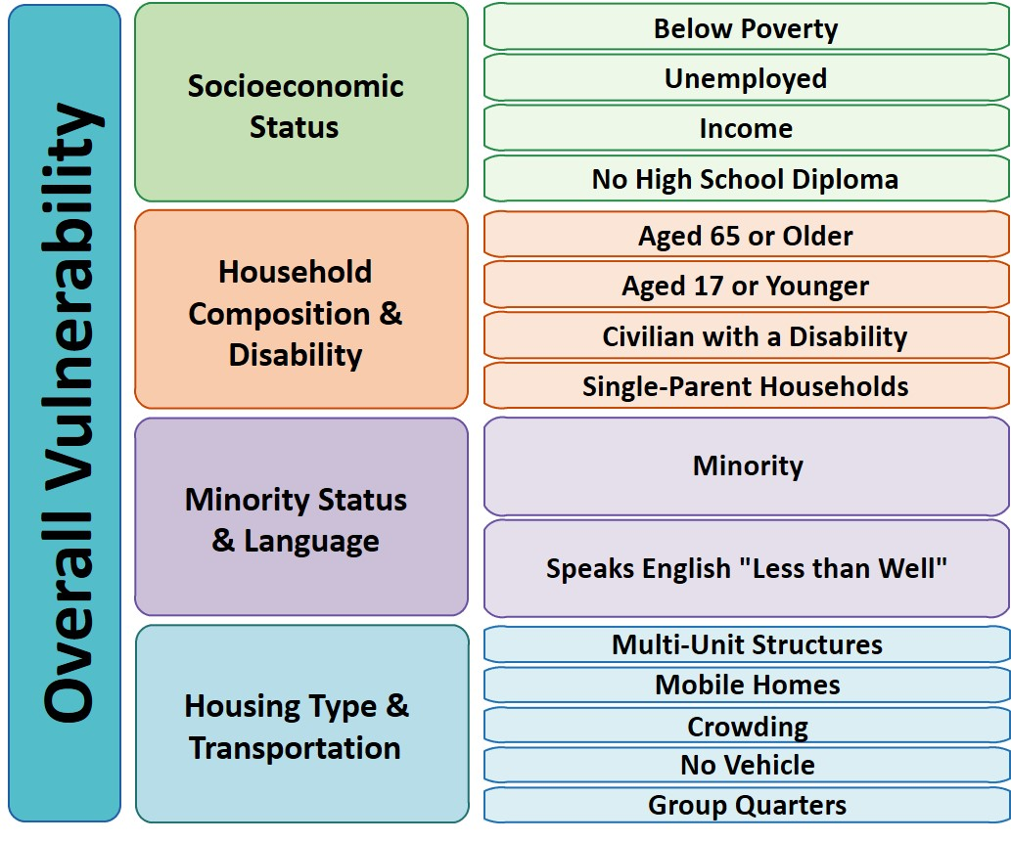
Social Vulnerability Index [Centers for Disease Control & Prevention / Agency for Toxic Substances & Disease Registry]
Social vulnerability refers to the potential negative effects on communities caused by external stresses on human health.
Such stresses include natural or human-caused disasters, or disease outbreaks.
Reducing social vulnerability can decrease both human suffering and economic loss.
https://www.atsdr.cdc.gov/placeandhealth/svi/index.html

Slide 13
Social Vulnerability: New York State Counties
https://hazards.fema.gov/nri/map

Slide 14
Social Vulner- ability Index (SVI) Indicators
Indicator | Broome | Chenango | Delaware | Tioga | Tompkins
Poverty | 26.6 | 23.8 | 25.5 | 19.1 | 23.9
Unemployment | 7.6 | 6.5 | 4.3 | 5.7 | 4.1
No HS Diploma | 9.7 | 11.5 | 10.5 | 8.2 | 5.5
>30% Income on Housing | 27.6 | 23.3 | 24.1 | 21.9 | 32.1
Uninsured | 3.9 | 3.4 | 5.7 | 3.1 | 3.6
Age 65 and older | 19.1 | 20.5 | 24.5 | 20.2 | 14.3
Age 17 and younger | 19.4 | 20.7 | 16.7 | 20.8 | 14.7
Disability | 15.6 | 18.7 | 17.7 | 15.3 | 10.1
Single Parent Household with children age<18 | 5.9 | 4.8 | 4.5 | 4 | 5.2
Limited English | 1.4 | 0.6 | 1.0 | 0.3 | 1.2
Minority | 17.2 | 5.5 | 8.4 | 5.5 | 23.1
Multiunit Housing | 8.0 | 3.2 | 1.5 | 2.2 | 14.1
Mobil Homes | 4.5 | 21.2 | 12.3 | 14.4 | 7.7
Crowded Living | 1.9 | 1.8 | 1.2 | 0.7 | 1.6
No Vehicle | 12.3 | 9.5 | 8.6 | 5.8 | 13.0
Group Quarters | 5.2 | 1.4 | 5.1 | 1.1 | 13.1

Slide 15
Community Resilience: New York State Counties
Community resilience is the ability of a community to prepare for anticipated natural hazards, adapt to changing conditions, and withstand and recover rapidly from disruptions.
https://hazards.fema.gov/nri/map

Slide 16
National Risk Index [ Risk Index = (Expected Annual Loss x Social Vulnerability) / Community Resilience ]
https://hazards.fema.gov/nri/map

Slide 17
National Risk Index
HAZARDS: Avalanche, Coastal Flooding, Cold Wave, Drought, Earthquake, Hail, Heat Wave, Hurricane, Ice Storm, Landslide, Lightning, Riverine Flooding, Strong Wind, Tornado, Tsunami, Volcanic Activity, Winter Weather
Hazard | Broome | Chenango | Delaware | Tioga | Tompkins
Cold wave | Relatively Moderate | Relatively Moderate | Relatively Moderate | Relatively Moderate | Relatively High
Drought | No Rating | No Rating | No Rating | Very Low | Relatively Low
Hail | Relatively Low | Very Low | Relatively Low | Very Low | Relatively Low
Heat wave | Relatively Low | Relatively Low | Very Low | Relatively Low | Relatively Low
Hurricane | Relatively Low | Very Low | Relatively Low | Very Low | Very Low
Ice storm | Relatively Moderate | Relatively Moderate | Relatively Low | Relatively Moderate | Relatively Low
Landslide | Relatively Moderate | Relatively Low | Relatively Moderate | Relatively Low | Relatively Moderate
Lightning | Relatively Low | Relatively Low | Relatively Low | Very Low | Relatively Low
River flooding | Relatively High | Relatively High | Relatively High | Relatively High | Relatively Moderate
Strong wind | Relatively Low | Very Low | Relatively Low | Relatively Low | Relatively Low
Tornado | Relatively Moderate | Relatively Low | Relatively Low | Relatively Low | Relatively Low
Wildfire | Very Low | Very Low | Very Low | Very Low | Very Low
Winter Weather | Very Low | Relatively Low | Very Low | Very Low | Very Low
https://hazards.fema.gov/nri/map

Slide 18
Individual & Organizational Actions for Climate Resilience
Understand the science
Address the harms: mitigation & adaptation
Access climate resilience resources
Become a climate advocate – communicate with policy makers
Raise awareness about how to prevent / recognize early symptoms of climate-related health conditions
Assess community vulnerabilities, services, access, resources, and capacity
Serve on committees within your organization to assess risks & readiness
Engage in community emergency preparedness and response
Promote resilience in health information systems (early warning, response, vulnerability, capacity)
Find out if your organization has a Climate Action Plan
How “green” is your work environment?
Sustainable food services
Electric vehicles
Waste management
Renewable energy sources
How ready is your organization to respond during extreme weather events?
Education on new / emerging diseases
Disaster preparedness and response
Workforce availability
Physical and emotional resilience
Pledge to Take Action on
Climate Change

Slide 19
Health Systems & Public Health Models for Climate Resilience
https://www.ipcc.ch/report/ar6/wg2/figures/chapter-7/figure-7-015
https://www.epa.gov/arc-x/public-health-adaptation-strategies-climate-change

Slide 20
Community Conversations: Healthy Communities in a Warming World
Methods
Held two health-focused events
Gave overview of climate effects
Various emission level conditions
Vulnerability & resilience factors
Presented two different scenarios
Flooding & migration
Extreme heat & migration
Led small group discussions
Climate impacts on health
Climate response - local capacity
Conducted pre & post surveys
Discussion Prompts
Climate Impact [30 minutes]
What are different health issues that we might be concerned about?
What local neighborhoods and communities are going to be most impacted?
Climate Response [30 minutes]
What resources, assets, and capacity do we have to respond to anticipated changes?
This project was reviewed by the Binghamton University Research Review Committee and determined to be exempt.

Slide 21
Summary of Discussions
Climate Impacts
Health Issues
Exacerbations of underlying health conditions (allergies, asthma, COPD)
Effects on young children (impacts on growth and development)
Lower participation in outdoor activity
Increases in infectious and vector-borne diseases as well as domestic violence
Food insecurity & nutritional deficiencies
Migration
High levels of stress among migrants
Increase in resource demands
Dynamic changes in community
Reduced access to healthcare services
Discrimination and prejudice
Climate Response
Improve power grid & infrastructure
Reduce energy consumption
Construct cooling centers
Expand mental health services
Foster leadership that listens and builds trust with community, especially vulnerable populations
Design walkable communities
Coordinate emergency response
Develop risk communication protocols
Leverage existing and build new infrastructure for housing
Inform residents about healthful eating and sustainable agriculture
“I enjoyed attending this event.”
Mean = 4.344 / 5 (n=34)
87% favorability

Slide 22
Pre & Post Survey Results
Survey Questions:
I feel confident explaining climate change to another person.
I can describe what will happen if the planet warms 2 degrees above pre-industrial levels.
My actions influence climate change.
Climate change is an important part of how I make daily decisions.
We can slow and/or stop global warming.
My community is well-prepared to lessen the impacts of climate change disasters and emergencies.
Sample size (both events): n=34
✓
✓
✓
✓
✓ = statistically significant improvement (p<.05)

Slide 23
Federal Climate Change Resources
Agency for Healthcare Research & Quality
Reducing Healthcare Carbon Emissions: A Primer on Measures and Actions for Healthcare Organizations to Mitigate Climate Change
Centers for Disease Control and Prevention
Climate and Health
Environmental Protection Agency
Climate Change and Human Health
Federal Emergency Management Agency
Ready.gov - Resolve to be Ready
National Academy of Medicine
Grand Challenge on Climate Change, Human Health, and Equity
Action Collaborative on Decarbonizing the U.S. Health Sector
Office of Climate Change and Health Equity
Climate Change & Health Equity, and Environmental Justice
U.S. Department of Health & Human Services
2021 Climate Action Plan

Slide 24
Web-based References & Resources
Agency for Toxic Substances and Disease Registry: CDC/ATSDR Social Vulnerability Index
https://www.atsdr.cdc.gov/placeandhealth/svi/index.html
Centers for Disease Control and Prevention: Climate Effects on Health
https://www.cdc.gov/climateandhealth/effects/default.htm#:~:text=The%20health%20effects%20of%20these,and%20threats%20to%20mental%20health
Climate Mapping for Resilience and Adaptation
https://livingatlas.arcgis.com/assessment-tool/explore/details
Federal Emergency Management Agency: National Risk Index
https://hazards.fema.gov/nri/map
U.S. Department of Health and Human Services: Climate Change and Health Equity
https://www.hhs.gov/climate-change-health-equity-environmental-justice/climate-change-health-equity/index.html
U.S. Environmental Protection Agency
Climate Change Indicators https://www.epa.gov/climate-indicators/health-society
Climate Change and Human Health https://www.epa.gov/climateimpacts/climate-change-and-human-health

Slide 25
Presentation References & Resources
Lee, H., Calvin, K., Dasgupta, D., Krinner, G., Mukherji, A., Thorne, P., ... & Ruane, A. C. (2023). Climate change 2023 synthesis report summary for policymakers. In Climate Change 2023: Synthesis Report. Contribution of Working Groups I, II and III to the Sixth Assessment Report of the Intergovernmental Panel on Climate Change. Geneva, Switzerland. doi:10.59327/IPCC/AR6-9789291691647.001 Available https://www.ipcc.ch/report/ar6/syr/downloads/report/IPCC_AR6_SYR_SPM.pdf
National Climate Resilience Framework. (2023). Washington, DC: The White House. Available: https://www.whitehouse.gov/wp-content/uploads/2023/09/National-Climate-Resilience-Framework-FINAL.pdf
NASA Ames Newsroom. (2023, August 14). NASA study reveals compounding climate risks at two degrees of warming. NASA Global Climate Change News. Available https://climate.nasa.gov/news/3278/nasa-study-reveals-compounding-climate-risks-at-two-degrees-of-warming/
Park, T., Hashimoto, H., Wang, W., Thrasher, B., Michaelis, A. R., Lee, T., ... & Nemani, R. R. (2023). What does global land climate look like at 2° C warming? Earth's Future, 11(5), e2022EF003330. doi:10.1029/2022EF003330
Pörtner, H. O., Roberts, D. C., Adams, H., Adler, C., Aldunce, P., Ali, E., ... & Ibrahim, Z. Z. (2022). Climate change 2022: Impacts, adaptation and vulnerability. Intergovernmental Panel on Climate Change (IPCC). New York: Cambridge University Press. doi:10.1017/9781009325844 Available https://www.ipcc.ch/report/ar6/wg2/downloads/report/IPCC_AR6_WGII_FrontMatter.pdf
Wheeler, N., & Watts, N. (2018). Climate change: From science to practice. Current Environmental Health Reports, 5, 170-178. doi:10.1007/s40572-018-0187-y

Slide 26
Thank You for Sharing a Part of Your Day!
Yvonne Johnston, DrPH, MS, FNP Public Health Division & O’Connor Office of Rural Health Studies
Email: johnston@binghamton.edu
Andreas Pape, PhD Economics Department &
The Graduate School
Email: apape@binghamton.edu
Pamela Mischen, PhD Environmental Studies Program & Binghamton University
Email: johnston@binghamton.edu
https://www.nursingcenter.com/ncblog/november-2019/climate-change

