Slide 1
Using Video Conferencing to Increase Access to
Evidence-Based Chronic Disease Self-Management Education in Rural Upstate New York
2024 Rural Health Symposium
Binghamton, NY
September 19, 2024

Slide 2
Presentation Panel
Introduction to Get Healthy North Country! Network
        Ann Morgan, Executive Director
        The Heart Network
How Virtual has Changed Program Delivery in
the North Country
    Jerome James, Access Program Director & Lifestyle Program Educator
    St. Lawrence County Health Initiative
The Claxton-Hepburn Medical Center
Diabetes Education Program
Shannon VanHouse, RN, CWOCN, CDCES
Claxton-Hepburn Medical Center

Slide 3
Get Healthy North Country!
Community Integrated Health Network
Facilitated by
The Heart Network

Slide 4
Get Healthy North Country!
Mission
To reduce the burden of chronic disease across our region.
Vision
A health and social care delivery system that emphasizes prevention, not treatment, of chronic disease AND one that offers every North Country resident equal opportunity to live their healthiest life.

Slide 5
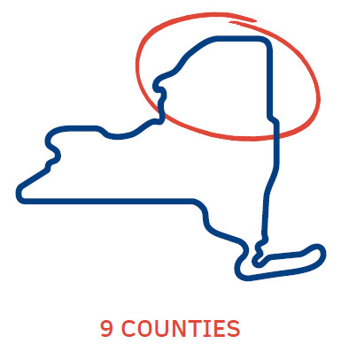



North Country Healthy Heart Network, Inc.
Board of Directors
GET HEALTHY NORTH COUNTRY!
Integrated Network Development Committee
Evidence-Based Programs
Committees, Work Groups, Teams

Slide 6
Program Delivery Network
11 organizations currently contracted to deliver CDSME, NDPP, and/or tobacco cessation group programs
Just one has the capacity to offer on-going, year-round opportunities in the communities they serve; most offer no more than 2 programs a year
As the delivery network grows, organizations now collectively have capacity to offer quarterly in-person programs in some counties
Thanks to virtual options, residents across the region have at least one opportunity monthly to join a program

Slide 7
www.GetHealthyNoCo.Org

Slide 8
For more information about the
Get Healthy North Country! Network
Ann Morgan
(518) 897-5981 amorgan@heartnetwork.org

Slide 9
St. Lawrence County Health Initiative
Lifestyle Program Training & Technical Assistance Center

Slide 10
Lifestyle Program Training & Technical Assistance Center
Training
Master Trainers for CDSME
Technical Assistance
Fidelity
Other Support
Networking
Establishing a uniform approach for sharing classes
Providing assistance with recruitment
Serving as a central hub for referrals
Data Collection
Recruiting and Retaining Leaders
Continuous Leader Training
DPP Master Trainer
Conducting various sessions multiple times a year

Slide 11

Lifestyle Program Training & Technical Assistance Center
EVIDENCE-BASED Programming
Chronic Disease Self-Management Education
  Administered by the Self-Management Resource Center
  Carried out by the Lifestyle Program Training & Technical Assistance Center within the Get Healthy North Country Coalition.
Diabetes Prevention Program
  Developed under the guidance of the Centers for Disease Control and Prevention
  Adheres to the Standards for CDC Recognition

Slide 12
Lifestyle Program Training & Technical Assistance Center
Moving an evidence-based IN-PERSON program to HYBRID delivery.
Conducting hybrid sessions using Zoom or other platforms
Ensuring continuous updates
Moving an evidence-based IN-PERSON program to VIRTUAL and TELEPHONIC delivery.
Self-Management Resource Center
Providing toolkit delivery via phone
Conducting virtual sessions using Zoom or other platforms
Ensuring continuous updates

Slide 13
Lifestyle Program Training & Technical Assistance Center
Virtual, Hybrid, and Telephonic “Pros”
Improved ability to serve a wider geographical area
Enhanced chances for leaders to collaborate
Promotes partnerships and collaboration
More flexibility in participation, overcoming weather and time constraints
Allows individuals restricted to their homes or beds to engage in activities
Reduces the likelihood of absenteeism due to discomfort or external factors
Expands access to a wide array of programs
Anonymity sometimes helps individuals to join in

Slide 14
Lifestyle Program Training & Technical Assistance Center
Virtual, Hybrid and Telephonic “Cons”
Ensuring consistent Internet connectivity in the North Country.
Recognizing the difficulties encountered by participants with restricted or unclear technology access.
Addressing limitations in effectively monitoring all participants.
Lack of personal connections and sensory signals in virtual meetings.
Respecting privacy and choice to not appear on screen.
Virtual interactions invading personal space as participants connect from home.
Some participants favor face-to-face interactions above virtual ones.
Challenges may arise due to frequent updates on virtual platforms.

Slide 15
Lifestyle Program Training & Technical Assistance Center

Slide 16
Lifestyle Program Training & Technical Assistance Center

Slide 17
Lifestyle Program Training & Technical Assistance Center

Slide 18
Lifestyle Program Training & Technical Assistance Center

Slide 19
Lifestyle Program Training & Technical Assistance Center
Source: Graph created by Binita Mahato

Slide 20
Lifestyle Program Training & Technical Assistance Center
Source: Graph created by Binita Mahato

Slide 21
Lifestyle Program Training & Technical Assistance Center
Source: Graph created by Binita Mahato

Slide 22
Lifestyle Program Training & Technical Assistance Center
Source: Graph created by Binita Mahato

Slide 23

Lifestyle Program Training & Technical Assistance Center
Questions?
For More Information:
Jerome James
315-261-2338
Jerome@gethealthyslc.org
Data graphs on slides 11, 12, 13, and 14 were created by Binita Mahato,
Center Business Development Specialist, St. Lawrence County Health Initiative

Slide 24
Prevention and Management Programs at Claxton-Hepburn Medical Center
Shannon VanHouse, RN, CWOCN, CDCES

Slide 25
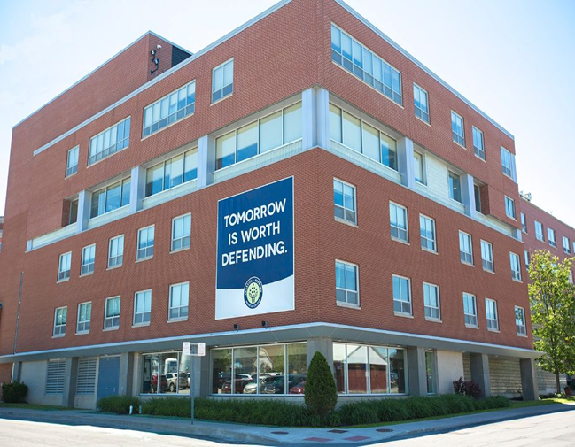
Who we are
Claxton-Hepburn Medical Center, (soon to be Northstar Health Alliance) is a small rural hospital located on the Canadian border.
The only American Diabetes Association (ADA) recognized Diabetes Self-Management Program (DSMP) in St. Lawrence county.

Slide 26
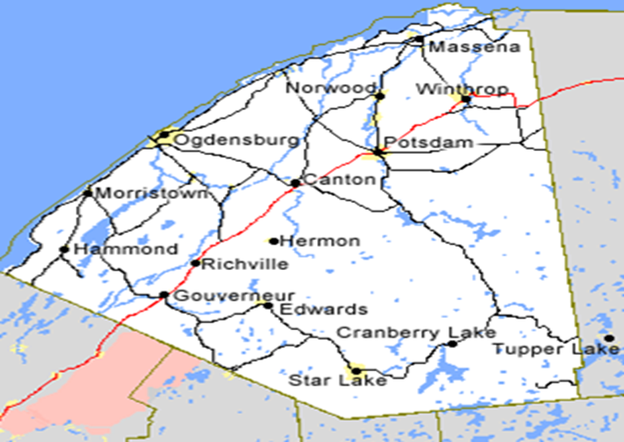
CHMC DSMP Territory
St. Lawrence county is the largest county in NYS with one of the lowest population densities.
It does not have direct access to an interstate highway within its borders.
Sparse healthcare resources
Among the highest poverty rate in the state

Slide 27
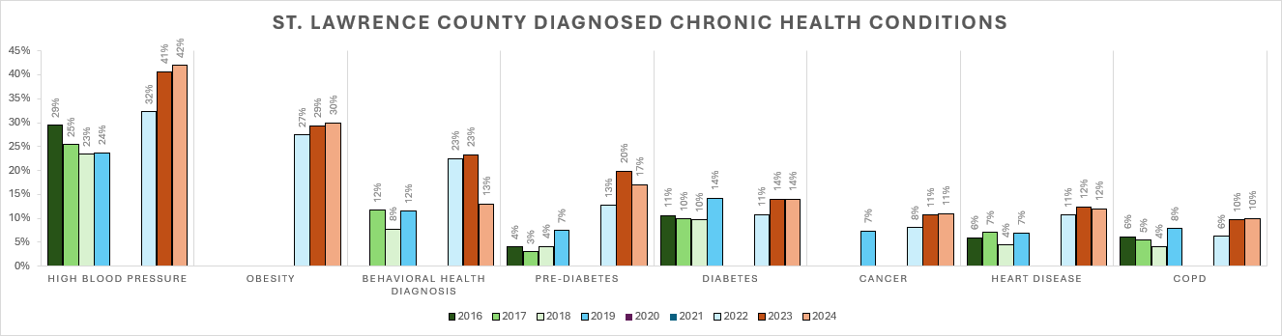

Slide 28
We Offer Programming That is Unique
Individual sessions for:
  Diabetes
  Prediabetes
  Weight loss
  Nutrition
Diabetes:101 group diabetes self-management classes
Thrive! NDPP Lifestyle modification program (NDPP)
Chronic disease self-management program (CDSMP)
Chronic pain self-management program (CPSMP)
Monthly Healthy Lifestyle Support Group
Partner with agencies like Cornell Cooperative Extension to provide Farm to Community Program and Food Rx
Created $25 Feeds Five Cooking Classes (YouTube)

Slide 29
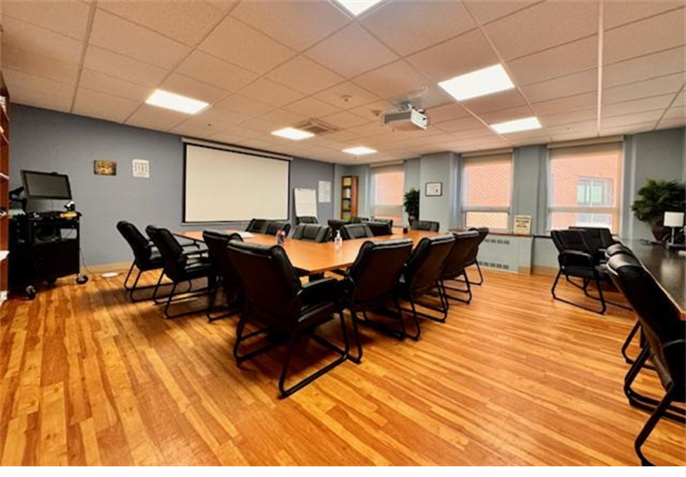
CHMC’s Diabetes Education Telehealth Conference Room
In 2018-19 as awareness of our programs and their success really started to grow, we started to receive more and referrals into the program as well as self-referrals from interested community members.
Travel was quickly identified as a significant barrier for participants. Financial burden of travel, time spent traveling, and weather being the most common issues.
We felt the impetus to seek alternatives to delivery of our programs to reach our community
In 2018 we sought funding to helped us create a more effect environment for hybrid learning.
2019 we were awarded grant funding through the Lion’s Club International Foundation and our CHCM Foundation

Slide 30
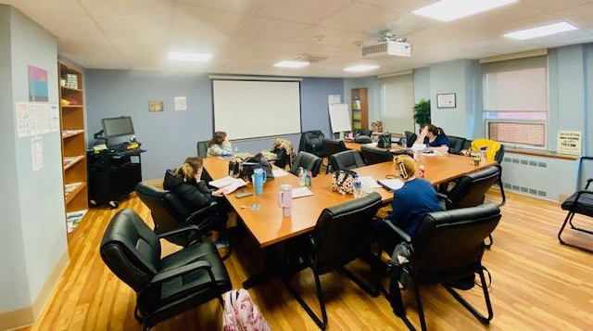
Benefits of Telehealth
Participants from all areas of our county, other county, as far as Florida were connected
Participants were able to fit classes into their busy schedules
Able to connect with participants/patients in their own environment
Cut unsafe travel during our long winter months
Quickly able to pivot in response to pandemic restrictions.

Slide 31
Trends with Telehealth
Patient volumes increased by 58%
During pandemic we were able to maintain connection with 41% of our patients through telehealth/distance learning modalities
Rebounded quickly out of the pandemic, increasing volumes by 91% with heavy reliance on telehealth
Over 120 individuals connected through email listserv
Increased rates of completion across all group classes
Increase in numbers of participants in group classes
DSME patients lowered A1c’s by 1.5 absolute percentage points
Individuals with A1c’s > 9%, dropped 3.8 absolute percentage points
Individuals self-management goals over 90% success rate
We are seeing more and more participants from far reaches of our county and beyond.

Slide 32
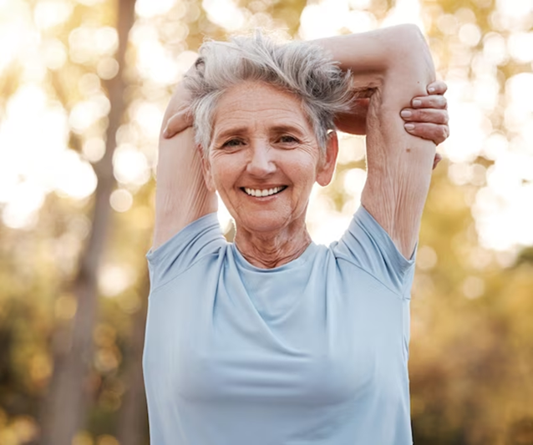
Participant Success Story
CB- 72 yof, retired educator, joined “Thrive” in May 2023. She has completed three consecutive 16 week sessions and has stayed connect through other programming. She winters in the south and was concerned about losing support/connection and falling off track with her goals.
She stayed connected via telehealth during winter months and has been extremely successful in achieving her health goals.
Since her start with Thrive and other programs she has lost 72 pounds, resulting in a BMI change from 40 down to 26.9.

Slide 33
Thank you so much for listening.
Questions or Comments?
Shannon VanHouse
315.713.5116
svanhouse@chmed.org

