Slide 1
Health Resources and Services Administration Office of Intergovernmental and External Affairs Behavioral Health in Rural Populations: Strategies and Resources April 21 , 2022
CAPT Christopher Bersani, Psy.D, ABPP
Deputy Regional Administrator
Office of Intergovernmental and External Affairs (HRSA IEA), Region 1-Boston

Slide 2
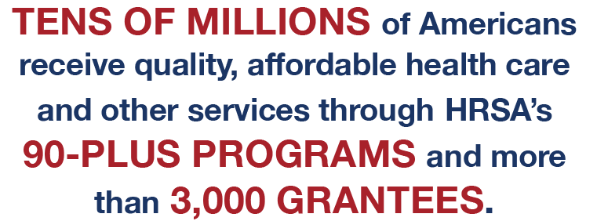
Health Resources and Services Administration (HRSA) Overview
Notes:
HRSA supports more than 90 programs through grants and cooperative agreements to more than 3,000 awardees, including community and faith-based organizations, colleges and universities, hospitals, state, local, and Tribal governments, and private entities.
Every year, HRSA programs serve tens of millions of people, including people living with HIV/AIDS, pregnant women, mothers and their families, and those otherwise unable to access quality health care.
Source: https://www.hrsa.gov/about/organization/bureaus/index.html

Slide 3
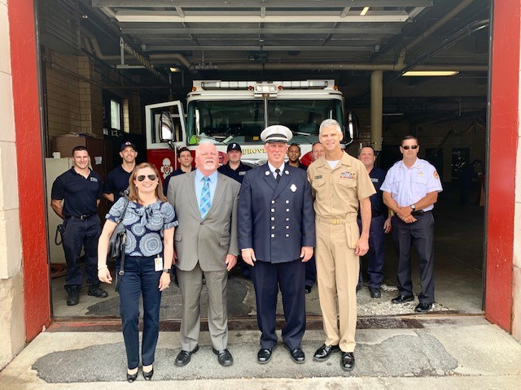
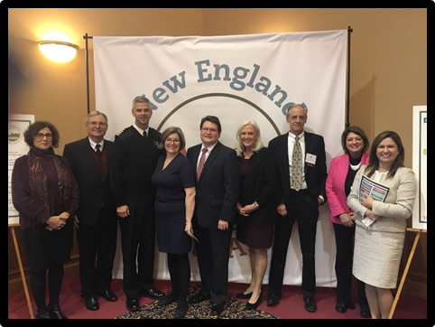
IEA Mission
To provide on-the-ground outreach to increase the reach, impact, and awareness of HRSA programs.
3

Slide 4
Core Functions
External Affairs and Outreach
Represent HRSA
Strategic Stakeholder Partnerships
Engage federal, state, local, and tribal partners
National & Regional Surveillance
Ensure the efficacy of regional resources
Regional Management
Identify & report ground-level communications and information
Serve as regional leaders
Conduct outreach to increase knowledge about HRSA’s program, and priorities
Manage National Organizations of States and Local Officials (NOSLO) Cooperatve Agreements
Build relationships to advance HRSA priorities
Provide targeted strategic action
Inform HRSA’s operations, decision-making, and allocation of resources
Coordinate Emergency Preparedness and Continuity of Operations, technology, and facilities management
Notes:
Role of IEA is different than other components of HRSA. IEA does not award or manage grants or cooperative agreements.
Instead, we work across HRSA’s program areas to extend the reach of the Bureau’s and Offices and to provide an additional touchpoint for HRSA’s stakeholders.
Our work can be categorized by these Core Functions.
External Affairs & Outreach: IEA staff oftentimes serve as the face of HRSA by providing local representation at meetings and events to promote HHS and HRSA initiatives and programs. IEA also shares information about HRSA resources and provides assistance to HRSA grantees, target populations and stakeholders at the local level.
Strategic Stakeholder Partnerships: IEA develops and maintains key partnerships in communities, states and regions on behalf of HRSA. IEA also collaborates with other HHS OpDivs, and other federal departments and agencies.
Regional Surveillance: IEA is uniquely positioned in the field, and therefore we are able to gather and assess ground-level intelligence about health care issues and trends in order to provide HRSA headquarters (HQ) with information that may impact decision making about our programs.
Regional Management: The administrative side of our work. IEA ensures efficacy of HRSA’s regional resources which include management of human capital, technology, and facilities.

Slide 5
Benefits of HRSA’s Regional Presence
Linkage to local and state-level partners
Leverage state and federal resources
Local representation, customer service support, and triage
Rapid response to crisis
Seamless participation and execution of HHS/HRSA initiatives
Intel from the field to HRSA Headquarters
Disseminate HRSA information to the field
Notes:
NOTE: These are general talking points. Feel free to modify/customize while still landing the main points. Please elaborate on the points below
Having a presence in the region allows for:
Linkage to local and state level partners: {Discuss your strong partnerships}
Leveraging of state and federal resources: {Discuss how you do this}
Local representation, customer service support and triage {Discuss how you do this}
Rapid response to crisis {Provide an example}
Seamless participation and execution of HHS/HRSA initiatives {Discuss how IEA “hits the ground running” when new initiatives are rolled out…no huge effort to orient to local jurisdictions and/or reinvent the wheel}
Intel from the field to HRSA Headquarters
Dissemination of HRSA information to the field

Slide 6
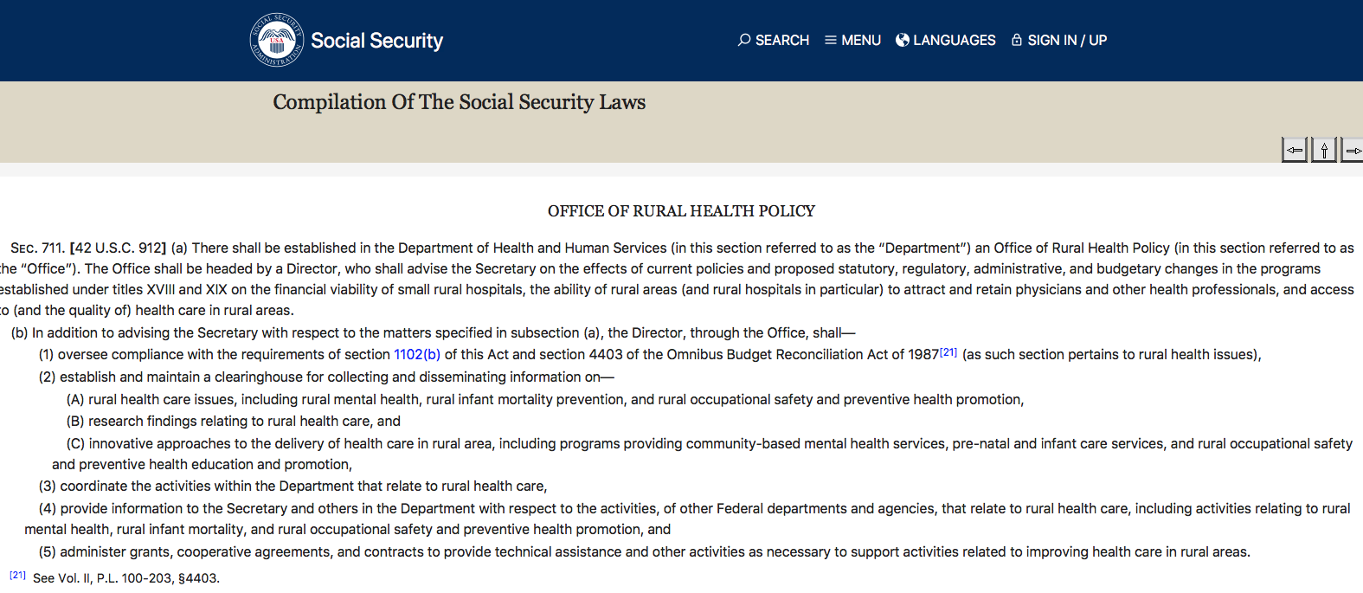
The Federal Office of Rural Health Policy
Policy Research Division (PRD)
Rural Strategic Initiatives Division
(RSID)
Community Based Division (CBD)
Office for the Advancement of Telehealth (OAT)
Hospital State Division (HSD)
Notes:
FORHP- Voice for Rural- review HHS regulations, administers Grant programs, and provide TA (policy and research role)

Slide 7
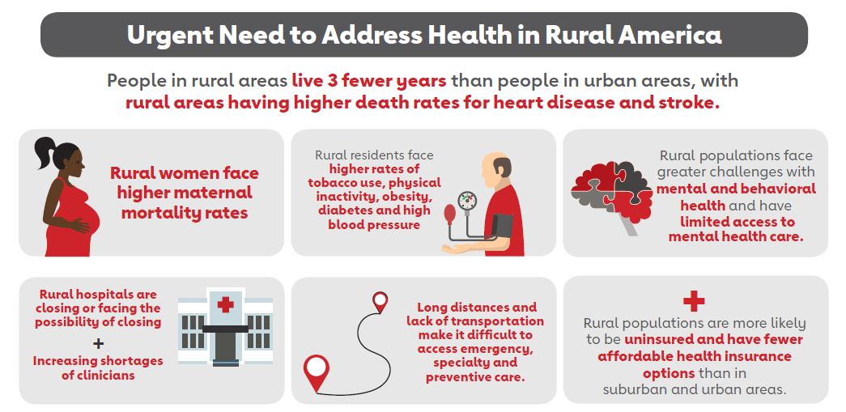
Rural Health Landscape The Oft-Cited Rural Health Concerns …

Slide 8
Workforce Funding from the American Rescue Plan Focusing solely on Rural Communities

Slide 9
Direct Technical Assistance to Hospitals and Clinics Free Services Available

Slide 10
Rural Residency Planning and Development Program (RRPD) Creating Long-Term and Sustainable Rural Residencies

Slide 11
Rural Communities Opioid Response Program Reducing OUD and SUD in Rural Communities
Notes:
FYI
The application cycle for the cooperative agreement for technical assistance (re-compete) to support RCORP grant recipients is now open with applications due on March 9, 2022. While this is a re-compete of the current RCORP technical assistance program, the scope of technical assistance to be provided has been broadened beyond substance use disorder to encompass behavioral health in alignment with the broadened scope of the RCORP initiative.
The application cycle for the RCORP-Behavioral Health Care Support grant program is now open with applications due April 19, 2022.
Please reach out to RSI Division Leadership (Megan Meacham, Allison Hutchings, Sarah O’Donnell) with any questions on these FY 2022 competitive opportunities; and please refer all applicant questions to us as well, and you may cc the RCORP inbox: ruralopioidresponse@hrsa.gov

Slide 12
Funding Opportunities Forecasted
Program | FY 2022 | FY 2023
Rural Health Care Services Outreach
Rural Health Network Development |  | Available Summer 2022 Awards Summer 2023
Rural Health Network Development Planning | Awards Summer 2022 | Available Summer 2022 Awards Summer 2023
Community Health Worker and Paraprofessional Training Program | COMING SOON
HRSA Website: https://www.hrsa.gov/grants/find-funding
Grants.gov: http://www.grants.gov/
Notes:
Rural Health Care Services Outreach Program
Three-year grant program
Provides support to promote rural health care services outreach projects utilizing evidence-based or promising practice models in order to address community-specific health concerns.
Forecasted open application date: Fall 2020
Anticipated award date: Spring 2021
Rural Health Network Development Program
The purpose of this three-year program is to support mature, integrated rural health care networks that have combined the functions of the entities participating in the network in order to address the health care needs of the targeted rural community.
Forecasted open application date: Summer 2022
Anticipated award date: Summer 2023
Rural Health Network Development Planning Program
One-year grant program
Provides support to rural communities for the implementation of activities needed to plan and develop formal and integrated health care networks such as, but not limited to, business plan development, community needs assessment, network organizational assessment, health information technology readiness assessment.
Forecasted open application date: Summer 2020
Anticipated award date: Summer 2021
Small Health Care Provider Quality Improvement Program
The goal of this 3-year grant program is to promote the development of an evidence-based quality improvement culture and to promote the delivery of cost-effective, coordinated health care services in primary care settings.
Additional goals of the program include enhanced chronic disease management and increased engagement of patients and their caregivers.
Forecasted open application date: Winter 2022
Anticipated award date: Summer 2022
Community Health Worker and Paraprofessional Training Program (CHWPTP)
CHWPTP will train community health workers and paraprofessionals to provide public health emergency response and address the public health needs of underserved communities.

Slide 13
HRSA Funding Opportunities
https://www.hrsa.gov/grants/fundingopportunities/default.aspx

Slide 14
Grants.gov
Notes:
Search Grants: There are two ways to search grants on Grants.gov – in the top right there is a search box in which you can search grant opportunities or you can click on the “Search Grants” tab at the top of the screen to look for opportunities.
Manage Subscriptions: Subscribe for a specific grant, subscribe to saved searches for grant opportunities, subscribe to all grants.

Slide 15
Rural COVID-19 Response
Notes:
FORHP has four programs focused on expanding COVID-19 response in rural communities through Medicare-certified Rural Health Clinics.
$460 million in direct payments to eligible Rural Health Clinics through the Rural Health Clinic COVID-19 Testing and Mitigation Program (ongoing)
$98 million to increase vaccine confidence to Rural Health Clinics through the Rural Health Clinic Vaccine Confidence Program (ongoing)
Over 200 Rural Health Clinics are receiving direct shipments of COVID-19 vaccines through the Rural Health Clinic COVID-19 Vaccine Distribution Program. Rural Health Clinics that are having difficulty accessing the COVID-19 vaccines they need to support their communities should contact RHCVaxDistribution@hrsa.gov or fill out this online form. (ongoing)
Rural Health Clinics can enroll and order free COVID-19 at-home self-testing supplies, N95 masks, and point-of-care testing supplies through the HRSA COVID-19 Testing Supply Program. Nearly 1,600 Rural Health Clinics have enrolled in the program since December 2021. Interested RHCs should contact rhccovidsupplies@narhc.org.
FYI. Upcoming events
May 18-20, 2022: The inaugural “National Rural SUD Health Equity and Stigma Summit” will be convened in Rochester, NY. The summit is being hosted by the University of Rochester, an RCORP Rural Center of Excellence on SUD.
June 8-10, 2022: The Fletcher Group, an RCORP Rural COE on SUD, will be hosting a meeting on rural recovery housing, the “Building Rural Recovery Ecosystems Summit,” in Memphis, TN.

Slide 16
The Opioid Crisis
The Nation is in the midst of an unprecedented opioid epidemic. More than 130 people a day die from opioid-related drug overdoses.
Prevention and access to treatment for opioid addiction and overdose reversal drugs are critical to fighting this epidemic.
HRSA supports its grantees with resources, technical assistance, and training to integrate behavioral health care services into practice settings and communities.
Notes:
The Nation is in the midst of an unprecedented opioid epidemic. More than 130 people a day die from opioid-related drug overdoses.
Prevention and access to treatment for opioid addiction and overdose reversal drugs are critical to fighting this epidemic. Primary care settings have increasingly become a gateway to better care for individuals with both behavioral health (including substance use) and primary care needs.
The Health Resources and Services Administration (HRSA) supports its grantees with resources, technical assistance, and training to integrate behavioral health care services into practice settings and communities.

Slide 17
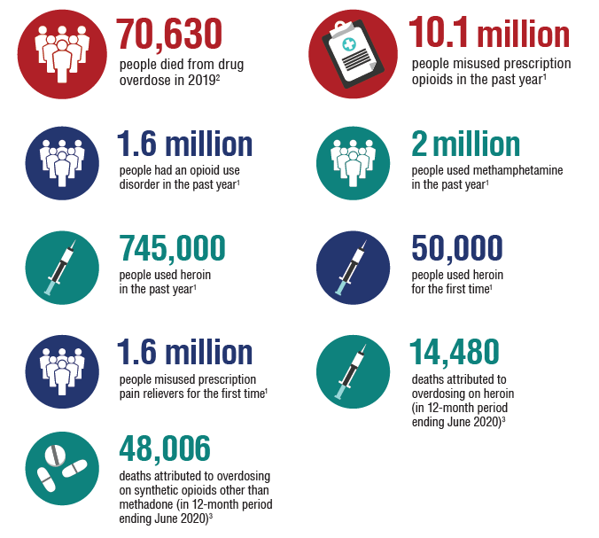
The Opioid Epidemic by the Numbers
Source: https://bhw.hrsa.gov/
Notes:
https://www.hhs.gov/opioids/sites/default/files/2021-02/opioids-infographic.pdf
In the late 1990s, pharmaceutical companies reassured the medical community that patients would not become addicted to opioid pain relievers and healthcare providers began to prescribe them at greater rates.
Increased prescription of opioid medications led to widespread misuse of both prescription and non-prescription opioids before it became clear that these medications could indeed be highly addictive.
In 2017 HHS declared a public health emergency and announced a 5-Point Strategy To Combat the Opioid Crisis
Understanding the Opioid Crisis
Opioid Crisis Devastating consequences of the opioid epidemic include increases in opioid misuse and related overdoses, as well as the rising incidence of newborns experiencing withdrawal syndrome due to opioid use and misuse during pregnancy.
Understanding the Scope of the Epidemic
Opioid Overdose Opioid overdoses accounted for more than 42,000 deaths in 2016, more than any previous year on record. An estimated 40% of opioid overdose deaths involved a prescription opioid.
Why do Adults Misuse Prescription Drugs? Policymakers can use this information from the National Survey on Drug Use and Health to help inform substance abuse prevention and treatment needs in their communities.

Slide 18
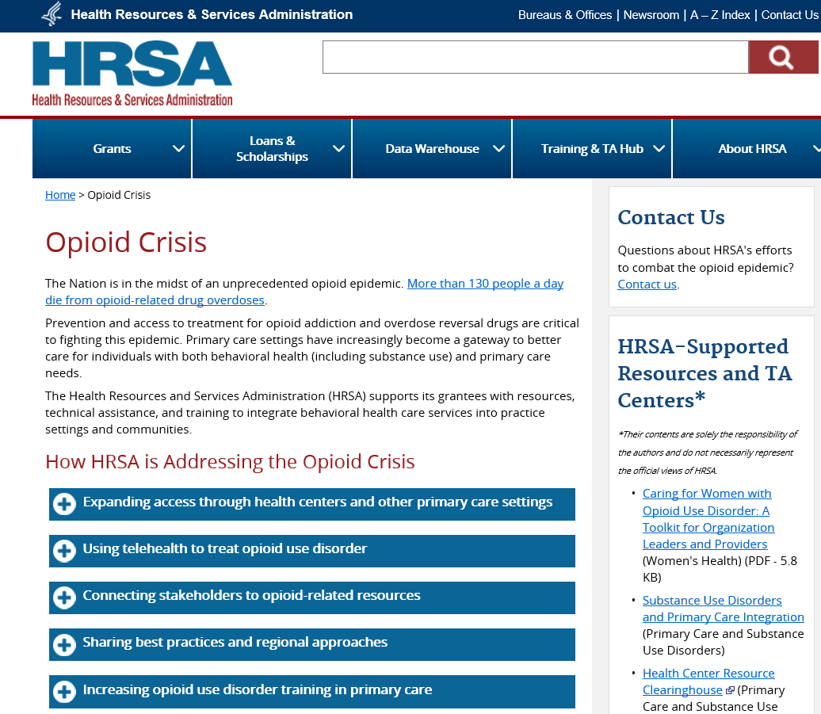
How HRSA is Addressing the Opioid Crisis
https://www.hrsa.gov/opioids

Slide 19
The Northeast Addressing the Opioid Crisis
Webinars & Meetings
Addressing the Behavioral Health Needs of Unsheltered and Underserved Populations during the Pandemic
Innovative Ways State Grantees are Improving Pediatric Mental Health Care Access
Expanding Access to Medication-Based Treatment for SUD in Underserved Rural Areas Utilizing Telehealth
Webinar Series for New York Rural Providers about Substance Use Disorder
Collaboration with SAMHSA on understanding the substance abuse crisis in Tribal Nations
Facilitating Buprenorphine training for HRSA-supported health center providers.
Mid-Atlantic Training Collaborative for Health and Human Services (MATCHHS) with a primary emphasis on behavioral health.
Behavioral Health Authority Meetings: R3 meets one-on-one with high-level state behavioral health leadership to share information about HRSA’s behavioral health programs in their states.
Notes:
IEA Sample of Activities in Regions 1, 2, and 3

Slide 20
Behavioral Health Regional Activities
Webinars
Workshops & Events
Trauma Informed Care Webinar Series for Community Health Workers
Addressing the Behavioral Health Needs of Unsheltered and Underserved Populations during the Pandemic
Suicide Prevention in Primary Care: Key Roles and New Opportunities
Innovative Ways State Grantees are Improving Pediatric Mental Health Care Access
Expanding Access to Medication-Based Treatment for Substance Use Disorder (SUD) in Underserved Rural Areas Utilizing Telehealth
School Mental Health Best Practices in Region 8
Community Health Workers – Opioid Training Workshop
Annual Kansas Opioids Conference
Provided a presentation on building a resilient workforce at the Williams James College forum on behavioral health workforce development
Presented on resiliency during the FY2021 New England Rural Health Association virtual conference
Health Center Association of Nebraska’s Opioids Summit
Region 8 SUD quarterly Technical Assistance: Moving Overdose Data into Action for State Prevention of SUD
Provided education on resiliency to federal leadership during internal workshops

Slide 21
HRSA Healthcare Workforce Programs - Behavioral Health
Graduate Psychology Education Program
Behavioral Health Workforce Education and Training (BHWET) Program for Professionals
Behavioral Health Workforce Education and Training (BHWET) Program for Paraprofessionals
Addiction Medicine Fellowship (AMF)
Nurse Education, Practice, Quality and Retention - Interprofessional Collaborative Practice Program: Behavioral Health Integration
Primary Care Training and Enhancement: Integrating Behavioral Health and Primary Care Program
_
_
_
_
_
_
Notes:
HRSA BHW programs related to BH:
Graduate Psychology Education Program
Prepares and builds capacity of the doctoral health psychology workforce to provide behavioral health care, including opioid use disorder and other substance use disorder prevention and treatment services, in high need and high demand areas.
Behavioral Health Workforce Education and Training (BHWET) for Professionals/Paraprofessionals
Aims to increase the supply of behavioral health professionals, while also improving distribution of a quality behavioral health workforce and thereby increasing access to behavioral health services.
Develops and expands community-based experiential training to increase the supply of students preparing to become peer support specialists and other behavioral health-related paraprofessionals, while also improving distribution of a quality behavioral health workforce.
A special focus is placed on children, adolescents, and transitional-aged youth at risk for behavioral health disorders in high need and high demand areas.
Addiction Medicine Fellowship (AMF)
Aims to expand the number of fellows at accredited AMF and Addiction Psychiatry Fellowship programs trained as addiction medicine specialists who work in underserved, community-based settings that integrate primary care with mental health disorder and substance use disorder prevention and treatment services.
Nurse Education, Practice, Quality and Retention - Interprofessional Collaborative Practice Program: Behavioral Health Integration
Aims to increase access to, and quality of, behavioral health services through team-based care models in interprofessional nurse-led primary care teams in rural or underserved areas. Aims to increase the training of the current and future nursing workforce, and strengthen their ability to provide integrated behavioral health care services in primary care settings through academic-practice partnerships.
Primary Care Training and Enhancement: Integrating Behavioral Health and Primary Care Program
Funds innovative training programs that integrate behavioral health care into primary care, particularly in rural and underserved settings with a special emphasis on the treatment of opioid use disorder. Aims to strengthen the primary care physician and physician assistant workforce, and promote primary care practice in underserved areas.

Slide 22
HRSA Healthcare Workforce Programs - Behavioral Health
Advanced Nursing Education Nurse Practitioner Residency Integration Program
Opioid-Impacted Family Support Program
Integrated Substance Use Disorder Training Program (ISTP)
Promoting Resilience and Mental Health Among Health Professional Workforce
Health and Public Safety Workforce Resiliency Training Program
Area Health Education Center (AHEC)
Regional Public Health Training Centers
State Loan Repayment Program
_
_
_
_
_
_
_
_
Notes:
Advanced Nursing Education Nurse Practitioner Residency Integration Program
Prepares new primary care or behavioral health nurse practitioners to work in integrated, community-based settings. Eligible applicants include accredited schools of nursing, nurse managed health clinics/centers, academic health centers, state or local governments, and other private or public nonprofit entities determined appropriate.
Opioid-Impacted Family Support Program
Supports training programs that enhance and expand paraprofessionals’ knowledge, skills and expertise, and increase the number of paraprofessionals who work on integrated, interprofessional teams to provide services to children whose parents are impacted by opioid use disorders/substance use disorders, and their family members who are in guardianship roles.
Integrated Substance Use Disorder Training Program (ISTP)
Aims to expand the number of nurse practitioners, physician assistants, health service psychologists, and/or social workers trained to provide mental health and substance use disorder, including opioid use disorder, services in underserved community-based settings that integrate primary care, mental health, and substance use disorder services.
Promoting Resilience and Mental Health Among Health Professional Workforce
Aims to establish, enhance, or expand evidence-informed or evidenced-based programs or protocols to promote resilience, mental health, and wellness among providers, other personnel, and members of the health workforce.
Health and Public Safety Workforce Resiliency Training Program
Plans, develops, operates or participates in health professions and nursing training activities using evidence-based or evidence-informed strategies, to reduce and address burnout, suicide, mental health conditions and substance use disorders and promote resiliency among health care students, residents, professionals, paraprofessionals, trainees, public safety officers, and employers of such individuals in rural and underserved communities.
Area Health Education Center (AHEC)
Regional Public Health Training Centers
State Loan Repayment Program

Slide 23
National Health Service Corps (NHSC) – Behavioral Health
NHSC Loan Repayment Program
Licensed primary care clinicians in eligible disciplines can receive loan repayment assistance through the NHSC Loan Repayment Program (NHSC LRP)
NHSC Substance Use Disorder (SUD) Loan Repayment Program
Supports the recruitment and retention of health professionals to expand access to SUD and prevent overdose deaths.
https://nhsc.hrsa.gov/loan-repayment/nhsc-sud-workforce-loan-repayment-program.html
NHSC Rural Community (RC) Loan Repayment Program
Supports providers working to combat the opioid epidemic and other substance use disorders in rural communities.
https://nhsc.hrsa.gov/loan-repayment/nhsc-rural-community-loan-repayment-program
Eligible disciplines and specialties:
_
_
_
_
_
Health Service Psychologists
Licensed Clinical Social Workers
Licensed Professional Counselors
Marriage and Family Therapists
Substance Use Disorder Counselors
Physicians (Psychiatry)
Physician Assistants (Psychiatry)
Nurse Practitioners (Psychiatry)
Psychiatric Nurse Specialists
Pharmacists
Registered nurses
_
_

Slide 24
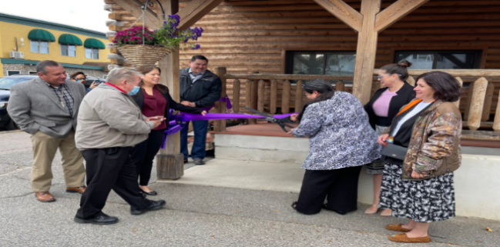
Successful Strategies
Safe Stations Academy
Opioids Marketing Campaign
Pediatric Mental Health Webinar Series
Wabanaki Public Health Culturally Based Drug Treatment and Wellness Center

Slide 25
Behavioral Health Workforce Support
Substance Use Warmline: 855-300-3595
Providers Clinical Support System (PCSS)
Rural Health Information Hub (RHIhub)
Rural Healthcare Workforce, Rural Mental Health, and Substance Use and Misuse in Rural Areas webpages
Toolkits –Mental Health, Suicide Prevention, Prevention and Treatment of Substance Use Disorders, Medication for Opioid Use Disorder
Telehealth Resource Centers
Primary Care Associations
AIDS Education and Training Center
HRSA Behavioral Health Workforce Research Center
National Center for Health Workforce Analysis
Notes:
Substance Use Warmline:
Provides free peer-to-peer consultation from physicians, clinical pharmacists, and nurses with special expertise in substance use evaluation and management.
http://nccc.ucsf.edu/clinical-resources/substance-use-resources/
Providers Clinical Support System (PCSS):
https://pcssnow.org/
Provides training and resources for primary care clinicians on the prevention and treatment of opioid use disorders and treatment of chronic pain. Includes access to coaching and mentoring
Rural Health Information Hub
The Rural Health Information Hub (RHIhub) provides toolkits that can help organizations plan by showing what has worked in rural communities.
Toolkits showcase program approaches that you can adapt to fit your community and the people you serve.
t https://www.ruralhealthinfo.org/
See recent publications from the FORHP-funded Rural Health Research Centers at https://www.ruralhealthresearch.org/publications. Recent briefs have focused on topics included skilled nursing facilities and home health agencies, cancer, and behavioral health.

Slide 26
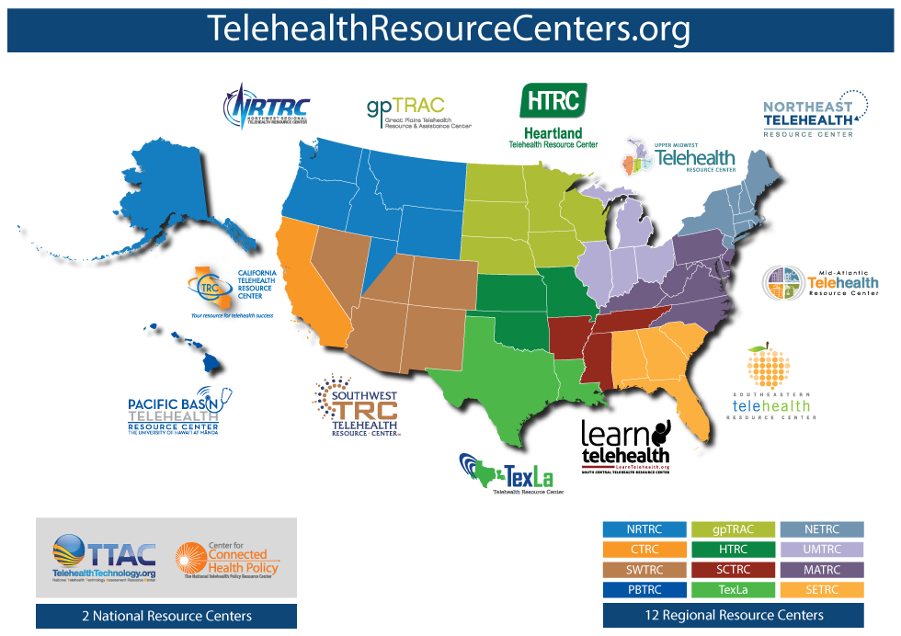
Office for the Advancement of Telehealth Telehealth Resource Centers
The purpose of the Telehealth Resource Center Program is to support delivery of telehealth technical assistance.
National Policy Telehealth Resource Center
National Technology Telehealth Resource Center
Regional Telehealth Resource Centers
In 2020, the Telehealth Resource Centers had over 10,000 technical assistance inquiries, a 350% increase over 2019
In 2020, the Telehealth Resource Centers reached 200,000 participants through 2,716 outreach events, a 200% increase over 2019

Slide 27
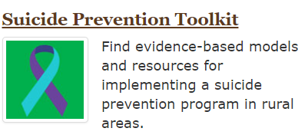
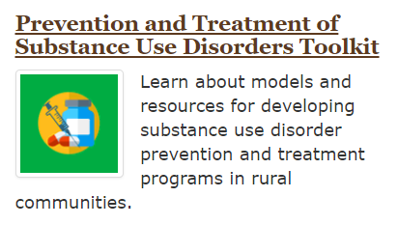
Rural Health Information Hub (RHIhub)
RHIhub - Nation’s rural health information source
library of resources
coverage of rural issues
state guides
toolkits
program models
much more!
website: https://www.ruralhealthinfo.org/
Provides customized assistance
By phone: 1.800.270.1898
By email: info@ruralhealthinfo.org

Slide 28
Network
IEA Partners & Stakeholders
HRSA Grantees
State and Local Leadership
State and Local Health Departments
Tribal Organizations
Community & Faith-Based Organizations
Colleges/Universities
Private Sector Organizations & Foundations
HHS Regional Directors/Regional Health Administrators
HHS Operating Divisions
Federal Departments or Agencies
Notes:
NOTE: These are general talking points. Feel free to modify/customize while still landing the main points.
IEA executes its work by tapping into our network.
IEA engages partners at various levels (Federal, state, community, local, grantee, etc.); brokers relationships and connect key contacts to address HHS, HRSA and other identified public health priorities. We foster strategic partnerships with State leadership, which may include the State Health Officer and other likely partners at the state level such as Ryan White Part B, MCHB Title V, State Office of Rural Health, the PCA, the PCO. We also represent HRSA on various regional workgroups.
IEA is in regular contact with HRSA Bureaus and Offices, HRSA Grantees, Governors/State Lawmakers, State Health Officers, Colleges/Universities, Tribal Organizations, Community & Faith-Based Organizations, Private Sector Organizations & Foundations, HHS Regional Directors, Regional Health Administrators, HHS OpDivs and other Federal Departments and Agencies.
IEA serves as HRSA representative for interagency workgroups and many special initiatives coming out of HHS or other federal partners.
It is important to note (as a reminder/as mentioned earlier):
A number of the other HHS OpDivs have a Regional presence, along with HRSA. Engaging with other OpDivs is a regular part of our day-to-day work(we share office space, etc…).
Explain the role of an RD and how HRSA works with the RD.
Also make note of other Federal partners in the Region, outside of HHS.

Slide 29
Connect with HRSA IEA
When should you contact IEA?
When might IEA reach out to you?
When you have questions about HRSA programs, data, policies, or resources
When you need contextual information about the regional/state landscape that may impact your stakeholders
When you are looking for a new type of partner or resources (including funding opportunities)
When you would like to share information with HRSA to inform decision making or programming
When you would like HRSA representation at a meeting or event
When HRSA has information about new funding opportunities, policies, resources, or priorities
When HRSA is convening stakeholders or brokering relationships
When HRSA is collecting information to inform an issue
When HRSA is interested in being present at a meeting or event
When HRSA is developing partnerships
Notes:
NOTE: Customize this slide based on the audience. Suggestions below.
Now that I’ve told you about IEA, here’s some suggestions about when you should contact me.
FOR STAKEHOLDERS:
When should you contact IEA?
When you would like to connect with HRSA programs
When you have questions about HRSA programs, data, policies, or resources
When you need contextual information about the regional/state landscape that may impact your stakeholders
When you are looking for a new type of partner or resource (including funding opportunities)
When you would like to share information with HRSA to inform decision making or programming
When you would like HRSA representation at a meeting or event
When will IEA reach out to you?
When IEA wants to share new information, collaborative opportunities, policies, resources, or priorities
When IEA needs more information about your program
When IEA needs to make a referral to your program
When IEA is convening stakeholders or brokering relationships and it concerns your program/stakeholders
When there is a public health emergency or has identified an issue/concern that affects your program and/or stakeholders
When is working on a project that involves your stakeholders

Slide 30
HRSA Resources
HRSA Website: www.hrsa.gov
Open Grant Opportunities at HRSA: www.hrsa.gov/grants/index.html
HRSA Data Warehouse: www.data.hrsa.gov
Primary Care Associations: https://bphc.hrsa.gov/qualityimprovement/strategicpartnerships/ncapca/associations.html
State Offices of Rural Health: https://www.ruralhealthinfo.org/organizations/state-office-of-rural-health
Community Behavioral Health/Mental Health/Substance Abuse Associations: https://www.thenationalcouncil.org/about/membership/state-association-members/
HRSA National Training and Technical Assistance Partners https://bphc.hrsa.gov/qualityimprovement/strategicpartnerships/ncapca/national-training
Telehealth Resource Centers: https://www.telehealthresourcecenter.org/
Area Health Education Centers (AHEC)
Notes:
HRSA-Supported Resources and TA Centers*
Clinician Consultation Center (Primary Care and Behavioral Health)
MCH Navigator (Maternal and Child Health)
Rural Health Information Hub (Rural Health)
SAMHSA-HRSA Center for Integrated Health Solutions (Primary Care and Behavioral Health)
TARGET Center (HIV/AIDS)
HHS Opioid Resources
AHRQ Data: Trends in Opioid-Related Hospitalizations
CDC: Guideline for Prescribing Opioids for Chronic Pain
CMS Medicare Part D Opioid Drug Mapping Tool
HHS Infographics on the Opioid Epidemic (PDF - 290 KB)
HHS Office on Women's Health Final Report: Opioid Use, Misuse, and Overdose in Women (PDF - 1.5 MB)
HHS Opioids Webpage
SAMHSA Addiction Technology Transfer Center
SAMHSA Knowledge Network
SAMHSA Medication-Assisted Treatment Waiver Training
SAMHSA Providers Clinical Support System

Slide 31
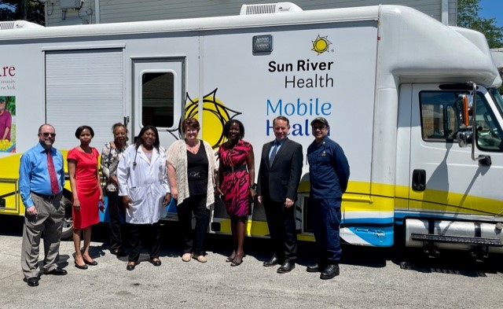
Region 2 - New York
Activities and Programs in Rural New York: 2021-2022
Collaborated with the Center of Excellence Institute for substance use disorder (SUD) webinar series:
Buprenorphine in New York State: A Clinical Overview
Harm Reduction for Health Care Providers
Rural Health Listening Session
Allegheny County
Conducted vaccination events to promote COVID-19 vaccinations in HUD communities
Oswego County
Jefferson County
Fulton County
New York Health Workforce Roundtable

Slide 32
Office of Intergovernmental and External Affairs – Region 2
Contact Information
Cheryl Donald, MA, MBA, LMFT
Regional Administrator
Email: cdonald@hrsa.gov
Phone: 212-264-2768
CAPT Chandak Ghosh, MD, MPH
Deputy Regional Administrator
Email: cghosh@hrsa.gov
Phone: 212-264-2545
CDR Wanda Pamphile, PharmD, MPH
NY Team Lead, Public Health Analyst
Email: wpamphile@hrsa.gov
Phone: 212-264-7171
Sockna Momie Cissé, MSW
Public Health Analyst
Email: scisse@hrsa.gov
Phone: 212-264-2541

Slide 33
Contact Information
CAPT Christopher Bersani, Psy.D, ABPP
Deputy Regional Administrator
HRSA Intergovernmental and External Affairs- Region 1
Email: CBersani@hrsa.gov
Phone: (617)-565-1470
Notes:
https://www.hrsa.gov/about/organization/bureaus/oro/index.html
Visit our booths at the exhibit hall tomorrow from 12:15-1pm.

Slide 34
Connect with HRSA
Learn more about our agency at:
www.HRSA.gov
Sign up for the HRSA eNews
FOLLOW US:

