Slide 1


The Impact of Adverse Childhood Experiences on Health and Wellbeing and the Importance of Providing Trauma-Informed Care
Rebecca Hoffmann Frances, LMFT
Notes:
My background
Including MaineHealth overview - rurality
And ACES work
Dyad leadership in ACES work
Community mental health/social service background to now a healthcare background
Housekeeping:
Moving through some slides quickly
Use chat box
Will end at quarter of and open it up for question but am also willing to take questions during the presentation if they pertain to that topic. I will try to keep us on course though because of the short amount of time and the amount of material.

Slide 2
Objectives
Identify adverse childhood experiences/trauma and explain the short and long-term impact they have on health and wellbeing.
Learn about trauma informed care and identify tools for becoming more trauma informed
Understand the unique challenges that rural healthcare settings face when working with patients who have a history of adverse childhood experiences and learn tools for providing trauma informed care in those settings.

Slide 3
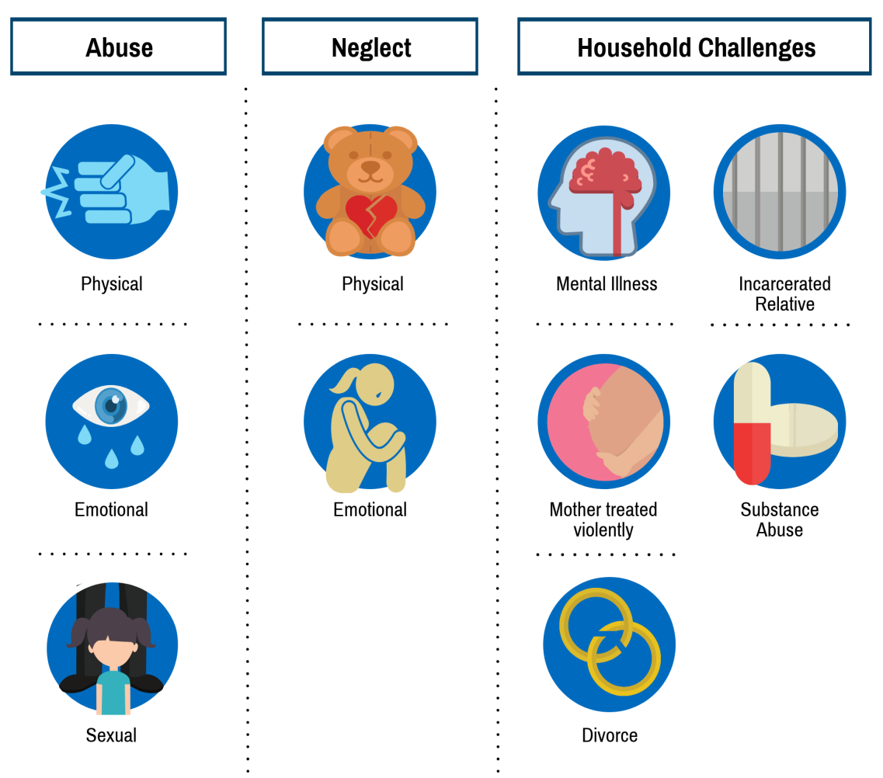

Adverse Childhood Experiences vs. Trauma
ACE are experiences that may be traumatic to children and youth during the first 18 years of life and include ten categories under abuse, neglect and household challenges. Trauma is more broadly defined by subjective experiences.
ACEs
TRAUMA
Notes:
Question for the group: Why are we talking about childhood trauma and not trauma at all ages?
SAMHSA defines trauma as: “An event, series of events, or set of circumstances that is experienced by an individual as physically or emotionally harmful or threatening and that has lasting adverse effects on the individual’s functioning and physical, social, emotional, or spiritual well-being.”
For children, witnessing an event that threatens the life or physical safety of a loved one, is also traumatic.
Event – single incident trauma (car accident, animal bite, school shooting)
Series of events – chronic trauma (abuse, neglect, living with an impaired caregiver, exposure to DV)
Set of circumstances – community violence, living in war zone, immigration
Exposure to ACE and trauma, without the interruption of resilience building protective factors, can lead to experiencing toxic stress. This is because of how trauma impacts our brain and psyche.

Slide 4
ACEs/Trauma and the Impact
An overwhelming event – witnessed or physically experienced – that threatens our physical and/or mental wellbeing
A sense of vulnerability or a loss of control
A feeling of helplessness and/or fearfulness
Impact on relationships and belief systems
Gabowitz & Konnath, 2008
Notes:
Trauma- How a person responds to a harmful event, or series of events, is now thought of as a process resulting from the interaction between the events themselves and the person, ameliorated or further undermined by their individual, familial, and community resilience or vulnerability and resources or lack thereof.
When the harmful event causes lasting suffering, the event is considered traumatic.
Trauma ruptures relationships, with oneself and others.
Trauma informed healthcare approaches M.R. Gerber (ed.)

Slide 5
Prevalence
As many as 90% of adults and 60% of youth have experienced at least one traumatic event
  Higher in the behavioral health field and with super utilizers of healthcare
37% of children have experienced more than one traumatic event
In the US, approximately five million children experience some for of trauma each year
Someone is sexually assaulted in the US every 2 minutes
Child Trauma Academy

Slide 6

Trauma and Threat Response
When there is a trauma reminder (trigger) later in life, the “thinking brain” shuts down and the “survival brain” takes over
This fight, flight, or freeze response can impact functioning
Notes:
What fires together wires together
A child’s reactions to trauma will vary depending on:
Age and developmental stage
Temperament
Perception of the danger faced
Trauma history (cumulative effects)
Adversities faced following the trauma
Availability of adults who can offer help, reassurance, and protection
Culture
Common reactions include challenges in social, emotional, behavioral and intellectual and academic functioning.
https://www.youtube.com/watch?v=ZLF_SEy6sdc

Slide 7
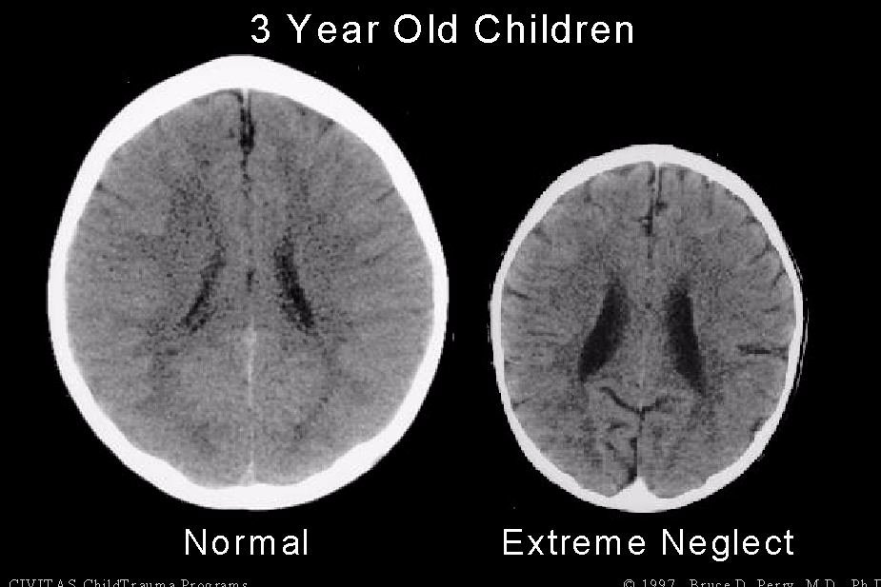
Notes:
Epigenetics= changes in organisms caused by modification of gene expression rather than alteration of the genetic code itself
Trauma can leave a chemical mark on a person’s genes, which then is passed down to subsequent generations. The mark doesn’t directly damage the gene; there’s no mutation. Instead it alters the mechanism by which the gene is converted into functioning proteins, or expressed.
Intergenerational trauma is now thought to pass intergenerationally through the immune system when a mother is pregnant. This happens through stress hormones like cortisol.

Slide 8
Resilience and Epigenetics
Biological predisposition for resilience vs. protective factors that increase resilience
Epigenetics = changes in organisms caused by modification of gene expression rather than alteration of the genetic code itself
Trauma can leave a chemical mark on a person’s genes, which then is passed down to subsequent generations. The mark doesn’t directly damage the gene; there’s no mutation. Instead it alters the mechanism by which the gene is converted into functioning proteins, or expressed.
Notes:
https://www.youtube.com/watch?v=3Ytt7QQ9_4o&app=desktop

Slide 9
Brief Overview of ACE Study
Examines the health and social effects of Adverse Childhood Experiences (ACE)
10-item questionnaire about occurrence of adversities in childhood such as abuse and neglect
About 17,000 adults participated; homogeneous group
Two-thirds reported at least one ACE
1 in 5 participants reported 3 or more ACEs
Found link between traumatic experiences in childhood and health risk behaviors and health problems as adults
Anda et al, 2006
Notes:
ACE study:
conducted by Kaiser Permanente and CDC in 1998
Asked questions about 10 pervasive adverse events, within the caregiving system
17,000, mostly white, middle to upper class, college-educated adults
2/3 reported at least one ACE
1 in 5 reported 3 or more ACE
Significant health implications when reach 4 or more ACE
The number of ACE is associated with adult high risk health behaviors such as smoking, alcohol and drug abuse, promiscuity and severe obesity and is correlated with depression, heart disease, cancer, chronic lung disease and shortened lifespan.
There is a dose-response relationship with many health problems; a person’s cumulative ACE score has a strong relationship to numerous health, social and behavioral problems throughout the lifespan, including substance abuse disorders.

Slide 10
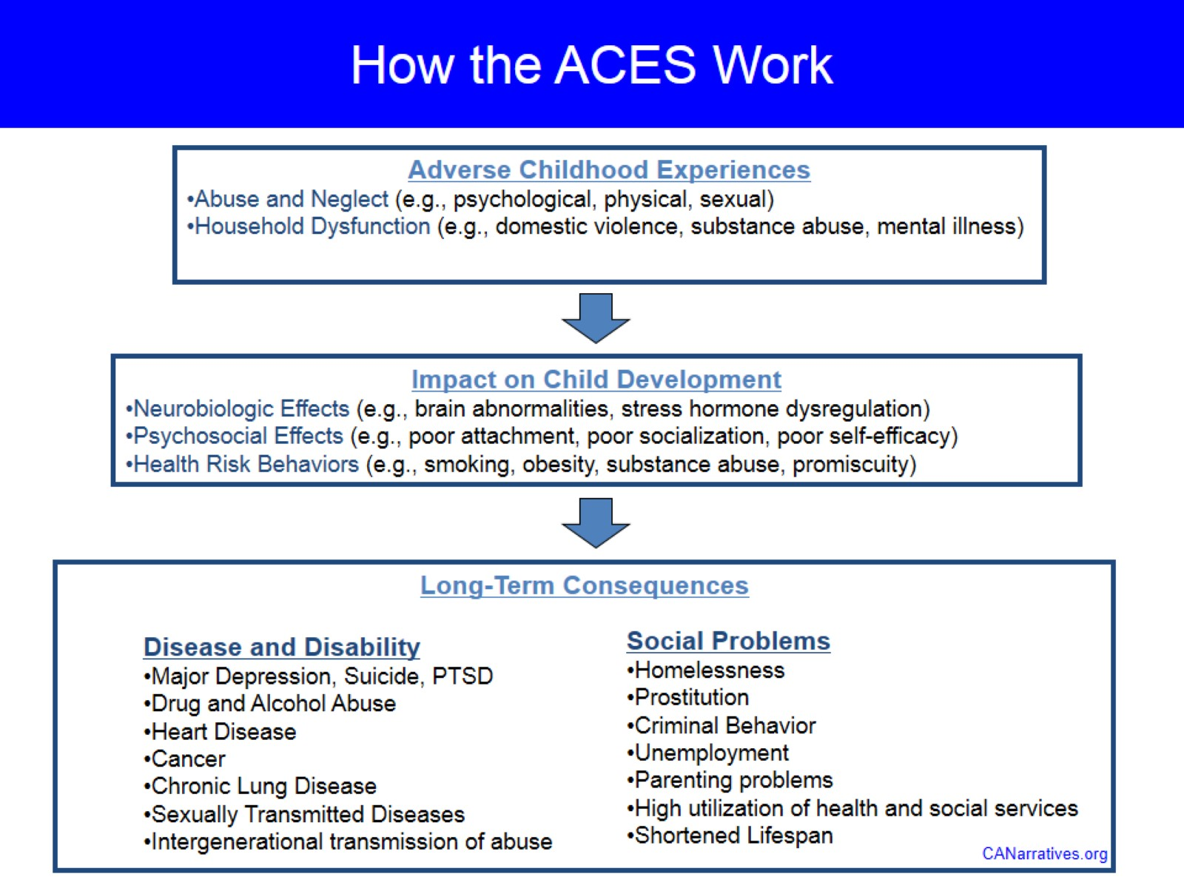
Notes:
By the time they reach high school, one quarter of all Maine students have experienced three or more Adverse Childhood Experiences (ACEs). Recent research suggests that communities with higher ACE scores also have higher rates of suspension, unexcused absences, and lower rates of graduation.

Slide 11
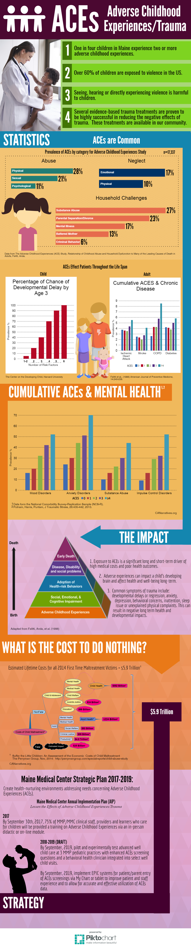
Notes:
RAPID FIRE
If you have three or more adverse experiences as a child your risk for heart disease is HIGHER than it is if you smoke

Slide 12
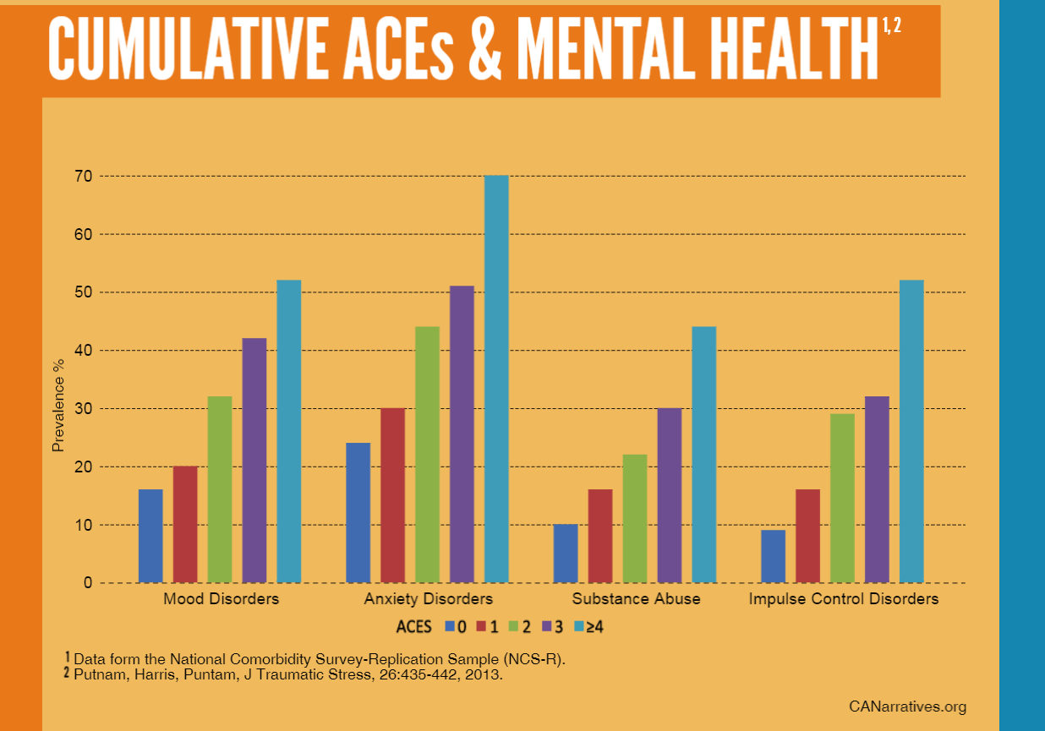
Notes:
Children who have experienced trauma are up to 5000% more likely to:
Attempt suicide
Use IV drugs
Develop an eating disorder
Mothers who had four or more ACEs were 12 times more likely to report very low food security or hunger.
Childrens Health Watch

Slide 13
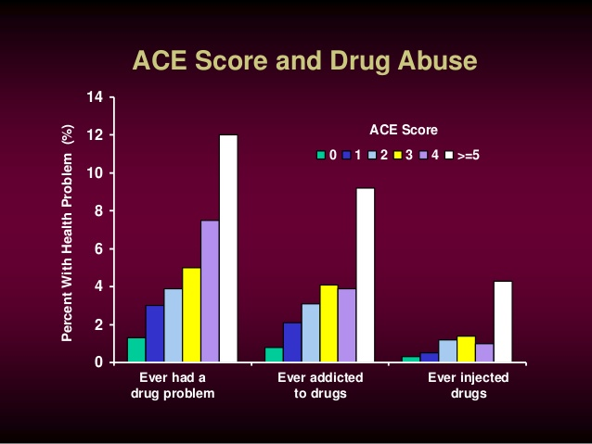

Slide 14
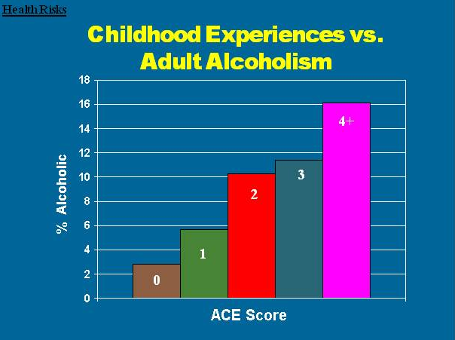
Notes:
Children with an ACE score of 5 are 8 times greater chance of being an alcoholic
Those with an ACE score of 6 on average die 20 years earlier

Slide 15
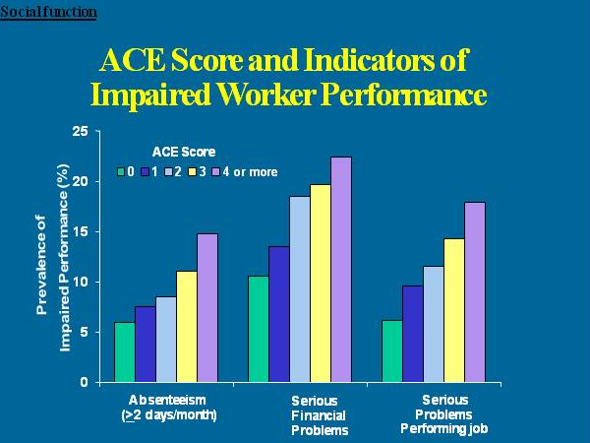
Notes:
Childhood Exposure and Indicators of Worker Performance Job-related problems were reported by 11.5% of the study cohort; financial problems were reported by 15.5%; and absenteeism, by 8.7%. Each of the eight adverse childhood experiences was associated with an increased likelihood of job problems, financial problems, and absenteeism (Table 2).

Slide 16
Solution: Trauma-Informed Care
SAMHSA definition: a strengths-based service delivery approach that is grounded in an understanding of and responsiveness to the impact of trauma, that emphasizes physical, psychological, and emotional safety for both providers and survivors, and that creates opportunities for survivors to rebuild a sense of control and empowerment
Trauma-informed care = Universal Precaution
  Everyone is a potential trauma survivor (including those working within an organization or system and those served by that system)
SAMHSA (2019)

Slide 17
Trauma-Informed Approach
An organization or system that is trauma-informed:
realizes the widespread impact of trauma and understands potential paths for recovery
recognizes the signs and symptoms of trauma in clients/patients, families, staff, and others involved with the system
responds by fully integrating knowledge about trauma into policies, procedures, and practices, and
seeks to actively resist re-traumatization
SAMHSA (2014)
Notes:
Building trauma-informed =building a more healing system of care.

Slide 18
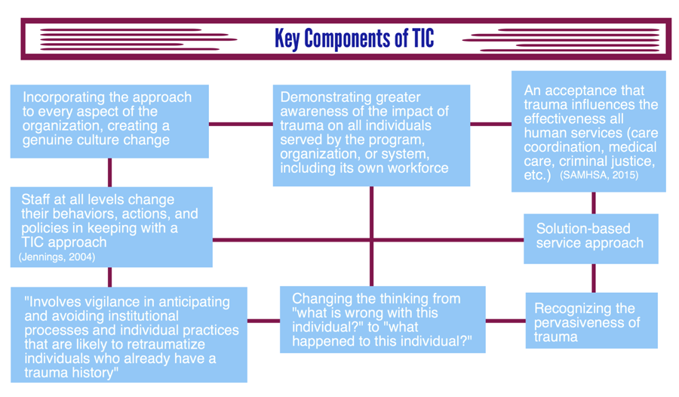
Chart by the Institute on Trauma and Trauma-Informed Care (2015)
Notes:
What happened to you OR what continues to happen to you?
Focus is on recognizing and accepting symptoms and health-risk behaviors as strategies developed to cope with exposure to trauma
Trauma affects how people approach services
The service system has often been retraumatizing
Example: Patient late for appts

Slide 19
The Continuum
Trauma
Aware
Trauma
Sensitive
Trauma Responsive
Trauma
Informed
Didactic
Focused on learning about the individual impact of trauma
Begin to see risk factors
Focused awareness at the system or agency level
Recognize the trauma impact on more than the individual
Planning and taking action
Integration of principles into staff behavior and practices
Integration into organizational structures
Measuring impact
Revision of policies and procedures
Fidelity to TI
Program assessments
Reduce stigma of trauma
Build community!
Notes:
Becoming trauma-informed is a journey, rather than a fixed set of interventions, that is guided by one’s trauma-informed mission and foundational principles.
Involves developing a shared understanding that maladaptive behaviors OR ways of relating often have their roots in traumatic experiences promotes a climate of compassion and respect.
RECIPE TO GET TO TRAUMA INFORMED:
A champion who recognizes importance and is able/willing to move it forward.
A significant staff team who are willing and ready to change.
A practice environment that supports open, honest questions, dialogue, feedback, and confidentiality.
Opportunities to educate staff throughout implementation.
Established goal or vision: what do you want to accomplish?
Financial resources to support practice change.

Slide 20
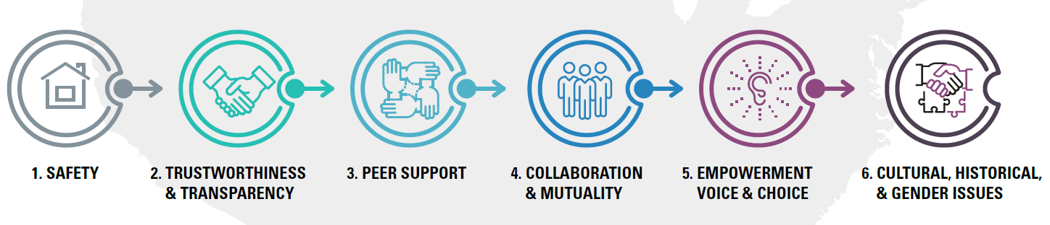
Trauma-Informed Principles
CDC (2019)

Slide 21
Trauma-Informed Care Principles
Safety:
  Throughout the organization, staff and the people they serve, whether children or adults, feel physically and psychologically safe; the physical setting is safe and interpersonal interactions promote a sense of safety. Understanding safety as defined by those served is a high priority.
Trustworthiness and Transparency:
  Organizational operations and decisions are conducted with transparency with the goal of building and maintaining trust with clients and family members, among staff, and others involved in the organization.
CDC (2019)
Notes:
Safety – A person’s definition of safety may not be the same as yours or mine
Trustworthiness -Trust extends to patients, staff, and management.

Slide 22
Trauma-Informed Care Principles
Peer Support:
  Peers are people with lived experience.
  Peer support and mutual self-help are key vehicles for establishing safety and hope, building trust, enhancing collaboration, and utilizing stories and lived experience to promote recovery and healing.
Collaboration and Mutuality:
  Importance is placed on partnering and the leveling of power differences between staff and clients and among organizational staff from the top down.
  Organization recognizes everyone has a role and all roles are important.
  Healing happens in relationships and in the meaningful sharing of power and decision-making.
CDC (2019)
Notes:
Mutuality = Reciprocity
In a mutual exchange one is both affecting the other and being affected by the other; one extends oneself out to the other and is also receptive to the impact of the other. There is openness to influence, emotional
availability, and a constantly changing pattern of responding to and affecting the other’s state.
All members of the team, including patients/clients, are equal.

Slide 23
Trauma-Informed Care Principles
Empowerment, Voice, and Choice:
Identifying individual strengths and differences and utilizing them as the foundation for recovery and healing
Understanding those involved in running the organization, those who provide services, and those who seek services may all have trauma histories
Operations, workforce development, and services are organized to foster empowerment for staff and those served
    All are supported in shared decision-making, choice, and goal-setting and staff are empowered to do their work by having adequate organizational support
    Allow patients/clients choice in every possible aspect of care
CDC (2019)
www.nursingcenter.com
Notes:
Shared decision making = sense of power and control
Which was the very thing taken away when trauma happened

Slide 24
Trauma-Informed Care Principles
Cultural, Historical, and Gender Issues:
  Organization moves past cultural stereotypes and biases
  Organization offers access to gender responsive services, leverages the healing value of cultural connections and incorporates policies and procedures that are responsive to ethnic, racial and cultural needs of staff and those the organization serves

Slide 25

Communicate with families in respectful, open, supportive ways
All staff and providers can help engage families at the start of the visit.
Focus on family strengths as well as problems and concerns
Relationships with service provider that foster trust can:
  Influence clinical outcomes
  Reduce barriers to appropriate mental health care
  Improve identification of mental health issues
Source: Pediatric Integrated Care Collaborative. John Hopkins University (2017)

Slide 26
Strategies
Greet Everyone
Be Self-Aware
Develop Interpersonal Supportive Techniques
State Your Role
Ask Open Ended-Questions
Recognize stress
Address stressors
Agree on next steps
Source: Pediatric Integrated Care Collaborative. John Hopkins University (2017)
Notes:
Examples:
1. Ask every patient what can be done to make them more comfortable during their appointment.
2. Before the physical exam, explain what parts of the body will be involved and allow the patient to ask questions.
3. Give the patient the option to shift their clothing out of the way instead of putting on a gown.
4. Provide a pillow for back support for patients who are anxious in the supine position.
5. If a patient seems moderately to highly anxious, offer ways for patients to signal distress either verbally or by raising their hand during a procedure.
Give up the mind-set of needing to make things right to focus on what solutions may come from the patient and family.

Slide 27
Educate staff and community partners about trauma and trauma informed care
Educate on trauma and impact of trauma on families
Understand importance of addressing trauma in all settings
Conduct a trauma-informed organizational assessment – completed by staff and consumers
Source: Pediatric Integrated Care Collaborative. John Hopkins University (2017)
Notes:
Understanding the health effects of trauma:
1. Understand that poor coping mechanisms, such as smoking, substance abuse, overeating, and high-risk sexual behavior, may be related to trauma history.
2. Engage with patients in a collaborative, non-judgmental manner when discussing health behavior change.
Develop awareness of your own biases. Patients are always looking for signs of judgement and can sense it often before you can.

Slide 28

Strategies
Educational Materials at staff meetings, staff newsletters, communications
Staff training time (formal and informal discussion)
Build knowledge in the community – all speaking the same language
Facilitate and engage in challenging conversations
Collect and use data
Source: Pediatric Integrated Care Collaborative. John Hopkins University (2017)
Notes:
Data example- Aces project

Slide 29

3. Create and support a healthy office environment
Make the office inviting
Provide materials on trauma-related health, mental health conditions, and ways to deal with stress
Recognize and address self-care needs of staff
  Normalize burnout and compassion fatigue
  Actively support staff self-care strategies
Source: Pediatric Integrated Care Collaborative. John Hopkins University (2017)

Slide 30
Strategies
Reflect community being served
Identify places to sit away from others
Communicate that you are trauma-informed and are committed to creating a safe space to heal
Be the first to talk about the impact of trauma. Do not wait for patient/client to bring it to you.
Provide self-care opportunities for staff
Model self-care and healthy work life boundaries
www.nursingcenter.com
Notes:
Danger and safety are core concerns for trauma survivors

Slide 31
4. Address trauma exposure
Routine screening for trauma events and reactions
Educating patients and families about trauma, traumatic stress, and treatment options
Secondary trauma support for staff
Notes:
Discharge instructions
Age based pamphlets that normalize trauma

Slide 32
Strategies
Decide if your organization will screen for current trauma or a history of traumatic events.
Consider if screenings will be face-to-face or self-reported by the patient.
Provide all staff with communication skills training about how to discuss a positive trauma screening with a patient.
Ensure your organization has the resources available to properly care for the patient, or have processes in place to refer patients to other resources.
Develop referral relationships with other organizations, keep a list of referral options
Provide warm hand-offs
Invest in training clinicians in evidence-based trauma treatment or identify those in the community who provide it
Provide secondary trauma support for staff – occupational hazard
www.nursingcenter.com
Notes:
Warm handoffs - Only around 10% of referrals actually turn into a connection to services
Secondary trauma - Reflect on your own trauma history (if applicable) and how it might influence patient interactions.

Slide 33
Challenges within rural settings
Higher rates of many medical, social, and psychological issues
Isolation exacerbates challenges
“Stranglehold of generational poverty”
Sometimes safety equals anonymity
Lack of access to evidence-based trauma treatment/experienced providers
Very few people with very full job descriptions- hard to add more to plates
Lack of training funds or availability of TIC training in rural areas (training is the often the first item that gets cut from a budget)
Access to services is already a challenge in rural areas, trauma increases barriers to access
Organizational stress is a barrier to implementing TIC
Krul, S. (2016) Trauma Informed Care In Rural Areas
Notes:
Staff training - More and more social service non profits are having to direct their budgets toward service provision so staff training gets caught.

Slide 34
Tools for rural settings
Maintain clear and transparent boundaries
Highlight trauma awareness and trauma informed movement
Partner with other organizations to expand client choice
Co-locate to increase anonymity
Don’t worry about “turning primary care doctors into psychiatrists”
Telehealth or telephone consult service
Create algorithms for responding –who to call when
Identification is intervention, especially in adults – finding the “why” behind the “what”
Share training resources
Legislation with funds included
www.ruralhealthinfor.org
Notes:
Are not trying to change someone’s specialty. Trying to give them awareness, and then tools to respond.
You do not need to be a cardiologist to lay a stethoscope on someone’s chest. Nadine Burke Harris
Telephone consult - Psychiatry Access Program – psychiatrist available by phone for consult

Slide 35
https://youtu.be/5lbUB8JS45g
Notes:
https://youtu.be/5lbUB8JS45g
Proven benefits of a trauma-informed approach:
1. Improved Client/Patient Outcomes
2. Increased Staff Satisfaction and Engagement
3. Been shown to reduce the need for crisis intervention services
4. Housing permanence improved
Working with people who have experienced trauma can be rewarding, but extremely challenging. You may not understand why a person behaves in certain ways. Be patient with yourself and those you serve.
Recognize that change happens very slowly.
You may never see the outcomes of your efforts.
Trust that our simple compassionate gestures are important elements to healing and surviving.

Slide 36
Please complete the course evaluation:
https://nysarh.org/webinar-evaluation/
Thank you!

