Slide 1
Veteran Rural Health Services
Sponsored by

Slide 2
Panelists
Richard Kazel, Syracuse VA Medical Center
Carolyn Turvey, Veterans Administration Office of Rural Health
Nicole Costa, Behavioral Health and Case Management
Derek Coy, New York State Health Foundation

Slide 3
Department of Veterans Affairs
Welcome

Slide 4
Department of Veterans Affairs
Overview
Federal Cabinet Level Agency
2nd largest Federal budget next to the DoD
Annual budget over $230 billion/year
170 Medical Centers
773 Community Based Outpatient Clinics
135 Community Living Centers
260 Vet Centers
8.76 million Veterans enrolled
97 million outpatient visits per year

Slide 5
Department of Veterans Affairs
Three Main Administrations
Veterans Benefit Administration
National Cemetery Administration
Veterans Health Administration

Slide 6
MISSON STATEMENT
Our Mission is
to care for our Veterans with compassion and excellence.

Slide 7
VA VISION
Our Vision is
to be the health care provider of choice, achieving the highest quality in health care delivery, education and research.

Slide 8
Department of Veterans Affairs
Four major dates
1989 – Cabinet level designation
1995 – 2000 – Major reform under Deputy Under Secretary for Health, Kenneth Kizer, MD, Ph.D.
2014 – Phoenix, Arizona VAMC
2019 – Mission Act implemented

Slide 9
VISN 2
12 Medical Centers all in New York State and New Jersey State
43 Community Based Outpatient Clinics
16 Vet Centers
8 National Cemeteries
2 Regional Offices

Slide 10
Department of Veterans Affairs
Top Priorities for VHA
Greater choice for Veterans
Modernize Systems
Focus resources more efficiently
Improve timeliness of service
Suicide prevention

Slide 11
Network 2
Website
Visn2.va.gov
This site contains access to a multitude of sites that will provide greater detail in all areas covered by these slides.

Slide 12
Rural Health for Veterans
VETERANS HEALTH ADMINISTRATION
Presentation for: NY State Association of Rural Health Presented by: Carolyn Turvey, PhD
Date of briefing: September 2019

Slide 13
Today’s presentation
U.S. Department of Veterans Affairs and the Office of Rural Health (ORH)
Rural Veterans in New York
MISSION Act
Closing/Q&A
Notes:
Thanks so much for asking me here today to talk about ORH and our constituents—rural Veterans.
I want to talk about what we do today, but I also want to spend some time explaining the why and the how—why ORH was created, how it was created, and how we are structured to accomplish our strategic goals.
Lets talk first about what we face and why the office of rural health came into being…

Slide 14
ORH Organization

Slide 15
Rural health Legislative mandate
Notes:
ORH was created by legislative mandate in 2006 through the efforts of a few very motivated VSOs and some important senators from rural states. The idea was, frankly, that rural Veterans didn’t have equal access to care, and an office specifically focused on them would serve to highlight and address access shortfalls.
This legislation remains in effect until today, and was amended in 2012 when ORH’s Veterans Rural Health Resource Centers were formalized by legislative act.
Not only is research essential to the progression of health care, it’s imperative to VA’s efforts to increase rural Veterans access to care – as directed by our Legislative mandate… “conduct, coordinate, promote and disseminate research” is front and center in our charge.
Our other major responsibility is to develop and promulgate best policy, best practices, and innovative and successful programs.
38 U.S. Code § 7308 - Office of Rural Health - https://www.law.cornell.edu/uscode/text/38/7308#
(a)Establishment.— There is established in the Department within the Office of the Under Secretary for Health an office to be known as the “Office of Rural Health” (in this section referred to as the “Office”).
(b)Head.— The Director of the Office of Rural Health shall be the head of the Office. The Director of the Office of Rural Health shall be appointed by the Under Secretary of Health from among individuals qualified to perform the duties of the position.
(c)Functions.—The functions of the Office are as follows:
(1) In cooperation with the medical, rehabilitation, health services, and cooperative studies research programs in the Office of Policy and the Office of Research and Development of the Veterans Health Administration, to assist the Under Secretary for Health in conducting, coordinating, promoting, and disseminating research into issues affecting veterans living in rural areas.
(2) To work with all personnel and offices of the Department of Veterans Affairs to develop, refine, and promulgate policies, best practices, lessons learned, and innovative and successful programs to improve care and services for veterans who reside in rural areas of the United States.
(3) To designate in each Veterans Integrated Service Network (VISN) an individual who shall consult on and coordinate the discharge in such Network of programs and activities of the Office for veterans who reside in rural areas of the United States.
(4) To perform such other functions and duties as the Secretary or the Under Secretary for Health considers appropriate.
(d)Rural Health Resource Centers.—
(1) There are, in the Office, veterans rural health resource centers that serve as satellite offices for the Office.
(2) The veterans rural health resource centers have purposes as follows:
(A) To improve the understanding of the Office of the challenges faced by veterans living in rural areas.
(B) To identify disparities in the availability of health care to veterans living in rural areas.
(C) To formulate practices or programs to enhance the delivery of health care to veterans living in rural areas.
(D) To develop special practices and products for the benefit of veterans living in rural areas and for implementation of such practices and products in the Department systemwide.
(Added Pub. L. 109–461, title II, § 212(a)(1), Dec. 22, 2006, 120 Stat. 3421; amended Pub. L. 112–154, title I, § 110, Aug. 6, 2012, 126 Stat. 1175.)

Slide 16
Office of Rural Health’s Goals
Notes:
Our strategic plan is focused on rural Veterans and the communities in which they live, and each of these goals grows directly out of our legislative mandate. In order to accomplish the objectives that grow out of these strategic goals, we rely on our collaborative partners inside and outside VHA. We manage and engage those partners across our organization, which looks like this

Slide 17
snapshot of rural veterans
Data are FY 2017 VA Internal Data Sources, US Census Bureau and VHA Survey of Enrollees
Notes:
22% of the General Population does not access the internet at home (Pew Research, 2016)
The top five states with the highest numbers of enrolled rural Veterans are California (71%), Texas (53%), New York (49%) Florida (47%) and Pennsylvania (46%). SOURCE: Urban_Rural Veterans_VetPop2016]
323M people in the United States / SOURCE: U.S. Census Bureau (2016)
60M live in rural areas (19%) / SOURCE: U.S. Census Bureau (2015)
18.5 (19M) Veterans in the United States / SOURCE: U.S. Census Bureau; American Community Survey (FY16)

Slide 18
ORH Program Overview
2019 portfolio includes 55 national access initiatives adopted at 99 percent of VA health systems across the country
All are designed to increase access to care for rural Veterans
Rural Promising Practices are field-tested, innovative projects that meet ORH criteria demonstrating increased access to care for rural Veterans
Six in mentored implementation spread to more than 50 sites across VA
Enterprise-Wide Initiatives enable VA to rapidly address systemic health care and access challenges experienced by Veterans in rural communities and expand national program office access efforts to sites serving rural Veterans
ORH leverages resources to study, innovate and spread Enterprise-Wide Initiatives through local and national partnerships
Notes:
Since 2012, ORH has funded $2.1B in projects [SOURCE: Mike Privman, ORH Budget Analyst, January 2019]
Number of EWIs for 2019: 55 (includes six Rural Promising Practices) [Kelly Lora Lewis, Senior Program Analyst, January 2019]
Promising Practices criteria: increased access; evidence of clinical impact; customer satisfaction and patient experience; return on investment; operational feasibility; strong partnerships and/or working relationships

Slide 19
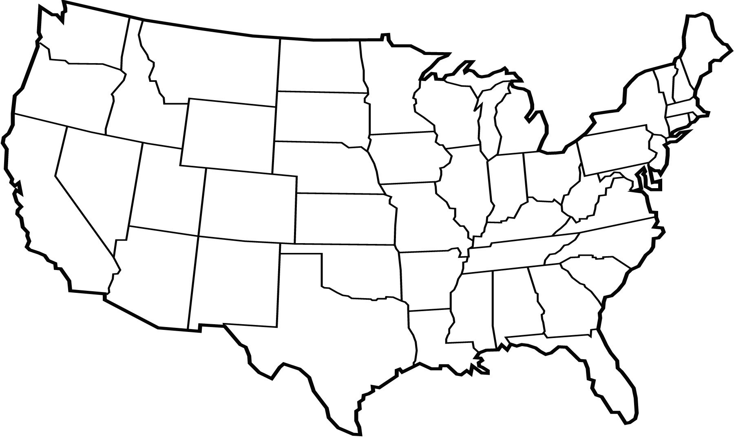
Current and proposed Veteran Rural Health Resource Centers (VRHRC)
VRHRC, Portland, OR
VRHRC, White River Junction, VT
Clinical Director: Travis I. Lovejoy PhD, MPH
Operations Director: Sarah Ono, PhD
Director: Matthew Vincenti, PhD
Matthew.Vincenti@va.gov
VRHRC, Iowa City, Iowa
Clinical Director: Carolyn Turvey, PhD Operations Acting Director: Samantha Solimeo, PhD, MPH ORH-CR@va.gov
Office of Rural Health Headquarters
Executive Director: Thomas F. Klobucar, PhD
Deputy Director: Sheila R. Robinson, DHA
VRHRC, Salt Lake City, Utah
Clinical Director: Byron Bair, MD
Operations Director: Nancy Dailey, MSN, RN
ORH-WR@va.gov
VRHRC, Gainesville, FL
Clinical Director: Keith Myers, DPT
Operations Director: Sergio Romero, PhD

Slide 20
Rural health Resource Centers Legislative mandate

Slide 21
Office of rural health overview
$270M total annual budget
FY 2019 portfolio includes 50+ Enterprise-Wide Initiatives adopted at 99% of VA medical centers across the country and U.S. territories
ORH Enterprise-Wide Initiatives | Fiscal Year 2017 | Fiscal Year 2018 | Fiscal Year 2019 (Projected)
Veterans Served | 1.5M | 2.5M | 2.65M
VHA Sites Served | 402 | 575 | 600
Expenditures | $208M | $248M | $251M
Notes:
We went through an exercise in late December 2018 wherein we asked our PO partners to project what their programs could be in an ideal world. In the end, that exercise prompted ORH to ask for a budget increase for the first time in our history—to $327 million in FY 18 and nearly $350 million in FY 19. naturally, we were turned down. But what this underscores is how wildly successful our enterprise wide initiatives have become, thanks to you and our other partners like you.
So lets take a graphic look at those enterprise wide initiatives
NOTE: (One caveat is that the list may include approved, but not operational sites)

Slide 22
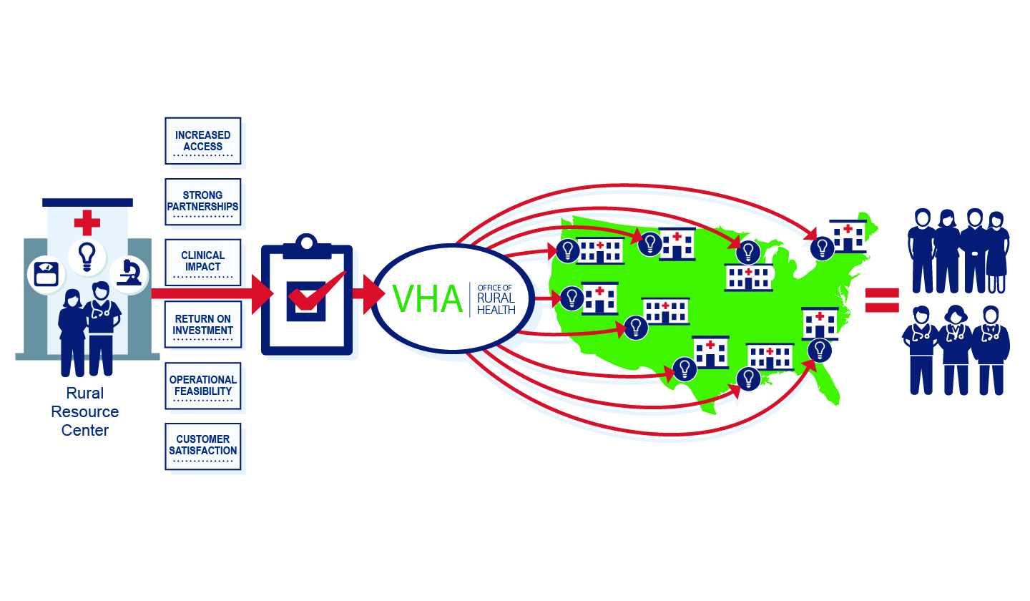
ORH Rural Promising Practices
Notes:
Our resource centers give birth to our ORH Rural Promising Practices through study, issue identification, innovation, evaluation, and modification when needed. It is only then that new programs are evaluated by a third party to see if they meet these criteria: increased access; evidence of clinical impact; customer satisfaction and patient experience; return on investment; operational feasibility; strong partnerships and/or working relationships
Explain process… point out where in the process RESEARCH IS NEEDED
Highlight how Veterans Rural Health Resource Centers were built on a research model based on the HRS&D structure

Slide 23
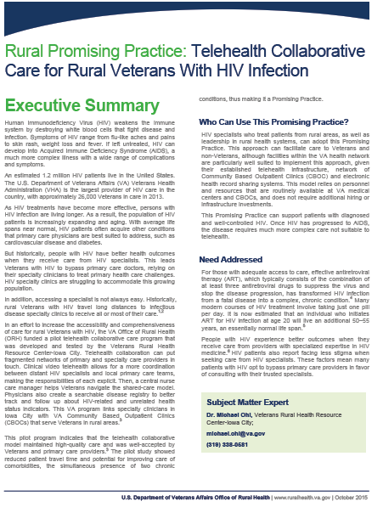
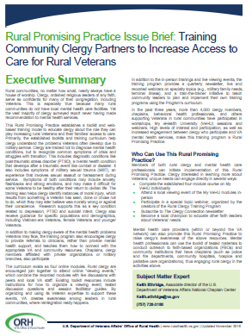
rural promising practices
Mentored implementation support
Clinical Video Telehealth Comprehensive Care to Veterans with Multiple Sclerosis
Community Clergy Training to Support Veterans’ Mental Health
Geriatric Scholars Training Program
Geriatric Research, Education, and Clinical Center Consultation Services
Remote, Home-Based Delivery of Cardiac Rehabilitation
Telehealth Collaborative Care for Rural Veterans with HIV Infection
One-page fact sheets and in-depth issue briefs on each
Rural Promising Practice
are available online at https://www.ruralhealth.va.gov/providers/promising_practices.asp
Notes:
Criteria:
1. Increased Access – The approach brings about measurable increases in access to care or services, for example, by reducing wait time or missed appointments.
2. Strong Partnerships – The approach creates partnerships and maximizes efficiency.
3. Clinical Impact – Results of the approach are proven and positive on the health of rural Veterans.
4. Return on Investment – The approach reduces the per capita costs of delivering care or services, while maintaining or improving outcomes.
5. Operational Feasibility – Implementation of the approach is feasible and strategies for success can easily be shared.
6. Customer Satisfaction – The approach demonstrated Veteran, provider, partner and caregiver satisfaction.

Slide 24
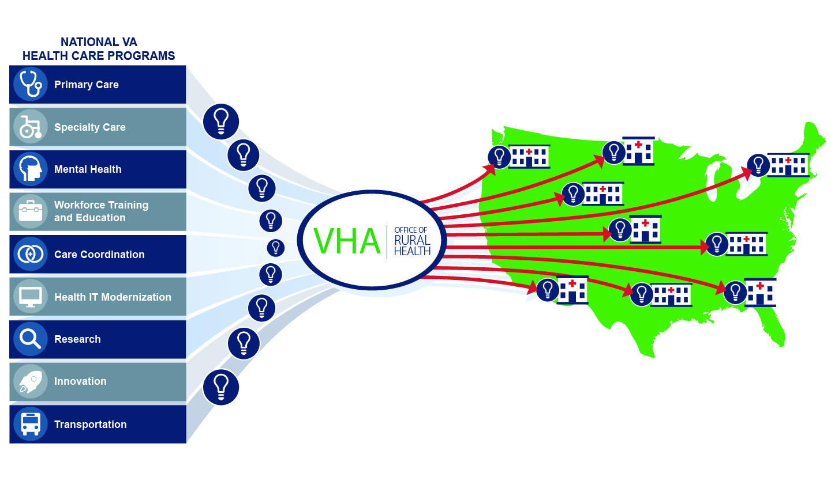
Enterprise-Wide Initiatives

Slide 25
Enterprise-Wide Initiative highlights
Teleprimary Care
establishes teleprimary care hubs with spoke sites to ensure access to primary care in rural areas where providers are unavailable
Telemental Health Hubs
connect mental health specialists with rural-serving sites where Veterans require same-day or urgent access to mental health services and where access is limited due to provider shortages or other barriers
TeleIntensive Care Unit (ICU)
connects VA facilities that do not have intensivists on staff with VA intensivists nationwide via telehealth to increase access to ICU services and specialty inpatient care for rural Veterans
Telerehabilitation Services
expands an integrated network of specialists who are specifically trained in delivering physical and rehabilitative therapy to rural Veterans using telehealth technology
National Telestroke Program
provides emergent telehealth care by qualified stroke neurologists in a timely manner to Veterans presenting symptoms of stroke at rural-serving VAMCs that do not have stroke neurologists on site
National Teleradiology Program
provides rural VA facilities with 24-hour diagnostic image interpretation, including access to sub-specialty radiologists within the VA

Slide 26
2019 Enterprise-Wide Initiatives
Advanced Care Planning via Group Visits
Clinical Pharmacy Specialist Providers
Clinical Skills Training in Women Veterans Health Care
Clinical Video Telehealth to Provide Comprehensive Care to Rural Veterans with Multiple Sclerosis
Community Clergy Training to Support Rural Veterans Mental Health
Genomic Counseling Services for Rural Facilities
Geriatric Research Education and Clinical Center Connect Program
Geriatric Scholars Program
Gerofit
Home Based Primary Care
Lung Cancer Screening
Medical Foster Home
Military Sexual Trauma Web Based Therapy
National Teleradiology Program
National Telestroke Program
Patient Aligned Care Team Health Advocate, Scribe
Precision Oncology
Remote Home Based Delivery of Cardiac Rehabilitation
Rural Access Network for Growth Enhancement
Rural ChooseVA Access Evaluation
Rural Faculty Development
Rural Health Community Coordinator Health Information Exchange
Rural Health Training Initiative
Rural Suicide Prevention
Rural VA Innovators Network
Rural Veteran Telerehabilitation Initiative
Simulation Learning for Suicide Prevention
Simulation Learning, Education, and Research Network Rural Coordinators
Sleep Telemedicine
Social Work in Patient Aligned Care Teams
State Veterans Homes Telehealth Initiative
Support for Caregivers of Veterans
Technology-based Eye Care Services
Teleaudiology
Teledermatology
Telehealth Collaborative Care for Rural Veterans with HIV Infection
Telehealth Equipment Modernization
TeleICU
Telemedicine for PTSD in Small Rural CBOCs
Telemental Health Hubs
Telephone Lifestyle Coaching
Teleprimary Care
Telerehabilitation
Transitions Nurse Program
Under Secretary for Health Rural Diffusion of Best Practices
VA Farming and Recovery Mental Health Services
VA Video Connect CVT Patient Tablet Program
VA-ECHO Expansion in Specialty Care
VA-ECHO Transgender Program
Veteran Transportation Services
Vets Prevail Web Based Behavioral Support
Women Veteran Care Coordination and Management

Slide 27
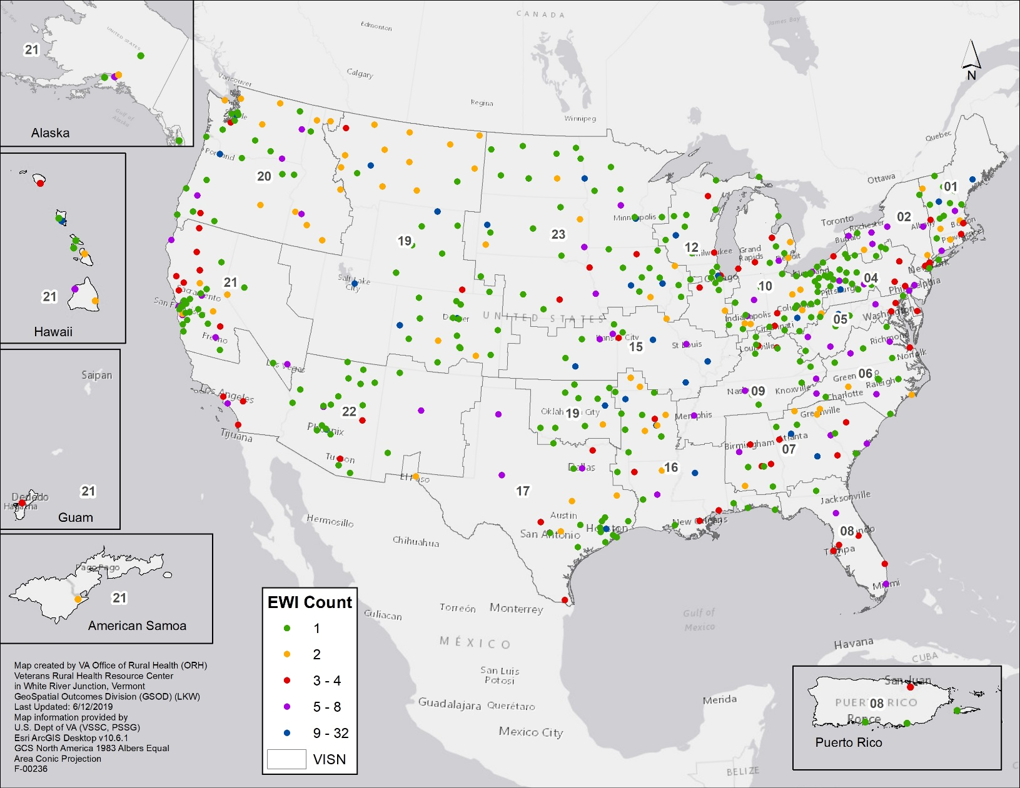
ORH FY2019 Enterprise-Wide Initiatives

Slide 28
ORH FY2019 Enterprise-Wide Initiatives IN New York
Enterprise-Wide Initiatives in New York
Advanced Care Planning via Group Visits
Clinical Video Telehealth to Provide Comprehensive Care to Rural Veterans with Multiple Sclerosis
Gerofit, Geriatric Fitness Program
Rural Health Community Coordinator Health Information Exchange
Home Based Primary Care
Clinical Pharmacy Specialist Providers
National Teleradiology Program
Remote Home Based Delivery of Cardiac Rehabilitation
Sleep Telemedicine
Social Work in Patient Aligned Care Teams
Teledermatology
Telemental Health Hubs
Teleprimary Care
National Telestroke Program
Rural VA Innovators Network
Veteran Transportation Services
Women Veteran Care Coordination and Management
Telehealth Equipment Modernization

Slide 29
Enrolled Veterans in New York Ranked
28% of New York’s Rural Veterans are enrolled in VA care
71% of New York’s Urban Veterans are enrolled in VA care
* EOY 18 Current Enrollment cube Verified population

Slide 30
FY 2019 funding execution
Rural Health Initiative Budget Total: $270 Million
Notes:
$251 Million for EWI’s with $19 Million for VRHRCs
FY18 Enterprise-Wide Initiatives
Advanced Care Planning via Group Visits
Clinical Pharmacy Specialist Providers
Clinical Skills Training in Women Veterans Health Care
Clinical Video Telehealth Patient Tablets
Clinical Video Telehealth to Provide Comprehensive Care to Rural Veterans with Multiple Sclerosis
Community Clergy Training to Support Rural Veterans Mental Health
Genomic Counseling Services for Rural Facilities
Geriatric Research Education and Clinical Center Connect Program
Geriatric Scholars Program
Gerofit, Geriatric Fitness Program
Home Based Primary Care
Lung Cancer Screening
Medical Foster Home
Military Sexual Trauma Web Based Therapy
National Teleradiology Program
National Telestroke Program
Patient Aligned Care Teams Health Advocate, Scribe
Precision Oncology
Remote Home Based Delivery of Cardiac Rehabilitation
Rural Access Network for Growth Enhancement
Rural Health Community Coordinator Health Information Exchange
Rural Health Training Initiative
Rural MyVA Access Evaluation
Rural Suicide Prevention
Rural VA Innovators Network
Rural Veterans Telerehabilitation Initiative
Simulation Based Learning for Suicide Prevention
Simulation Learning, Education, and Research Network Rural Coordinators
Sleep Telemedicine
Social Work in Patient Aligned Care Teams
State Veterans Homes (SVH) Telehealth Initiative
Support for Caregivers of Veterans
Technology-based Eye Care Services
Teleaudiology
Teledermatology
Telehealth Collaborative Care for Rural Veterans with HIV Infection
Telehealth Equipment Modernization
Tele-Intensive Care Unit (ICU)
Telemental Health Hubs
Telephone Lifestyle Coaching
Teleprimary Care
Telerehabilitation Services
Transitions Nurse Program
Under Secretary for Health Rural Diffusion of Best Practices
VA-ECHO Expansion in Specialty Care
Veteran Transportation Services
Vets Prevail Web Based Behavioral Support
Women Veteran Care Coordination and Management
Data from Mike Privman, ORH Budget Analyst on December 14, 2018
Enterprise Wide Initiatives
FY 2019 as of Dec 14, 2018
Primary Care
67,385,498
Specialty Care
81,876,789
Mental Health
55,402,393
Workforce Training and Education
13,888,106
Care Coordination
8,317,150
Health IT Modernization
115,178
Research
1,495,164
Innovation
13,509,422
Transportation
12,900,000
Total all EWI
254,889,700

Slide 31
FY 2020 Rural health initiative budget
Rural Health Initiative Budget Total: $270 Million
Notes:
$245 Million for EWI’s with $25 Million for VRHRCs
FY 2020 Preliminary - Data from Mike Privman, ORH Budget Analyst on May 24, 2019
Primary Care 23.4M
Specialty Care 71.4M
Mental Health 25.3M
Workforce Training and Education 12.0M
Care Coordination 8.3M
Clinical Resource Hubs 85.2M
Research 1.3M
Innovation 12.3M
Transportation 6.0M
Veteran Rural Health Resource Centers 24.9M
Total 270M
Data from Mike Privman, ORH Budget Analyst on April 3, 2019
Enterprise Wide Initiatives
FY 2019
Primary Care 66,571,211
Specialty Care 82,926,032
Mental Health 54,354,634
Workforce Training and Education 14,186,023
Care Coordination 8,344,855
Health IT Modernization 115,178
Research 1,495,164
Innovation 12,745,116
Transportation 12,690,000
Veteran Rural Health Resource Centers 18,670,925 (Placeholder for critical needs) (2,099,137)
Total 270,000,000

Slide 32
FY 2018 Enterprise-wide initiatives outcomes
2.5 million+ Veterans
estimated to be impacted through Enterprise-Wide Initiatives
$251 million
ORH funding for Enterprise-Wide Initiatives
50+ Enterprise- Wide Initiatives
in coordination with VHA program office partners
99 percent
of VA medical centers across all 18 Veterans Integrated Service Networks

Slide 33
VA Maintaining Internal Systems and Strengthening Integrated Outside Networks (MISSION) Act of 2018

Slide 34
Va mission act: an overview of key elements
What is the MISSION Act?
The VA Maintaining Internal Systems and Strengthening Integrated Outside Networks (MISSION) Act of 2018 was signed into law by the president on June 6, 2018. The Act will fundamentally transform VA’s health care system, fulfill the president’s commitment to provide Veterans with more choice in their health care providers and prevent a funding shortfall in the current Veterans Choice Program. The Act includes four main pillars:
Consolidating VA’s community care programs.
Expanding the Program of Comprehensive Assistance for Family Caregivers to eligible Veterans of all eras.
Providing VA the necessary flexibility to align its infrastructure footprint with the needs of our nation’s Veterans.
Strengthening VA’s ability to recruit and retain quality health care professionals.
What is it NOT?
The MISSION Act is not a step toward privatization. It’s about significantly improving Veterans’ experience and enhancing their access to care.

Slide 35
Va mission act: an overview of key elements
Key Elements
Community Care - The Act consolidates VA’s multiple community care programs, including the Veterans Choice Program, into a new Veterans community care program, which is easier to navigate, for Veterans and their families, community providers and VA employees.
Caregivers Program - The Act expands eligibility for VA’s Program of Comprehensive Assistance for Family Caregivers (PCAFC) by including eligible Veterans from all eras of service. Post-9/11 Veterans have benefited greatly from PCAFC. Expansion will occur in two phases, starting with those who were injured on or before May 7, 1975, with further expansion beginning two years later. The expansion timeline is still under development.
Asset and Infrastructure - The Asset and Infrastructure Review (AIR) process in the Act will provide VA the necessary flexibility to align its infrastructure footprint with the needs of the nation’s Veterans.
Recruit and Retain - VA is focused on recruitment to ensure Veterans are receiving the care they have earned. This Act will allow for additional, improved recruitment efforts, including a new scholarship program, greater access to VA’s education debt-reduction program and improved flexibility for providing bonuses for recruitment, relocation and retention.
Information Sharing - For the purpose of providing health care or other health care related functions, the Act allows VA to share patient information that would otherwise be protected. It also allows for disclosing this information for purposes of recovering or collecting reasonable charges for care furnished to, or paid on behalf of, a Veteran in connection with a nonservice-connected disability.

Slide 36
MISSION ACT Benefits
The VA MISSION Act:
Strengthens VA’s ability to recruit and retain clinicians.
Authorizes “Anywhere to Anywhere” telehealth across state lines.
Empowers Veterans with increased access to community care.
Establishes a new urgent care benefit that eligible Veterans can access through VA’s network of urgent care providers in the community.
VA serves approximately 9 million enrolled Veterans at 1,255 health care facilities around the country every year.
Notes:
https://www.vapulse.va.gov/docs/DOC-239020

Slide 37
Questions

Slide 38
rural.health.inquiry@va.gov
(202) 632-8615
Carolyn Turvey, PhD
ORH Clinical Director, Iowa City, IA
Carolyn.Turvey@va.gov

Slide 39
Working in Rural Communities
Nicole Costa, LCSW
Director of Community Case Management Services
Behavioral Health Care Line
Syracuse VA Medical Center

Slide 40
Welcome to community case management!!
Wild Turkeys…
Turn left at the house with yellow curtains…
This Photo by Unknown Author is licensed under CC BY-SA
This Photo by Unknown Author is licensed under CC BY-NC-ND

Slide 42
Serious Mental Illness…
Per National Handbook: Serious Mental Illness is defined as a mental, behavioral, or emotional disorder that meets DSM criteria (excluding cognitive and development disorders and disorders due to a general medical condition) that meets all of the following criteria:
Single unremitting episode of symptoms or with frequently recurring and/or prolonged episodes of symptoms
Symptoms result in impairments in mood, thinking, family or other interpersonal relationships, behavior and/or self-care which substantially interfere with or limit major life activities
The impact of these symptoms results in a functional impartment equivalent to a Global Assessment of Functioning (GAF) score of 50 or below.

Slide 43
What is Recovery…
SAMSHA Definition:
“A process of change through which individuals improve their health and wellness, live a self-directed life, and strive to reach their full potential”
September is Recovery Month

Slide 44
A little geography…13 counties
Approximately 220 miles
Approximately 110 miles

Slide 45
National guidelines and directives…
VHA Homeless Program (Health Care for Homeless Veterans-HCHV)
Outreach
Acute and chronic homeless Veterans
HUD-VASH
Partnership with HUD to issue Section 8 vouchers for eligible Veterans
Contract Residential and Grant & per Diem Programs
Emergency and transitional housing for eligible Veterans
Veterans Justice Outreach
Support and advocacy for justice involved Veterans
VHA Office of Mental Health (Intensive Community Mental Health Recovery Services: Mental Health Intensive Case Management-MHICM)
Case management for Veterans with a diagnosed Serious Mental Illness
Goal to reduce psychiatric hospitalizations

Slide 46
Assertive Community Treatment…
Assertive Community Treatment is an evidenced based practice that offers treatment, rehabilitation, and support services, using a person-centered, recovery-based approach, to individuals that have been diagnosed with serious mental illness (SMI)
Services are provided to individuals by a mobile, multidisciplinary team in community settings. The goal of ACT services is to assist individuals to achieve their personally meaningful goals and life roles.
Services include:
Assertive outreach
Mental health treatment
Vocational support
Integrated dual disorder treatment
Family education
Wellness skills
Community linkages
Peer Support
(NYS Department of Mental Health)

Slide 47
Shared Case Management Model with MHICM…
ICMHR Follows the Assertive Community Treatment Model (ACT)
Per National Directive, “ICMHR Services have provided clinical community-based case management services to Veterans with SMI, severe functional impairment and high inpatient mental health unit utilization, in coordination with existing community and VA services”.
How we do this:
High staff to Veteran ratio (7-15 per case manager)
Multiple visits per week as needed (2-3 visits per week)
Clinical case management provided by an interdisciplinary team where all members of the team are available to provide for the Veteran
RN, SW, LMPHC, Peer Support, Psychiatry/NP
Interventions occurring primarily in the community rather than office settings
Shared caseload

Slide 48
Shared Case Management Model with MHICM…
Program Criteria:
Diagnosis is SMI
Inadequately Served (unable to maintain successful and stable community integration through use of conventional services. Ie. Outpatient treatment)
High resource use-30 days or inpatient mental health treatment OR 3 or more episodes of inpatient hospitalization

Slide 49
Shared Case Management with HUD VASH…
Similar to shared case management of the MHICM program and follows the ACT Model
Per National Handbook:
“HUD-VASH will provide clinical case management and supportive services to Veteran in HUD-VASH by utilizing the principals of Housing First, a team-based model of care, comprised of multidisciplinary staff, and shared caseloads”.
Stages of treatment:
Intensive-Minimum of weekly visits, but more frequently as needed
Stabilization-Twice monthly home visits
Maintenance-Monthly visits
Preparation for Discharge-after 6-12 months in case management and visits 1/quarter
Graduation-No longer need case management, but maintains the housing voucher due to financial purposes

Slide 50
Shared Case Management with HUD VASH…
The Clinical Team:
Program Coordinator
Nursing
Peer Support
Substance Use Disorder Specialist
Housing Specialist
Social Work Case Management
Psychiatry Resident on rotation

Slide 51
Common challenges of rural health care and engagement…
Making connections to treatment
Weather
Distance to travel
Wifi/Internet
Few natural community resources/supports
Lack of public transportation
Hiring strong applicants/lack of interest in rural work
Wild turkeys ☺

Slide 52
Other ways we support staff and overcome challenges…
Check in before/after appointments
Double up visits
Snow Tires
Education to staff on community resources
Partner up with community providers
Team meetings/case conferences
Team Work!!!
Telehealth services

Slide 53
Data…(to date)
VASH
257 total HUD VASH Vouchers and total of 24 available Vouchers
Watertown total of 40 Vouchers
Rome total of 41 Vouchers
Syracuse total of 166 Vouchers
GPD
Total Beds: 28 (24 in Syracuse and 4 in Binghamton)
Total utilization to date: 64 (53 Syracuse and 11 in Binghamton)

Slide 54
Data…(to date)
Outreach:
1,055 consults/hotline calls, self-referrals
Literally homeless: 283
Imminent risk of homelessness: 86
Unstably housed: 515
Stably housed: 169
MHICM:
Average PRE Admission psychiatry admissions:
2.52
Average POST Admission psychiatry admissions:
0.93
Average Pre Admission days:
36.42
Average POST Admission days:
18.42

Slide 55
A success story and the power of Peers…
I began to work with (Veteran) during the late Spring of this year. (Veteran) is a U.S. Army Vietnam Veteran who had been living at a local fair grounds in rural update NY, for three decades. He is the bookbinder for the fair and takes great pride in his craft. A fiercely independent and private person, (Veteran) was resistant to seeking out benefits or assistance from the VA or any other government entity. He had not been under the care of a physician in more than 30 years.
(Veteran) had lived on the fairgrounds over the many winters, and the previous winter was particularly treacherous and cold. (Veterans) access to food and resources was severely limited. Over time, (Veteran) was agreeable to applying for and receiving a non-service connected pension. Veteran was eventually open to being seen at the VA for medical care and would be interested in obtaining housing on a HUD VASH voucher.
He toured an apartment building and began the application process. Still hesitant about where he wanted to live, (Veteran) said he was wary of such a big move—away from his solitary shop and into an apartment complex.
Upon his first physical in more than three decades, (Veteran) was told that he needed to be admitted to the hospital right away—he was undergoing kidney failure. After weeks of treatment and rehabilitation, (Veteran) was stronger and healthier. During that time, the HCHV team got to work! (Veterans) housing voucher was ready, and he moved directly from his hospital bed at the VA Medical Center to his apartment
(Veterans) story is one of resilience and growth. A Veteran who prided himself on a life of solitude and independence, finally willing to be open and receive care from others. It seemed like fate stepped in at the right time—where (Veteran) got his physical at the right moment to avert disaster and possibly death, and is now connected to care and receiving ongoing case management. My connection to (Veteran) supports the strength of Peer Support—for those Veterans who are vulnerable but reluctant to speak to anyone but another Veteran, Peers can lead the way.

Slide 56
References and contact information…
Homeless hotline number
1-877-424-3838
SSVF Solider On
1-866-406-8449
Veterans Crisis Line
1-800-727-8255
Intensive Community Mental Health Recovery Services
VHA Handbook 1162.08-January 7, 2016
Housing and Urban Development Department of Veterans Affairs Supportive Housing Program
VHA Handbook 1162.05-Updated October 31. 2017
New York State Office of Mental Health

Slide 58
The Work We Do…
Expand Community Options
Invest in Research
Serve as the “Glue” in New York’s veteran Community

Slide 59
Why We Do What We Do
Limitations on VA Care
Challenges in the Private Sector
Veteran-centric Approach

Slide 60
The Mission Act
Origins & Need
Implementation
Impact on Veterans

Slide 61
Veterans & The Future of Rural Health?

Slide 62
Thank You
Sponsored by

