Slide 1
Traffic Safety As A Social Determinant of Health
New York State Association for Rural Health
September 27, 2018

Slide 2
Objectives
Participants will:
Learn how Mobility Safety impacts health and healthcare
Understand why Mobility Safety intersects with the Social Determinants of Health
Discover how partnerships with the NYS Governor’s Traffic Safety Committee can improve health indicators

Slide 3
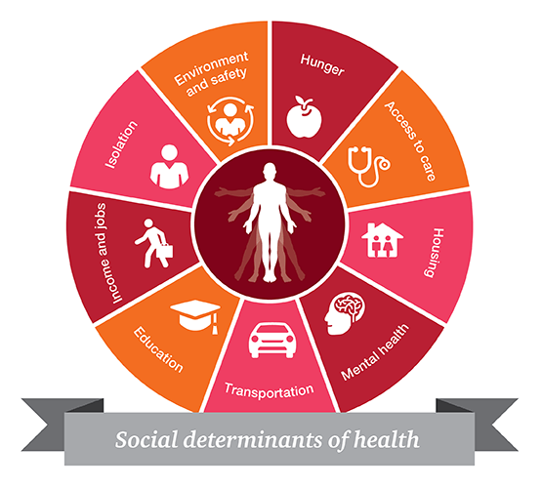
Traffic safety impacts on health and healthcare

Slide 4
Dangers on Rural Roadways
In 2014, 602 children ages 12 years and younger died in crashes, more than 121,350 were injured
More than $380 million in direct medical costs
In 2015, more than 10,000 died in alcohol impaired driving crashes
Death rates for American Indians/Alaska Natives are 1.5 times more than for other Americans
18,590 lives were lost on rural roadways in 2016 (ref FHA) – more than half of the total; even though only 19% of the total population lived in rural areas
Center for Disease Control
Notes:
Urban and rural areas have fundamentally different characteristics with regard to density of road networks, land use, and travel patterns. Consequently, the characteristics of fatal motor vehicle crashes differ between rural and urban areas. For example, pedestrian and bicyclist deaths and deaths at intersections are more prevalent in urban areas, whereas a larger proportion of passenger vehicle and large truck occupant deaths and deaths on high-speed roads occur in rural areas. Although 19 percent of people in the U.S. live in rural areas 1 and 30 percent of the vehicle miles traveled occur in rural areas, 2 more than half of crash deaths occur there.

Slide 5
Rural Crash Factors and Consequences
Infrastructure
Narrow Roadways
No Shoulder
Driver Behavior
Environment
Poorer Road Conditions
Undivided Traffic Streams
Few Traffic Controls
Less Seatbelt Usage
More Miles Driven
Inclement Weather
Slow Moving Vehicles
Deer and other Animal Crashes
Less Lighting
No Controlled Entrances
Higher DWI Incidents
Older, Less Safe Cars
Greater Rates of Speed
Long Distance to Emergency Health Care
Less Traffic Safety Enforcement
Risk Taking
Distracted Driving

Slide 6
Traffic Safety
GTSC
Partners
When you gamble with safety, you bet your life.

Slide 7
Governor’s Traffic Safety Committee
Governor's traffic safety committee (GTSC) awards federal highway safety grant funds to local, state and not-for-profit agencies for projects to improve highway safety and reduce deaths and serious injuries due to crashes. The goals of New York’s comprehensive statewide highway safety program are to prevent motor vehicle crashes, save lives, and reduce the severity of injuries suffered in crashes.
Highway Safety Plan Program Areas:
Impaired Driving
Police Traffic Services
Motorcycle Safety
Pedestrian, Bicycle and Wheel-Sport Safety
Occupant Protection
Traffic Records
Community Traffic Safety Programs
Program Management

Slide 8
Data-Driven Problem Identification
The statewide data-driven problem identification process focuses on the analysis of crashes, fatalities and injuries to determine what is occurring, where, when, why and how it is occurring and who is involved.
Traffic Safety Statistical Repository (TSSR)
An online tool available to assist agencies in conducting problem identification at the local level
Developed by the Institute for Traffic Safety Management and Research (ITSMR), the system can be accessed through ITSMR’s website and at https://www.itsmr.org/tssr.
Users of the TSSR have direct online access to New York’s motor vehicle crash data from the state’s Accident Information System (AIS)
The site includes reports on motor vehicle crashes statewide and by individual counties; some data by municipalities within counties are also available
Statewide and county reports with ticket data support data driven programs at the local and state levels.

Slide 9
NYS Highway Safety strategies
Community Traffic Safety Program
Strategy CP-1: Community-Based Highway Safety Programs
Strategy CP-2: Statewide Implementation of Traffic Safety Initiatives
Strategy CP-3: Statewide Communications and Outreach
Strategy CP-4: Younger Driver Outreach and Education
Strategy CP-5: Older Driver Outreach and Education
Strategy CP-6: Outreach to Minority and Other Underserved Population

Slide 10
Traffic Safety
GTSC
Partners
Public
Private
Law Enforcement
When you gamble with safety, you bet your life.

Slide 11
Mobility Safety Across the Lifespan

Slide 12
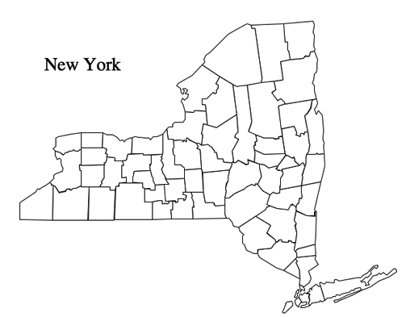
Regional Approach
Regional Highway Safety and Child Passenger Safety Grantee since 2016
Allegany County
Cattaraugus County
Chautauqua County
Steuben County
Southern Erie County: Seneca Nation of Indians

Slide 13
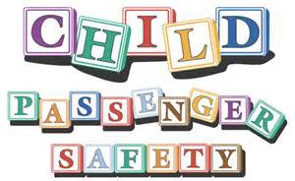
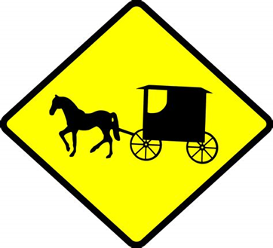
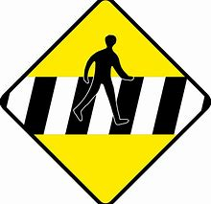
Educational Programs and Campaigns
Educational Programs and Campaigns focusing on:
Aging Adult Drivers
Teens and Distracted Driving
Seatbelt Usage in Male Pick-Up Drivers
Sharing the Roadways with SMV and Amish Neighbors
Child Passenger Safety Program
Child and Adult Pedestrian Safety

Slide 14
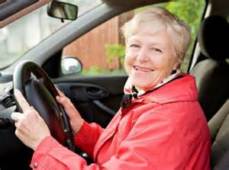
aging Adult Drivers
Crash Data by Age | Allegany County | Cattaraugus County | Chautauqua County | Steuben County
50 years of age and older involved in a crash | 336 | 735 | 1,346 | 941
% of 50 years of age crashes in comparison to all crashes | 37.26% | 37.11% | 37.34% | 38.15%
% of 50 years of age fatalities in comparison to total crashes fatalities | 75% | 18.18% | 25% | 27.27%
2015 Institute for Traffic Safety Management and Research
Drive Well Toolkit: Promoting Older Driver Safety and Mobility in Your Community

Slide 15
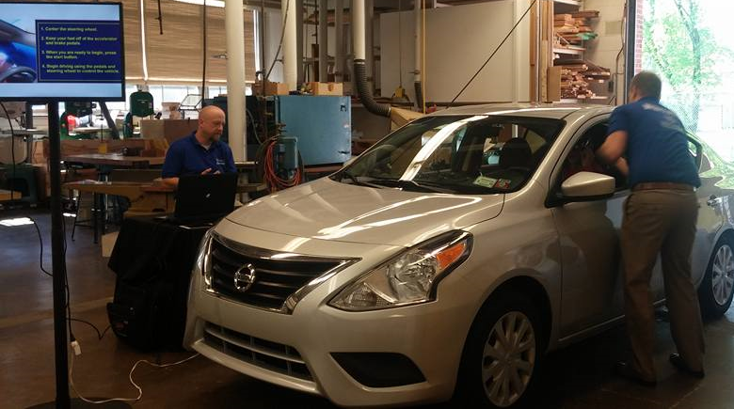
Teens and Distracted Driving
2015 County Crash Summary- Crash Contributing Factors | Allegany County | Cattaraugus County | Chautauqua County | Steuben County
Driver Inattention/Distraction | 19 | 68 | 161 | 49
2015 Institute for Traffic Safety Management and Research

Slide 16
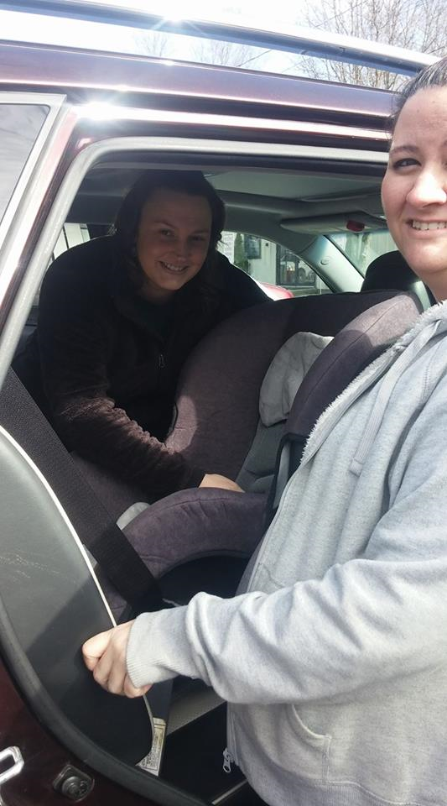
Occupant Restraints
2014 Motor Vehicle Occupants Ticketed for Safety Restraints | Allegany County* | Cattaraugus County | Chautauqua County | Steuben County
Total Tickets | 761 | 1218 | 1885 | 1787
Children Under 16 | 53 | 123 | 285 | 354
*Allegany County Trend Data for Motor Vehicle Occupants Ticketed for Safety Restraints | 2012 | 2013 | 2014
Total Tickets | 1036 | 858 | 761
Children Under 16 | 85 | 59 | 53
NYSDMV TSLED Ticket System

Slide 17
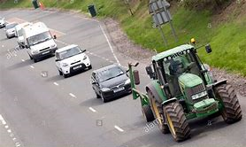
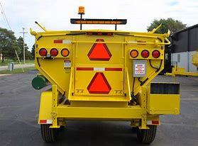
Slow Moving Vehicle Awareness
Sharing the Road with Slow Moving Vehicles and Our Amish Neighbors
Advisory Committee
English Driver Outreach
BOCES 5-Hour Course Curriculum
Media Releases
Amish Community
Community Brokers Partnership
Agriculture Community
Cornell Cooperative Extension Partnership

Slide 18
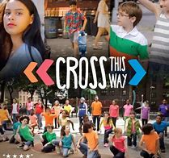
Pedestrian Safety
County Pedestrian Crash Summary | Allegany County | Cattaraugus County | Chautauqua County | Steuben County
Fatal | 0 | 2 | 3 | 1
Personal Injury | 5 | 20 | 41 | 21
Property Damage | 0 | 1 | 2 | 0
2016 Preliminary Report- Institute for Traffic Safety Management and Research

Slide 19
Traffic Safety Initiatives

Slide 20
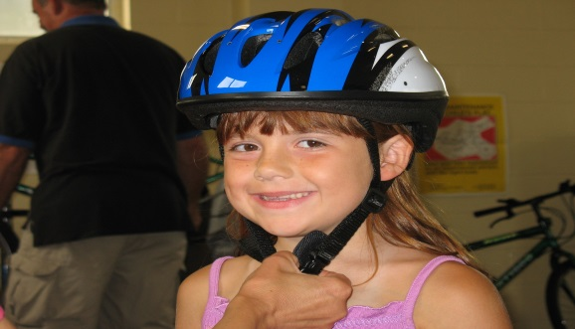
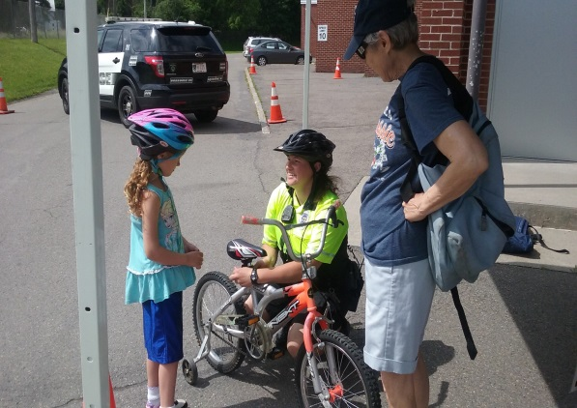
Injury Prevention and Traffic Safety Program Bike/Ped Coalition
Bike Program
* Bike Rodeos at schools and public events
* Bikeology 101- Community Bike Ride
* Helmet Education and Distribution
Pedestrian Safety
* Tiny Town Pedestrian Safety Course
* Walk To School Day
* Partnering with Seven Valleys Health Coalition for environmental changes
within the community.

Slide 21
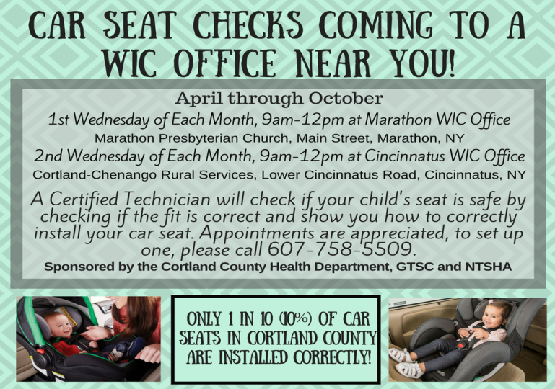
Child Safety Seats
Traveling Tots Program
Education and Distribution of seats
Day Cares and Schools
Parent groups
DSS staff trainings and other organizations who transport children
Seat Checks/ at least 4 every year
School bus ride along
CPST Instructors

Slide 22
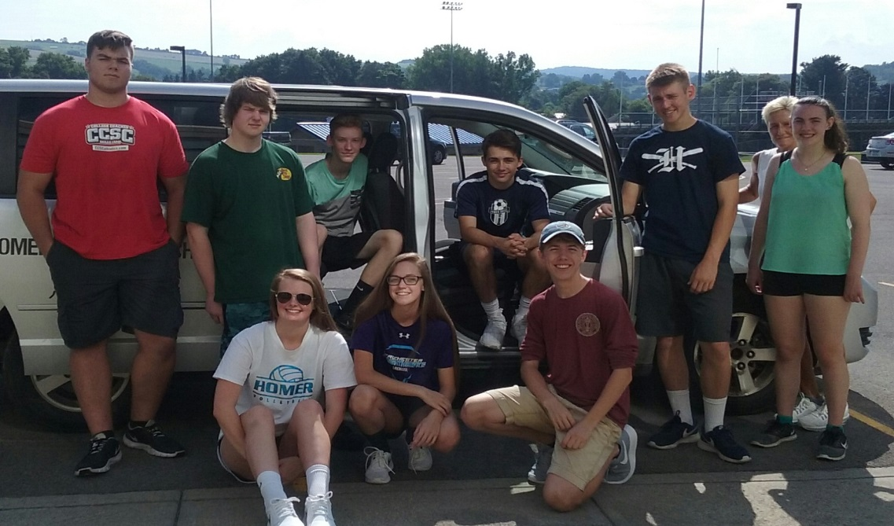
Driver Safety/ Education and Enforcement
Safe Driving Awareness
Alive at 25
Teen Driver Safety at High School

Slide 23
Traffic Safety
GTSC
Partners
Public
Private
Law Enforcement
When you gamble with safety, you bet your life.

