Slide 1
Lead • Empower • Innovate
Telehealth and COVID-19
PRESENTED BY:
Katy Cook, MS, CTC
Telehealth Project Manager
Nancy DelMastro, MPH, CTC
Telehealth Project Specialist
06/18/2020

Slide 2
Disclaimer
Adirondack Health Institute (AHI) has made every attempt to ensure the accuracy and reliability of the information provided in this webinar. However, the information is provided “as is” without warranty of any kind. AHI does not accept any responsibility or liability for the accuracy, content, completeness, legality or reliability of the information contained in this webinar. You should contact the insurance provider directly for further information on their participation or coverage.
https://ahihealth.org/what-we-do/telemedicine/
Notes:
It is worth mentioning that changes and updates are occurring on an almost hourly basis in some instances. The information presented here today could be different tomorrow. Your best source of information is our website: https://ahihealth.org/what-we-do/telemedicine/, or the Northeast Telehealth Resource Center site: www.netrc.org.

Slide 3
Today’s Webinar Topics
DOH Updates
OPWDD Updates
OMH Updates
OASAS Updates
CMS/Medicare FFS Updates
OIG Update
Third-Party Payer Update
Software Platforms and Resources
What’s Next for Telehealth?

Slide 4
Medicaid/DOH
Medicaid FFS/DOH

Slide 5
Medicaid
DOH released a comprehensive guidance document regarding the use of telehealth including telephonic services during the COVID-19 state of emergency.
For dates of service on or after 3/1/2020, for the duration of the State Disaster Emergency, NYS Medicaid will reimburse telephonic assessment, monitoring, and E & M services provided to members in cases where face-to-face visits may not be recommended.
Telephonic communication will be covered when provided by any qualified practitioner or service provider. All telephonic encounters documented as appropriate by the provider would be considered medically necessary for payment purposes in Medicaid FFS or Medicaid Managed Care.
Payment for telephonic encounters for health care and health care support services will be supported in six different payment pathways utilizing the usual provider billing structure.
Notes:
This comprehensive guidance document is updated frequently. The intent of this guidance is to provide broad expansion for the ability of all Medicaid providers in all situations to use a wide variety of communication methods to deliver services remotely during the COVID-19 State of Emergency, to the extent it is appropriate for the care of the member.

Slide 6
Telehealth Definitions
Definition of Telehealth
Telehealth is defined as the use of electronic information and communication technologies to deliver health care to patients at a distance. Medicaid covered services provided via telehealth include assessment, diagnosis, consultation, treatment, education, care management and/or self-management of a Medicaid member. For purposes of the State of Emergency, this definition is expanded to include telephonic, telemedicine (including teledentistry), store and forward, and remote patient monitoring.
Originating Site
The originating site is where the member is located at the time health care services are delivered to him/her by means of telehealth. Originating sites during the State of Emergency can be anywhere the member is located, including their home. There are no limits on originating sites during the State of Emergency.
Distant Site
The distant site is any location including the provider’s home that is within the fifty United States or United States' territories. During the State of Emergency all sites are eligible to be distant sites for delivery and payment purposes including FQHCs for all patients including patients dually eligible for Medicaid and Medicare. This includes clinic providers working from their homes or any other location during the State of Emergency.
Notes:
In terms of eligible providers, during the State of Emergency, all Medicaid provider types are eligible to provide telehealth, but services should be appropriate for telehealth and should be within the provider’s scope of practice.
As an FYI, telemedicine includes teledentistry.

Slide 7
Confidentiality and Consent
Confidentiality:
During the COVID-19 nationwide public health emergency, the HHS Office for Civil Rights (OCR) has issued a Notification of Enforcement Discretion for telehealth remote communications. OCR will exercise its enforcement discretion and will not impose penalties for noncompliance with the regulatory requirements under the HIPAA Rules against covered health care providers in connection with the good faith provision of telehealth during the emergency.
Consent:
The practitioner shall confirm the member’s identity and provide the member with basic information about the services that he/she will be receiving via telehealth/telephone. Written consent by the member is not required. Telehealth/telephonic sessions/services shall not be recorded without the member's consent.
Notes:
Confidentiality: All providers must take steps to reasonably ensure privacy during all patient-practitioner interactions. We will discuss the HHS OCR notification later in the webinar.

Slide 8
Waiver of SHIN-NY Written Consent for Telehealth
To help facilitate and support the approach of expanding telemedicine, NYS DOH is allowing informed, verbal, documented consent for telehealth visits in lieu of the current SHIN-NY written consent requirements per 10 NYCRR Part 300.
The following procedures shall be adhered to by QEs and their Participants when providing telehealth services without written consent.
1. Verbal consent shall be given by a patient to a provider prior to, or during the telehealth visit, but before accessing patient information via the SHIN-NY.
2. Patient verbal consent shall be noted by the provider in the patient’s medical record that is provided to the QE.
3. QEs shall record any notation of verbal consent received as part of a telehealth visit between a patient and a provider as a valid consent.
4. This exception to written consent shall be temporary and shall end upon declaration by the Governor that the State of Emergency has been lifted. Once this happens, patient consent must be obtained again consistent with existing SHIN-NY regulations.
Notes:
QE = qualified entity

Slide 9
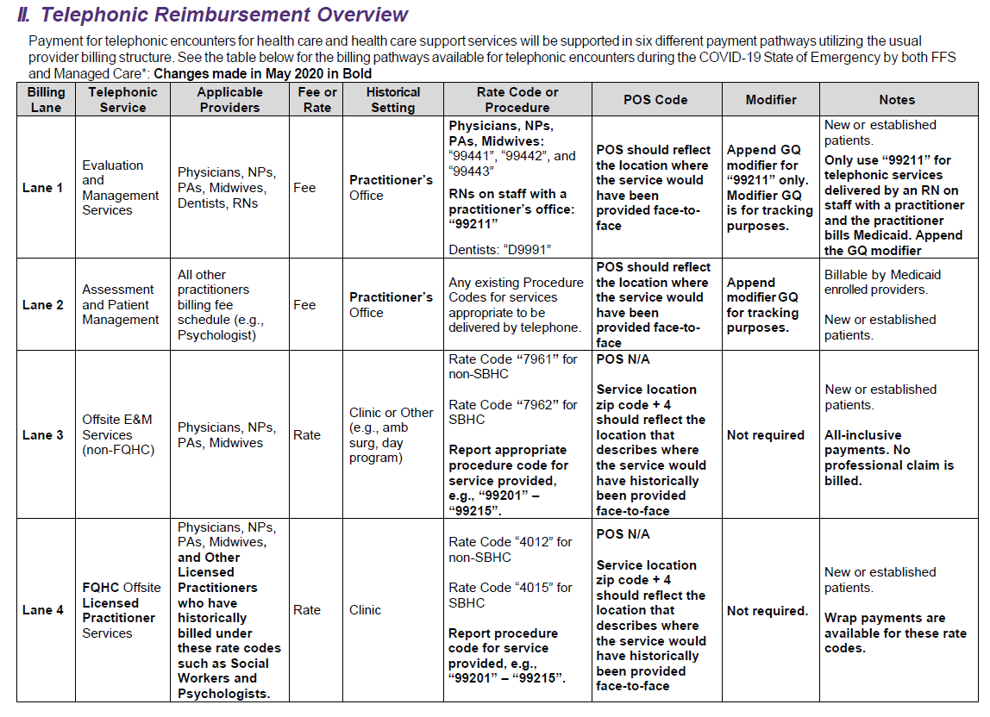
Notes:
The chart has two basic sections. Lanes 1-2 are for use by fee schedule billers (primarily practitioners in office-based settings) and lanes 3-6 are for all other billers that primarily bill rates for clinic and other services. Practitioners that usually bill the fee schedule directly should bill for telephonic services using lane 1 and 2 based on practitioner types noted. Clinics should bill using lanes 3, 4 and 5 depending on FQHC status and practitioner type.
Changes are noted in bold – a few examples of changes include the addition of the POS Code and modifier columns and:
Lane 1: Changed setting from Office to Practitioners Office and under Notes – Only use 99211 for telephonic services delivered by a nurse on staff with a practitioner that bills Medicaid, append GQ mod.
Relevant CPT codes are:
“99441”: Telephone evaluation and management service; 5-10 minutes of medical discussion Fee: $12.56
“99442”: 11-20 minutes of medical discussion Fee: $23.48
“99443”: 21-30 minutes of medical discussion Fee: $37.41
Lane 2: Changed setting from Office to Practitioners Office
Lane 3: Added in addition to the two rate codes that clinics should report the appropriate CPT code for the service provided, i.e. 99201-99215 – no modifier is required.
Lane 4: Changed Telephonic Service column to note FQHC Offsite Licensed Practitioner Services which now includes social workers and psychologists, and that wrap payments are available for the listed rate codes – no modifier is required.

Slide 10
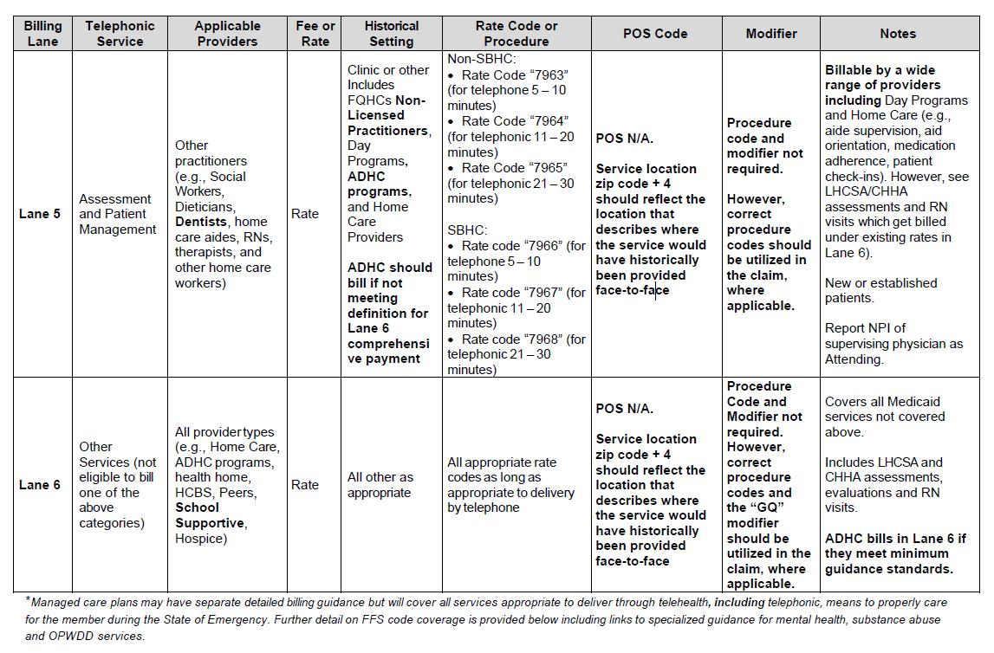
Notes:
Lane 5 is for clinics , non-licensed practitioners and FQHCs and should be used for any and all patient assessment and management services that are appropriate to be billed telephonically unless otherwise noted. Lane 6 is reserved for all other services that do not fit into the first 5 lanes. Telephonic services should only be used when audio-visual services are NOT possible.
Changes are noted in bold – a few examples of changes include the addition of the POS Code and modifier columns and:
Lane 5: Added dentists as an applicable provider and added FQHC non-licensed practitioners and ADHC programs into the setting column. No CPT code or modifiers are required.
Lane 6: Added school supportive as a setting, and that ADHC programs will bill in lane 6 if they meet minimum guidance standards.

Slide 11
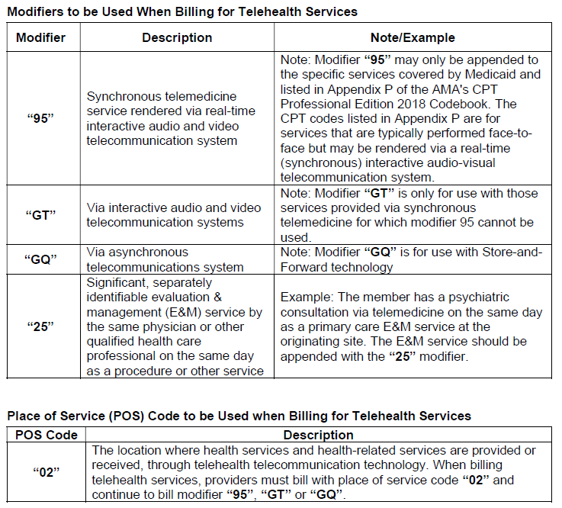
Billing Rules - Telemedicine
When billing for teledentistry services, modifiers cannot be used by dentists. Additional guidance was issued in the January 2020 Medicaid update which allows for two dental codes “D9995” and “D9996” to be used in place of modifiers. Both dental codes “D9995” and “D9996” along with “Q3014” were added to the dental fee schedule.
Notes:
Dual eligible: For individuals with Medicare and Medicaid, if Medicare covers the telehealth encounter, Medicaid will reimburse the Part B coinsurance and deductible to the extent permitted by state law.
All other billing rules that have been in place remain the same. Please refer to the DOH Medicaid Update for specifics.

Slide 12
Medicaid Managed Care Plans
Medicaid Managed Care Plans (MMCP):
MMC plans are required to cover, at a minimum, services that are covered by Medicaid fee-for-service and also included in the MMC benefit package, when determined medically necessary and must provide telehealth coverage as described in the guidance. MMC Plans may establish claiming requirements (e.g., specialized coding) that vary from FFS billing instructions in this guidance.
Absent existing state mandated rates or negotiated rates for telehealth/telephonic services, MMC plans must reimburse network providers at the same rate that would be reimbursed for providing the same service via a face-to-face encounter.
MMC plans may not limit member access to telehealth/telephonic services to solely the MMCP’s telehealth vendors and must cover appropriate telehealth/telephonic services provided by other network providers.
Questions regarding MMC reimbursement and/or documentation requirements should be directed to the member's MMC plan.
Notes:
Bolded important statements.

Slide 13
Notes from 05.05.2020 DOH OHIP Webinar
Looking Ahead:
It is unknown what the future will look like when lifting restrictions. DOH will continue to monitor and update policy guidance accordingly.
Greg Allen stated that DOH expects that some face-to face visits may migrate to telehealth as appropriate.
He suggests referring to specific State Agency Partner Guidance - Slide 41 provides links. Slide deck can be accessed here.
OMH, OASAS, OCFS, and OPWDD have their own guidance.
Questions can be sent to:
Telehealth.policy@health.ny.gov

Slide 14
OPWDD
OPWDD

Slide 15
OPWDD and Telehealth
In response to increasing concerns related to COVID-19, all nonresidential facilities and programs certified or operated by OPWDD are permitted and encouraged to deliver services via telehealth remotely to individuals with I/DD, whenever possible.
Health and habilitation services are permitted for delivery via telehealth, where a provider exercising good clinical judgment determines a telehealth encounter is appropriate for the delivery of services to an individual. OPWDD providers should also consult any State-issued COVID-19 guidance for specific services, which may address telehealth.
Where a service or support requires the physical presence of a staff member for the health and safety of the individual, it is not appropriate to be delivered via telehealth.
Source: https://opwdd.ny.gov/system/files/documents/2020/04/4.14.2020-updated-opwdd-telehealth-guidance-from-4.9-with-revisions-shown.pdf
Notes:
Don’t need to say: Non-residential facilities and programs may deliver health and habilitation services remotely (i.e., via telehealth or telephonic modalities) and bill for such services when they are delivered in accordance with requirements established in the guidance document.

Slide 16
OPWDD and Telehealth
Telehealth is the use of electronic information and communication technologies to deliver services to an individual who is at a different location than the OPWDD Provider. The use of simultaneous, two-way audio-visual communications to deliver certain health, habilitation, and respite services constitutes telehealth.
During the COVID-19 emergency, telephonic (audio-only) modalities may be used in limited circumstances relative to the use of telehealth. Certain health, habilitation and respite services are permitted for delivery via telehealth, where a provider exercising good clinical judgment determines a telehealth encounter is appropriate for the delivery of services to an individual.
Respite services can only be provided using two-way audio-visual technology; telephonic transmission is not permissible.

Slide 17
OPWDD Telehealth Billing Guidelines
Health services delivered by means of telehealth shall be entitled to reimbursement from Medicaid.
The following applies to providers using Telehealth:
Providers shall be either:
licensed or certified in NYS, currently registered in accordance with NYS Education Law or other applicable law, and enrolled in NYS Medicaid,
licensed as a physician in NYS and in current good standing in NYS, or
licensed as a physician, registered nurse, licensed practical nurse, nurse practitioner, or physician assistant in any state in the United States and in current good standing in that state.
Reimbursement will be made in accordance with existing Medicaid policy related to supervision and billing rules and requirements. For the duration of the emergency response to COVID-19, non-residential habilitation and respite services delivered by means of telehealth shall also be entitled to reimbursement from Medicaid.
For providers that provide habilitative or respite services via telehealth, the agency or entity must be certified or operated by OPWDD. Direct Support Professionals and other staff members who are not licensed or certified but who are authorized to deliver a service by the agency they work for may deliver habilitative and respite services via telehealth as a staff member of the OPWDD-certified or operated provider. The provider will bill Medicaid for those services delivered by staff members who are not licensed or certified themselves. Providers of HCBS waiver services should bill for the service as they normally would.
Notes:
Don’t read Part A but instead say: Telehealth services shall be delivered by providers acting within their scope of practice, exercising good clinical judgement and practice in the appropriate use of Telehealth with respect to the service.
Additionally, for the duration of the emergency response to COVID-19, providers delivering services as Independent Practitioner Services for Individuals with Developmental Disabilities (IPSIDD) may deliver such services via telehealth and bill at the IPSIDD rate.

Slide 18
OMH
OMH
Notes:
Certain regulatory requirements applicable to telemental health services—including requirements for the written approval process, policies, and procedures—have been waived. In addition, the definition of telemental health for Medicaid-reimbursable services is expanded to include telephonic and video. Any limitations and restrictions pertaining to the location of the telemental health practitioner while providing services have also been waived.
OMH guidance has largely stayed the same since the March updates.

Slide 19
OMH Guidance
OMH Expanded Telemental Health Guidance supersedes any other State-issued telehealth guidance.
OMH guidance only applies to OMH Licensed and OMH Designated Programs and Services.
This guidance does not apply to private practitioners.
Applies only during the declared state of emergency. On 6/6/2020, Governor Cuomo issued Executive Order 202.38, which extends telehealth regulatory flexibility for OMH-licensed, funded, and designated programs until 7/6/2020.

Slide 20
OMH - Expanded Guidance and Self-Attestation
Introduced rapid approval of the use of telemental health to deliver services which will allow for continuity of care, regardless of mandatory or self-imposed quarantines.
Includes expanded definition of telemental health and eligible practitioners.
Programs/agencies previously approved through traditional telemental health approval process do not need to submit self-attestation.
Programs/agencies that submitted the initial self-attestation do not need to submit a revised copy.
Only one attestation needed per agency; please specify programs to be covered as listed in the OMH Mental Health Provider Data Exchange (MHPD) or by Adult BH HCBS service type.
Self-Attestation: https://omh.ny.gov/omhweb/guidance/self-attestation-telemental-health-disaster-emergency.pdf
Notes:
They will certify to the following:
• Practitioner(s) will possess a current and valid license, permit, limited permit or other credential to the extent required in NYS to deliver the service.
• Transmission linkages will be dedicated, secure, and meet minimum federal and NYS requirements.
• Confidentiality will be maintained as required by NYS Mental Hygiene Law and HIPAA Privacy Rules.
• Claim modifiers “95” or “GT” will be used on each claim representing a service via telemental health.

Slide 21
OMH - Applicable Services
This Supplemental Guidance is applicable to the following OMH licensed programs and designated services:
OMH Licensed Programs: Article 31 Clinics, Certified Community Behavioral Health Clinics (CCBHCs), Personalized Recovery Oriented Services (PROS), Assertive Community Treatment (ACT), Continuing Day Treatment (adult), Children’s Day Treatment, Treatment Apartment Programs, and Partial Hospitalization.
OMH Designated Services: Children and Family Treatment and Support Services (CFTSS), Adult Behavioral Health Home and Community Based Services (BH HCBS), Adult BH HCBS Eligibility Assessments, and Recovery Coordination services.
There is no change in the Medicaid reimbursement rates or methodology. In order to claim for services delivered via telemental health, provider must ensure the following:
Providers may deliver any service appropriate for individuals to receive via telemental health. Including:
o Individual, group, and collateral services;
o Clinic Integrated Outpatient Services (IOS); and
o Clinic Based – Intensive Outpatient Program (CB-IOP) services

Slide 22
OMH – Supplemental Guidance for OMH-Funded Programs
Supplemental guidance for OMH-funded programs waives the face-to-face requirements for state-aid funded programs for the duration of the declared state of emergency.
This guidance applies to the following OMH programs and designated services:
Assisted Competitive Employment (ACE)
Transitional Employment Program (TEP)
Affirmative Business/Industry (ABI)
Transformed Business Model (TBM)
Ongoing Integrated Supported Employment (OISE)
Work Programs
Supported Education Programs
Psychosocial Clubs
Non-Medicaid Care Coordination 2720
Health Home Non-Medicaid Care Management 2620
Advocacy/Support Services (Non-Licensed Program) – 1760
Crisis Intervention (Non-Licensed Program) – 2680
Drop-in Center (Non-Licensed Program) – 1770
Recovery Centers- 2750
Home Based Crisis Intervention (HBCI)
Notes:
Service Delivery:
This guidance only addresses service delivery modality (telehealth/telephonic), it DOES NOT change the funding amount, nor the service requirements.

Slide 23
OMH - Expanded Definitions
Telemental Health for Medicaid-reimbursable services is temporarily expanded to include:
Telephonic; and/or
Video, including technology commonly available on smart phones and other devices.
Telemental Health practitioner includes any professional, paraprofessional, or unlicensed behavioral health staff who deliver a qualified service via telemental health. Any limitations and restrictions pertaining to the location of the telemental health practitioner while providing services via telemental health are waived.
Notes:
The OMH FAQ which will be linked in this PPT says that text message and email are not included in the telemental health waiver.
Verbal consent is allowable during the COVID-19 disaster emergency period. Providers of telemental health services can collect consent for services verbally so long as the consent is informed (i.e. providers are informing patients about the services provided, their right to refuse, right to revoke consent at any time, etc.), and the verbal consent is recorded by the provider in the patient’s treatment record.
Providers should also be advised that in subsequent in-person appointments that occur at a later date, written consent from the patient should be obtained.

Slide 24
OMH – Billing Guidance
During the duration of the declared disaster emergency, services can be delivered through telephone and/or video using any staff allowable under current program regulations or State-issued guidance as medically appropriate.
Medicaid FFS and Medicaid Managed Care providers must use claim modifiers “95” or “GT” on each claim representing a service delivered via telemental health. Please note for the duration of the disaster emergency, these modifier definitions will be expanded to included telephonic-only services. Providers must use these modifiers when billing for services delivered telephonically. For further guidance regarding the appropriate modifier for each CPT code, refer to https://omh.ny.gov/omhweb/guidance/covid-19-telehealth-modifiers.xlsx
Providers should indicate in their documentation that the service was provided telephonically or via video.
Providers may deliver any service appropriate for individuals to receive via telemental health.

Slide 25
OMH - More Information
Please visit https://omh.ny.gov/omhweb/guidance/ for up-to-date guidance documents from OMH.
Disaster Emergency FAQs: https://omh.ny.gov/omhweb/guidance/omh-covid-19-disaster-emergency-faqs.pdf
Self-Attestation: https://omh.ny.gov/omhweb/guidance/self-attestation-telemental-health-disaster-emergency.pdf
Reminder: Self-Attestations must be submitted to Amy Smith at amy.smith@omh.ny.gov

Slide 26
OASAS
OASAS

Slide 27
OASAS Telepractice Guidance
OASAS Telepractice Guidance:
Supersedes any other State or Federal telehealth guidance.
Applies to OASAS Certified and otherwise authorized Programs and Services - all are encouraged to submit a self-attestation.
Only applies during the declared state of emergency, which pursuant to Executive Order 202 is currently 9/2/2020.
Providers are encouraged to submit the attestation for Telepractice designation prior to that time to ensure that there is no lapse in OASAS approval to deliver services via Telepractice.
NOTE: This guidance does NOT apply to private practitioners.

Slide 28
OASAS Guidance
Expedited Approval Process:
Complete the Self-Attestation form.
Self-Attestation forms should be submitted to the OASAS bureau of certification on-line at certification@oasas.ny.gov
Providers may supply one, Self-Attestation for multiple PRU’s as long as each PRU is identified.
Approval occurs upon submission of the Telepractice Self-Attestation.
Notes:
SAY:
•This approval is time-limited and effective only during the disaster emergency
•Programs/agencies already designated to offer telehealth, do not need to seek additional approval.
The COVID disaster emergency allows for the following expansion of services that are not normally permissible:
•Service delivery via telephone is not permissible outside of the COVID emergency.
•CRPAs and interns are not authorized to deliver services outside of the COVID emergency.
•Buprenorphine initiation via telephone or telepractice is not permissible outside of the COVID emergency.

Slide 29
OASAS Guidance Continued
Telepractice for Medicaid-reimbursable services is temporarily expanded and includes:
Two-way audio/video communication;
Video, including technology commonly available on smart phones and other devices; and/or
Telephonic communication
Services to be delivered are those allowable under current program regulations or State-issued guidance as clinically appropriate and include assessment, individual, group, medication management and collateral services.
Notes:
Telepractice is not limited to certified or authorized OASAS locations. The client and/or practitioner can be at any site that meets with privacy and confidentiality standards, including a home. The space utilized for a Telepractice session should assure the privacy and protection of patient confidentiality.

Slide 30
Updated Guidance 3.18.2020
The Telepractice Waiver & Attestation Materials dated March 9, 2020 and March 13, 2020, are updated to clarify that, during the duration of the declared disaster emergency:
Peer Services delivered by CRPAs are allowable services and may be delivered by providers who have submitted a telepractice attestation or are otherwise approved to deliver telepractice services.
Assessment, counseling, and other non-medical services may be provided using telepractice by unlicensed staff, CASAC-T’s and individuals who possess a limited permit.
Providers should bill for services delivered by telepractice and telephonic means in the same way they usually bill for these services, with the only additional requirement being the inclusion of appropriate modifiers for telepractice (95 or GT) and Place of Service Code (02) on Medicaid claims.
Refer to this link for billing guidelines: https://www.health.ny.gov/health_care/medicaid/program/update/2019/feb19_mu_speced.pdf

Slide 31
OASAS Technology Requirements
Providers should be utilizing HIPAA and 42 CFR Part 2 compliant technologies, or other video conferencing solutions the client has agreed to. Although, it is noted that the Department of Health and Human Services’ (HHS) Office of Civil Rights (OCR) has stated that it will not enforce HIPAA with telehealth during this emergency.
HHS provided the list below of vendors that represent that they provide HIPAA-compliant video communication products and that they will enter into a HIPAA Business Associates Agreement (BAA):
Skype for Business
Updox
VSee
Zoom for Healthcare
Doxy.me
Google G Suite Hangouts Meet
However, while acknowledging this relaxing of enforcement, OASAS providers approved for Telepractice should make every effort to utilize HIPAA and 42 CFR Part 2 compliant technologies.
Notes:
Informed consent continues to be required. While written consent is preferable, oral consent is permissible when it is the only available option or circumstances require immediate service delivery which do not allow time for written consent.
The verbal consent will suffice, provided the program notes this in the patient record and follows up with a written consent at the earliest possible convenience. Consent only needs to be documented once, while each encounter conducted via telepractice must be documented in the patient record.
Group sessions can be conducted through Telepractice via many available platforms listed on this slide. Telephonic group sessions are also permitted where a provider is able to verify the call-in was not distributed to anyone not invited (this can be done by asking), has obtained consent from participants, and has a plan for how such sessions can be conducted to ensure meaningful participation by patients.

Slide 32
Telepractice and Controlled Substances
The Drug Enforcement Agency (DEA) has issued guidance waiving the requirement of a face to face IN PERSON medical evaluation with a patient and DEA registered/DATA waived practioners prior to prescribing controlled substances (including buprenorphine). A prescription can now be issued when the practitioner and patient have a telepractice session that is conducted using a using an audio-visual, real-time, two-way interactive communication system.
Telephonic only communication is not sufficient.
Source: https://www.deadiversion.usdoj.gov/coronavirus.html
Notes:
Thus, the practitioner may issue a prescription either electronically (for schedules II-V) or by calling in an emergency schedule II prescription to the pharmacy.
The term "practitioner" in this context includes a physician, dentist, veterinarian, or other person licensed, registered, or otherwise permitted, by the United States or the jurisdiction in which s/he practices to prescribe controlled substances in the course of his/her professional practice.

Slide 33
Ryan Haight Act Waived
CMS has temporarily waived provisions of the Ryan-Haight Act to allow practitioners to prescribe Schedule II-V controlled substances via telemedicine without an in-person medical evaluation provided:
The prescription is issued for a legitimate medical purpose by a practitioner acting in the usual course of his/her professional practice;
The telemedicine communication is conducted using an audiovisual, real-time, two-way interactive communication system; &
The practitioner is acting in accordance with applicable Federal and State laws.
Notes:
For patients who have had an in-person medical evaluation previously, CMS is allowing practitioners to issue a prescription for a schedule II - V controlled substance after communicating with the patient via telemedicine, or any other means (including by telephone but PLEASE NOTE: OASAS Is requiring telemedicine but the Ryan Haight act allows telephone) so long as the prescription is issued for a legitimate medical purpose and the practitioner is acting in the usual course of his or her professional practice.

Slide 34
OASAS Helpful Links
OASAS COVID-19 Resource Page: https://oasas.ny.gov/keywords/coronavirus
OASAS Guidance Updated 3.18: https://oasas.ny.gov/system/files/documents/2020/03/telepractice-update-ii_0.pdf
OASAS FAQ Updated 5.12: https://oasas.ny.gov/system/files/documents/2020/05/telepractice-coronavirus-faqs_0.pdf
Telepractice Informed Consent Document: https://oasas.ny.gov/system/files/documents/2020/04/telepractice-informed-consent.pdf

Slide 35
CMS - Medicare
Medicare
Notes:
On April 30th, the Centers for Medicare & Medicaid Services (CMS) announced through a press release an updated COVID-19 Waivers Summary Document and provider-specific fact sheets which included expansions in telehealth policy to address needs related to the public health emergency.
Changes related to telehealth are addressed on the following slides.

Slide 36
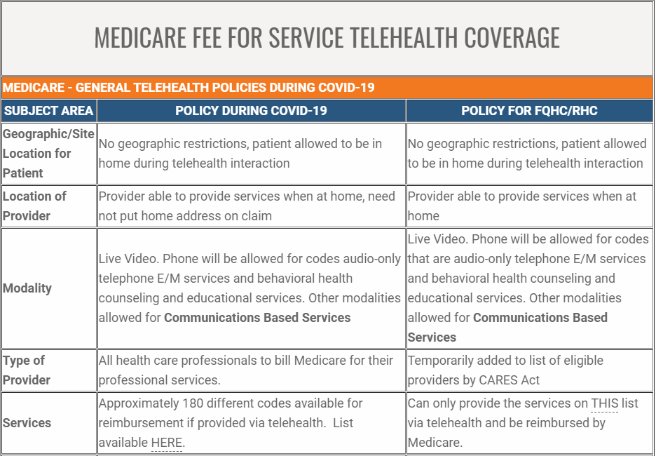
CMS Updates as of 05.01.2020
List of eligible telehealth codes can be found here.
Notes:
During the Public Health Emergency (PHE), CMS will now allow all health care professionals that are eligible to bill Medicare to be reimbursed for telehealth services, including physical therapists, occupational therapists, and speech language pathologists. Before this change, the eligible provider list was limited to doctors, nurse practitioners, physician assistants, and certain others.
CMS also announced they are waiving the requirement of video technology use for a certain set of services for the remainder of the PHE and increasing the payment amount for telephone visits (codes 99441-99443) to match payments for similar office and outpatient visits.
The previous reimbursement range was between $14 and $41 and is now updated to between $46 and $110. Payments are retroactive to 3/1/2020.
Reimbursement Amount: During the PHE, CMS has implemented payment parity, meaning providers will be reimbursed the same as if the service was provided in-person. Some rates for telephone visits have increased. Per the final interim rule, providers are allowed to report POS code that would have been reported had the service been furnished in person so that providers can receive the appropriate facility or non-facility rate and use the modifier “95” to indicate the service took place through telehealth. If providers wish to continue to use POS code 02, they may, and it pays the facility rate.

Slide 37
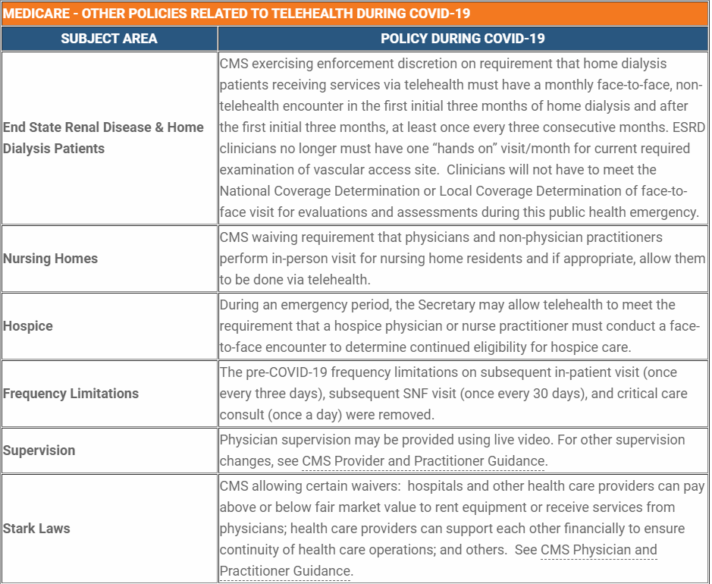
Other Medicare Telehealth Policies
Notes:
Additional updates include:
Providers do not need to put their home address on claims if they conducted a telehealth visit while at home
OIG is providing health care providers the flexibility to reduce or waive out-of-pocket costs and co-pays
Prior existing relationships do not need to be established for telehealth visits
Hospitals can bill an originating site fee when the patient is at home

Slide 38
Physician Office Telehealth Services
Modifier CS – COVID-19 Testing-related service. Waives deductible & co-insurance for testing-related services 3/1/20 to end of PHE. However, claims will not process at 100% payable until system update 7/1/2020 at which time NGS will reprocess all claims with CS modifier. Do not bill coinsurance or deduct to patients for testing–related services. Reopen claims to add this modifier if necessary.
Modifier CR – Catastrophe-related service. Informational on claims relevant to the PHE; phone calls, eVisits, and on-line assessments. Not for use on claims for telehealth (audio-visual) services, or those services allowed prior to the COVID-19 PHE. Claims will pay with or without this modifier.
Modifier 95 – Telemedicine modifier. Add to all newly allowed telehealth (audio-visual) services for the COVID-19 PHE as per CMS list.

Slide 39
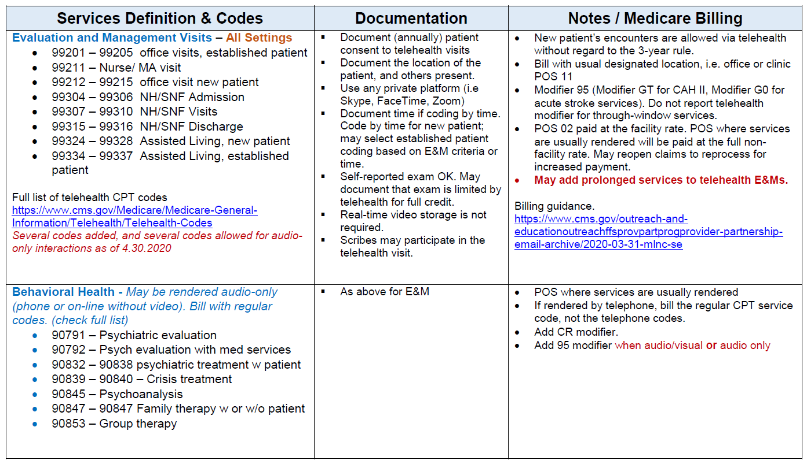
Physician Office Telehealth Services
Notes:
Source: HealthCentric Advisors Coding & Guidelines Summary for Medicare Telehealth

Slide 40
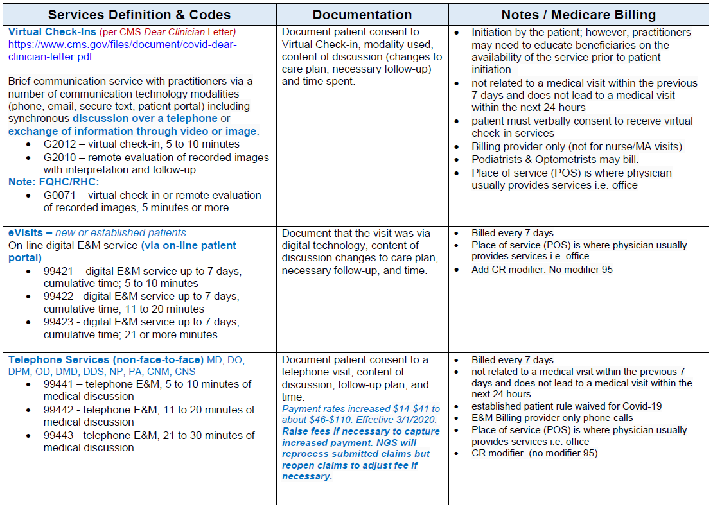
Physician Office Telehealth Services
Notes:
Source: HealthCentric Advisors Coding & Guidelines Summary for Medicare Telehealth

Slide 41
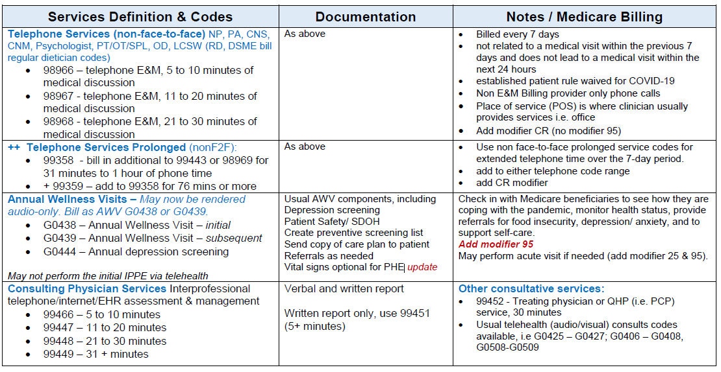
Physician Office Telehealth Services
Notes:
Source: HealthCentric Advisors Coding & Guidelines Summary for Medicare Telehealth
Facility Billing: Can still bill the Q3014 code which is billable by a facility where the patient is located (does not include the home, patient has to be in a previously eligible facility)

Slide 42
PT/OT/SLP Telehealth Services
Notes:
Source: HealthCentric Advisors Coding & Guidelines Summary for Medicare Telehealth
Facility Billing: Can still bill the Q3014 code which is billable by a facility where the patient is located (does not include the home, patient has to be in a previously eligible facility)

Slide 43
CMS Updates for FQHC/RHCs as of 05.01.2020
Medicare Coverage of FQHC/RHCs providing telehealth: Previously, FQHC/RHCs were not able to be paid by Medicare for telehealth services as a distant site. However, as required by the CARES Act, Medicare will now cover and reimburse telehealth services provided by RHCs and FQHCs from January 27th through the duration of the PHE. Detailed guidance can be found here, and the Center for Connected Health Policy created a great document summarizing these changes, linked here.
The key flexibilities afforded to FQHC/RHCs include:
Any telehealth service listed in the Medicare telehealth code list may be provided by the RHC/FQHC practitioners;
Effective March 6^{th,} patients may be at any site, including their home;
The services can be furnished by any health care practitioner working for the RHC or FQHC within their scope of practice; and
The practitioners can furnish the telehealth services from any distant site location, including their homes, during the time they are working for the RHC or FQHC.

Slide 44
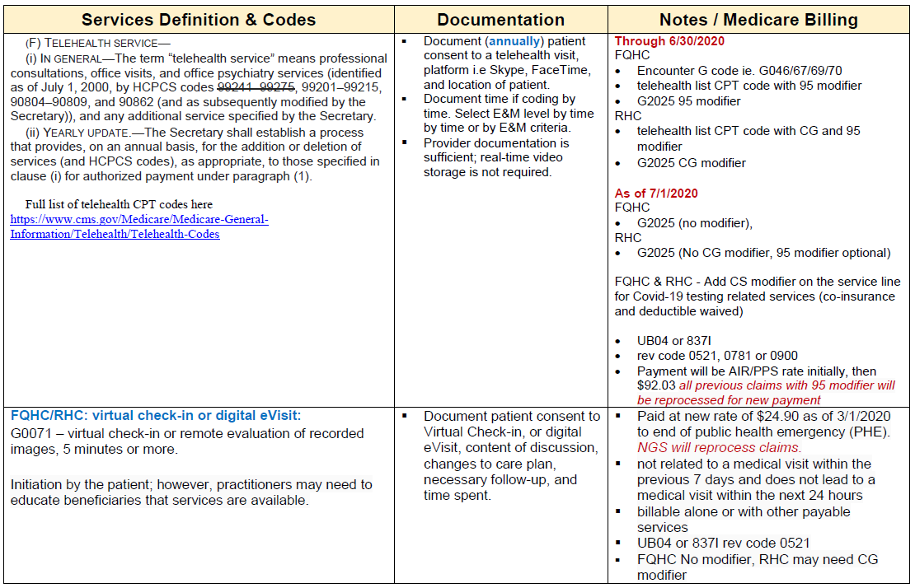
CMS Updates for FQHC/RHCs as of 05.01.2020
Notes:
For FQHCs, telehealth distant site services furnished between January 27, 2020, and June 30, 2020, that are also FQHC qualifying visits, three HCPCS/CPT codes for distant site telehealth services must be used:
• PPS specific payment system code: GO466, G0467, G0469, or G0470
• The HCPCS/CPT code that describes the services furnished via telehealth with modifier 95; and
• G2025 with modifier 95.
These claims will be paid at the FQHC PPS rate until June 30, 2020, and automatically reprocessed beginning on July 1, 2020, at the $92.03 rate. FQHCs do not need to resubmit these claims for the payment adjustment. Beginning July 1, 2020, FQHCs will only be required to submit G2025 where no modifier is required.
For RHCs, services provided January 27, 2020 to June 30, 2020 will be billed with HCPCS code G2025 with the modifier “CG” on the claim and the CPT code with both the “CG” and “95” modifiers.
This is being done as the processing system is not anticipated to be in place until then. Beginning July 1, 2020, the RHC will no longer need to use the CG modifier with G2025.

Slide 45
CMS Updates as of 05.01.2020
CMS has added hospitals to the list of locations that qualify for an originating site facility fee when a hospital-based provider issues a clinical encounter to a Medicare patient currently under outpatient care, including patients at home. Guidance found here.
CMS is also permitting hospitals to furnish clinical services provided by a hospital-based provider practicing remotely to Medicare patients registered as hospital outpatients, including those at home. Examples of such services include counseling education and therapy. CMS released a hospital fact sheet, linked here.
Notes:
Don’t have to say: When a physician or nonphysician practitioner who typically furnishes professional services in the hospital outpatient department furnishes telehealth services during the PHE, they bill with a hospital outpatient place of service since that is likely where the services would have been furnished if not for the COVID-19 PHE.
The physician or practitioner is paid for the service under the PFS at the facility rate, which does not include payment for resources such as clinical staff, supplies, or office overhead since those things are usually supplied by the hospital outpatient department.
During the PHE, if the beneficiary’s home or temporary expansion site is considered to be a provider-based department of the hospital, and the beneficiary is registered as an outpatient of the hospital for purposes of receiving telehealth services billed by the physician or practitioner, the hospital may bill under the PFS for the originating site facility fee associated with the telehealth service.

Slide 46
CMS Updates as of 05.01.2020
CMS also released a FAQ document addressing issues for hospitals and CAHs regarding the Emergency Medical Treatment and Active Labor Act (EMTALA). The document has a section devoted to telehealth where hospitals and CAHs can get answers to questions such as:
Can emergency physicians and other health care practitioners conduct medical screening exams (MSEs) under EMTALA via telehealth?
Hospitals may consider providing telehealth appointments for patients at home as emergency medicine providers; what obligation does this create?
Can out-of-state emergency physicians provide telehealth to beneficiaries in a different state?
Is the rule to allow for direct supervision using interactive audio and video technology limited to the duration of the public health emergency?
Notes:
Question 1: Yes. QMPs, including emergency physicians, can perform MSEs using telehealth equipment. The QMP may be on-campus and using technology to self-contain or offsite due to staffing shortages. The MSE may be performed solely via telehealth if clinically appropriate. If the patient is seen by a QMP located on campus via electronic two-way technology, the service would not be considered a telehealth visit. Regardless of location, the QMP must be performing within the scope of his/her state practice act and approved by the hospital’s governing body to perform MSEs.
Question 2: The use of telehealth to provide evaluation of individuals who have not physically presented to the hospital for treatment does not create an EMTALA obligation.
Question 3: For Medicare and Medicaid, CMS has waived the licensure requirement, provided that the physician has a valid license in another state. However, in order for this federal waiver to be effective, the state also would have to waive its licensure requirements, either individually or categorically, for the type of practice for which the physician is licensed in their home state.
Question 4: Yes. Waivers under section 1135 typically end no later than the termination of the PHE period, or 60 days from the date the waiver or modification is first published unless the Secretary of the Department of Health and Human Services (HHS) extends the waiver by notice for additional periods of up to 60 days, up to the end of the public health emergency period.

Slide 47
CMS Updates as of 05.01.2020
Opioid Treatment Programs (OTPs) may furnish periodic assessments via telephone: During the PHE, CMS is allowing OTP periodic assessments to be furnished via two-way interactive audio-video communication technology and, in cases where beneficiaries do not have access to two-way audio-video communications technology, the periodic assessments may be furnished using audio-only telephone calls, provided all other applicable requirements are met.
More on this can be found here.

Slide 48
CMS Updates as of 05.01.2020
Time-Based Level Selection for E & M Telehealth: CMS allowed for the E & M level selection for office/outpatient services furnished via telehealth can be based on medical decision-making or time for the duration of the PHE. In doing so, CMS referenced typical times associated with E & M services in the Medicare public use file.
However, the times in the public use file do not always align with the typical times included in the office/outpatient E & M code descriptors, causing confusion in the physician community. CMS resolved this confusion in April by revising its policy to clarify that the times listed in the CPT code descriptor should be used.

Slide 49
CMS Updates as of 05.01.2020
Loosened RPM Billing Requirements: Historically, RPM services described by CPT code 99454 could not be reported for monitoring of fewer than 16 days during a 30-day period.
However, acknowledging that many patients with COVID-19 who need RPM do not need to be monitored for a full 16 days, CMS, for the duration of the PHE, is allowing RPM services to be reported for periods of time that are fewer than 16 of 30 days, but no less than 2 days.
CMS emphasized that payment for when monitoring lasts for fewer than 16 of 30 days, but no less than 2 days, is limited to patients who have a suspected or confirmed diagnosis of COVID-19.

Slide 50
OIG Update
OIG Update

Slide 51
OIG Policy Statement
The Office of Inspector General (OIG) issued a Policy Statement to notify physicians and other practitioners that they will not be subject to administrative sanctions for reducing or waiving any cost-sharing obligations Federal health care program beneficiaries may owe for telehealth services furnished consistent with the then applicable coverage and payment rules.
OIG will not subject physicians and other practitioners to OIG administrative sanctions for arrangements that satisfy both of the following conditions:
A physician or other practitioner reduces or waives cost-sharing obligations (i.e., coinsurance and deductibles) that a beneficiary may owe for telehealth services furnished consistent with the then-applicable coverage and payment rules.
The telehealth services are furnished during the time period subject to the COVID-19 Declaration.
Source: https://oig.hhs.gov/fraud/docs/alertsandbulletins/2020/policy-telehealth-2020.pdf
Notes:
This Policy Statement is subject to the following considerations:
Nothing in this Policy Statement requires physicians or other practitioners to reduce or waive any cost-sharing obligations Federal health care program beneficiaries may owe for telehealth services during the time period specified in condition 2 above.
For any free telehealth services furnished during the time period subject to the COVID19 Declaration, OIG will not view the provision of free telehealth services alone to be an inducement or as likely to influence future referrals.
OIG intends for the Policy Statement to apply to a broad category of non-face-to-face services furnished through various modalities, including telehealth visits, virtual check-in services, e-visits, monthly remote care management, and monthly remote patient monitoring.

Slide 52
Third-Party Payers
Notes:
https://www.dfs.ny.gov/industry_guidance/coronavirus/telehealth_ins_prov_info
DFS adopted a new emergency regulation that requires New York State insurance companies to waive cost-sharing, including, deductibles, copayments (copays), and coinsurance for in-network telehealth visits, whether or not related to COVID-19, during the state of emergency. All of the organizations on the slide follow those rules.
What should a health care provider do if an insurer is placing additional credentialing and approval requirements on providers or requiring them to use a specific technology in order to reimburse for telehealth services?
Health Care Providers can file a complaint with DFS at www.dfs.ny.gov/complaint.

Slide 53
Telehealth Software Examples
Software Options

Slide 54
Telehealth Platforms
Utilize your EHR - many have a video option built in!
Example: MEDENT has a Video Visit feature which is an easy way for a practice to have HIPAA compliant video communication with their patients, without the need for app downloads or plugins. The cost structure has changed from a per visit fee to a monthly rate of $29/provider, regardless of the number of visits they conduct throughout the month.
When a patient is scheduled for a Video Visit, they are sent a link via e-mail or text. This e-mail or text includes the appointment date, time, and provider; a link to the visit; and a recommendation that the patient connects via Wi-Fi.
Notes:
I know that Cerner, Epic, and Netsmart are other EMR’s that have optional telehealth add-ons.
A partner using MEDENT for video visits noted: Did have some issues as Iphones seem to be fussy about launching the session on the patients end.
For Windows 8.1, Mozilla is the best browser to use and for Windows 10, you will have the least amount of problems running in Chrome.
If you utilize this EMR, reach out to your representative to find out more.

Slide 55
Telehealth Platforms
Other common platforms include:
Vsee: https://vsee.com/ - The VSee site notes one can “get it free," though the American Academy of Family Physicians (AAFP) website has heard members report it costing up to $250/month.
Doxy.Me: https://doxy.me/ - Self-touted to be “a simple, free, and secure telemedicine solution.”
Vidyo: https://www.vidyo.com/video-conferencing-solutions/industry/telehealth
eVisit: https://evisit.com/ - The AAFP website reports eVisit ranges from $50/month to $150/month.
Zoom: https://zoom.us/
Hale Health: https://www.hale.co/
swyMED: http://swymed.com/covid-19-telehealth-rapid-response/
Notes:
Something to also check on/be aware of are your upload and download speeds for your facility. With telehealth visits now being offered, you will likely see a significant increase in your data usage – you will want to be sure you have enough bandwidth to support it.

Slide 56
Telehealth Platforms
Key Questions You Will Want Answered When Exploring Telehealth Platforms:
Can I exit my contract at any time (i.e., not locked into a 2-year contract)?
Is there a waiting room feature so I can queue my patients up?
Is the platform device agnostic (i.e., can physicians/providers and patients use device of their choosing for virtual care)?
Is there an out-of-office message noting we’re not available to take your call right now? (i.e., during off hours or overnight)?
Does the software have the ability to schedule a visit? Note: This is a more advanced feature; it's not absolutely required to have now, but it's nice to have.
Is the platform deployable in days?

Slide 57
Telehealth in a Post-Pandemic World
https://www.statnews.com/2020/06/09/seema-verma-telehealth-access-covid19/
Notes:
More and more people - doctors, law makers and patients are all seeing the benefits of telehealth.
How will this effect the reimbursement landscape?
Verma says that CMS is evaluating ways to preserve access to telemedicine visits in settings such as patient’s homes, hospice care, and nursing homes. It is also considering ways to permanently broaden the types of services that can be provided via telemedicine, such as emergency care, physical therapy, and mental health consultations.
As for NYS telehealth regulation - pre-COVID rules in NY were pretty progressive compared to other states.. Will telephonic visits be reimbursable? What will change? That is still unknown.

Slide 58
Telehealth Programs Transitioning Post-Pandemic
Consumer adoption of telehealth has skyrocketed.
Practices must create sustainable, regulated telehealth programs post-COVID-19:
Switching to HIPAA compliant platforms
Updating workflows, policies and procedures
Review and monitor regulatory changes
Reach out to private payers for updated policies
Notes:
Expect utilization to stay high - patients have been favorable to telehealth and may expect their providers to continue offering the service.
A recent McKinsey & Company COVID-19 Consumer survey found that about 76% of consumers say they are highly or moderately likely to use telehealth in the future. 74% of people who had used telehealth reported high satisfaction. https://www.fiercehealthcare.com/tech/telehealth-could-grow-to-a-250b-revenue-opportunity-post-covid-mckinsey-reports
While many health care practices have scrambled to adopt telehealth during the pandemic, they must think about transitioning to follow what pre-COVID regulations were. This means using HIPAA compliant software, reviewing state and federal regulations, and updating your practice workflow to ensure telehealth can be a sustainable addition.

Slide 59
Katy Cook kcook@ahihealth.org
Nancy DelMastro ndelmastro@ahihealth.org
Questions?
www.ahihealth.org | 518.480.0111

